Slide 1

AMCC 5160 / LECTURE 02
Generative
Editing
Images, art direction, and video
Harry Yang / 8 September 2026
Opening
01
Notes:
Spoken teaching script (54 seconds at the planning pace)
Imagine you are the art director. Your exhibition opens tomorrow. You love this glass pear, but you want to see it in ivory ceramic. You give the editor a tiny request: change the material, keep everything else. Then you notice the reflection. Should it still look like glass? Suddenly, a three-word edit contains a whole argument about the world.
That is our starting point. We will follow this fictional artwork through image editing, exhibition design, and a moving shot. The exhibition is called AFTER RAIN. The pear is our recurring character. By the end, you should be able to explain a model's mechanism, defend a visual choice, and catch a failure that a beautiful preview can hide. First, look carefully at what you think must survive.
Teaching cues
Let the opening request land before naming the technical topic. Point to the blue stem, then to the water.
Welcome. Today we will use one fictional exhibition, AFTER RAIN, to connect the mechanics of image editing to art direction and then moving images. The visual examples are prepared, so the lecture works without a live model. Opening question: what does an editor have to understand to change glass into ceramic?
Sources and visual credits
Classroom images generated with ImageGen, 7 September 2026. Fictional exhibition and sculpture. These are illustrative examples, not a benchmark or a real artwork attribution.

Slide 2
OPENING
One object, three creative decisions
Image editing
Art and moving images
How can the material change
while identity survives?
How can a visual choice
carry an idea through time?
Opening
02
Notes:
Spoken teaching script (46 seconds at the planning pace)
We are going to give the same object three different jobs. First it is a technical puzzle: can its material change while its identity survives? Then it becomes an artwork: can its placement and lighting make us feel that it is fragile? Finally it becomes a character in time: can it disappear behind something and return as the same object?
Those jobs demand different judgments. A technically clean image may say very little. An expressive poster may contain an intentional impossibility. A wonderful still may belong to a broken video. As its job changes, you may find yourself approving a change that you would have rejected five minutes earlier.
Teaching cues
Original teaching extension.
Sources and visual credits
Classroom images generated with ImageGen, 7 September 2026. Fictional exhibition and sculpture. These are illustrative examples, not a benchmark or a real artwork attribution.

Slide 3

OPENING
The reflection is part of the edit
SOURCE
MATERIAL EDIT
Glass becomes ceramic. What should happen to the reflection?
Opening
03
Notes:
Spoken teaching script (42 seconds at the planning pace)
For a few seconds, ignore the pear. Look at the water beneath it. Now look back at the body. If the body becomes opaque ceramic, what happens to the light that used to pass through the glass? The answer cannot live entirely inside the object's outline.
This comparison is a prepared classroom illustration. Use it to locate the consequences of the request: transmission, highlights, and the reflection below. We still want the blue stem and recognizable silhouette. But preserving every surrounding pixel could preserve the wrong optics. a successful local edit may require a carefully justified change somewhere else.
Teaching cues
Give five seconds of silent looking. Point below the pear before discussing the material itself.
2 minutes. Ask students to look silently for ten seconds, then name changes beyond the pear. Expected observations: the transmitted glow disappears, the body becomes opaque, and the reflected appearance changes. The exact ripple pattern and highlights also drift. Do not claim exact pixel preservation. Ask whether those changes are necessary consequences or unintended differences.
Sources and visual credits
Classroom images generated with ImageGen, 7 September 2026. Fictional exhibition and sculpture. These are illustrative examples, not a benchmark or a real artwork attribution.

Slide 4
OPENING
Necessary change or accidental drift?
Visible difference | Interpretation | What to inspect
Amber glow disappears | Expected for opaque ceramic | Light transmission
Blue stem changes shape | Possible identity drift | Silhouette
Reflection changes | May be necessary | Material and geometry
The edit contract determines which differences count as errors.
Opening
04
Notes:
Spoken teaching script (43 seconds at the planning pace)
Let us make the opening comparison more disciplined. The disappearance of transmitted amber light is consistent with changing transparent glass into opaque ceramic. A changed blue stem, by contrast, would need a separate justification because the instruction did not request that transformation.
The reflection is more interesting. A material change can require its appearance to change, while its placement should still agree with the object and the water. We cannot classify every difference using a simple rule that change is bad. We need a model of the intended scene. That is why the edit contract includes allowed consequences as well as invariants.
Teaching cues
Original teaching extension. The edit contract determines which differences count as errors.
Sources and visual credits
Classroom images generated with ImageGen, 7 September 2026. Fictional exhibition and sculpture. These are illustrative examples, not a benchmark or a real artwork attribution.

Slide 5
OPENING
Tonight’s route
90 minutes
Spoken teaching across 123 slides
Part 1
How image editors work
Part 2
Art direction and iteration
Topic 3
Video editing and visual transformation
In addition
Presentations, break, and discussion pauses
Opening
05
Notes:
Spoken teaching script (48 seconds at the planning pace)
Here is the route through that puzzle. We begin inside an image editor: its representations, sampling process, and controls. Then we take the art director's seat and decide what those controls should accomplish. In the final technical section, the image starts moving and the preservation problem becomes harder.
The spoken script is planned for about ninety minutes. The marked discussions, the break, and student presentations need additional class time. You will see the same pear return in different situations. Each return asks us to revise our judgment, rather than learn a completely unrelated example. At the end, three readings let us question who sets the goal and who decides whether it was achieved.
Teaching cues
The 90-minute transcript is spoken teaching time. Presentations, break and studio discussion are additional.
Sources and visual credits
https://hyang.org/amcc5160/

Slide 6
OPENING
Three decisions you can defend
01
Which control addresses this failure?
02
Which poster belongs in this exhibition?
03
Which moment would make you reject the clip?
Opening
06
Notes:
Spoken teaching script (45 seconds at the planning pace)
Here are three decisions I want you to be able to defend by the end. When an edit fails, which control would you change, and why? When two posters both look good, which belongs in this exhibition? When a video looks convincing, which moment would you inspect before accepting it?
You do need a link between mechanism and consequence. A mask tells us where; a reference can show us what; an artistic brief tells us why the result matters. Today we will practice making those links aloud. The aim is to leave with reasons you can use when the next tool has a different interface.
Teaching cues
Original teaching extension.
Sources and visual credits
https://hyang.org/amcc5160/

Slide 7
PART 1
How image
editors work
What changes? What survives?
Part 1 / Image editing
07
Notes:
Spoken teaching script (25 seconds at the planning pace)
The pear gives us a concrete technical problem: change its material while retaining the information that makes it recognizable. We can describe this as conditional generation under preservation constraints. The inputs specify the change; the contract specifies what should survive. Throughout this section, connect each mechanism to one part of that problem. We begin by making our expectations explicit.
Teaching cues
Transition from the opening material edit to its technical explanation. The core problem is conditional generation under preservation constraints. Ask the class to hold onto both halves of that sentence.
Sources and visual credits
Classroom images generated with ImageGen, 7 September 2026. Fictional exhibition and sculpture. These are illustrative examples, not a benchmark or a real artwork attribution.

Slide 8
PAUSE THE VIDEO · CLASS DISCUSSION
Before Part 1: image editing
01
When glass becomes ceramic, what should stay the same?
02
Which parts of the scene must change with the material?
03
What could a model misunderstand in that request?
Discuss these three questions. Resume when the class is ready.
08
Notes:
Spoken teaching script (37 seconds at the planning pace)
Before we open the machinery, decide what success should look like. When glass becomes ceramic, what should stay the same? Which parts of the scene must change with the material? What could a model misunderstand in that request?
Discuss these three questions and point to visible evidence for your choices. If your partner wants to preserve a detail that you want to change, identify the artistic intention behind each answer. Pause the video here. We will return to these expectations when we write the worked ceramic-edit contract.
Teaching cues
Hear one preservation demand and one permitted optical consequence. Return to both answers on slide 42. Pause the video after the three questions.
Pause after reading all three questions. Invite contrasting views and ask for visible evidence. No making, sketching, or tool use is required.
Sources and visual credits
Original classroom discussion questions.

Slide 9

PART 1 / IMAGE EDITING
The edit contract
Change
The gallery becomes a forest.
Preserve
Pear identity, pedestal, framing.
Allow
Reflections and ambient light to adapt.
Part 1 / Image editing
09
Notes:
Spoken teaching script (42 seconds at the planning pace)
The gallery has become a forest. Let us write the edit contract. The intended change is the environment. The pear's identity, its pedestal, and the framing should remain recognizable. The ambient light and reflections are allowed to adapt to the forest.
Why include that last category? Because preserving every visible relationship would contradict the new setting. Imagine retaining a bright gallery-window reflection inside a dark forest. The model might preserve the source faithfully and still produce an implausible scene. Before generating, separate the requested change, the invariants, and the consequences that should adapt. Afterwards, inspect those categories separately.
Teaching cues
This generated background edit is a classroom example. The contract separates the intended change, the invariants, and the physically dependent changes. A command to preserve absolutely everything conflicts with a change of environment: light and reflections may need to adapt. The blue stem is a useful identity cue. Inspect shape and screen position before admiring the atmosphere.
Sources and visual credits
Classroom images generated with ImageGen, 7 September 2026. Fictional exhibition and sculpture. These are illustrative examples, not a benchmark or a real artwork attribution.

Slide 10
PART 1 / IMAGE EDITING
An invariant can be semantic or exact
Semantic preservation
Exact preservation
The same pear remains recognizable.
Its appearance can adapt to new light.
Specified pixels remain identical.
Copying or compositing can enforce this.
Part 1 / Image editing
10
Notes:
Spoken teaching script (43 seconds at the planning pace)
Suppose a curator says, keep the pear exactly the same. There are at least two meanings hiding in that sentence. One means that a visitor should recognize the same sculpture in a new room. Its highlights may change with the room. The other means that selected pixel values must remain identical.
Those are different requirements. Generative conditioning can encourage recognizable identity. Copying source pixels or compositing can enforce exact preservation in a specified region. Neither requirement automatically makes the whole image coherent: a copied region may now have the wrong lighting. Before choosing a tool, settle the meaning of same.
Teaching cues
Original teaching extension.
Sources and visual credits
Classroom images generated with ImageGen, 7 September 2026. Fictional exhibition and sculpture. These are illustrative examples, not a benchmark or a real artwork attribution.

Slide 11
PART 1 / IMAGE EDITING
Editing as conditional generation
y ∼ pθ(y | x, c, r)
x source image c edit instruction
r optional references y edited result
A plausible result can still violate the edit contract.
Part 1 / Image editing
11
Notes:
Spoken teaching script (35 seconds at the planning pace)
Read the expression as a distribution of possible edited results, given the source, instruction, and optional references. The symbol theta represents the model's learned parameters. The vertical bar means 'given.' We are not asking for a unique answer in every case. Two different forest scenes might both satisfy the same brief.
However, a source image is a condition rather than a promise that every unmentioned pixel will be copied. To judge success, we need a more precise contract than 'it looks plausible.'
Teaching cues
Explain each symbol before reading the formula. The vertical bar means given. Theta represents learned parameters. The distribution expresses that several valid outputs may exist for the same request. The source is a condition, not a guarantee that every unmentioned pixel will be copied. Ask for two valid forest edits with different lighting. This is a general teaching formulation.
Sources and visual credits
https://arxiv.org/abs/2211.09800
https://arxiv.org/abs/2605.10730

Slide 12
PART 1 / IMAGE EDITING
A condition is not a hard constraint
y ∼ pθ(y | x, c, r)
accept(y) = contract checks pass
Many outputs can satisfy the same instruction.
A probability model does not certify preservation.
Part 1 / Image editing
12
Notes:
Spoken teaching script (34 seconds at the planning pace)
The probability expression says that the system produces a candidate given conditions. It does not contain a certificate that the candidate passes our checks. The acceptance step is a separate decision that we impose on the result.
Imagine two forest outputs. Both look plausible, but one changes the pear's stem and one retains it. The model can assign probability to both; our contract can reject one. In practice, acceptance may involve human inspection, image comparisons, or explicit production constraints.
Teaching cues
Original teaching extension.
Sources and visual credits
https://arxiv.org/abs/2211.09800
https://arxiv.org/abs/2605.10730

Slide 13
PART 1 / IMAGE EDITING
A smaller workspace: image latents
1024 × 1024 × 3
3,145,728 RGB values
64 × 64 × 64
262,144 latent values
12× fewer values
For this f16c64 example
A variational autoencoder (VAE) compresses images into latent representations.
Part 1 / Image editing
13
Notes:
Spoken teaching script (45 seconds at the planning pace)
The RGB image has 1024 by 1024 pixels and three channels: just over three million scalar values. With spatial reduction by sixteen and sixty-four latent channels, the representation becomes 64 by 64 by 64: 262,144 values.
Notice the trap. Sixteen times smaller along each spatial axis does not mean sixteen times fewer values overall, because the number of channels changes too. Here the scalar count falls by a factor of twelve. That is specific to this configuration. The model works in a learned representation, and its decoder must recover visible detail. Our next question is what that compression already loses before we request any edit.
Teaching cues
Read dimensions and units slowly. Ask for the scalar count before explaining the factor of twelve.
The example uses the f16c64 VAE configuration reported for Qwen-Image-2.0. Divide each spatial axis by 16, then multiply by 64 channels. Do not confuse 16-fold spatial reduction with 16-fold total value compression. 3,145,728 divided by 262,144 is 12. These are counts of scalar values, not bytes, information bits, or measured speed. Tiny lettering and fine textures are good places to inspect reconstruction.
Sources and visual credits
https://arxiv.org/abs/2605.10730

Slide 14
PART 1 / IMAGE EDITING
Is the detail lost before the edit?
01
Encode the source with the VAE
02
Decode without requesting a change
03
Inspect tiny text, fine texture, and edges
A reconstruction check separates representation loss from editing failure.
14
Notes:
Spoken teaching script (46 seconds at the planning pace)
Suppose the small exhibition caption is already blurry after an edit. You might spend an hour rewriting the prompt to say, preserve every letter. There is a quicker diagnostic: encode the original image and decode it again without requesting a change.
If the letters are already damaged in that round trip, part of the problem lies in representation and reconstruction. A more emphatic instruction cannot restore a detail the editing path never retained faithfully. Look at fine text, thin edges, and small textures first. If reconstruction is sound but the edit damages them, investigate the editing stage. It also explains why exact exhibition typography deserves its own editable layer.
Teaching cues
Original teaching extension. A reconstruction check separates representation loss from editing failure.
Sources and visual credits
https://arxiv.org/abs/2605.10730

Slide 15
PART 1 / IMAGE EDITING
Why token count matters
Illustrative tokenization | Token count N | Attention pairs N²
64 × 64 latent locations | 4,096 | 16,777,216
Group 2 × 2 locations | 1,024 | 1,048,576
4× fewer tokens gives 16× fewer pair scores in dense self-attention.
Part 1 / Image editing
15
Notes:
Spoken teaching script (39 seconds at the planning pace)
Now consider the number of tokens a transformer processes. In our toy example, one token per position on a 64 by 64 grid gives 4,096 tokens. Grouping each two-by-two region gives 1,024 tokens, a reduction by four.
Dense self-attention compares token pairs. Squaring the two counts gives 16,777,216 and 1,048,576 pair scores. That is a reduction by sixteen. This is why representation choices matter so much for cost. It is not a claim that the whole system runs sixteen times faster. Text tokens, reference tokens, other layers, and implementation details also matter.
Teaching cues
2 minutes. This is a toy calculation for image tokens only, not a specification of Qwen-Image-2.0 patchification or a runtime benchmark. Ask which ratio is four and which is sixteen. Grouping trades spatial granularity for cost. Real systems add text and reference tokens, and memory-efficient attention changes memory use. The quadratic pair-count argument remains useful.
Sources and visual credits
https://arxiv.org/abs/1706.03762

Slide 16
PART 1 / IMAGE EDITING
Double the resolution: count the cost
2× each spatial axis
4× as many image tokens
4× image tokens
16× dense attention pair scores
A component calculation
Measure whole-system runtime.
Part 1 / Image editing
16
Notes:
Spoken teaching script (43 seconds at the planning pace)
Before reading the second number, make a prediction. We double the image width and double its height, keeping the patch scheme fixed. How many image tokens do we get? Four times as many. In dense self-attention, each token can compare with every other token. Four times four gives sixteen times as many pair scores.
This calculation describes the image-token attention component, not a promise that the entire system becomes sixteen times slower. Other operations and implementations matter. The useful habit is to ask what grew: pixels, tokens, comparisons, or measured runtime. They are related quantities, but they are not interchangeable.
Teaching cues
Cover the second result briefly with a gesture while students predict. Stress component cost versus total runtime.
Original teaching extension.
Sources and visual credits
https://arxiv.org/abs/1706.03762

Slide 17
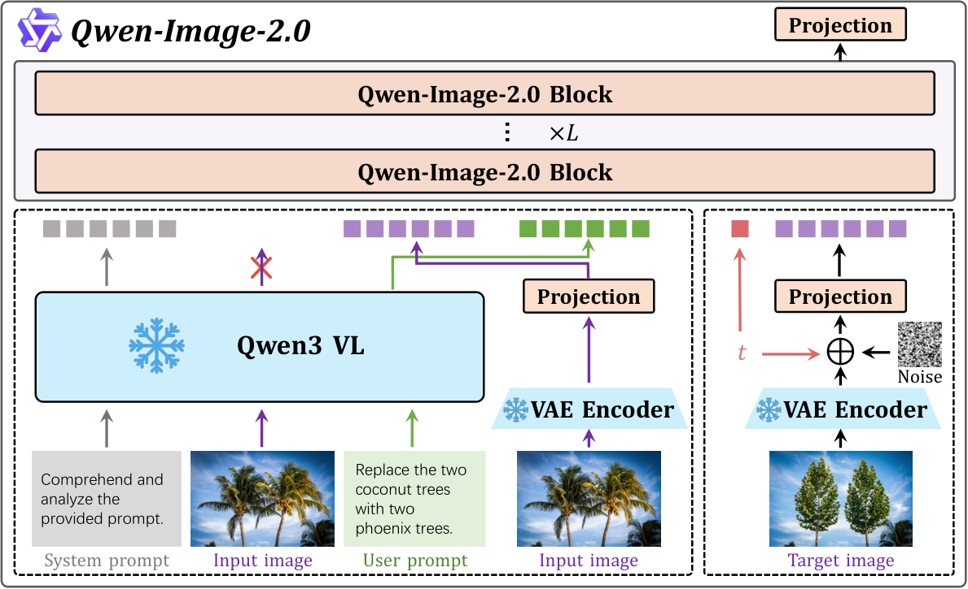
PART 1 / IMAGE EDITING
Inside a current image editor
Qwen-Image-2.0 / May 2026 / Original architecture figure
17
Notes:
Spoken teaching script (43 seconds at the planning pace)
Let us walk through this architecture from the input side. The source image contributes semantic information through a vision-language component and visual information through a VAE. The target stream begins with an evolving noisy representation. The transformer processes that stream together with the conditions.
During training, we possess an example of the desired edited target, so we can measure what the model should learn. During inference, we have the source and request but not the desired target. The model must generate it. That difference is essential. The architecture does not quietly receive the answer when you ask it to edit your photograph.
Teaching cues
Read the source diagram from the bottom. The input image informs semantic conditioning through Qwen3-VL and supplies appearance through the VAE. The noisy target stream appears on the right. The transformer processes the conditions with the evolving target. During training, a target image is available. At inference, the desired target is unknown and must be generated. Explain this distinction explicitly.
Sources and visual credits
https://arxiv.org/abs/2605.10730

Slide 18
PART 1 / IMAGE EDITING
The missing target at inference
Training example
Inference request
Source + request + edited target
A known target supplies supervision.
Source + request + references
The edited target must be generated.
Part 1 / Image editing
18
Notes:
Spoken teaching script (48 seconds at the planning pace)
There is a piece of information on the left that we do not possess on the right: the desired edited image. During supervised training, a source, an instruction, and a target show the model what a successful change looks like. During use, we provide the request because that target does not yet exist.
This distinction explains a surprisingly common confusion. Showing a reference to an editor is not automatically teaching new weights. It may simply be conditioning this particular generation. Adaptation, which we will reach with LoRA, changes trainable parameters. It is available when we construct the learning signal, and absent when we ask the trained model to make our ceramic pear.
Teaching cues
Original teaching extension.
Sources and visual credits
https://arxiv.org/abs/2605.10730

Slide 19
PART 1 / IMAGE EDITING
Two representations of the source
Semantic features
Visual latents
What is present?
Which object does “it” refer to?
Which change does the prompt request?
What does it look like?
Where are its shapes and textures?
Which details help retain identity?
Understanding the request and retaining appearance are related tasks.
Part 1 / Image editing
19
Notes:
Spoken teaching script (38 seconds at the planning pace)
Think of these two representations using our pear. Semantic features help with questions such as: which object is the pear, what does ceramic mean, and what does 'it' refer to in the instruction? Visual latents provide appearance information, including shapes and textures that help keep the particular source recognizable.
This is a conceptual distinction, not a claim that the branches have perfectly isolated responsibilities. Learned representations can overlap in what they encode. If an edit fails, ask whether the model misunderstood the request or lost important visual information.
Teaching cues
Use the pear: semantic features help locate a pear and interpret ceramic. Visual latents contain appearance information needed to keep the source recognizable. This is a conceptual reading of the architecture, not a claim that the two branches have perfectly separate roles. Neither branch supplies a formal guarantee of identity.
Sources and visual credits
https://arxiv.org/abs/2605.10730

Slide 20
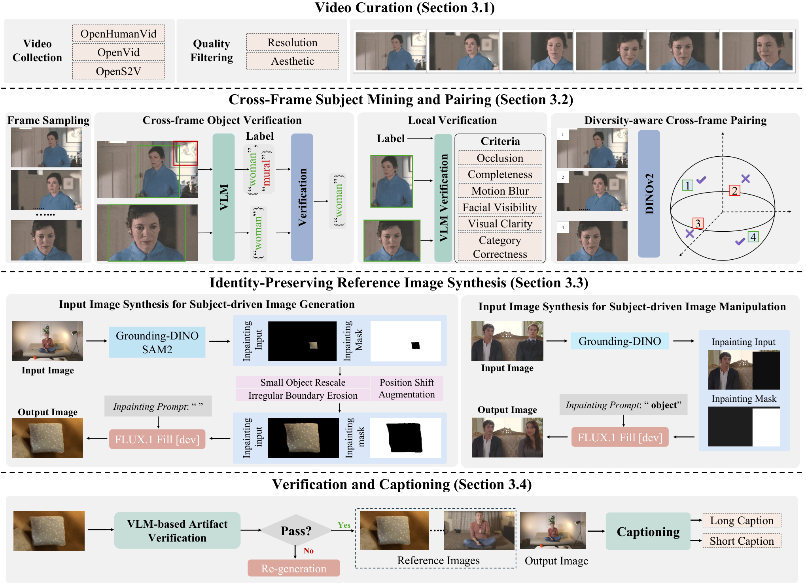
PART 1 / IMAGE EDITING
OpenSubject: identity across new scenes
Same identity,
varied viewpoints
Synthesize new
reference contexts
Verify identity
and edit fidelity
Video pairs teach what can change while identity persists.
Yexin Liu et al., including Harry Yang · OpenSubject · Fig. 2
20
Notes:
Spoken teaching script (58 seconds at the planning pace)
How do you teach a system the difference between a pear and this particular pear? That question connects to OpenSubject, research I coauthored with Yexin Liu and our collaborators. A video offers something valuable: repeated observations of a subject as the view changes. The shared identity is a learning opportunity.
Follow the main path in the figure. We curate clips, verify subjects across frames, and select diverse pairs. Inpainting or outpainting helps synthesize reference inputs, followed by verification. The corpus contains 2.5 million samples; the contribution is training data and a benchmark. For our exhibition, imagine the same sculpture photographed in several rooms. We want freedom to change the setting without losing its distinctive features. That is a classroom application of the identity problem, rather than a claim that our fictional pear was tested in the paper.
Teaching cues
Follow only the main curation-to-verification path; credit Yexin Liu and the full collaboration.
Research coauthored by Harry Yang. Credit the full team. Figure reproduced from the cited paper. Classroom artistic connections are teaching interpretations, not additional experimental claims. Explain the main path rather than reading every diagram label.
Sources and visual credits
Yexin Liu et al., including Harry Yang · OpenSubject · Fig. 2
https://arxiv.org/html/2512.08294v2

Slide 21
PART 1 / IMAGE EDITING
Flow matching: the training target
zₜ = (1 − t) ε + t z₁
v* = z₁ − ε
ε is noise. z₁ is the target image latent.
The model learns a velocity at intermediate t.
Teaching convention: t = 0 is noise, t = 1 is data.
Part 1 / Image editing
21
Notes:
Spoken teaching script (46 seconds at the planning pace)
The editor needs a way to learn how to move from noise toward an image. In this simple flow-matching setup, we construct an intermediate latent by mixing noise, epsilon, with a known target latent, z one. The mixing variable t tells us where we are along that training path.
For this straight interpolation, the target velocity is the target latent minus the noise. The model sees an intermediate state and learns to predict that direction, given the source and instruction. There is also an important clock distinction: t here is the generative process's time. Later, our video will have another time axis—the seconds that pass in the scene.
Teaching cues
Point first to t, then the target. Explicitly distinguish sampling time from scene time.
Define the time convention before explaining the equation. Some papers reverse it. Choose a noise sample and a target latent, then interpolate. The model predicts a direction of travel given z_t, t, and the editing conditions. During training we know z_1. At inference we do not. The simple straight path is a teaching example of conditional flow matching, not the only valid path or sampler.
Sources and visual credits
https://arxiv.org/abs/2210.02747

Slide 22
PART 1 / IMAGE EDITING
The interpolation endpoints
z₀ = (1 − 0) ε + 0 z₁ = ε
z₁ = (1 − 1) ε + 1 z₁
Substitute the endpoints before reasoning about the path.
Part 1 / Image editing
22
Notes:
Spoken teaching script (40 seconds at the planning pace)
Before trusting an equation, check its easiest cases. At t equals zero, the coefficient on the target becomes zero, so we recover the noise. At t equals one, the coefficient on noise vanishes, so we recover the target latent.
Along this simple straight path, the difference between target and noise gives the direction we train the model to predict. You do not need to imagine a recognizable half-finished image at every intermediate point. The calculation takes place in a learned representation, and this path is a teaching construction rather than the only possible design.
Teaching cues
Original teaching extension.
Sources and visual credits
https://arxiv.org/abs/2210.02747

Slide 23
PART 1 / IMAGE EDITING
Predict the next sampling step
zₜ₊Δₜ = zₜ + Δt · vθ(zₜ, t, x, c)
0.20 + 0.10 × 0.60 = ?
A scalar example of an Euler update.
Repeat updates, then decode the final latent into pixels.
Part 1 / Image editing
23
Notes:
Spoken teaching script (40 seconds at the planning pace)
Here is the smallest possible sampling calculation. One coordinate currently equals 0.20. Its predicted velocity is 0.60, and the next step has size 0.10. Before looking at the result, say what operation should happen. We add a small amount of motion to the current state: 0.20 plus 0.10 times 0.60, giving 0.26.
In a real latent, many coordinates update together. These numbers are invented to show an Euler step, and practical samplers can use more elaborate solvers. But the sequence is now less mysterious: predict a direction, take a step, repeat, then decode.
Teaching cues
Let students predict the result without an on-slide answer. The answer is 0.26, explained in the spoken script.
Pause before saying 0.26. Keep the coordinate, velocity, and step size distinct.
Ask students to compute the second line. 0.20 is one latent coordinate, 0.60 is its predicted velocity, and 0.10 is the step size. These invented scalar values are not measured model behavior. Many practical samplers use more elaborate schedules or solvers. More steps mean more model evaluations, but do not guarantee that an ambiguous instruction becomes correct.
Sources and visual credits
https://arxiv.org/abs/2210.02747

Slide 24
PART 1 / IMAGE EDITING
A better solver cannot clarify the brief
Numerical question
Editing question
Does the solver follow
the learned field accurately?
Does that learned field
produce the intended change?
Part 1 / Image editing
24
Notes:
Spoken teaching script (45 seconds at the planning pace)
Imagine following a beautifully accurate set of directions to the wrong gallery. Taking smaller steps will not repair the destination. The same distinction helps with generative sampling. A better numerical solver can follow a learned field more accurately. That alone does not settle an ambiguous editing request.
If the pear's boundary is unstable across sampling settings, numerical or model behavior may matter. If we never specified whether the glass reflection should become ceramic, we also have a brief problem. Ask whether the system struggled to realize a clear instruction, or whether we have not agreed on what success means. Those situations call for different next actions.
Teaching cues
Original teaching extension.
Sources and visual credits
https://arxiv.org/abs/2210.02747

Slide 25
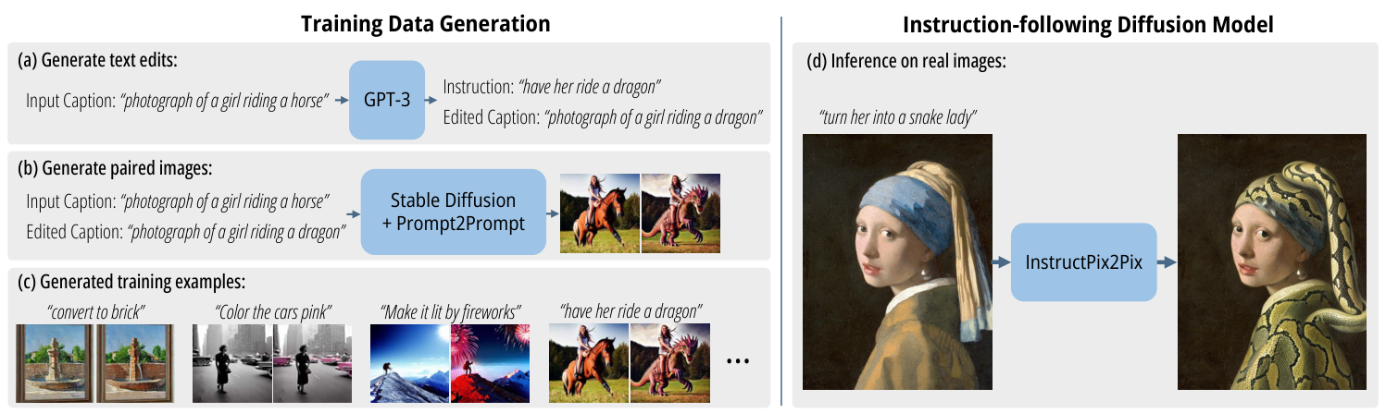
PART 1 / IMAGE EDITING
Where edit supervision comes from
A training example pairs a source, an instruction, and an edited target.
InstructPix2Pix used synthetic edit data to teach this relationship.
Brooks, Holynski & Efros / CVPR 2023 / Figure 2 excerpt
25
Notes:
Spoken teaching script (45 seconds at the planning pace)
Where does the ability to follow an edit instruction come from? A training example can contain a source image, an instruction, and the corresponding edited target. InstructPix2Pix is an early example that used synthetic editing data to teach this relationship.
Suppose a training pair says 'make the object ceramic,' but its target also moves the camera and replaces the background. The learning signal no longer cleanly identifies the requested transformation. The model may learn unwanted associations. This gives us an important data-quality question: did the target accomplish the requested change while preserving what should remain? Attractive targets alone are not enough to teach dependable editing.
Teaching cues
This older paper is a useful foundation for understanding current systems. Explain the left side as data creation and the right side as learning to edit. Ask what happens if an alleged material-change pair also moves the camera. Such unwanted correlations can teach the model the wrong meaning of an edit. Training pairs need both successful change and preservation, not merely attractive targets.
Sources and visual credits
https://arxiv.org/abs/2211.09800

Slide 26
PART 1 / IMAGE EDITING
What a mismatched training pair teaches
Instruction | Unwanted target change | Possible learned association
Make it ceramic | Camera moves closer | Material implies reframing
Replace the background | Subject becomes larger | Setting implies scale change
Change the color | Object identity changes | Color implies replacement
Illustrative failure cases, not measured dataset statistics.
Part 1 / Image editing
26
Notes:
Spoken teaching script (45 seconds at the planning pace)
A training pair is a lesson, and lessons can accidentally teach the wrong thing. Imagine a source glass pear and a target ceramic pear that also has a different background. The written request says only to change the material. Which visible changes should the model associate with that request?
If this mismatch recurs in the training data, the model can learn an unwanted association between a material change and a scene change. Compare the instruction with the actual difference between source and target. Ask what supervision is rewarding, including changes nobody meant to label. The preservation contract begins in the examples used to teach the editor.
Teaching cues
Original teaching extension. Illustrative failure cases, not measured dataset statistics.
Sources and visual credits
https://arxiv.org/abs/2211.09800

Slide 27
PART 1 / IMAGE EDITING
Classifier-free guidance (CFG)
v̂ = vbase + s (vcond − vbase)
vbase baseline prediction vcond conditioned prediction
s = 1 recovers the conditioned prediction.
Larger s extrapolates. It can also amplify artifacts.
Part 1 / Image editing
27
Notes:
Spoken teaching script (46 seconds at the planning pace)
Sometimes a conditioned prediction moves in the right direction but too weakly. Classifier-free guidance uses the difference between a conditioned prediction and a baseline prediction to steer the result. Read the formula as baseline, plus a scaled change in direction.
When s equals one, the baseline terms cancel and we recover the conditioned prediction. Above one, we extrapolate beyond it. That can strengthen the requested change, but it can strengthen errors as well. In an editing system, the baseline may still retain image information; baseline does not always mean no information at all. Think of guidance as a specific operation on predictions, rather than a universal quality dial.
Teaching cues
Trace the cancellation at s = 1 with a pointer. Define baseline for the system being discussed.
This is the simplified classifier-free guidance form. The definition of the baseline depends on the system: an empty-text prediction may retain source-image conditioning. Do not call every baseline completely unconditional. Guidance changes inference, whereas fine-tuning changes model parameters. The later video example provides an actual ablation. Some distilled models do not expose the same guidance control.
Sources and visual credits
https://arxiv.org/abs/2207.12598
https://arxiv.org/abs/2608.14790

Slide 28
PART 1 / IMAGE EDITING
Guidance goes beyond the prediction
0.2 + 2 × (0.5 − 0.2) = 0.8
vbase = 0.2, vcond = 0.5, s = 2
Extrapolation can strengthen useful changes and errors.
Part 1 / Image editing
28
Notes:
Spoken teaching script (41 seconds at the planning pace)
The baseline predicts 0.2 and the conditioned version predicts 0.5. With guidance scale two, do we get a value somewhere between them? No. We take 0.2 plus twice the difference of 0.3, which gives 0.8. We have moved beyond the conditioned prediction.
If the useful direction includes a slight mistake, we can amplify both. For the pear, the new material might become clearer while the stem or boundary becomes less faithful. Compare the requested change and preservation separately. One slider can move those judgments in opposite directions; a single overall impression can hide the tradeoff.
Teaching cues
Ask whether 0.8 lies between 0.2 and 0.5. Explain why extrapolation is intentional.
Original teaching extension.
Sources and visual credits
https://arxiv.org/abs/2207.12598
https://arxiv.org/abs/2608.14790

Slide 29
PART 1 / IMAGE EDITING
Different controls carry different information
Control | What it supplies | Useful when…
Instruction | Requested semantic change | The object or action is clear
Mask | Region eligible for editing | Locality matters
ControlNet | Spatial cues: edges, depth, pose | Pose or layout must survive
Reference image | Appearance or identity cues | Words are insufficient
Availability and exact behavior depend on the editor.
Part 1 / Image editing
29
Notes:
Spoken teaching script (58 seconds at the planning pace)
Different controls communicate different kinds of information. Text describes a requested change. A mask specifies a region. A spatial condition can describe pose, depth, or edges. An image reference can supply appearance information that would be difficult to express precisely in words.
These are not interchangeable knobs, and every product does not expose all of them. ControlNet and IP-Adapter are examples of distinct architectural approaches. If exact untouched pixels are essential, a generation mask alone may be insufficient; explicit copying or compositing can enforce that requirement. Choose a control by asking what information is missing, then check whether the resulting image actually respected it. A mask indicates a permitted region; it does not by itself solve seams or the reflection of a changed material. The next slide names an architecture that learns to use a spatial condition.
Teaching cues
Compare information types, not a menu that every product offers. A mask constrains where a system may modify content, but an actual hard copy or compositing step is needed for exact pixel preservation. ControlNet is a concrete architecture for spatial conditions. IP-Adapter is a concrete image-prompt adapter. They are distinct mechanisms and can be combined in some pipelines.
Sources and visual credits
https://arxiv.org/abs/2302.05543
https://arxiv.org/abs/2308.06721

Slide 30
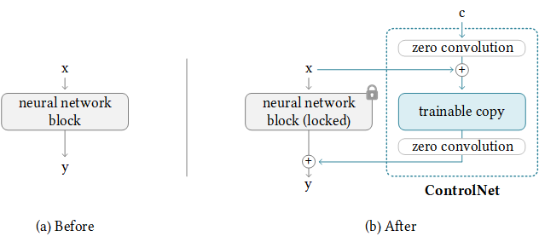
PART 1 / IMAGE EDITING
ControlNet: add spatial conditioning
Freeze the pretrained diffusion model.
Train a copied branch with a spatial condition.
Zero-initialized 1 × 1 convolutions connect the paths.
Zhang, Rao & Agrawala · ICCV 2023 · Original ControlNet block diagram
30
Notes:
Spoken teaching script (52 seconds at the planning pace)
Suppose your sentence is understood, but the pear keeps changing shape. You can describe its outline with more adjectives, or supply spatial evidence. ControlNet gives an edge map, depth map, or pose a learned route into a compatible diffusion model.
Trace the two paths in this original architecture. The pretrained path stays frozen. A trainable copy processes the added condition, and zero-initialized one-by-one convolutions connect its features to the main path. Initially those connections contribute zero; training learns their contribution. The copied branch itself starts from pretrained weights, not all zeros.
Now return to our request. Edges can help specify the outline. They cannot, by themselves, tell us whether the reflected ceramic looks convincing or the blue stem retains its identity.
Teaching cues
Trace frozen path, copied branch, then zero-initialized connections in that order. Do not call the entire branch zero-initialized.
Trace the locked path and trainable path separately. Zero initialization concerns the connecting convolutions, not every weight of the copied branch. This is the original ControlNet architecture, not a claim about the internal architecture of every current image editor.
Sources and visual credits
ControlNet: Zhang, Rao & Agrawala, Adding Conditional Control to Text-to-Image Diffusion Models (ICCV 2023). https://openaccess.thecvf.com/content/ICCV2023/html/Zhang_Adding_Conditional_Control_to_Text-to-Image_Diffusion_Models_ICCV_2023_paper.html ; original authors’ block diagram: https://github.com/lllyasviel/ControlNet/blob/main/github_page/he.png

Slide 31
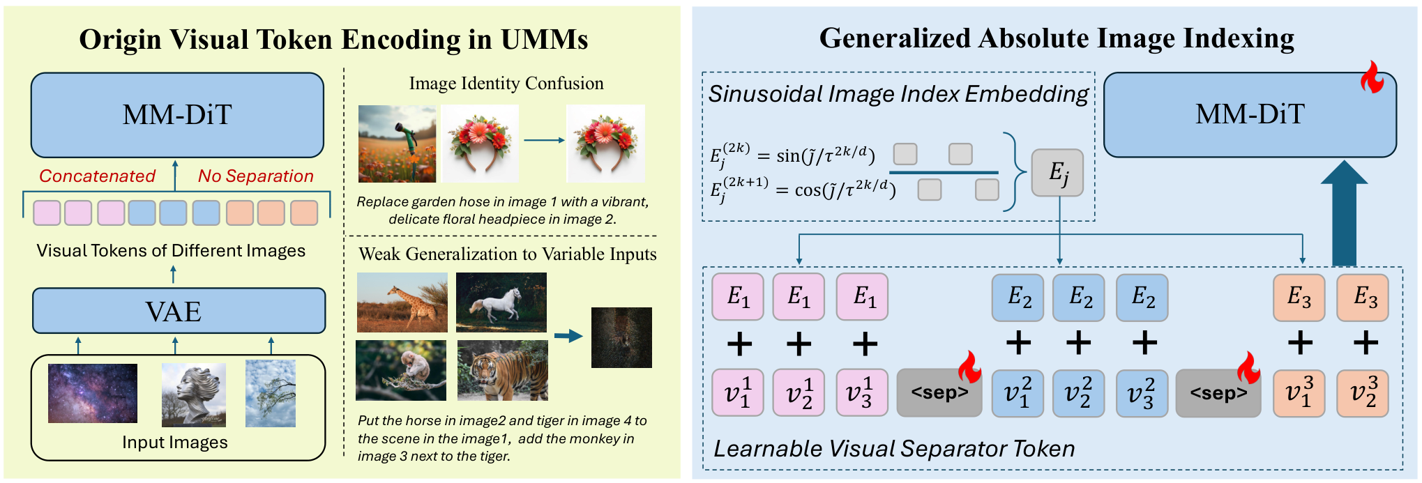
PART 1 / IMAGE EDITING
Multiple references need distinct identities
Image index: which reference? Separator: where does it end?
Generalized Multi-Image Editing / January 2026 / Figure 1 excerpt
31
Notes:
Spoken teaching script (42 seconds at the planning pace)
With several references, the system must know which reference contributes which information. Imagine asking for the sculpture from image one and the atmosphere from image two. If the references become confused, you may get the wrong object with the right lighting.
The illustrated research approach uses separators and image-index information to distinguish inputs. In an art brief, name the role of each image rather than presenting a pile of vaguely related inspiration. Then inspect for leakage: did a composition reference accidentally replace the subject? This figure describes one proposed mechanism, not a universal design used by every editor.
Teaching cues
The paper proposes learned separator tokens and an image-index embedding to distinguish inputs. Ask students to translate its problem into an art brief: the model should take the sculpture from reference one and atmosphere from reference two, rather than blend all content indiscriminately. The figure illustrates a particular research design, not a universal architecture.
Sources and visual credits
https://arxiv.org/abs/2601.05572

Slide 32
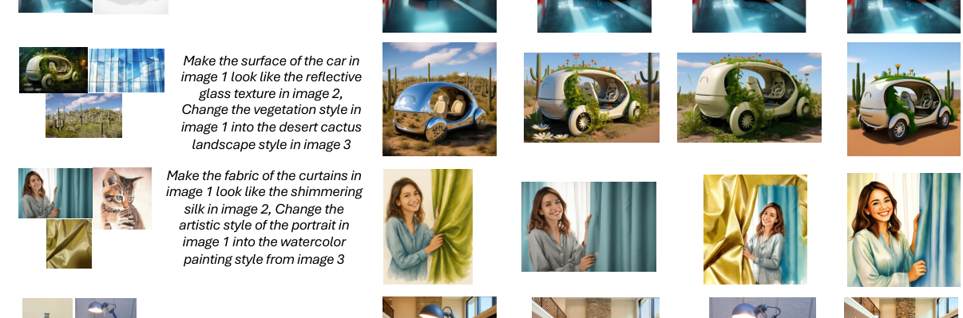
PART 1 / IMAGE EDITING
A reference-role failure is visible in the output
Input
Instruction
Ours
DreamOmni2
Qwen-Edit
OmniGen2
Which reference supplied the subject? Which supplied the requested change?
Multi-image editing / January 2026 / Published qualitative examples
32
Notes:
Spoken teaching script (41 seconds at the planning pace)
Look at these published multi-image examples with reference roles in mind. Before judging the output, identify what each input was supposed to contribute. Then trace the subject and the requested transformation into the result.
A reference-role failure can look superficially attractive. The system may borrow the wrong object's appearance or import a background that was never intended. We are examining qualitative examples from a particular paper, not conducting a broad comparison between products. The figure helps us practice an inspection method: follow the intended contribution of each input and look for unintended transfers between them.
Teaching cues
Original teaching extension. Multi-image editing / January 2026 / Published qualitative examples
Sources and visual credits
https://arxiv.org/abs/2601.05572

Slide 33
PART 1 / IMAGE EDITING
Attention as weighted information gathering
Illustrative query: “pear surface” | Weight | Value
Material-reference token | 0.8 | 0.9
Background-reference token | 0.2 | 0.1
Weighted value = 0.8 × 0.9 + 0.2 × 0.1 = 0.74
Part 1 / Image editing
33
Notes:
Spoken teaching script (43 seconds at the planning pace)
Attention lets a token gather information from other tokens with different weights. Our simplified scalar example gives weight 0.8 to a value of 0.9, and weight 0.2 to a value of 0.1. The weighted result is 0.74.
The real mechanism operates on learned vectors, so this is arithmetic intuition rather than a literal description of artistic decision-making. The important structure is selective combination: every available source need not contribute equally. In a multi-reference edit, the system also needs to distinguish where information came from. Otherwise, gathering information successfully can still produce the wrong mixture of subject identity and visual style.
Teaching cues
A deliberately tiny attention example with one scalar value per token. Real attention uses learned vectors and many heads. The weights sum to one after softmax. The model does not literally expose these semantic labels. Ask what a reference mix-up would do to the result. A large attention weight is not, by itself, a reliable causal explanation of the generated image.
Sources and visual credits
https://arxiv.org/abs/1706.03762

Slide 34
PART 1 / IMAGE EDITING
Softmax weights sum to one
0.8 + 0.2 = 1
0.8 × 0.9 + 0.2 × 0.1 = 0.74
This scalar example illustrates weighted combination.
Attention weights alone do not establish causality.
Part 1 / Image editing
34
Notes:
Spoken teaching script (41 seconds at the planning pace)
The weights in this simplified attention example sum to one. That makes the result a weighted combination of the values. A larger weight makes the associated value contribute more to this particular calculation.
Now be cautious about jumping from the calculation to an explanation of the final image. Real networks contain many layers, heads, and transformations. A high weight at one point may not tell us why a visible feature ultimately appeared. For practical reference editing, the useful question remains whether the intended information survives in the output, regardless of how compelling an attention visualization looks.
Teaching cues
Original teaching extension.
Sources and visual credits
https://arxiv.org/abs/1706.03762

Slide 35
PART 1 / IMAGE EDITING
LoRA: low-rank adaptation
W′ = W + B A
4,096² versus 2 × 4,096 × 16
A rank-16 update uses 131,072 parameters here.
The full square matrix has 16,777,216 parameters.
Reference conditioning supplies input. LoRA learns a parameter update.
Part 1 / Image editing
35
Notes:
Spoken teaching script (56 seconds at the planning pace)
What if a useful concept must recur across many requests? A reference can condition a generation, while LoRA adapts selected learned weights using a low-rank update. The update is a product of two smaller matrices. Instead of learning every entry of a large update matrix independently, we express that update as a product of two smaller matrices.
For a 4096 by 4096 weight matrix and rank sixteen, the full matrix has 16,777,216 entries. The two factors together have 131,072, a factor of 128 fewer for this update. That is not a claim that the entire model shrinks by 128. The base weights still exist. Low rank makes adaptation economical, but does not certify that the learned subject survives a new pose. That question requires examples the adaptation did not already see.
Teaching cues
Count both low-rank factors. The ratio concerns this update matrix, not the full model.
Optional technical depth, 2 minutes. In this toy layer, W has dimension 4096 by 4096, B is 4096 by 16, and A is 16 by 4096. The update is 128 times smaller in parameter count. This does not imply the whole model is 128 times smaller or faster. A reusable subject or visual language may motivate adaptation, but overfitting and data quality still matter.
Sources and visual credits
https://arxiv.org/abs/2106.09685

Slide 36
PART 1 / IMAGE EDITING
Did it learn the subject or the setting?
Training success
Useful generalization
The adapted model reproduces
familiar views and backgrounds.
The concept survives a new view,
setting, or composition.
Part 1 / Image editing
36
Notes:
Spoken teaching script (44 seconds at the planning pace)
An adapted model reproduces your favorite training portrait perfectly. Is that enough to use the character in a new film? Consider what else it may have learned: the familiar camera angle, the background, even the lighting that always accompanied the subject.
A held-out check deliberately changes those circumstances. Ask for a new view or a different setting and inspect the distinctive features. We want a reusable concept, rather than a narrow ability to reproduce familiar combinations. For the pear, keep the blue stem recognizable while moving the exhibition outdoors. If identity collapses there, more praise for the training examples will not solve the problem.
Teaching cues
Original teaching extension.
Sources and visual credits
https://arxiv.org/abs/2106.09685

Slide 37
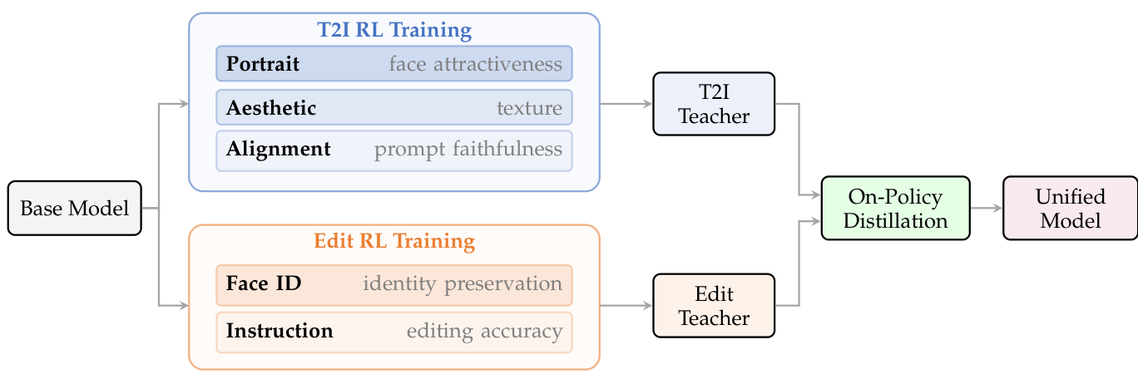
PART 1 / IMAGE EDITING
What does the reward favor?
Qwen-Image-2.0-RL separates task-specific reward training, then distills.
Aesthetic preference and identity preservation can pull in different directions.
Qwen-Image-2.0-RL / June 2026 / Figure 1 excerpt
37
Notes:
Spoken teaching script (46 seconds at the planning pace)
A reward tells a learning process what kinds of outputs to favor. The figure shows a recent approach that separates task-specific reward training and then distills what is learned. Look at the categories: editing quality involves more than a single judgment of attractiveness.
Now imagine an artwork whose purpose is to feel awkward or disturbing. A generic preference for polished images could work against that purpose. Human preference signals are useful, but they do not define artistic merit for every project. This is the bridge to the next section: technical optimization can help produce candidates, while an artist still needs to decide which properties serve the work.
Teaching cues
Point to the task-specific reward categories in the original figure. Human preference is a signal used to shape outputs, not a definition of artistic merit. Ask whether a disturbing, awkward image that perfectly serves an artwork should score below a polished portrait. That question prepares the transition to art direction. Avoid treating the author-reported evaluation as a universal ranking.
Sources and visual credits
https://arxiv.org/abs/2606.27608

Slide 38
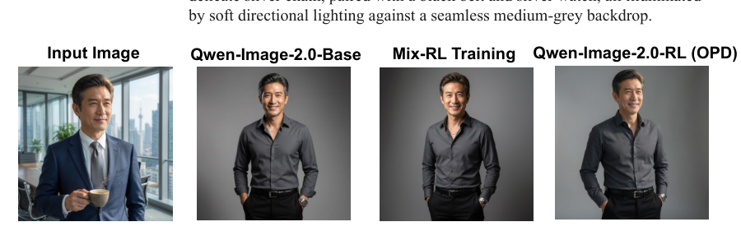
PART 1 / IMAGE EDITING
One reward cannot stand in for every intention
Request: a studio portrait preserving the reference subject’s facial features.
Separate edit fidelity from the preference signal used to rank outputs.
Qwen-Image-2.0-RL / June 2026 / Published edit examples
38
Notes:
Spoken teaching script (44 seconds at the planning pace)
These edit examples invite a question about evaluation. Which properties would you reward separately? You might ask whether the instruction was carried out, whether identity survived, and whether the image is visually convincing.
Those judgments can disagree. A highly polished output might erase an awkward feature that is central to the artwork. An unusual composition might serve the brief while attracting a lower generic preference score. We should understand what a reward encourages before treating a high score as artistic approval. The published examples illustrate the research setting; our classroom task is to articulate the intention against which we would judge a particular result.
Teaching cues
Original teaching extension. Qwen-Image-2.0-RL / June 2026 / Published edit examples
Sources and visual credits
https://arxiv.org/abs/2606.27608

Slide 39
PART 1 / IMAGE EDITING
Attractiveness and fidelity are separate tests
Beautiful, but wrong
Faithful, but unconvincing
The image is attractive.
The pear changes identity.
The exhibition’s premise disappears.
The right object changes.
The reflection contradicts it.
The material feels pasted on.
Evaluate the requested change and the retained world separately.
Part 1 / Image editing
39
Notes:
Spoken teaching script (45 seconds at the planning pace)
Which failure would you notice first? On one side, the output is beautiful, but it has quietly replaced our particular sculpture with a generic decorative pear. On the other, the right sculpture is present, but its reflection still behaves like the old material.
The first may win a quick aesthetic vote. The second may pass a checklist that only asks whether the requested object changed. Neither satisfies the full brief. Has the editor lost identity, broken the scene's optical logic, or missed the work's intention? Naming the mismatch gives us a next action. Saying only that an output looks a little wrong leaves the diagnosis unfinished.
Teaching cues
Invite a quick show of hands on which failure is easiest to overlook. Return to the explicit brief.
Ask for a third category: technically successful but artistically uninteresting. This slide presents an original critique framework, not quantitative model results. Ask students to give evidence from visible properties rather than saying only that they like an image. Good critique identifies a relationship that succeeds or fails.
Sources and visual credits
Original teaching framework or exercise.

Slide 40
PART 1 / IMAGE EDITING
A useful diagnosis changes the next action
Observed failure | First hypothesis | Candidate revision
Wrong object changes | Ambiguous reference | Clarify object or region
Identity drifts | Weak appearance grounding | Improve source/reference
Reflection contradicts material | Dependent change omitted | Revise light or composite
Choose the next step from evidence in the failed result.
Part 1 / Image editing
40
Notes:
Spoken teaching script (43 seconds at the planning pace)
A diagnosis becomes useful when it changes the next action. If the wrong object changes, first suspect an ambiguous reference or region specification. If the correct object becomes another instance, appearance grounding may be the issue. If the material looks disconnected from its reflection, the dependent change may be missing.
These are candidate explanations, not automatic conclusions. Choose a small revision that tests one of them. If it does not help, reconsider the hypothesis. This is more informative than changing the prompt, seed, reference, and model all at once, because then a successful result would leave us unsure which intervention mattered.
Teaching cues
Original teaching extension. Choose the next step from evidence in the failed result.
Sources and visual credits
Original teaching example and classroom reasoning.

Slide 41
PAUSE THE VIDEO · CLASS DISCUSSION
Discuss: the ceramic edit
01
Would you preserve the reflection or let it change? Why?
02
When would a mask help more than a longer prompt?
03
What would edges or depth control still leave uncertain?
Discuss these three questions. Resume when the class is ready.
41
Notes:
Spoken teaching script (38 seconds at the planning pace)
We now have several ways to communicate an edit. Would you preserve the reflection or let it change, and why? When would a mask help more than a longer prompt? What would edges or depth control still leave uncertain?
Discuss these three questions using the pear already on screen. For each control you favor, name the failure it addresses and something it cannot settle. Pause the video here. The next slide offers one possible contract; compare it with your reasoning rather than treating it as the only artistic answer.
Teaching cues
Pause after reading all three questions. Invite contrasting views and ask for visible evidence. No making, sketching, or tool use is required.
Sources and visual credits
Original classroom discussion questions.

Slide 42
PART 1 / IMAGE EDITING
A worked ceramic-edit contract
Preserve the blue stem and pear silhouette.
Allow transmission, highlights, and reflections to adapt.
Inspect the boundary and water before accepting the edit.
Part 1 / Image editing
42
Notes:
Spoken teaching script (45 seconds at the planning pace)
Here is one defensible answer to the ceramic puzzle. Preserve the blue stem and recognizable silhouette. Allow transmission, highlights, and the reflection to change with the new material. Then inspect the boundary and water, because that is where the request reaches beyond the object.
Notice the wording: allow a justified consequence, rather than permit arbitrary drift. We have not given the model permission to redesign the gallery. We have named the changes necessary to make this material transformation coherent. A mask could help localize work, while compositing might protect a region that truly must remain exact. The contract tells us how to use those tools.
Teaching cues
Original teaching extension.
Sources and visual credits
Original teaching example and classroom reasoning.

Slide 43
PART 1 / IMAGE EDITING
The brief, the model, and the review
01
The brief: define the intended change.
02
The model: propose an edited result.
03
The review: check the change and what survived.
Part 1 / Image editing
43
Notes:
Spoken teaching script (46 seconds at the planning pace)
We can now explain our opening puzzle at three levels. The brief decides what should change and what should survive. The model uses representations, conditioning, and sampling to propose a result. Our review checks whether that proposal actually satisfies the brief.
Keep those levels separate when you diagnose a failure. Stronger guidance will not choose the exhibition's purpose. A more eloquent artistic statement will not enforce identical pixels. A beautiful preview will not prove preservation. The useful skill is connecting the right intervention to the observed problem. If your partner can tell when to use it and what it leaves uncertain, you have understood more than its name.
Teaching cues
Use this as a verbal retrieval check: ask one student to explain latent, another guidance, and another the difference between a reference and LoRA. Then transition to the break. Do not read every line aloud.
Sources and visual credits
Original teaching framework or exercise.

Slide 44
PAUSE THE VIDEO · CLASS DISCUSSION
After Part 1: explain the control
01
How does ControlNet differ from a mask or a text prompt?
02
Why can stronger guidance make an edit worse?
03
What evidence would show that an edit preserved identity?
Discuss these three questions. Resume when the class is ready.
44
Notes:
Spoken teaching script (34 seconds at the planning pace)
We can now explain our controls rather than just name them. How does ControlNet differ from a mask or a text prompt? Why can stronger guidance make an edit worse? What evidence would show that an edit preserved identity?
Discuss these three questions. Choose a concrete requirement—a silhouette, an untouched region, or a distinctive stem—and connect your explanation to it. Then consider whether the control guarantees that requirement or only helps express it. Pause the video here before the break.
Teaching cues
Ask one student to explain a mechanism and another to name a failure it does not solve. Pause the video after the three questions.
Pause after reading all three questions. Invite contrasting views and ask for visible evidence. No making, sketching, or tool use is required.
Sources and visual credits
Original classroom discussion questions.

Slide 45
Break
10 minutes
After the break: what makes a set of images belong to one artwork?
Part 1 / Image editing
45
Notes:
Spoken teaching script (29 seconds at the planning pace)
We will take ten minutes and resume when the class is ready. When you come back, think about a series of images you would recognize as belonging to one artwork. What makes them belong together: the subject, the palette, the treatment of space, or something else?
Leave that question open for now. We will use it to move from individual editing operations to a coherent visual language.
Teaching cues
Take a ten-minute break if appropriate. Resume when the class is ready. Leave this slide visible.
Sources and visual credits
Classroom images generated with ImageGen, 7 September 2026. Fictional exhibition and sculpture. These are illustrative examples, not a benchmark or a real artwork attribution.

Slide 46
PART 1 / IMAGE EDITING
One exhibition, different visual worlds
“
What makes two very different images belong to the same artwork?
Part 1 / Image editing
46
Notes:
Spoken teaching script (46 seconds at the planning pace)
Look again at the artwork we have been using as a technical test. After the break, it has a different job. We are no longer asking only whether the edit obeys a request. We are asking what a visitor might feel, and which visual decisions create that feeling.
Two images can have different surfaces and still belong to one exhibition. Two images can share a palette and feel unrelated. The difference is worth arguing about. In the next section, I will show prepared alternatives for AFTER RAIN. Choose a direction in your mind, and be ready to explain a visible reason. Your neighbor may choose the other one.
Teaching cues
Original teaching extension.
Sources and visual credits
Classroom images generated with ImageGen, 7 September 2026. Fictional exhibition and sculpture. These are illustrative examples, not a benchmark or a real artwork attribution.

Slide 47
PART 2
Art direction
Reference, composition, and iteration
Part 2 / Art direction
47
Notes:
Spoken teaching script (24 seconds at the planning pace)
Now take the art director’s seat. The model can produce many plausible outputs; we decide which differences matter for AFTER RAIN. As we compare the prepared images, name the visible relationship that carries the idea. That could be scale, light, or the treatment of space. Your explanation will be more useful than simply calling an image impressive.
Teaching cues
The same editor can produce many plausible images. Art direction chooses which differences matter. Frame the section around a coherent body of work rather than prompt tricks.
Sources and visual credits
Classroom images generated with ImageGen, 7 September 2026. Fictional exhibition and sculpture. These are illustrative examples, not a benchmark or a real artwork attribution.

Slide 48
PAUSE THE VIDEO · CLASS DISCUSSION
Before Part 2: artistic intention
01
What makes an image feel fragile rather than merely attractive?
02
Can very different images belong to the same artwork? Why?
03
Which artistic decisions would you keep for yourself?
Discuss these three questions. Resume when the class is ready.
48
Notes:
Spoken teaching script (36 seconds at the planning pace)
Before seeing the poster alternatives, consider what you want a visitor to experience. What makes an image feel fragile rather than merely attractive? Can very different images belong to the same artwork, and why? Which artistic decisions would you keep for yourself?
Discuss these three questions. You might disagree about the effect of empty space or the meaning of a material. Locate the visual evidence behind that disagreement. Pause the video here. Keep your starting position in mind when we compare the prepared directions.
Teaching cues
Collect opposing readings of fragility. Keep them available when comparing the posters on slide 65. Pause the video after the three questions.
Pause after reading all three questions. Invite contrasting views and ask for visible evidence. No making, sketching, or tool use is required.
Sources and visual credits
Original classroom discussion questions.

Slide 49
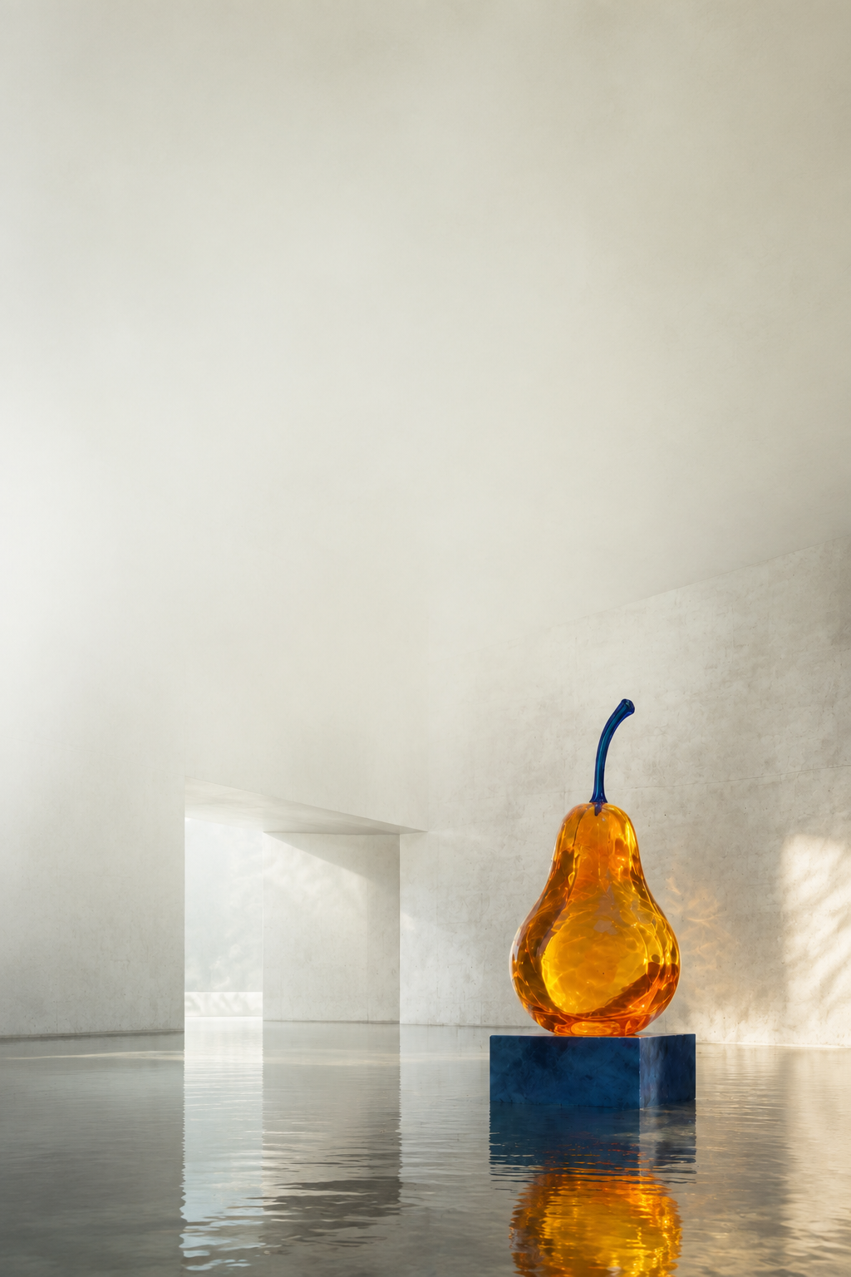
PART 2 / THE CLASSROOM COMMISSION
AFTER RAIN
A fictional exhibition about fragile objects in changing environments.
Deliverables: a poster and a five-second moving image.
Keep the amber pear and blue stem recognizable.
Part 2 / Art direction
49
Notes:
Spoken teaching script (44 seconds at the planning pace)
Here is our commission: AFTER RAIN, a fictional exhibition about fragile objects in changing environments. Imagine a visitor seeing its poster across a corridor before encountering a five-second moving image inside. What should that visitor expect to feel?
The prepared examples keep the amber pear and blue stem recognizable. We will examine photographic and collage directions, then consider how a moving reveal changes the experience. Nobody needs to generate an image during this lecture. Fragile is a useful beginning, but it is not yet an art direction. We need to translate that word into something visible enough to compare and precise enough to revise.
Teaching cues
Describe the prepared commission as a scenario for discussion; do not assign image production.
This is a fictional classroom commission. Students can use the supplied assets or substitute their own subject. The conceptual premise is fragility: a stable object appears in environments that alter how we read it. Ask how material, scale, and atmosphere could support that premise. Avoid turning the assignment into a generic advertisement.
Sources and visual credits
Classroom images generated with ImageGen, 7 September 2026. Fictional exhibition and sculpture. These are illustrative examples, not a benchmark or a real artwork attribution.

Slide 50
PART 2 / ART DIRECTION
Making fragility visible
Artistic intention | Possible visual decision | Question for critique
Vulnerability | Small object, large surroundings | Does scale create exposure?
Stillness | Quiet light, restrained movement | Does time feel suspended?
Instability | Reflection before direct view | Does the reveal change meaning?
Possible interpretations of a fictional brief, not a fixed recipe.
Part 2 / Art direction
50
Notes:
Spoken teaching script (48 seconds at the planning pace)
Try replacing fragile with expensive in the brief. You might still choose glass, but would you use the same composition? A large centered object and assertive lighting might suggest a luxury product. A small object surrounded by quiet space might instead seem exposed.
Scale can make the pear feel vulnerable. Restrained light can make us look closely. A reflection can suggest a world less stable than the object itself. These are artistic hypotheses to test against an audience's reading, not a formula that makes every image fragile. Point to the feature doing the work. If nobody can locate it in the image, the intention may still be living only in the prompt.
Teaching cues
Original teaching extension. Possible interpretations of a fictional brief, not a fixed recipe.
Sources and visual credits
Classroom images generated with ImageGen, 7 September 2026. Fictional exhibition and sculpture. These are illustrative examples, not a benchmark or a real artwork attribution.

Slide 51
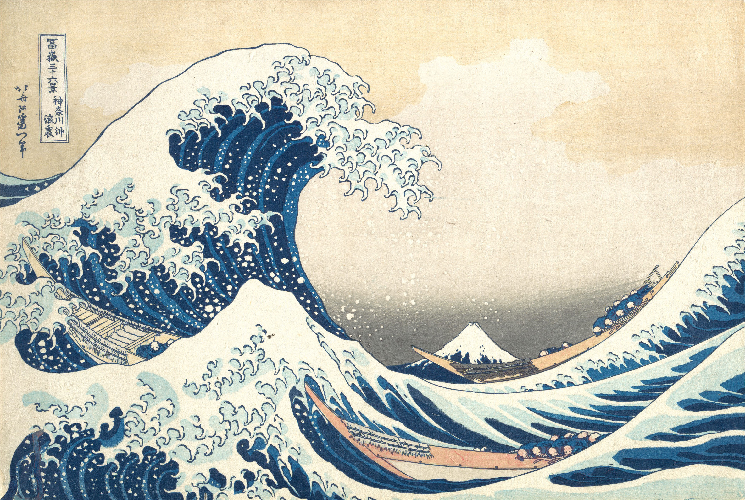
PART 2 / ART DIRECTION
Hokusai: scale, rhythm, and tension
Scale
A small distant mountain.
Rhythm
Repeated curves and crests.
Tension
A wave hangs over the boats.
Hokusai, Under the Wave off Kanagawa, ca. 1830–32. The Met.
51
Notes:
Spoken teaching script (46 seconds at the planning pace)
In Hokusai's Great Wave, look first for Mount Fuji. It is small and distant. Now follow the curves of the wave and the boats beneath it. Scale and rhythm create a tension we can discuss without turning the artwork into a style label.
For AFTER RAIN, we might borrow a relationship: a small, vulnerable form facing a much larger environment. We do not need to reproduce the wave or ask for a generic imitation of the artist. The reference becomes useful when we can say which visual decision we are studying. Then we must test its translation. Our quiet flooded gallery has a different subject and emotional register.
Teaching cues
Locate Mount Fuji before tracing the wave. Discuss composition and attribution rather than requesting imitation.
Spend 2 minutes looking before explaining. Ask students to trace the path of their eye without drawing over the artwork. These compositional observations are the lecturer’s visual reading. The work is a woodblock print from Thirty-six Views of Mount Fuji. Translate a formal relationship into your own brief: for example, a small vulnerable subject under a large curved mass. Distinguish a formal lesson from copying an entire image.
Sources and visual credits
https://www.metmuseum.org/art/collection/search/45434

Slide 52
PART 2 / ART DIRECTION
Reference as a relationship, not a label
Name the scale relationship or visual rhythm you need.
Translate that relationship to your own subject.
Judge the translation against the new work’s intention.
Part 2 / Art direction
52
Notes:
Spoken teaching script (46 seconds at the planning pace)
Instead of using a reference as a label, describe a relationship you can observe. You might want a small stable form beneath a large dynamic curve, or a rhythm that moves the eye through the composition.
Then translate that relationship into the new subject and brief. The result should be judged as its own artwork, not as a contest to resemble the reference. This approach makes references more useful to collaborators because they can understand what you are borrowing. It also makes iteration more focused: if the intended tension is missing, you can revise scale or rhythm rather than vaguely asking for more influence from the source.
Teaching cues
Original teaching extension.
Sources and visual credits
https://www.metmuseum.org/art/collection/search/45434

Slide 53
PART 2 / ART DIRECTION
Where does your eye arrive?
A small object in a large, quiet space.
A reflection extends its presence.
Where can the title live?
Part 2 / Art direction
53
Notes:
Spoken teaching script (49 seconds at the planning pace)
Before admiring the surface detail, decide where your eye arrives. Is it the pear, the reflection, or the space waiting above them? A poster has to organize that first encounter. If every region is equally busy, the audience has to invent a hierarchy we have not provided.
Here, the open area can make the object feel small and give the title somewhere to live. We can ruin the sense of quiet by filling every available gap with decorative detail, even if each addition is attractive on its own. When revising this image, I would first ask whether the composition expresses the intended scale and silence. More texture comes later, if the work needs it.
Teaching cues
Give the audience a silent first look. Ask where the eye arrives before discussing type.
The prepared image gives the object relatively little area and leaves a large pale field above it. Ask whether that feels contemplative, empty, or monumental. The answers depend on the brief. The pear appears smaller than in the opening image, so this is a deliberately recomposed artwork, not a preservation test. Image editing and graphic layout need different checks.
Sources and visual credits
Classroom images generated with ImageGen, 7 September 2026. Fictional exhibition and sculpture. These are illustrative examples, not a benchmark or a real artwork attribution.

Slide 54
PART 2 / ART DIRECTION
Negative space has a job
In the composition
In the finished poster
It changes the apparent scale
and isolation of the object.
It provides room for a title
and controls the reading order.
Part 2 / Art direction
54
Notes:
Spoken teaching script (43 seconds at the planning pace)
Negative space does two jobs in this poster. It changes how large or isolated the object feels, and it creates a place for typography. These are connected design decisions rather than separate finishing steps.
If you fill the pale area with dramatic detail, the image may become more visually active but leave no calm route for reading the title. If you reserve too much space, the subject might lose the presence you wanted. Evaluate the space in relation to the finished use. A generative background is part of a larger composition when it must carry text, branding, or other exact elements.
Teaching cues
Original teaching extension.
Sources and visual credits
Classroom images generated with ImageGen, 7 September 2026. Fictional exhibition and sculpture. These are illustrative examples, not a benchmark or a real artwork attribution.

Slide 55
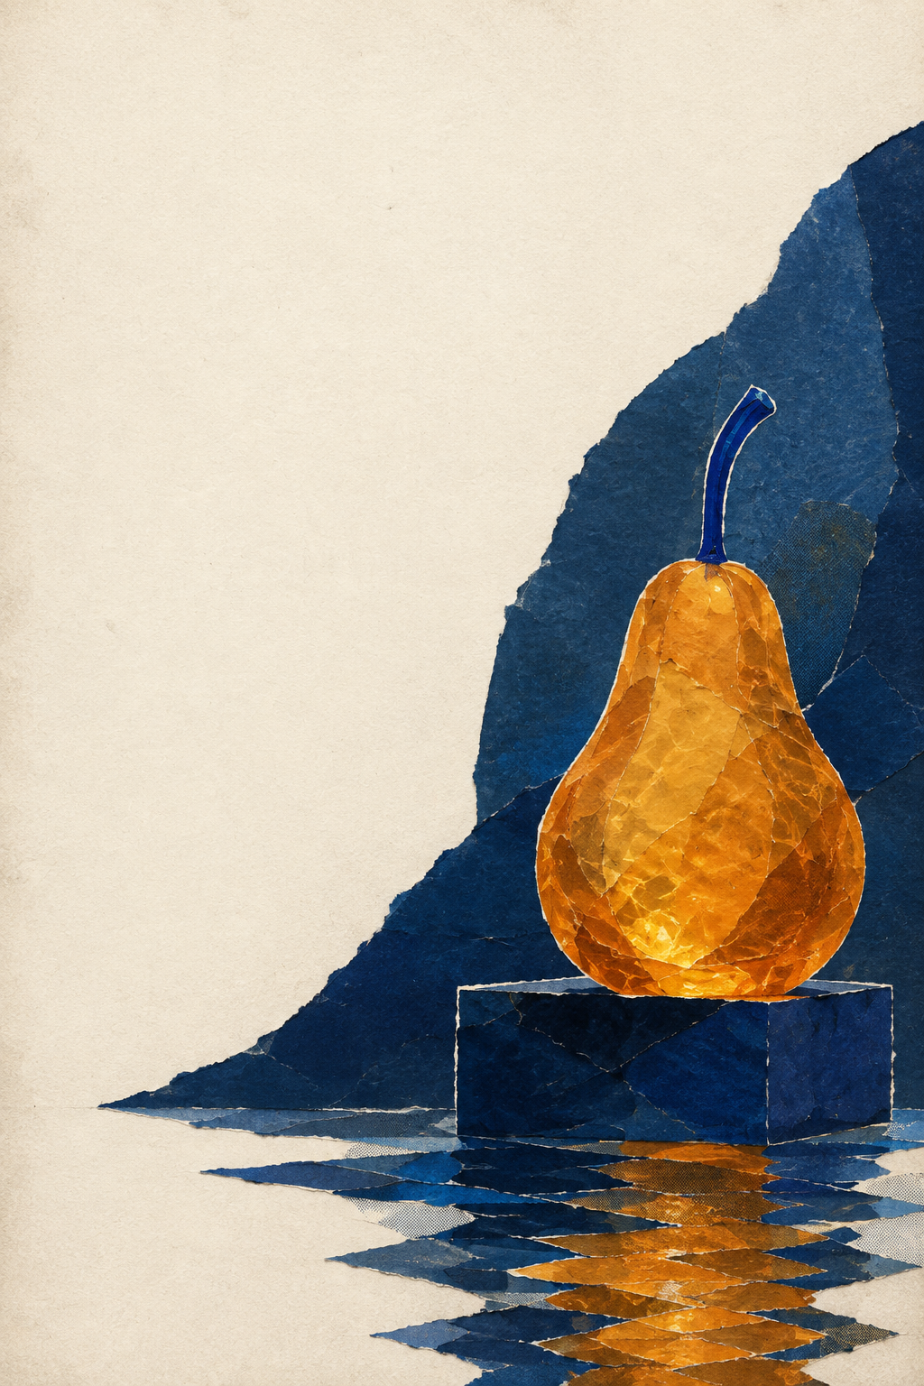
PART 2 / ART DIRECTION
A visual language has rules
Torn edges replace smooth contours.
Flat layers replace optical depth.
Amber and indigo remain the anchors.
Part 2 / Art direction
55
Notes:
Spoken teaching script (43 seconds at the planning pace)
The collage direction changes the rules of the world. Torn edges replace smooth contours. Flat layers replace optical depth. Amber and indigo keep a connection to our recurring subject. Look at how those decisions affect the pear's apparent weight and vulnerability.
If the body looks like paper but the water behaves like a photograph, do we accept that collision? We might, if it is deliberate and supports the work. We might reject it as an unresolved mixture. The answer depends on the intended visual language. The next comparison asks you to locate precisely where that language holds together or breaks.
Teaching cues
The collage interpretation retains the subject cues while changing how surfaces, space, and light are represented. Ask which rules must remain consistent across a series. A list of artist names is less precise than a description of visible operations. This example is an AI-generated paper-collage illustration, not a physical collage or an attributed historical artwork.
Sources and visual credits
Classroom images generated with ImageGen, 7 September 2026. Fictional exhibition and sculpture. These are illustrative examples, not a benchmark or a real artwork attribution.

Slide 56
PART 2 / ART DIRECTION
When a reflection breaks the collage
Coherent treatment
Unintended exception
Edges, depth, and reflections
follow the chosen paper language.
A photographic reflection
contradicts the flat material system.
Part 2 / Art direction
56
Notes:
Spoken teaching script (46 seconds at the planning pace)
A photographic reflection inside a paper collage can be a mistake, or the most interesting decision in the image. We need to know whether the mismatch is an intentional disruption and whether it produces the intended effect.
Suppose the exhibition explores unstable memories. An impossibly photographic reflection could make sense. Suppose the brief calls for a coherent world assembled from torn paper. The same reflection might weaken it. This does not mean every accident deserves an explanation after the fact. Make the intention specific, examine what the viewer can actually see, and compare alternatives. A strong critique can distinguish a productive contradiction from an excuse for an unresolved result.
Teaching cues
Invite one interpretation that makes the reflection intentional and one that makes it a flaw.
Original teaching extension.
Sources and visual credits
Classroom images generated with ImageGen, 7 September 2026. Fictional exhibition and sculpture. These are illustrative examples, not a benchmark or a real artwork attribution.

Slide 57
PART 2 / ART DIRECTION
Reference roles
Reference | Borrow | Do not borrow
Subject image | Pear silhouette and blue stem | Its original background
Composition study | Scale and negative space | Unrelated objects
Material study | Edge quality and surface behavior | A conflicting light direction
A short role statement reduces ambiguity before generation.
Part 2 / Art direction
57
Notes:
Spoken teaching script (41 seconds at the planning pace)
A reference becomes easier to use when we assign it a role. One image might define the subject, another the composition, and another the material treatment. Name the property you want from each.
The model may not isolate those roles perfectly. That is why you should look for unwanted transfers, such as importing a reference's background when you only wanted its palette. Try removing one reference and observing what disappears. Start with the smallest useful set. If five references contradict one another, adding a sixth may make the problem harder to diagnose rather than solve it.
Teaching cues
These are instructions an art director can write for a multi-reference workflow. The rows describe roles, not a claim that a model mechanically isolates each attribute. A useful test is to remove one reference and ask whether the output loses the intended quality. Too many conflicting references can make diagnosis harder. Start with only what the image needs.
Sources and visual credits
Original teaching framework or exercise.

Slide 58
PART 2 / ART DIRECTION
What did the reference contribute?
01
State what the reference should contribute
02
Compare outputs with and without it
03
Inspect the intended quality and unwanted transfers
Part 2 / Art direction
58
Notes:
Spoken teaching script (49 seconds at the planning pace)
We have added a reference because we think it helps. How would we discover whether it actually does? Remove it and compare. First state its intended role: perhaps the pear's silhouette, perhaps the composition's sense of scale. Then look for that quality in outputs with and without the reference.
Also inspect what came along uninvited. A useful subject reference can carry a background or lighting scheme we did not want. This is an ablation: change one component to understand its contribution. Random generation makes one lucky comparison weak evidence, so several samples can help. If we cannot explain what a reference contributes, we may be making the request more complicated without making the direction clearer.
Teaching cues
Original teaching extension.
Sources and visual credits
Original teaching example and classroom reasoning.

Slide 59
PART 2 / ART DIRECTION
An art-direction prompt
“
Use the pear reference for its silhouette and blue stem. Place it low on the right in a quiet flooded gallery. Leave the upper left pale and open for a title. Use soft daylight and restrained amber reflections. Keep the mood fragile and still.
Subject identity + composition + light + purpose
Part 2 / Art direction
59
Notes:
Spoken teaching script (46 seconds at the planning pace)
Listen to how this prompt distributes responsibility. The pear reference supplies silhouette and the blue stem. Placement low on the right organizes the composition. A pale upper-left area reserves space for the title. Soft daylight and restrained reflections support the mood.
Every phrase points toward something we could inspect in an output. Compare that with asking for a stunning masterpiece with beautiful lighting. This prompt is still a proposal, not a binding contract enforced by the model. If an output fails, we can now name the failed relationship: the title area is crowded, the light is too assertive, or the reference's background has leaked into the scene.
Teaching cues
Read this prompt as a set of visual decisions. Ask students to mark the words that refer to observable properties. Fragile is interpretive, so the surrounding instructions make it more actionable. This is a proposed classroom prompt, not the exact prompt used for every prepared image. Exact generation provenance is documented in the asset notes.
Sources and visual credits
Original teaching framework or exercise.

Slide 60
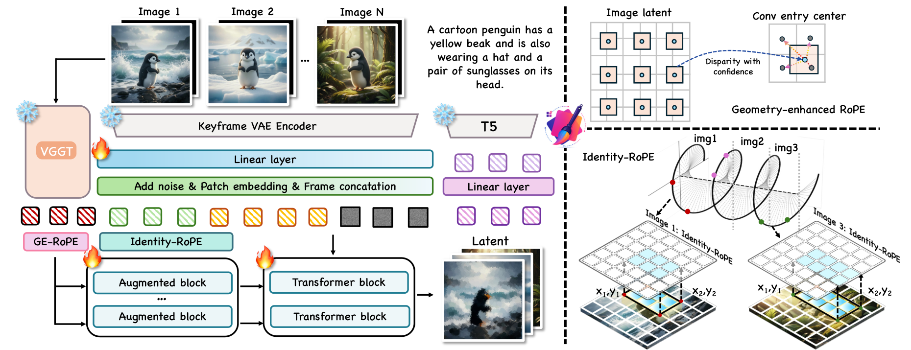
PART 2 / ART DIRECTION
Group Editing: one decision, many views
A coherent series requires correspondence across images.
Yue Ma et al., including Harry Yang · Group Editing · CVPR 2026 · Fig. 2
60
Notes:
Spoken teaching script (49 seconds at the planning pace)
A single poster can look coherent by itself. A series exposes a harder problem: does the same material decision survive across viewpoints? Our Group Editing collaboration studies related images that should be edited consistently. Treating each image independently can produce slightly different costumes or materials.
The method arranges related images as pseudo-video frames to use a video model's consistency prior. VGGT provides geometric correspondences. Geometry-enhanced rotary positional embeddings connect geometry features with image latents, while Identity-RoPE supports identity preservation. Follow the penguin examples through the figure before reading every label.
Reliable correspondence is part of the technical problem: when views cannot be matched well, repeating the same instruction alone does not establish a coherent series.
Teaching cues
Follow the penguin examples, then name correspondence. Explain RoPE once in plain language.
Research coauthored by Harry Yang. Credit the full team. Figure reproduced from the cited paper. Classroom artistic connections are teaching interpretations, not additional experimental claims. Explain the main path rather than reading every diagram label.
Sources and visual credits
Yue Ma et al., including Harry Yang · Group Editing · CVPR 2026 · Fig. 2
https://arxiv.org/html/2603.22883v3

Slide 61
PART 2 / ART DIRECTION
Iteration as a controlled comparison
Version | One deliberate change | Inspect | Decision
A | Baseline composition | Eye path | Keep framing
B | Softer light | Material legibility | Compare
C | More open title area | Hierarchy | Compare
Illustrative iteration plan. Keep a record of unsuccessful versions.
Part 2 / Art direction
61
Notes:
Spoken teaching script (41 seconds at the planning pace)
Iteration becomes informative when we know what changed between attempts. Suppose we compare two lighting treatments. Keep the subject and composition instructions stable, and record the references and model version. If a seed control exists, holding it fixed can help the first comparison.
A shared seed still does not guarantee identical composition after a prompt change. If results vary widely, examine several outputs for each condition. Otherwise, one lucky sample may decide the whole direction. The table is a proposed experiment, not measured results. Its purpose is to make each generation answer a question about the artwork.
Teaching cues
This table is a proposed experiment, not measured outputs. When seed controls are available, hold them fixed for the first comparison. A shared seed is not a guarantee of identical composition after an instruction change. If the result is unstable, compare several samples under each condition. Record model version, references, and the actual prompt.
Sources and visual credits
Original teaching framework or exercise.

Slide 62
PART 2 / ART DIRECTION
A lucky image or a reliable direction?
A single comparison
A stronger comparison
One attractive output may reflect
a favorable random sample.
Several outputs per condition reveal
stability, drift, and recurring failures.
Part 2 / Art direction
62
Notes:
Spoken teaching script (48 seconds at the planning pace)
Imagine you compare two prompts once, and the second gives a wonderful poster. Did its wording cause the improvement, or did it receive a favorable random sample? From one output, it can be difficult to tell. Several outputs per condition reveal whether the direction is stable or merely fortunate.
For art direction, we can ask two different questions. Would I exhibit this particular image? Could I reliably develop a series using this direction? One exceptional output may answer the first while leaving the second unresolved. Repeating generations is helpful when it reveals a pattern relevant to the brief; it becomes a distraction when we keep browsing alternatives to avoid deciding what we value.
Teaching cues
Original teaching extension.
Sources and visual credits
Original teaching example and classroom reasoning.

Slide 63
PART 2 / ART DIRECTION
AFTER
RAIN
Typography is part of the image
Studies in fragile light
A clear first read.
Space for the artwork.
Exact, editable type.
A FICTIONAL EXHIBITION
Generated classroom image with editable type
63
Notes:
Spoken teaching script (49 seconds at the planning pace)
Now the image becomes a poster. The title is an editable typographic layer, which lets us choose its wording, line breaks, and placement exactly. That matters when a work has to carry an exhibition name rather than merely resemble a poster in a generated preview.
Look at how the title occupies the area we deliberately left open. The image and type were designed to cooperate. We can adjust hierarchy without asking the model to regenerate the sculpture and risk changing it. This is a useful division of labor: generation develops the visual material, and direct layout controls exact communication. The audience sees one composition. It does not need to know which parts came from which tool.
Teaching cues
Point to title placement and the image space reserved for it. The type is editable in the deck.
The title and supporting text are editable PowerPoint objects over a generated background. Ask what students read first, then second. The title occupies reserved negative space rather than competing with the sculpture. Even when a model can render lettering, use editable type when exact wording, kerning, and hierarchy need deliberate control. The left side names the design decisions, and the right side shows the finished poster.
Sources and visual credits
Classroom images generated with ImageGen, 7 September 2026. Fictional exhibition and sculpture. These are illustrative examples, not a benchmark or a real artwork attribution.

Slide 64
PART 2 / ART DIRECTION
Typography needs a reading order
01
What should the viewer read first?
02
Where does the eye move next?
03
Does the type leave room for the artwork?
Part 2 / Art direction
64
Notes:
Spoken teaching script (44 seconds at the planning pace)
Typography establishes a sequence of attention. Ask what the viewer should read first, what comes next, and where their eye returns to the artwork. In our poster, reserved space allows the title to be clear without covering the sculpture.
This is also a production decision. Exact text can remain editable, while the image carries the material and atmosphere. If the title feels too dominant, change size, placement, or contrast and inspect the whole composition again. Do not judge the text in isolation from the image. The poster is the relationship between them, including the empty space that lets each element do its job.
Teaching cues
Original teaching extension.
Sources and visual credits
Classroom images generated with ImageGen, 7 September 2026. Fictional exhibition and sculpture. These are illustrative examples, not a benchmark or a real artwork attribution.

Slide 65
AFTER
RAIN
AFTER
RAIN
Studies in fragile light
Studies in fragile light
QUIET / SPATIAL
TACTILE / GRAPHIC
Part 2 / Art direction
65
Notes:
Spoken teaching script (51 seconds at the planning pace)
Take a few seconds with both directions before I describe them. Which would you put outside AFTER RAIN? Choose privately first, so your answer is not just a response to mine. Then identify the visible feature that made you choose.
The photographic direction can invite attention to material and atmosphere. The collage direction can make fragility feel constructed through paper edges and layers. Both can serve the brief, but they make different promises to a visitor. A useful defense goes beyond realism versus abstraction. Tell us what the audience is likely to notice or feel, and how the composition produces that reading. We will use the disagreement to decide what to revise, rather than vote for a universally better image.
Teaching cues
Allow five seconds of looking before offering interpretations. Hear a reason for each direction.
Ask students to choose a direction for AFTER RAIN and give one reason tied to the premise. The two layouts intentionally use different material languages. The answer is not decided by realism. Discuss which would work as a moving image and what should move. The title overlays are native text. Both images are generated classroom examples.
Sources and visual credits
Classroom images generated with ImageGen, 7 September 2026. Fictional exhibition and sculpture. These are illustrative examples, not a benchmark or a real artwork attribution.

Slide 66
PART 2 / ART DIRECTION
Why would you exhibit this one?
Name the visual decision that carries fragility.
Explain why the rejected direction serves it less well.
Keep an unexpected failure if it becomes an intentional choice.
Part 2 / Art direction
66
Notes:
Spoken teaching script (46 seconds at the planning pace)
Selection is an artistic decision. Once generation gives us many plausible alternatives, choosing one determines what the work becomes. The reason should connect to the brief: perhaps the small object feels more exposed, or the torn edge makes fragility physically legible.
The rejected direction is useful evidence too. Explain what it does well and why you are choosing something else for this exhibition. An unexpected model output can also change the direction, if you choose to develop it deliberately. The key question is whether you can now articulate the intention and carry it through subsequent decisions. Surprise can begin a work; it does not finish the artist's judgment.
Teaching cues
Original teaching extension.
Sources and visual credits
Classroom images generated with ImageGen, 7 September 2026. Fictional exhibition and sculpture. These are illustrative examples, not a benchmark or a real artwork attribution.

Slide 67
PART 2 / ART DIRECTION
A critique with observable evidence
Question | Evidence to point at
Intent | The image communicates fragility through scale or material
Coherence | Lighting, edges, and spatial logic support one language
Control | The subject remains recognizable through variation
Hierarchy | The first and second points of attention are clear
Part 2 / Art direction
67
Notes:
Spoken teaching script (43 seconds at the planning pace)
A useful critique names a visible feature, explains its effect, and proposes a revision. For example: the crisp reflection makes the collage feel photographic, so I would simplify its shape to match the flatter layers.
Compare that with 'I do not like the reflection.' The first comment gives the artist a relationship to inspect and a possible next move. You can disagree about the intended effect, but make the disagreement specific. This is a classroom critique framework rather than an official grading rubric. Use it to connect evidence in the image to the idea the work is trying to communicate.
Teaching cues
This is a qualitative critique rubric, not an official course grading rubric. Ask reviewers to name a visible feature, its effect, and a possible revision. A productive comment might be: the crisp reflection makes the paper collage feel photographic, so I would simplify it. Disagreement about the intended effect is useful when evidence is specific.
Sources and visual credits
Original teaching framework or exercise.

Slide 68
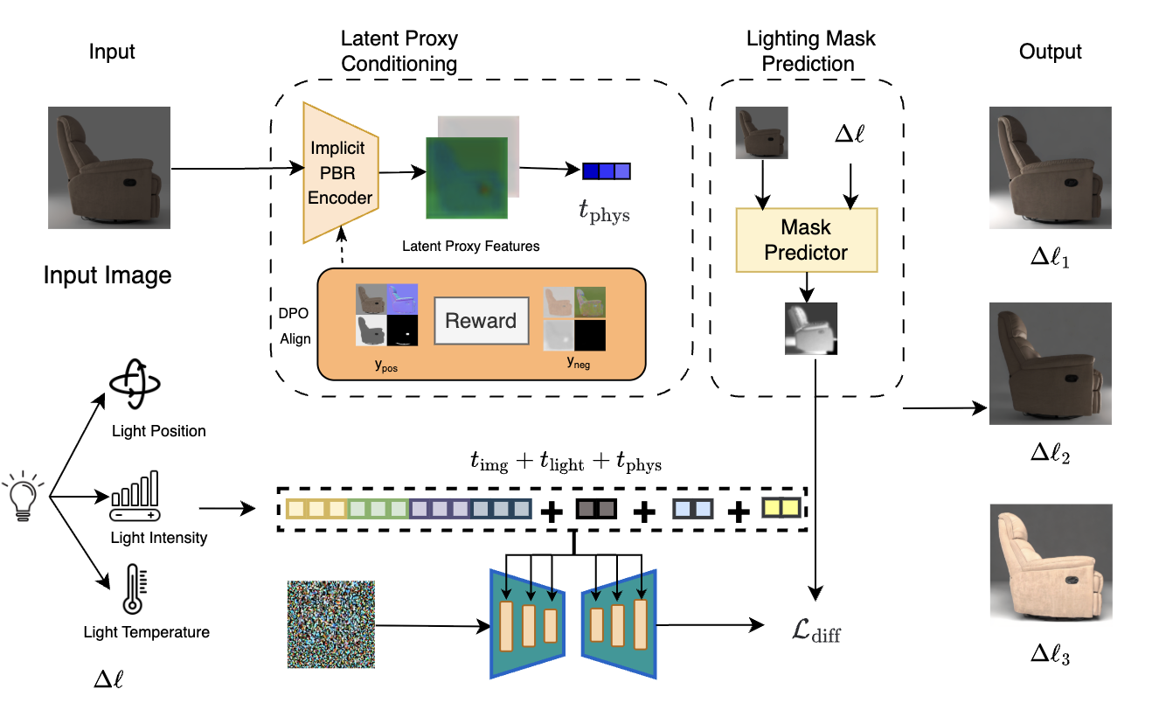
PART 2 / ART DIRECTION
LightCtrl: lighting as an artistic choice
Direction, intensity, and color change how a material reads.
Haoze Zheng et al., including Harry Yang · LightCtrl · CVPR 2026 · Fig. 2
68
Notes:
Spoken teaching script (60 seconds at the planning pace)
A curator asks, can the same sculpture feel more vulnerable without changing its shape? Lighting is one way to answer. Our LightCtrl collaboration studies controllable relighting from a single image, including light direction, intensity, and color temperature.
Follow the chair through the figure. The latent proxy encoder extracts compact physical cues. A lighting-aware mask guides the denoiser toward regions affected by the change, and preference optimization in the proxy branch supports physical consistency. The method connects an interpretable lighting request with image generation.
For our pear, look for consequences rather than the word dramatic: where do highlights move, what happens to shadow, and how does the material read? Inferring geometry and material from one photograph is ambiguous, so the result still needs inspection. The exhibition example is our application of the idea, not an additional result reported by the paper.
Teaching cues
Point to input and relit results before the technical branches. Tie each lighting control to a visible consequence.
Research coauthored by Harry Yang. Credit the full team. Figure reproduced from the cited paper. Classroom artistic connections are teaching interpretations, not additional experimental claims. Explain the main path rather than reading every diagram label.
Sources and visual credits
Haoze Zheng et al., including Harry Yang · LightCtrl · CVPR 2026 · Fig. 2
https://arxiv.org/html/2603.15555v1

Slide 69
PAUSE THE VIDEO · CLASS DISCUSSION
Discuss: two artistic directions
01
Which poster communicates fragility more clearly? Why?
02
What does the rejected direction reveal about your choice?
03
Which single revision would most change the audience’s reading?
Discuss these three questions. Resume when the class is ready.
69
Notes:
Spoken teaching script (35 seconds at the planning pace)
Choose between the two prepared directions for AFTER RAIN. Which poster communicates fragility more clearly, and why? What does the rejected direction reveal about your choice? Which single revision would most change the audience’s reading?
Discuss these three questions with a specific visual feature in view. You can prefer quiet space or the instability of torn paper, but explain how that choice serves the exhibition. Pause the video here. Listen for a persuasive reason to choose the direction you initially rejected.
Teaching cues
Pause after reading all three questions. Invite contrasting views and ask for visible evidence. No making, sketching, or tool use is required.
Sources and visual credits
Original classroom discussion questions.

Slide 70
PART 2 / ART DIRECTION
A process record makes critique more precise
Record | Why keep it?
Intention and invariants | Defines what the attempt was testing
Prompt and reference roles | Explains how the attempt was specified
Rejected result and observation | Makes the next revision informed
A small record can make an experiment reproducible and teachable.
Part 2 / Art direction
70
Notes:
Spoken teaching script (45 seconds at the planning pace)
Consider what a process record lets us discuss. An artist can record the intention and invariants, the prompt and reference roles, and one observation about a rejected result. That record explains what an attempt was testing.
Without that context, a folder of attractive images can be difficult to interpret. We may not know which input changed or why a version was rejected. A few precise notes make a comparison more informative. In a critique, this lets us ask about the artist’s decisions and the evidence behind them rather than guessing only from the final image. It also helps distinguish an intentional departure from an accidental change.
Teaching cues
Original teaching extension. A small record can make an experiment reproducible and teachable.
Sources and visual credits
Original teaching example and classroom reasoning.

Slide 71
PAUSE THE VIDEO · CLASS DISCUSSION
A gallery conversation
01
Which visible decision carries the idea?
02
What changed without a clear artistic reason?
03
Which revision would most change the audience’s reading?
Discuss these three questions. Resume when the class is ready.
71
Notes:
Spoken teaching script (56 seconds at the planning pace)
Imagine we are standing between the two finished posters in a gallery review. I would begin with a visible decision that carries the idea, then locate an unintended change, then propose one revision worth discussing. The order matters: the critique begins by understanding the work before prescribing a repair.
We can hear two contrasting readings of the same poster. One person may find the empty space quiet; another may find it emotionally distant. Ask which details support each reading. There is no image-making task here. We are practicing how to make feedback useful to the next decision. A good proposal names what would change and what effect we expect, so that a later version could confirm or challenge the reasoning. Discuss these three questions, then pause the video for the gallery conversation.
Teaching cues
Pause the video. Hear two opposing readings of the same visual choice before inviting a revision.
3 minutes. Invite two pairs, ideally with different artistic choices. Ask the room to identify the visual rule before the creators explain it. End by asking which properties should remain stable if the image begins to move.
Sources and visual credits
Original teaching framework or exercise.

Slide 72
PAUSE THE VIDEO · CLASS DISCUSSION
After Part 2: defend a decision
01
How can a technically correct image fail as an artwork?
02
Which visual rule should remain across a series?
03
What evidence makes a critique useful for the next revision?
Discuss these three questions. Resume when the class is ready.
72
Notes:
Spoken teaching script (36 seconds at the planning pace)
Before the artwork begins to move, defend a decision about the images. How can a technically correct image fail as an artwork? Which visual rule should remain across a series? What evidence makes a critique useful for the next revision?
Discuss these three questions through one of the prepared posters. Make words such as coherent or expressive concrete: locate the feature, describe its effect, and explain what changing it would do. Pause the video here. We will carry those artistic rules into the video section.
Teaching cues
Ask for a visible feature before accepting a judgment about the work. Invite a second defensible interpretation. Pause the video after the three questions.
Pause after reading all three questions. Invite contrasting views and ask for visible evidence. No making, sketching, or tool use is required.
Sources and visual credits
Original classroom discussion questions.

Slide 73
TOPIC 3
Generative
video editing
Visual transformation across time
Topic 3 / Video editing
73
Notes:
Spoken teaching script (22 seconds at the planning pace)
Our image now has to survive time. The subject can move, disappear, and return. We will examine selected frames from published research, follow the technical representations, and use a prepared AFTER RAIN scenario to decide what a convincing edit requires. Keep the preservation contract, but add an event that could break it.
Teaching cues
The preservation contract now includes motion and time. A convincing still frame can fail as soon as it moves. We will examine actual published frame sequences, then design a short reveal for the exhibition.
Sources and visual credits
Classroom images generated with ImageGen, 7 September 2026. Fictional exhibition and sculpture. These are illustrative examples, not a benchmark or a real artwork attribution.

Slide 74
PAUSE THE VIDEO · CLASS DISCUSSION
Before Topic 3: images in motion
01
What new failures become possible when an image moves?
02
What should happen when the pear disappears behind a column?
03
Can four convincing frames prove that a video works?
Discuss these three questions. Resume when the class is ready.
74
Notes:
Spoken teaching script (37 seconds at the planning pace)
A moving image creates new ways to break our contract. What new failures become possible when an image moves? What should happen when the pear disappears behind a column? Can four convincing frames prove that a video works?
Discuss these three questions. Separate a correct change in visibility from an unwanted change in identity. Name a moment you would need to see between the selected frames before accepting the shot. Pause the video here. Your prediction will give us a concrete test for the methods that follow.
Teaching cues
Let students predict the occlusion failure before showing the technical approaches. Pause the video after the three questions.
Pause after reading all three questions. Invite contrasting views and ask for visible evidence. No making, sketching, or tool use is required.
Sources and visual credits
Original classroom discussion questions.

Slide 75

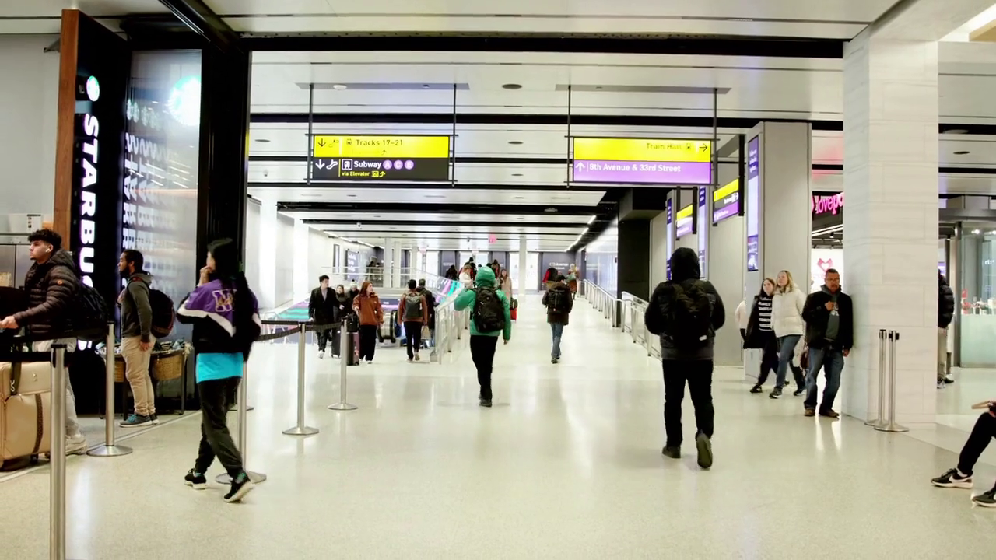
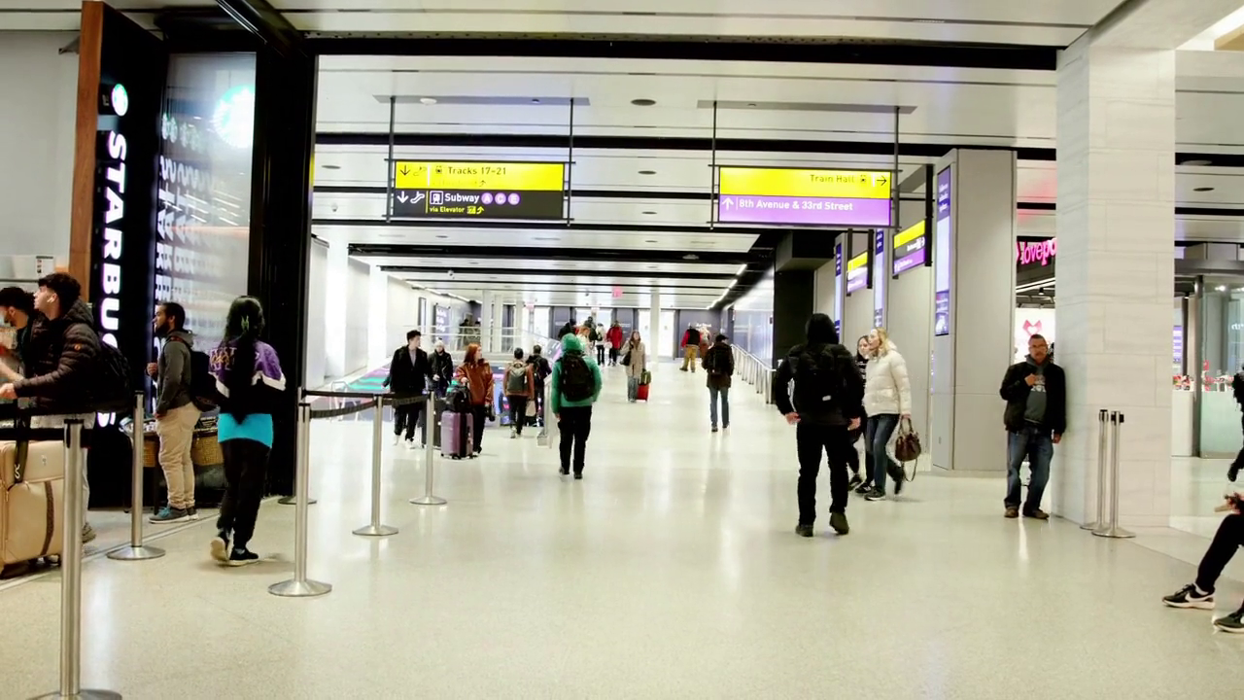
TOPIC 3 / VIDEO EDITING
A video edit must survive the next frame
Identity persists while pose, visibility, and viewpoint change.
Published source frames / Qwen-Video-Edit, Figure 6
75
Notes:
Spoken teaching script (46 seconds at the planning pace)
A still image lets us choose a flattering instant. A video makes the object keep its promises in the next frame. Look at the source sequence. As viewpoint and visibility change, we continue to recognize the subject. An edit has to preserve that relationship while introducing its requested transformation.
Remember our two clocks. The sampling steps describe how a model generates a result. The frames here describe time passing in the depicted scene. A system may use many sampling steps to produce a short clip, but those steps are not extra seconds of action. Now the preservation contract must hold across an event, not just inside a frame.
Teaching cues
Keep sampling time and scene time distinct. These stills are selected frames, not full playback.
Show the source frames in chronological order. Ask what should remain consistent during a stylization and what must change because the scene moves. Temporal consistency is not a demand for identical frames. The precise sampling intervals are those of the source figure, not claimed playback times. These are selected frames, not proof of full-video quality.
Sources and visual credits
https://arxiv.org/abs/2608.14790

Slide 76
TOPIC 3 / VIDEO EDITING
Consistency is not stillness
Expected change
Unwanted instability
Pose, perspective, illumination,
and visibility evolve with the shot.
Identity, texture, or style jumps
without support from scene motion.
Topic 3 / Video editing
76
Notes:
Spoken teaching script (43 seconds at the planning pace)
Would a video be perfectly consistent if every frame were identical? Only if the intended scene were perfectly still. In our moving shot, pose, viewpoint, illumination, and visibility should change. Consistency means that those changes remain coherent with the scene.
The blue stem may become hidden during a turn. That is different from its color changing without a lighting explanation. A texture should move with its surface, rather than crawl independently across it. If there is no convincing explanation, you may have found instability. This is why the goal cannot simply be to minimize change from one frame to the next.
Teaching cues
Original teaching extension.
Sources and visual credits
https://arxiv.org/abs/2608.14790

Slide 77

TOPIC 3 / VIDEO EDITING
A moving image can reveal an idea
REFLECTION
PARTIAL REVEAL
FULL OBJECT
Let the audience infer the object before seeing it.
Topic 3 / Video editing
77
Notes:
Spoken teaching script (48 seconds at the planning pace)
Here is a prepared storyboard, not a generated video result. In the first view, the reflection suggests an object we have not fully seen. A partial view then gives us enough evidence to make a guess. The wide view finally changes our understanding of the setting.
The audience is doing something during those five seconds: forming an expectation, testing it, and revising it. Compare this sequence with revealing everything in the first frame. The same sculpture could be present, but the experience would differ. For AFTER RAIN, the timing of information can carry fragility as strongly as material or lighting. We should decide that structure before asking a tool to fill in motion.
Teaching cues
Identify the sequence as a prepared storyboard, not an observed generated result. Describe audience inference.
A conceptual three-shot storyboard, not generated video frames. Read left to right: reflection, partial view, wide view. Ask how long each shot should last in a five-second piece. A possible allocation is 1.5, 1.5, and 2 seconds. The proposed cuts are artistic choices. Do not present this strip as temporal-consistency evidence.
Sources and visual credits
Classroom images generated with ImageGen, 7 September 2026. Fictional exhibition and sculpture. These are illustrative examples, not a benchmark or a real artwork attribution.

Slide 78
TOPIC 3 / VIDEO EDITING
Five seconds can have a structure
0.0–1.5 seconds
Reflection suggests the object
1.5–3.0 seconds
A partial view tests the inference
3.0–5.0 seconds
The wide view changes its context
Topic 3 / Video editing
78
Notes:
Spoken teaching script (45 seconds at the planning pace)
Five seconds is short, but it can still have a structure. Our proposed first interval shows a reflection, giving the viewer clues. The second offers a partial view. The final interval reveals the wider setting and changes how the object is understood.
Try another allocation and predict the effect. A longer reflection might create uncertainty; a quick reveal might make the piece feel like a product shot. These timings are artistic proposals, not measured outputs from a video model. By deciding the experience first, we can evaluate whether the generated motion and cuts support it. A technically smooth sequence can still have the wrong rhythm.
Teaching cues
Original teaching extension.
Sources and visual credits
Classroom images generated with ImageGen, 7 September 2026. Fictional exhibition and sculpture. These are illustrative examples, not a benchmark or a real artwork attribution.

Slide 79
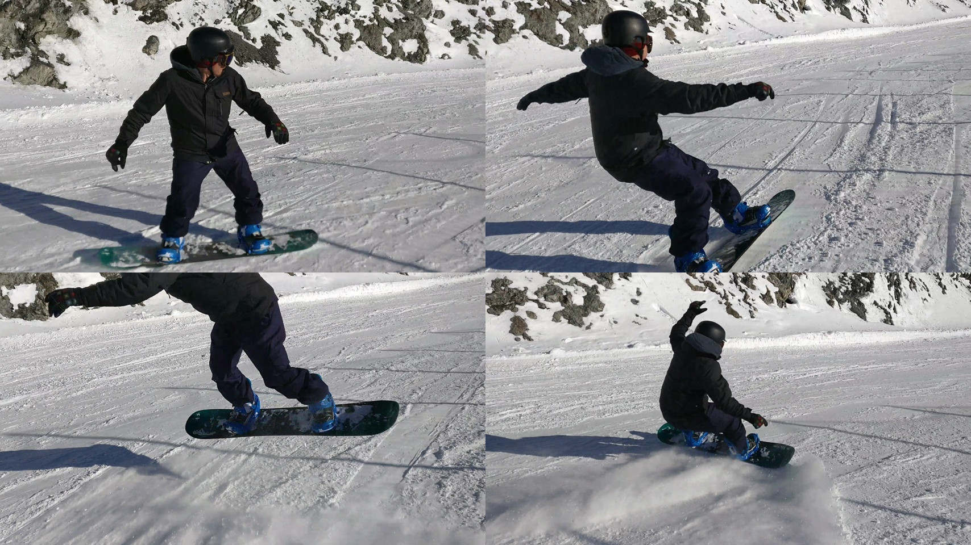
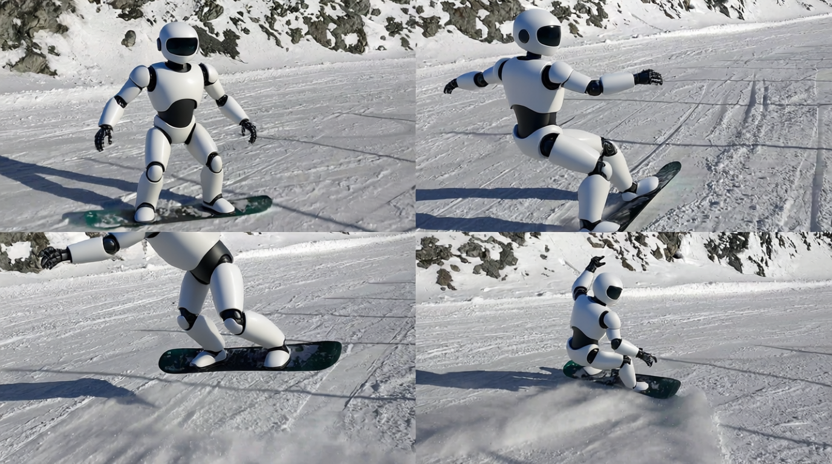
TOPIC 3 / VIDEO EDITING
An image editor can read a contact sheet
INPUT CONTACT SHEET
EDITED CONTACT SHEET
Instruction: edit the skier into a robot. / Published Figure 2
Topic 3 / Video editing
79
Notes:
Spoken teaching script (42 seconds at the planning pace)
The research begins with a surprisingly simple experiment: arrange video frames into a contact sheet and give that image to an image editor. This asks whether an existing image-editing capability can transfer across multiple views presented together.
Treat the result as evidence that motivates a research direction. A grid can make frames available in a shared context, but a successful-looking selection does not prove reliable video editing. There may be flicker between the sampled frames. The next steps investigate how to represent video more effectively and adapt the model, rather than assuming a contact sheet alone solves time.
Teaching cues
The paper first applies the unmodified image editor to a grid of video frames. The visible result motivates the research question: can an image editing prior transfer to video? This is a contact-sheet experiment, not yet the full video system. Selected frames can hide flicker between them. Use this as a hypothesis-generating observation.
Sources and visual credits
https://arxiv.org/abs/2608.14790

Slide 80
TOPIC 3 / VIDEO EDITING
Four good frames can hide a bad video
Sampled frames show selected appearances.
They omit transitions and some visibility events.
Full playback is needed to test continuity.
Topic 3 / Video editing
80
Notes:
Spoken teaching script (43 seconds at the planning pace)
But the missing intervals are where some of the most revealing failures live. A feature can jump, disappear, and return between the frames on this page.
Use the contact sheet for what it does well: compare appearance across selected moments and locate regions to inspect. Then review full playback, with closer attention around turns and occlusion. Think of a film review based only on publicity stills. You might judge the costume and lighting, but you have not yet seen the performance. In generative video, that missing performance includes whether the same object continues to exist convincingly from moment to moment.
Teaching cues
Original teaching extension.
Sources and visual credits
https://arxiv.org/abs/2608.14790

Slide 81
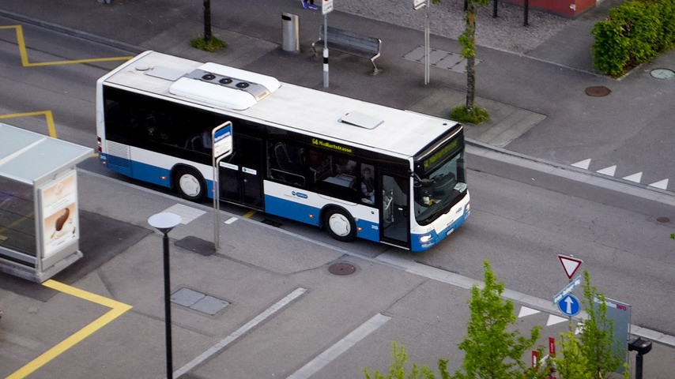
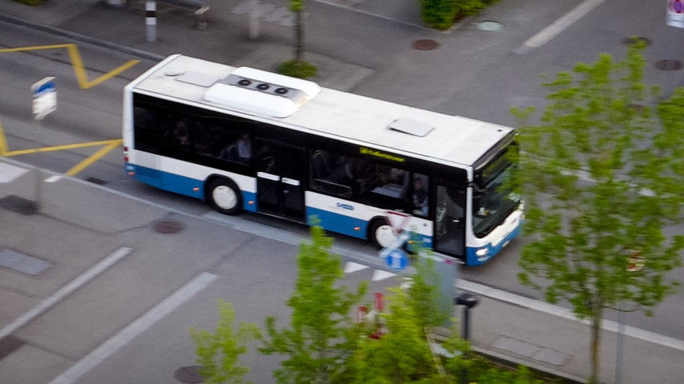
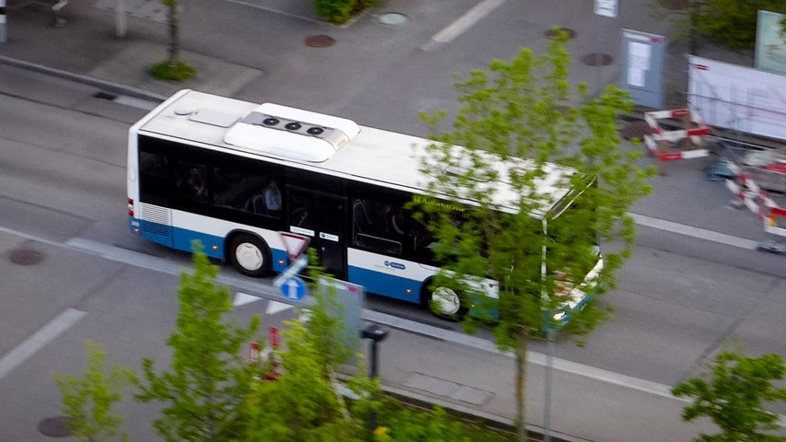
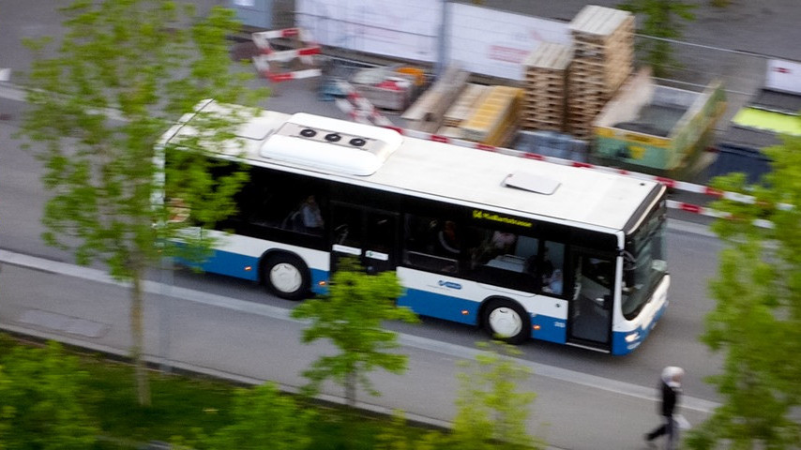
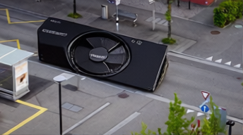
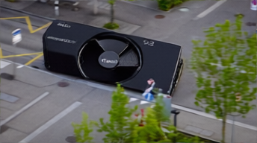
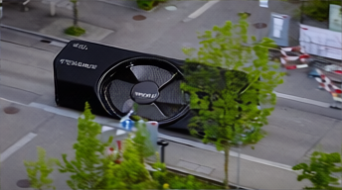
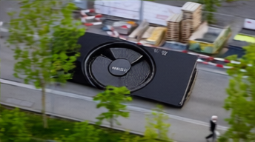
TOPIC 3 / VIDEO EDITING
The grid can live in latent space
SOURCE
EDITED
Separate frame encodings, shared canvas positions / Published Figure 3
81
Notes:
Spoken teaching script (43 seconds at the planning pace)
The grid can also be constructed in latent space. Instead of only combining visible pixel images, the method encodes frames and arranges their tokens into a virtual image grid. The published example changes a bus into a graphics card.
The key idea is shared treatment of positions within that constructed representation. Do not confuse this step with using a video VAE; they are different design decisions. Putting frames near one another in a representation can help the model exchange information, but it does not impose a guarantee of physical continuity. We still need to inspect what survives across changing views.
Teaching cues
The paper also encodes frames separately and joins the tokens into a virtual image grid. The original figure shows the instruction changing a bus into a graphics card. The important idea is shared positional treatment. Point out that grouping frames alone does not create a guarantee of physical motion or continuity. This step is distinct from replacing the image VAE with a video VAE.
Sources and visual credits
https://arxiv.org/abs/2608.14790

Slide 82
TOPIC 3 / VIDEO EDITING
A virtual grid is a representation choice
What it provides
What it does not guarantee
A shared arrangement of tokens
for the image-editing transformer.
Physical motion, correct occlusion,
or persistent identity.
Topic 3 / Video editing
82
Notes:
Spoken teaching script (43 seconds at the planning pace)
A virtual grid provides a way to arrange information for a model trained around image-like structure. It creates shared context and positional relationships among frame representations. That can be a useful bridge when reusing an image editor.
But arrangement alone does not enforce the laws of motion or the persistence of a hidden object. Those abilities depend on the model, adaptation, data, and other parts of the workflow. Separate the representation choice from the capability claim. A diagram can explain how frames enter a system without proving that the system handles every difficult event. That proof would require appropriate outputs and evaluation.
Teaching cues
Original teaching extension.
Sources and visual credits
https://arxiv.org/abs/2608.14790

Slide 83
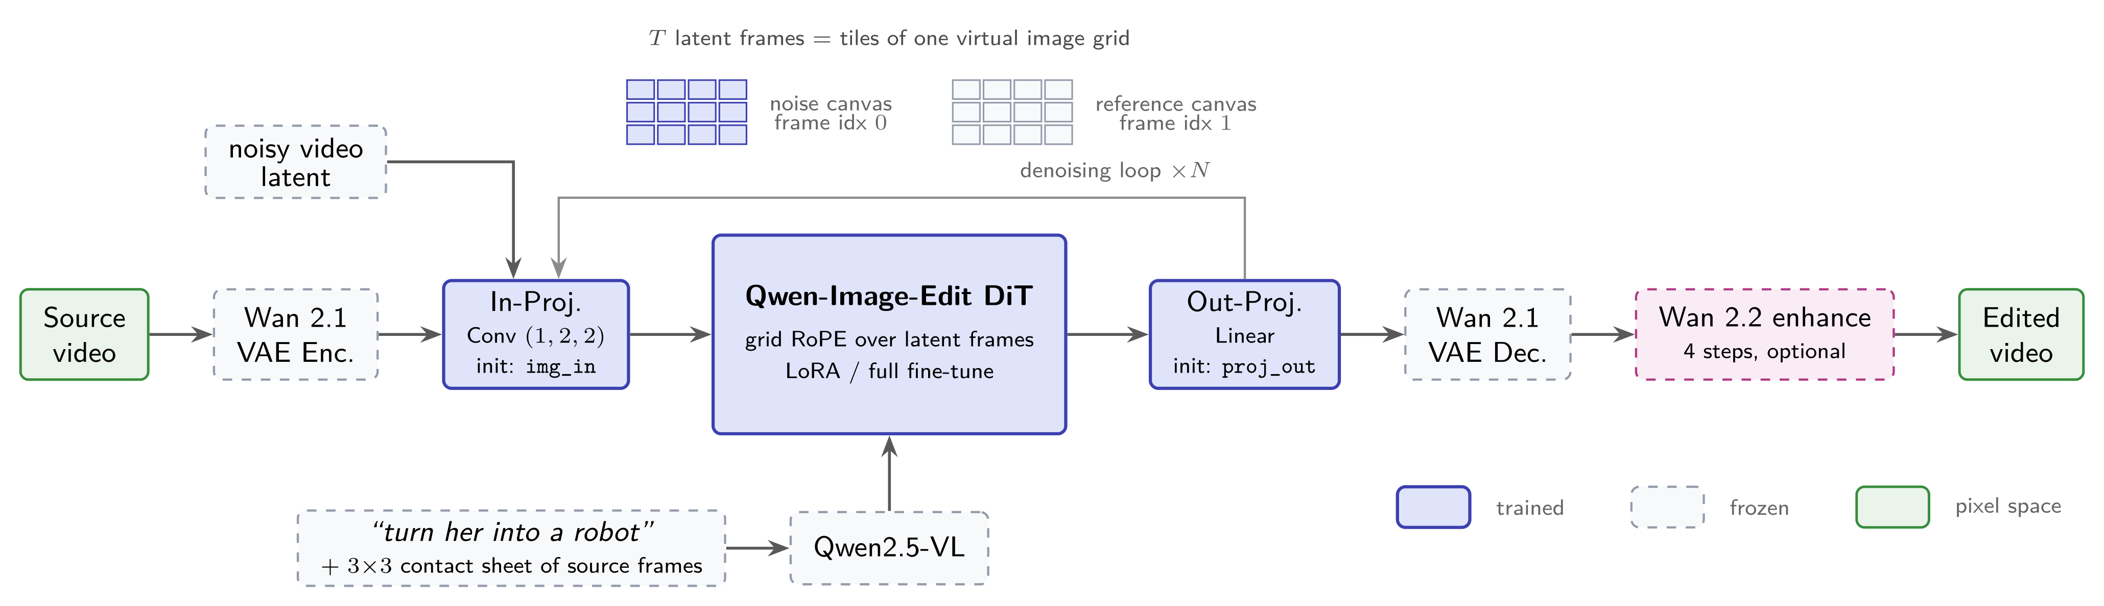
TOPIC 3 / VIDEO EDITING
Repurposing an image model for video
Video VAE latents enter an image-editing transformer.
Learned projections connect the representations.
Qwen-Video-Edit / August 2026 / Original Figure 5
83
Notes:
Spoken teaching script (45 seconds at the planning pace)
This architecture asks whether an image editor's abilities can be reused for video. The video VAE encodes a clip into a compressed latent representation. Learned projections connect those video latents with the image-editing transformer, so the model can operate on a compatible arrangement of information.
Trace that main route before reading the smaller branches. Adaptation connects them; the paper explores LoRA and full training choices, with an optional enhancement stage. The attractive idea is reuse of editing knowledge. The test is whether that reuse preserves the temporal relationships our shot needs. Architecture explains where information flows; the edited clip shows whether the intended event survives.
Teaching cues
Walk through the source diagram once. Wan 2.1 encodes and decodes the video. The image-editing transformer operates on a virtual latent canvas. Two projections and the transformer are trained, with LoRA or full fine-tuning. The optional Wan 2.2 stage provides temporal enhancement. This is a specific research design, not an account of every commercial video editor.
Sources and visual credits
https://arxiv.org/abs/2608.14790

Slide 84
TOPIC 3 / VIDEO EDITING
Adaptation connects incompatible representations
01
Encode the clip with a video VAE
02
Project video latents into the editing model
03
Adapt the model and decode the edited result
Topic 3 / Video editing
84
Notes:
Spoken teaching script (46 seconds at the planning pace)
The image model and video VAE do not necessarily speak the same representational language. Learned projections help connect them. Adaptation then allows the editing transformer to operate usefully with the video representation.
This is a common engineering pattern: reuse a capable component while learning the interface and behavior needed for another task. The benefit is not automatic. A projection must preserve useful information, and the adapted model must learn how the new structure relates to edits. In the published pipeline, decoding returns the edited representation to video. Follow the information through every stage rather than treating the name of the reused model as an explanation by itself.
Teaching cues
Original teaching extension.
Sources and visual credits
https://arxiv.org/abs/2608.14790

Slide 85
TOPIC 3 / VIDEO EDITING
45 frames become 12: why?
45 pixel frames
4 × 11 + 1
12 latent frames
11 + 1
One virtual 3 × 4 grid
For this example
Wan 2.1 VAE keeps the first frame special, then compresses time by groups of four.
Topic 3 / Video editing
85
Notes:
Spoken teaching script (45 seconds at the planning pace)
Here is a counting puzzle with a small trap. In this example, forty-five pixel frames are compressed with a special first frame and a factor of four for the remaining temporal groups. Forty-five is four times eleven, plus one. The latent sequence therefore has eleven plus one, or twelve frames.
Those twelve latent frames can be arranged in the illustrated three-by-four virtual grid. Simply dividing forty-five by four would miss the first-frame convention. This arithmetic belongs to the representation used in this example; it is not a rule for every video model. A small detail in temporal compression changes what the editing model actually receives.
Teaching cues
Say four times eleven plus one; then eleven plus one. Keep pixel frames distinct from latent frames.
The paper reports the 4k+1 to k+1 relationship and this 45-to-12 example. Ask why simply dividing 45 by four misses the first-frame convention. Spatial compression also applies. The input projection uses 2-by-2 spatial patches with temporal kernel size one, so it does not itself merge adjacent latent frames. Keep source-video time distinct from generative sampling time.
Sources and visual credits
https://arxiv.org/abs/2608.14790

Slide 86
TOPIC 3 / VIDEO EDITING
Temporal compression preserves a special first frame
4k + 1 = 45
k = (45 − 1) / 4 = 11
For 45 pixel frames, k = 11.
The latent sequence has k + 1 = 12 frames.
Topic 3 / Video editing
86
Notes:
Spoken teaching script (39 seconds at the planning pace)
Solve the frame-count relationship step by step. Start with four k plus one equals forty-five. Subtract one to obtain forty-four, then divide by four to get k equals eleven. The latent sequence contains k plus one frames, so its length is twelve.
This arithmetic encodes the special handling of the first frame in the stated convention. It is different from simply dividing the total number of pixel frames by four. Understanding them can prevent mistakes when arranging latent frames into a virtual grid or comparing the representation with the original clip.
Teaching cues
Original teaching extension.
Sources and visual credits
https://arxiv.org/abs/2608.14790

Slide 87
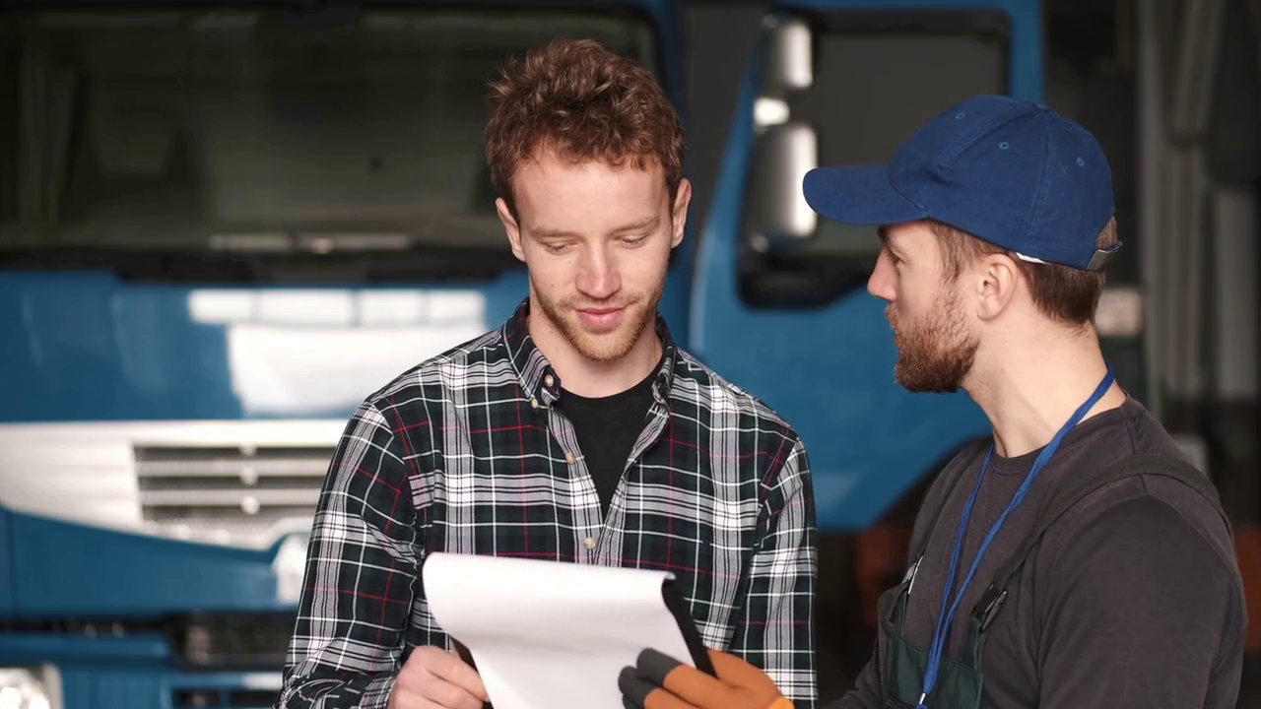
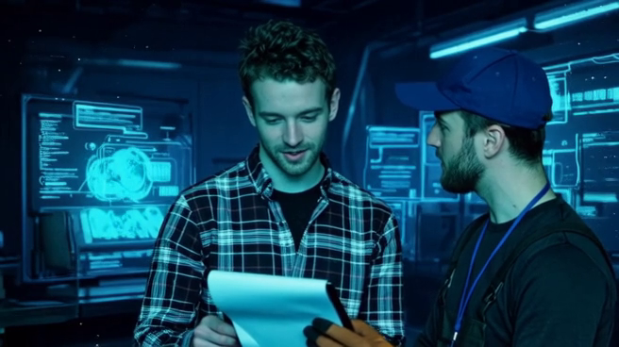
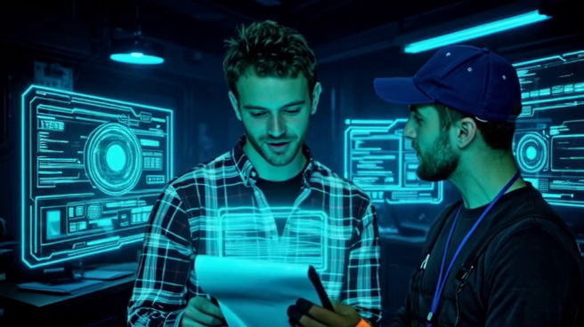
TOPIC 3 / VIDEO EDITING
Guidance in a published video ablation
SOURCE
WITHOUT CFG
WITH CFG
Request: a cyberpunk workshop with holographic documents.
Qwen-Video-Edit, Figure 7 / CFG scale 4 in the authors’ example
87
Notes:
Spoken teaching script (43 seconds at the planning pace)
The requested edit turns the scene into a cyberpunk workshop with holographic documents. Compare the results before focusing on the setting labels. Which version carries out the requested transformation more completely, and what visible evidence supports your answer?
The paper presents this case as an example where classifier-free guidance improves edit completeness. Its baseline retains source latents, and its implementation includes rescaling. This does not establish one universally best guidance value. Guidance also has a computation cost when it requires another model pass. Relate the example back to our equation: changing a prediction combination affects how strongly the result follows the condition.
Teaching cues
The requested change is a cyberpunk workshop with holographic documents. Ask the class to compare the edited content before naming the settings. The paper reports more complete edits with classifier-free guidance in this example. Its implementation retains the source latents in the baseline pass and uses rescaling. This is qualitative evidence from a selected case, not a universal optimum for the guidance scale. A second model pass also has a computation cost.
Sources and visual credits
https://arxiv.org/abs/2608.14790

Slide 88
TOPIC 3 / VIDEO EDITING
What this comparison actually shows
Evidence shown
Evidence still needed
In this selected example, guidance
makes the edit more complete.
Broader clips, failure cases,
and a quality–cost comparison.
Topic 3 / Video editing
88
Notes:
Spoken teaching script (46 seconds at the planning pace)
An ablation asks what changes when one component is removed. In the displayed example, guidance makes more of the requested transformation visible. That is useful evidence about this comparison. It is not yet a measurement of reliability across the kinds of shots we might produce for an exhibition.
As a reader, separate the observation from the next question. We can observe a more complete edit here. We would still want to know what happens across other clips, how often preservation suffers, and what the computation costs. You can learn a mechanism from a selected example while designing a stronger test for the decision you actually need to make.
Teaching cues
Original teaching extension.
Sources and visual credits
https://arxiv.org/abs/2608.14790

Slide 89
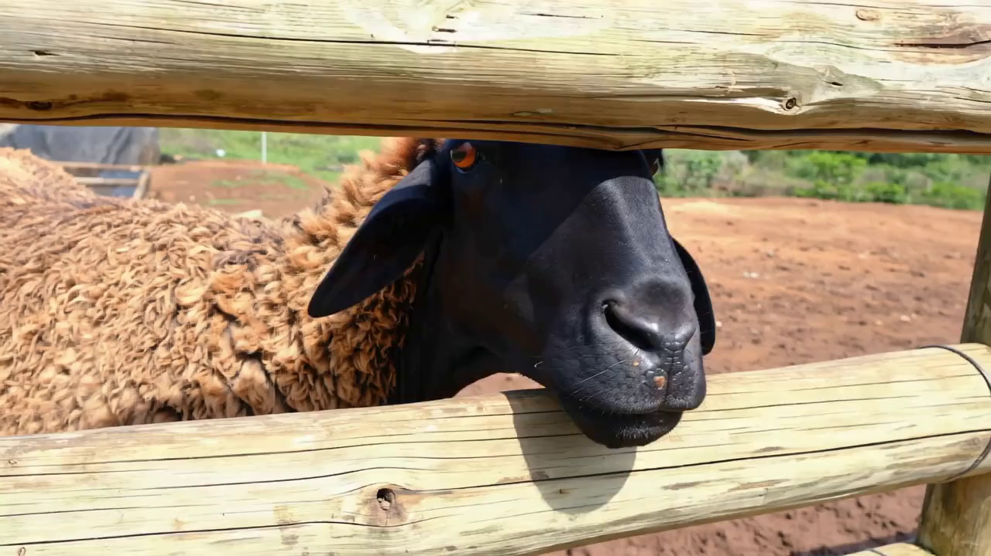
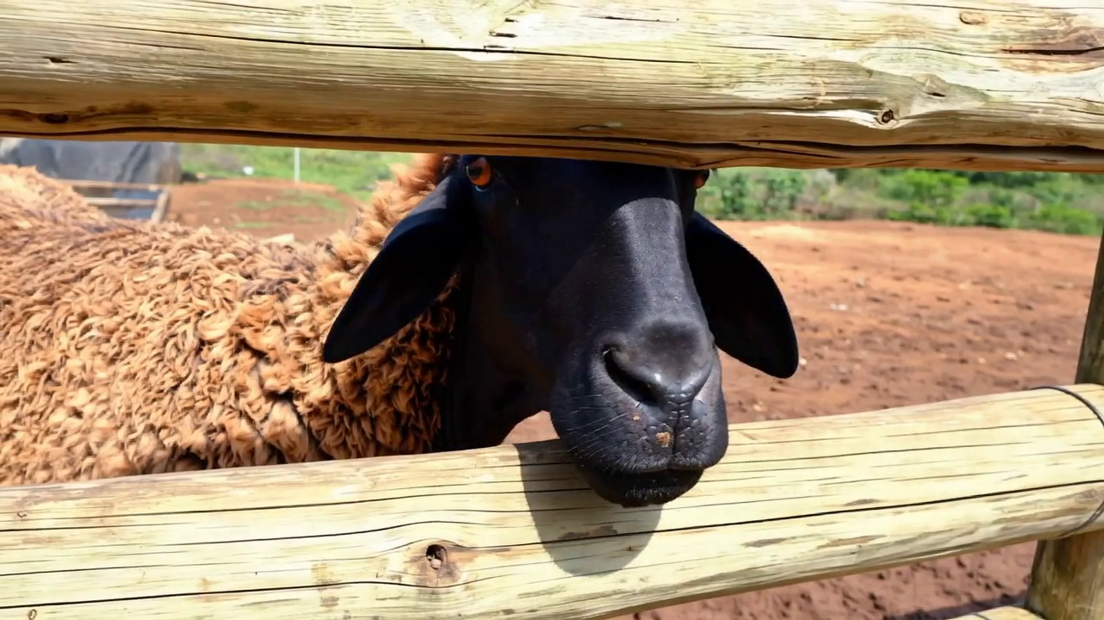
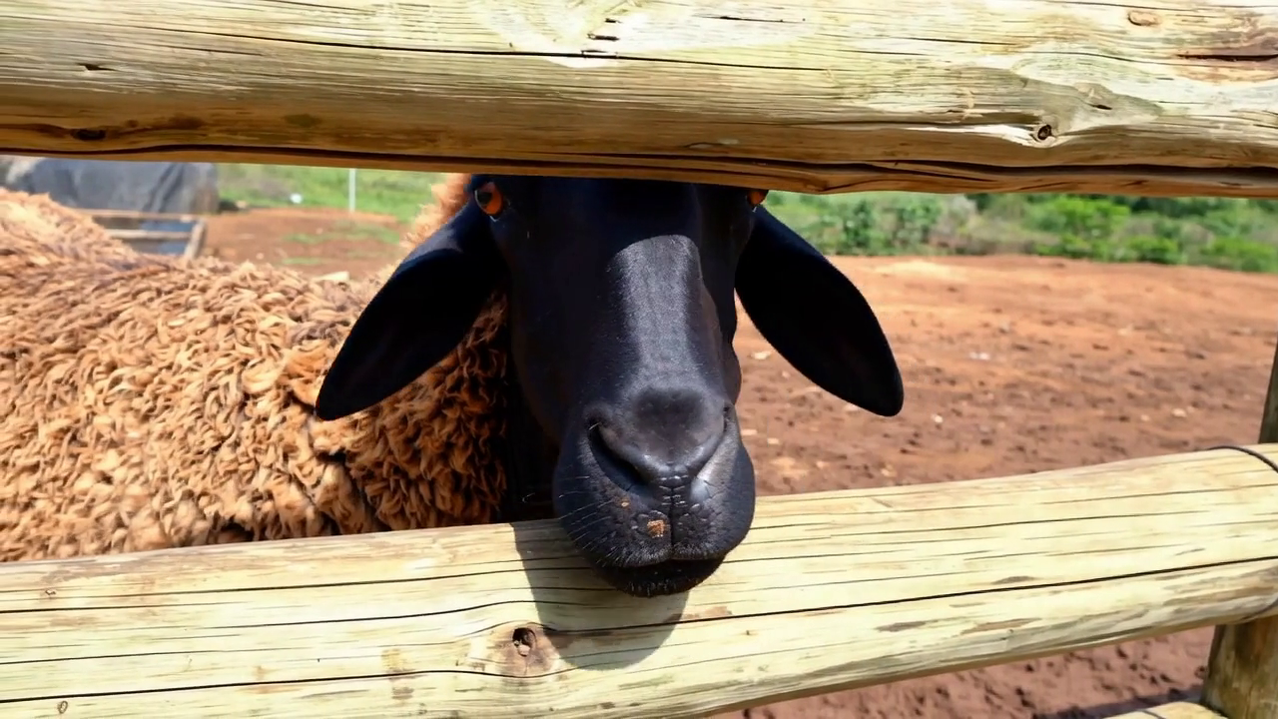
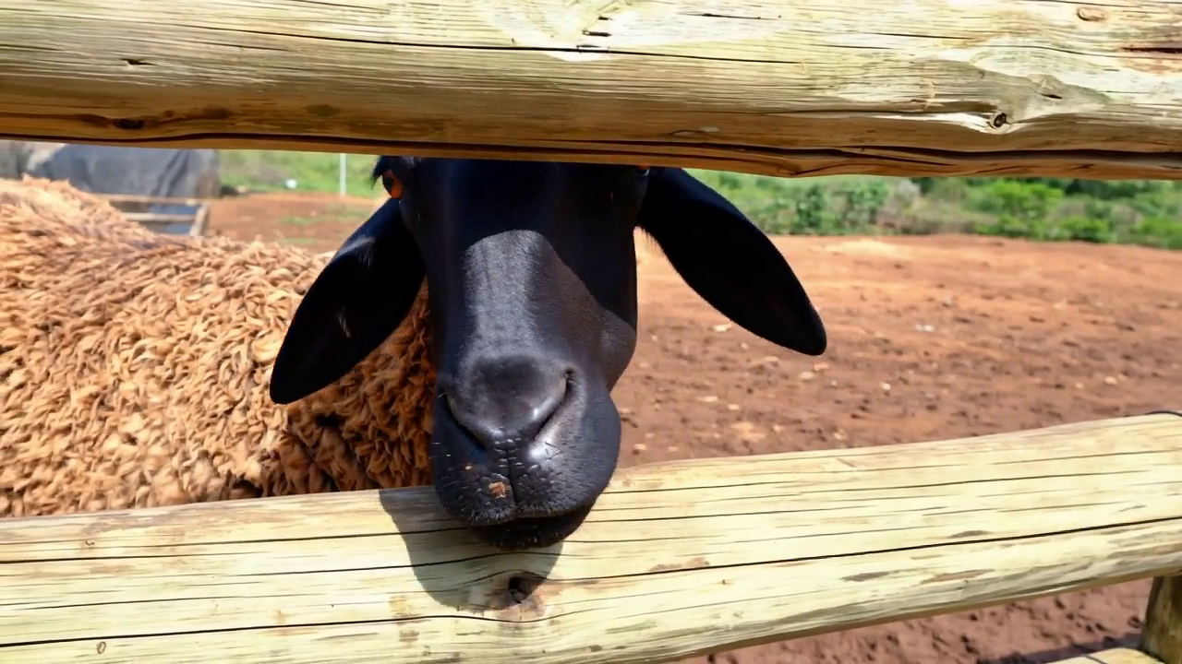
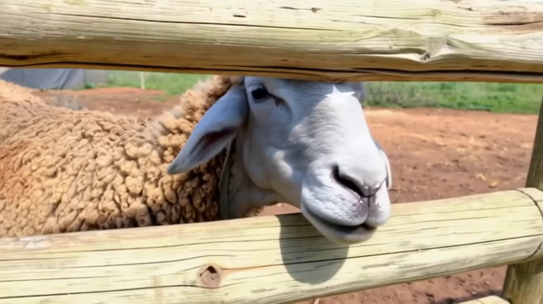
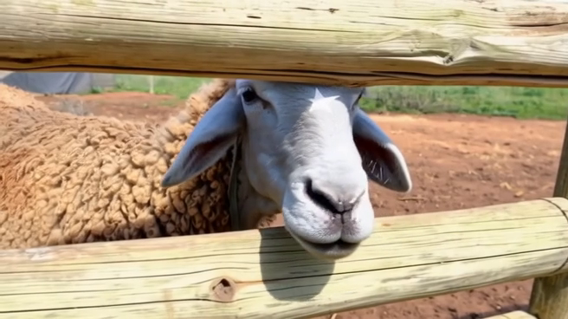
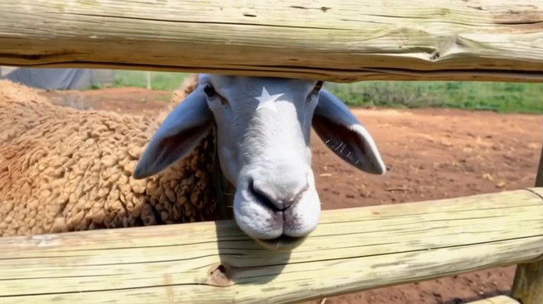
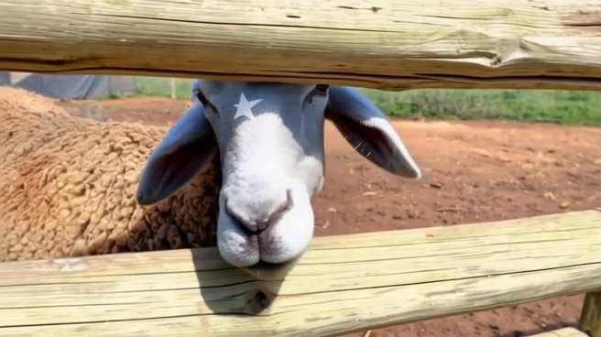
TOPIC 3 / VIDEO EDITING
Local editing across frames
SOURCE
EDITED
An attribute changes while the moving subject should remain recognizable.
Source above, edited below / Qwen-Video-Edit, Figure 6
89
Notes:
Spoken teaching script (40 seconds at the planning pace)
This is a local edit: the sheep's face changes and receives a white star-shaped patch. Look at the patch across poses. Does it remain attached to the same facial region, with a plausible change in apparent shape as the head turns?
The most attractive frame is not enough. An identity marker can slide, disappear, or change shape at another moment. Selected frames let us ask the right questions, but the full clip is needed to check continuity between them. For our discussion, identify a small recognizable feature that will make identity drift easier to notice.
Teaching cues
The paper changes the sheep’s face and adds a white star-shaped patch. Ask students to inspect placement across poses, rather than only the prettiest frame. Read the star as an identity marker. These selected frames are sufficient to discuss what to inspect, but cannot establish the absence of between-frame flicker.
Sources and visual credits
https://arxiv.org/abs/2608.14790

Slide 90
TOPIC 3 / VIDEO EDITING
Follow the identity marker
01
Choose a small recognizable feature
02
Track it through pose and partial visibility
03
Inspect its reappearance, shape, and attachment
Topic 3 / Video editing
90
Notes:
Spoken teaching script (43 seconds at the planning pace)
Choose a distinctive feature and follow it through the shot: its attachment to the subject, its shape, and its reappearance after partial visibility.
For our pear, the blue stem is a useful witness. It may become hidden as the camera moves; we should allow that. When it returns, it should still belong to the same object. A marker that slides across the surface or reappears in a new shape tells us something a general impression of smooth motion might miss. We are using the marker as a diagnostic aid, while still judging the whole object's identity and the shot's intended motion.
Teaching cues
Track the feature relative to the subject, not relative to the screen.
Original teaching extension.
Sources and visual credits
https://arxiv.org/abs/2608.14790

Slide 91
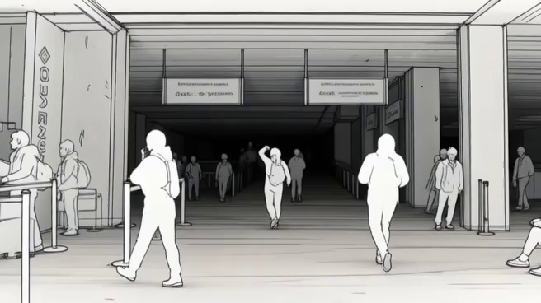
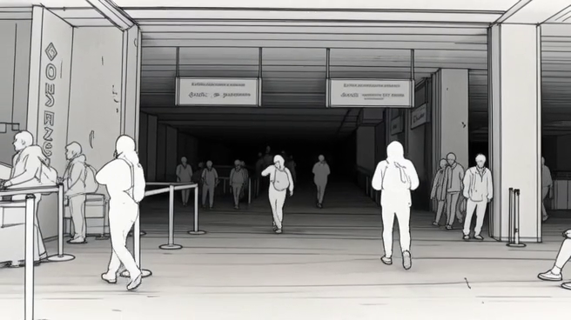
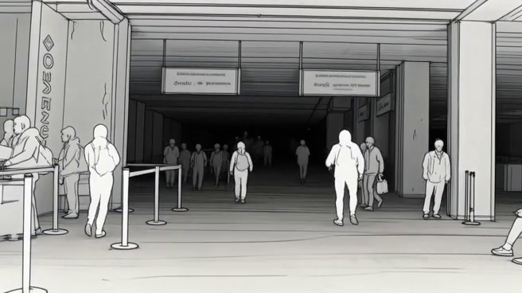
TOPIC 3 / VIDEO EDITING
Global stylization across frames
SOURCE
EDITED
A shared visual language must survive the whole shot.
Source above, edited below / Qwen-Video-Edit, Figure 6
91
Notes:
Spoken teaching script (43 seconds at the planning pace)
Here the instruction changes the whole sequence into a minimal monochrome sketch. Local object replacement and global stylization allow different degrees of visual freedom. Even with a large style change, motion and scene structure should remain readable.
Look for rules across frames: line density, silhouette treatment, and the handling of depth. Do they feel like one visual language? This connects directly to our collage discussion. A style is more useful to an art director when described through operations that can persist through time. If every frame reinvents those operations, the result may feel unstable even when each still is appealing.
Teaching cues
The original instruction requests a minimal monochrome sketch. Ask whether line density, silhouette treatment, and spatial depth feel consistent. A global style change gives more freedom than a local replacement, yet the scene still needs readable motion. Connect to the collage rules developed in Part 2.
Sources and visual credits
https://arxiv.org/abs/2608.14790

Slide 92
TOPIC 3 / VIDEO EDITING
A style can flicker while motion stays correct
Line density changes without a scene explanation.
Textures appear to crawl across stable surfaces.
Review the visual language as well as object motion.
Topic 3 / Video editing
92
Notes:
Spoken teaching script (43 seconds at the planning pace)
A video can preserve object motion while its style flickers. Line density may jump, a paper texture may crawl, or shading may switch between flat and volumetric treatments without a scene explanation.
Review style as a set of temporal rules, just as we reviewed it across surfaces in the collage. Some variation is appropriate when the camera or light changes. The question is whether the material language remains coherent. If your artwork depends on a particular drawing or collage treatment, this check is as important as whether the subject stays in the same place. Motion correctness alone does not establish visual consistency.
Teaching cues
Original teaching extension.
Sources and visual credits
https://arxiv.org/abs/2608.14790

Slide 93
TOPIC 3 / VIDEO EDITING
Why raw frame difference is misleading
E = mean |Iₜ₊₁ − warp(Iₜ, Fₜ)|
Align corresponding visible content before comparing.
Use a visibility mask to exclude occlusions.
Low error can also reward an overly static video.
Topic 3 / Video editing
93
Notes:
Spoken teaching script (49 seconds at the planning pace)
If we subtract one frame from the next, a perfectly correct camera movement can create a large difference. The same surface has simply moved to another pixel location. A more meaningful comparison first aligns corresponding visible content, then measures the remaining appearance difference.
The teaching equation uses a motion warp for that alignment and a visibility mask to exclude occluded regions. We should not demand agreement for content that is hidden or newly revealed. This is an illustrative metric, not a claim about the exact evaluation used by the paper. A low difference can also reward a video that barely moves. A metric must be checked against the task it is supposed to represent.
Teaching cues
Optional technical depth. This is an illustrative temporal-consistency metric, not the evaluation used by the Qwen paper. F_t is an estimated motion field, and warp aligns the first frame to the second. New surfaces, occlusions, and errors in optical flow complicate interpretation. Ask why simply freezing the video could look good under a naive metric. Human review of the intended motion is still needed.
Sources and visual credits
https://arxiv.org/abs/2307.10373

Slide 94
TOPIC 3 / VIDEO EDITING
The frozen video wins the wrong test
A misleading shortcut
The intended result
Repeated frames can reduce
a naive difference score.
The requested motion must persist
while appearance remains coherent.
Topic 3 / Video editing
94
Notes:
Spoken teaching script (45 seconds at the planning pace)
Imagine two candidates for our five-second shot. One shows a coherent camera move around the pear with modest frame differences. The other repeats a single beautiful frame. A naive difference score might prefer the frozen version. Our audience would immediately notice that the intended reveal never happened.
That is a useful example of optimizing the measurement while missing the purpose. We need evidence for both coherent appearance and requested motion. Neither can substitute for the other. Each time, one easy-to-observe quality tempted us to stand in for the whole brief. Good evaluation keeps the intended result in view, especially when a convenient score seems reassuring.
Teaching cues
Use the deliberately frozen candidate as a thought experiment, not as a measured benchmark result.
Original teaching extension.
Sources and visual credits
https://arxiv.org/abs/2307.10373

Slide 95
TOPIC 3 / VIDEO EDITING
A keyframe can anchor the edit
1
Choose a representative source frame
2
Edit its appearance and inspect the result
3
Propagate the approved look through the clip
4
Review motion, occlusion, and the final frame
Example workflow: Runway Aleph 2.0 / Edit Studio, May 2026
95
Notes:
Spoken teaching script (46 seconds at the planning pace)
An edited keyframe can make an art direction easier to approve. Instead of describing every material and lighting choice in words, we can point to an image and say, this is the appearance we want. The workflow then carries that approved look through the source clip.
Follow the four stages: select a representative frame, edit and inspect its appearance, propagate the look, and review the resulting motion. Will the material persist during a turn? Will the identity survive a column passing in front of it? This distinction is central to the Runway reading later: an appealing interaction pattern still needs a shot review suited to the artwork.
Teaching cues
Runway’s published workflow provides a practical counterpart to the research architecture. Keep the discussion at the documented workflow level. Proprietary internals are not public evidence. Before class, the instructor can open the linked prompting guide or announcement. The prepared slides work without an account. Features and access can change after the verification date.
Sources and visual credits
https://runway.com/news/introducing-aleph-2-and-edit-studio
https://help.runwayml.com/hc/en-us/articles/52150503729171-Aleph-2-0-Prompting-Guide

Slide 96
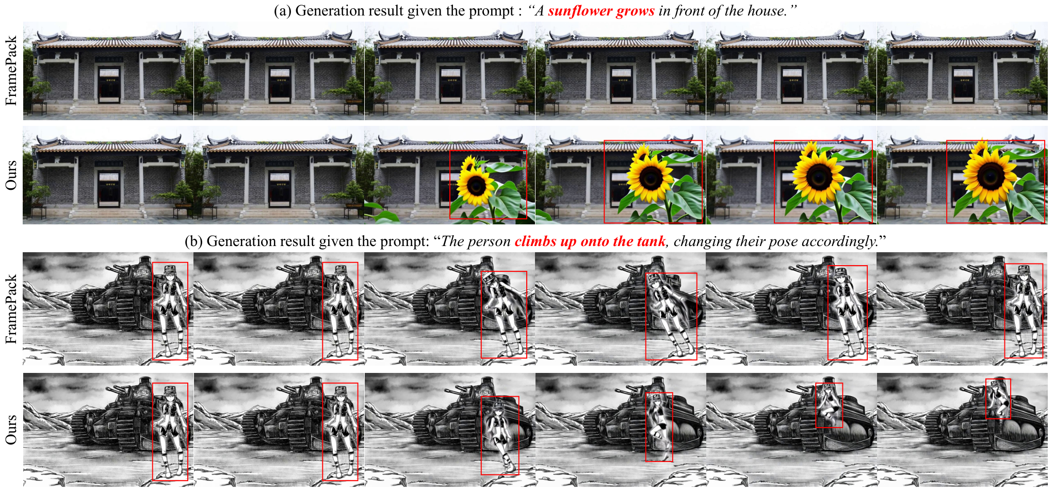
TOPIC 3 / VIDEO EDITING
AlignVid: when the image overrules the text
Selective attention scaling can help the requested event happen.
Yexin Liu et al., including Harry Yang · AlignVid · May 2026 revision · Fig. 1
96
Notes:
Spoken teaching script (56 seconds at the planning pace)
What if the approved image is so influential that the requested event never happens? Our AlignVid collaboration studies that tension in image-to-video generation. In the published examples, a baseline omits a sunflower or leaves a person standing; the corresponding AlignVid results implement more of the requested event.
The intervention scales queries or keys in selected attention blocks and denoising steps without retraining. In a scalar form, scaling Q by gamma changes the weights to softmax of gamma times Q K transpose over square root d. It changes attention concentration. Classifier-free guidance instead combines predictions with different conditioning; these are distinct operations.
For an artist, the interesting failure is a faithful-looking image that refuses to do what the scene requires. The published frames illustrate that tension; a finished shot still needs temporal review.
Teaching cues
Describe the requested events first, then selective attention scaling. Credit the collaborative research.
Research coauthored by Harry Yang. Credit the full team. Figure reproduced from the cited paper. Classroom artistic connections are teaching interpretations, not additional experimental claims. Explain the main path rather than reading every diagram label.
Sources and visual credits
Yexin Liu et al., including Harry Yang · AlignVid · May 2026 revision · Fig. 1
https://arxiv.org/html/2512.01334v2

Slide 97
TOPIC 3 / VIDEO EDITING
A five-second video edit brief
“
Change the pear’s body to ivory ceramic throughout the shot. Keep the blue stem, camera movement, and object position. Let reflections match the new material. The pear must remain the same object when it reappears from behind the column.
Transformation + motion invariants + visibility event
Topic 3 / Video editing
97
Notes:
Spoken teaching script (44 seconds at the planning pace)
Our five-second brief changes the pear's body to ivory ceramic while retaining the blue stem, camera movement, and position. Reflections may adapt to the new material. The pear must remain the same object after passing behind a column.
Which clause is hardest to verify? The reappearance is a strong candidate, because the system must maintain identity through a period of invisibility. This is more demanding than transferring a visible color from frame to frame. Begin with one clear transformation in a short clip. Then make the critical visibility event part of the review, rather than discovering it only after choosing a favorite result.
Teaching cues
This is an original proposed brief for the exhibition. Ask which clause is likely hardest: the reappearance after occlusion. A model must infer properties of temporarily hidden content, not just transfer visible color. Use a short clip with one clear transformation for the first trial. This slide does not claim an actual video was generated from the brief.
Sources and visual credits
Original teaching framework or exercise.

Slide 98
TOPIC 3 / VIDEO EDITING
The moment the pear returns
01
Inspect identity before the column
02
Allow partial or complete invisibility
03
Compare identity and material on reappearance
Topic 3 / Video editing
98
Notes:
Spoken teaching script (45 seconds at the planning pace)
The column is the moment of truth. Before the pear disappears, we can inspect its silhouette, material, and stem. During occlusion, there may be nothing visible to compare. When it returns, the model has to make the same object convincing again.
Do not reject correct invisibility as a failure. Instead, compare the identity before and after the event, including how the object emerges at the boundary. A smooth-looking clip can still reveal a subtly redesigned pear on the other side. We are not merely watching for anything strange; we are testing the preservation requirement at the point where the shot makes it hardest to satisfy.
Teaching cues
Point before, during, and after the column in the imagined shot; correct invisibility is allowed.
Original teaching extension.
Sources and visual credits
Original teaching example and classroom reasoning.

Slide 99
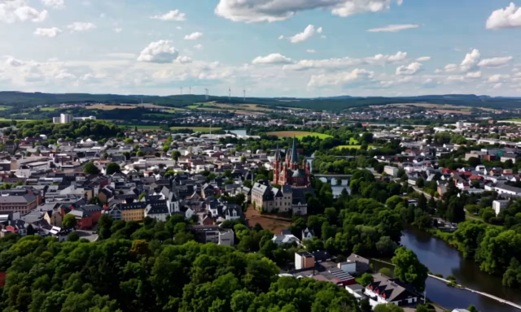
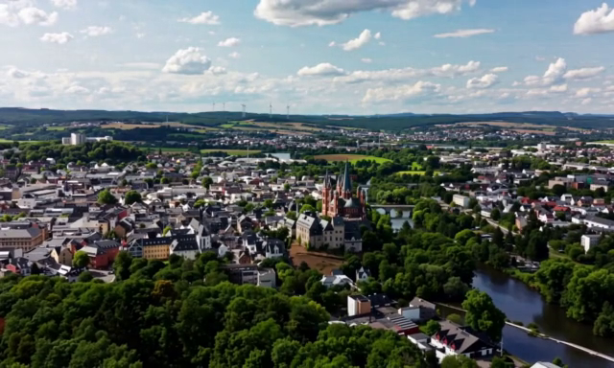
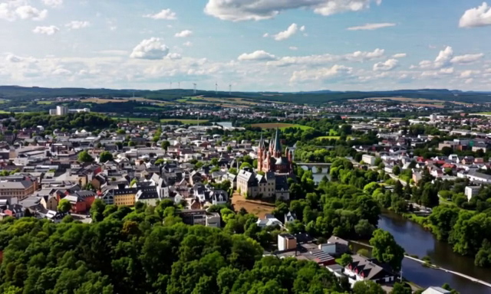
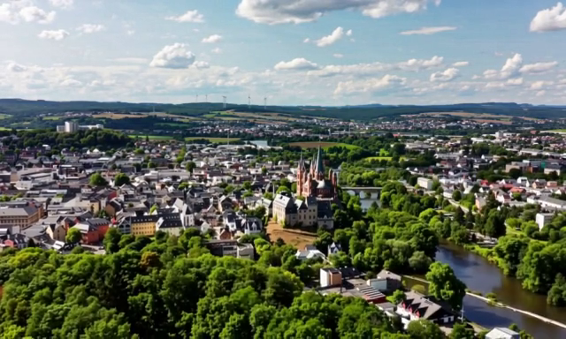
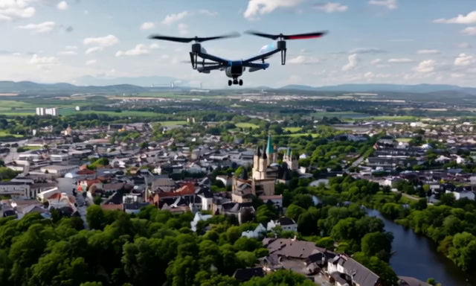
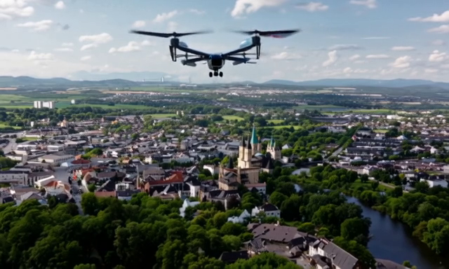
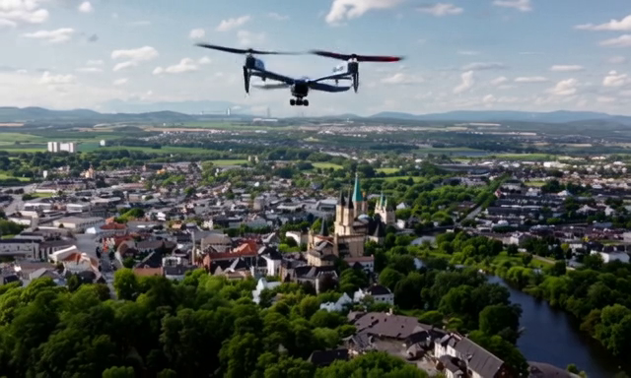
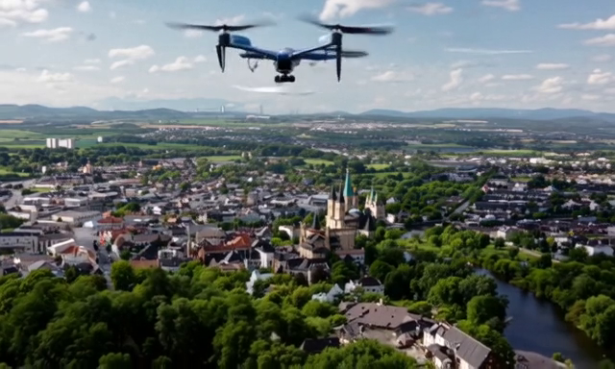
TOPIC 3 / VIDEO EDITING
A small addition creates new relationships
SOURCE
EDITED
Inspect placement, scale, contact with the scene, and motion.
Source above, edited below / Qwen-Video-Edit, Figure 6
99
Notes:
Spoken teaching script (43 seconds at the planning pace)
Adding a small object creates several new relationships. In this published example, the edit adds a drone. Even if the drone looks convincing by itself, its scale, placement, and movement must fit the scene.
Imagine a camera moving forward while the added object changes size in the wrong direction. The object might be beautifully rendered, but its relationship with the camera would expose the edit. Or it might hover at an unintended location relative to other objects. When you review an addition, evaluate those relationships across time. A close-up of the inserted object cannot answer every question about whether it belongs.
Teaching cues
The published example adds a drone. Ask students where a failure could appear even if the new object looks excellent in one frame. Examples include inconsistent scale, hovering in a physically odd place, and movement that contradicts the camera. Again, selected frames do not substitute for full-speed playback.
Sources and visual credits
https://arxiv.org/abs/2608.14790

Slide 100
TOPIC 3 / VIDEO EDITING
An addition must belong to camera motion
Single-frame appearance
Scene relationship
Texture, shape, and local lighting
may look convincing.
Scale, placement, and trajectory
must remain coherent as the camera moves.
Topic 3 / Video editing
100
Notes:
Spoken teaching script (44 seconds at the planning pace)
An added object must fit the camera as well as the scene. A convincing texture and shape in one still do not establish a coherent trajectory. If the camera approaches, the apparent size and position of the addition should evolve in a compatible way.
The exact expectation depends on whether the object is stationary or moving independently. That is why the brief should specify the intended relationship. Inspect the addition relative to nearby objects and the background, not only in a crop. A production-quality edit is a collection of relationships that survive over time, rather than a new object that looks impressive in isolation.
Teaching cues
Original teaching extension.
Sources and visual credits
https://arxiv.org/abs/2608.14790

Slide 101
TOPIC 3 / VIDEO EDITING
The shot review
Viewing mode | What to inspect
Full speed | Does the transformation distract from the intended action?
Frame by frame | Do edges, markers, reflections, or textures jump?
Occlusion / re-entry | Does the same object return?
First / last frame | Does the shot support the next cut?
Fast or complex motion remains a reported challenge for the research system.
Topic 3 / Video editing
101
Notes:
Spoken teaching script (42 seconds at the planning pace)
Review the whole shot at normal speed, then inspect moments where failure is most likely. Pay attention to identity, intended motion, occlusion, boundaries, and the ending. High-motion content is a limitation the research authors specifically identify.
If a clip fails, choose a revision based on the failure. You might reduce the transformation, shorten the segment, add a reference frame where supported, or repair part of the result through conventional compositing. Another generation is useful when it tests a reasoned hypothesis. Do not let repeated attempts distract you from whether the piece still communicates the artistic intention you began with.
Teaching cues
Use this review protocol on any system. The paper specifically identifies high-motion content as a limitation. Separate author-reported limitations from this general classroom checklist. If a clip fails, reduce the transformation, choose a shorter segment, add a reference frame where available, or use a conventional compositing pass. Keep the intended artwork in view.
Sources and visual credits
https://arxiv.org/abs/2608.14790

Slide 102
TOPIC 3 / VIDEO EDITING
A failed shot suggests a different workflow
Failure | Possible next step
Drift after long occlusion | Try a shorter segment or a useful keyframe
Boundary artifacts | Repair with a compositing pass
Transformation overwhelms motion | Reduce the edit and compare again
A workflow change can be more useful than another unchanged prompt.
Topic 3 / Video editing
102
Notes:
Spoken teaching script (46 seconds at the planning pace)
A failed shot is information about the workflow. If the appearance is wrong from the beginning, revising the keyframe or the material direction may help. If the first frame is convincing but identity breaks after occlusion, the problem calls for temporal review and a more suitable propagation or editing approach.
If a region must remain exact, direct compositing may be part of the solution. We can also split a complicated transformation into stages, provided the transitions remain coherent. The important move is to connect the observed failure to the next intervention. Repeating a vague request with more enthusiasm does not use what the failed shot has taught us.
Teaching cues
Original teaching extension. A workflow change can be more useful than another unchanged prompt.
Sources and visual credits
https://arxiv.org/abs/2608.14790

Slide 103
PAUSE THE VIDEO · CLASS DISCUSSION
Discuss: the difficult moment
01
Which moment in this shot would you inspect most closely?
02
What should remain recognizable after the column?
03
What failure would make you reject an attractive clip?
Discuss these three questions. Resume when the class is ready.
103
Notes:
Spoken teaching script (35 seconds at the planning pace)
Return to the proposed five-second ceramic-pear shot. Which moment would you inspect most closely? What should remain recognizable after the column? What failure would make you reject an attractive clip?
Discuss these three questions by describing an event and the evidence you would seek. If your answer is temporal consistency, make it visible: what changes, when, and why would that violate the intended shot? Pause the video here. Compare your acceptance criteria with another person’s before we examine the compact review plan.
Teaching cues
Pause after reading all three questions. Invite contrasting views and ask for visible evidence. No making, sketching, or tool use is required.
Sources and visual credits
Original classroom discussion questions.

Slide 104
TOPIC 3 / VIDEO EDITING
A five-second test plan
The request
The evidence
Ceramic body; blue stem retained.
Camera and object motion preserved.
Full playback plus inspection
before and after the column.
Topic 3 / Video editing
104
Notes:
Spoken teaching script (43 seconds at the planning pace)
Here is a compact test plan. The request is an ivory ceramic body with the blue stem retained. Camera motion and object motion should follow the source. The clip includes a column so that we can inspect a difficult reappearance.
The evidence includes normal-speed playback and a closer look before and after that event. We also inspect reflections because a material change has optical consequences. This plan does not require a long benchmark suite. It simply makes the request, the likely failure, and the acceptance evidence explicit. You can use the same structure to test a different subject or visual transformation.
Teaching cues
Original teaching extension.
Sources and visual credits
Original teaching example and classroom reasoning.

Slide 105
TOPIC 3 / VIDEO EDITING
Three decisions without a model
Why does a material edit affect a reflection?
How does a reference differ from LoRA?
Why can four good frames still make a bad video?
Topic 3 / Video editing
105
Notes:
Spoken teaching script (43 seconds at the planning pace)
Let us check whether the mechanisms are now useful without a model in front of us. Consider the three questions on screen. A material change reaches the reflection: explain why. A subject reference and LoRA both help represent a concept: explain the difference. Four frames look excellent: explain why the clip can still fail.
Take a short silent beat before answering. The next slide names the decisions hiding inside the questions. If you get stuck, locate the type of problem first: the physical scene, the model's information, or evidence across time. That is often enough to begin a clear answer.
Teaching cues
Allow a short silent retrieval beat. Do not read the answers immediately.
Give students one minute to answer individually. Then take one response per question. Ask them to connect technical mechanisms to an artistic consequence. The next slide contains concise answers. If time permits, ask which idea they will use in their next project.
Sources and visual credits
Original teaching framework or exercise.

Slide 106
TOPIC 3 / VIDEO EDITING
Match the problem to the intervention
Choose the intervention
Choose the evidence
Optical consequences → edit contract
This request → reference conditioning
Learned adaptation → LoRA
Exact regions → pixel comparison
Identity → distinctive features
Continuity → full playback
Explain why the intervention fits the observed failure.
Topic 3 / Video editing
106
Notes:
Spoken teaching script (46 seconds at the planning pace)
Here are the decisions those questions conceal. If the reflection must change with the new material, we need to define the permitted region and consequences of the edit. If we want a concept for this request, a reference can condition generation; if we want learned adaptation, LoRA changes selected weights. If continuity matters, the evidence must include the intervals between our chosen stills.
Each decision rules out a tempting shortcut. Freezing every surrounding pixel may freeze the wrong reflection. Calling every supplied image training confuses conditioning with adaptation. Calling four stills a successful video omits time. Use this slide to repair your explanation, rather than memorize a preferred sentence.
Teaching cues
Use the intervention and evidence columns to diagnose answers, not as extra facts to memorize.
Original teaching extension.
Sources and visual credits
Original teaching example and classroom reasoning.

Slide 107
TOPIC 3 / VIDEO EDITING
The mechanisms behind your decisions
Material changes alter how light interacts with the object.
A reference conditions an output. LoRA changes learned weights.
Errors can occur between sampled frames or during occlusion.
Topic 3 / Video editing
107
Notes:
Spoken teaching script (47 seconds at the planning pace)
The material changes how light interacts with the pear, so its visible consequences can extend into the reflection. A reference conditions an output; LoRA learns a low-rank update to selected model weights. Four good frames leave unobserved transitions, including events such as occlusion where identity can fail.
Those are compact answers, but each has an application. They help us write a better preservation contract, choose between two kinds of intervention, and design a more revealing review. If your answer used different words and preserved those distinctions, it works. Tomorrow's interface may rename its controls, but the difference between specifying a request, adapting a model, and checking its result will still matter.
Teaching cues
These answers are a starting point. Reflection changes can be necessary rather than errors. Conditioning can be rich without being a weight update. Video evaluation needs actual motion and events, not a small still-image selection. Close the loop with the opening before/after comparison.
Sources and visual credits
Original teaching framework or exercise.

Slide 108
TOPIC 3 / VIDEO EDITING
Three levels of checking an edit
01
Did the requested change happen?
02
Did the necessary invariants survive?
03
Does the result serve the artwork’s intention?
Topic 3 / Video editing
108
Notes:
Spoken teaching script (42 seconds at the planning pace)
We can check an edit at three levels. First, did the requested transformation occur? Second, did the necessary invariants survive? Third, does the result serve the artwork's intention?
A result can pass the first level and fail the second, as when the correct material appears on a different object. It can pass both technical levels and still fail the artistic one, as when the chosen effect undermines the intended mood. Keeping the levels separate makes critique more precise. It also explains why neither a generic aesthetic score nor a strict pixel comparison can answer every question we care about.
Teaching cues
Original teaching extension.
Sources and visual credits
Original teaching example and classroom reasoning.

Slide 109
Who decides?
Models propose images.
Artists choose what matters.
The readings question both roles.
Topic 3 / Video editing
109
Notes:
Spoken teaching script (47 seconds at the planning pace)
We have spent the lecture making the editing request more precise. Now consider who gets to choose the request in the first place. A system can offer convincing alternatives, but somebody still decides which intention matters and which evidence counts as success.
The three readings let us examine that responsibility from different positions. Pachocki raises questions about capable AI systems and human values. Koe asks readers to reconsider their own goals and habits. Runway presents a workflow for turning an approved image into a video edit. Keep our pear in mind as we read them: we can delegate parts of its production while still arguing about what the artwork should become.
Teaching cues
Transition toward responsibility and readings. This is a bridge, not the end of class.
Final discussion. Ask each student to name one thing they will deliberately change and one thing they will check. The goal is to use technical understanding to make more deliberate artistic choices. This is the end of the main lecture.
Sources and visual credits
Classroom images generated with ImageGen, 7 September 2026. Fictional exhibition and sculpture. These are illustrative examples, not a benchmark or a real artwork attribution.

Slide 110
PAUSE THE VIDEO · CLASS DISCUSSION
After Topic 3: judge the whole shot
01
What can an approved keyframe establish—and what can it not?
02
Why might a low frame-difference score reward a bad video?
03
Which evidence would convince you that identity survived motion?
Discuss these three questions. Resume when the class is ready.
110
Notes:
Spoken teaching script (39 seconds at the planning pace)
We have an approved appearance and a moving shot to judge. What can an approved keyframe establish, and what can it not? Why might a low frame-difference score reward a bad video? Which evidence would convince you that identity survived motion?
Discuss these three questions. Your answer should account for the requested event as well as the subject’s appearance. Use the column, a turn, or the sketch treatment as a concrete example. Pause the video here. We will next ask how the readings change our view of responsibility for those decisions.
Teaching cues
Ask for evidence of motion as well as stable appearance; challenge any answer based only on one frame. Pause the video after the three questions.
Pause after reading all three questions. Invite contrasting views and ask for visible evidence. No making, sketching, or tool use is required.
Sources and visual credits
Original classroom discussion questions.

Slide 111
READINGS AND TECHNICAL EXTENSIONS
AI goals and human direction
An Alien Mind
Jakub Pachocki / OpenAI / 6 September 2026
Which creative decisions would you delegate to AI,
and what evidence would make you trust the result?
How to fix your entire life in 1 day
Dan Koe / 23 December 2025
What do you want your creative practice to become,
and what small experiment could you begin tomorrow?
Readings and technical extensions
111
Notes:
Spoken teaching script (46 seconds at the planning pace)
These first two readings ask about direction from different sides. An Alien Mind considers the relationship between an AI system achieving a goal and respecting human values. Dan Koe's essay invites people to examine the goals and habits directing their own lives. We will use its proposal as material for critical discussion of creative practice.
Find a specific claim, explain your interpretation, and connect it to a decision from the lecture. A fictional artist is fine for discussing personal direction. The fifth quiz question asks you to reflect on one reading of your choice. Our class discussion can compare all three perspectives without requiring everyone to disclose personal experiences.
Teaching cues
Introduce the contrast between AI goals and human direction. Invite a specific claim, a reason, and a lecture connection. Quiz 02 question 5 is a reflection on ONE chosen reading. Personal disclosure is optional; a fictional artist is sufficient. Full discussion follows on slides 120–122.
Sources and visual credits
Jakub Pachocki, An Alien Mind. OpenAI, 6 September 2026.
https://openai.com/index/an-alien-mind/
Dan Koe, How to fix your entire life in 1 day. Author newsletter, 23 December 2025.
https://letters.thedankoe.com/p/how-to-fix-your-entire-life-in-1

Slide 112
READINGS AND TECHNICAL EXTENSIONS
Reading 3: image-guided video editing
Introducing Aleph 2.0 and Edit Studio
Runway / 21 May 2026
Before generating the clip
An edited frame establishes the desired appearance.
After generating the clip
Test persistence through motion and occlusion.
Readings and technical extensions
112
Notes:
Spoken teaching script (48 seconds at the planning pace)
The third reading moves from questions about direction to a concrete editing workflow. Runway's announcement of Aleph 2.0 and Edit Studio describes establishing an appearance in an edited image and applying that change through video. It connects directly to our keyframe discussion.
Read it with the ceramic pear and column in mind. Which decision does the interface make easier to express? Which result would you still need to watch before approval? The page is a vendor's account, so its demonstrations illustrate claimed capabilities rather than supply an independent comparative evaluation. We can learn from the interaction design and still propose an occlusion test that asks whether the workflow meets this exhibition's particular needs.
Teaching cues
Original teaching extension. Read the announcement critically alongside your own test plan.
Sources and visual credits
Runway, 21 May 2026.
https://runway.com/news/introducing-aleph-2-and-edit-studio

Slide 113
READINGS AND TECHNICAL EXTENSIONS
Optional technical reading
InstructPix2Pix (2023)
Edit supervision and image/text guidance
Flow Matching (2023)
Learning velocity fields for generation
Qwen-Image-2.0 (May 2026)
Unified generation and editing architecture
Qwen-Video-Edit (August 2026)
Repurposing an image editor for video
Readings and technical extensions
113
Notes:
Spoken teaching script (38 seconds at the planning pace)
These technical papers are optional companions to the discussion readings. Choose according to the question you want to investigate. InstructPix2Pix helps explain edit supervision; Flow Matching develops the generative training framework. Qwen-Image-2.0 and Qwen-Video-Edit provide recent architecture examples.
You do not need to read all of them before trying the class discussion. Start with a question, locate the part of the paper that addresses it, and distinguish the proposed method from the authors' evidence. The slide notes retain the other references on multi-image inputs, rewards, composition, and video editing.
Teaching cues
These technical papers complement the two assigned discussion essays. InstructPix2Pix explains image-edit supervision and guidance; Flow Matching develops the velocity-field training framework; Qwen-Image-2.0 describes a recent unified image architecture; Qwen-Video-Edit studies adaptation from image to video editing. Students can select the paper most relevant to their studio project. The instructor guide also retains the multi-image editing, reward design, Hokusai, and Aleph references. Full supplementary reading list: InstructPix2Pix (2023): Edit supervision and image/text guidance; Flow Matching (2023): Learning velocity fields for generation; Qwen-Image-2.0 (May 2026): Unified generation and editing architecture; Generalized Multi-Image Editing (Jan 2026): Keeping reference identities distinct; Hokusai at The Met: Composition study and artwork context; Qwen-Image-2.0-RL (June 2026): Reward design and artistic judgment; Qwen-Video-Edit (August 2026): Repurposing an image editor for video; Runway Aleph 2.0 (May 2026): Keyframe editing workflow
Sources and visual credits
InstructPix2Pix (2023)
https://arxiv.org/abs/2211.09800
Flow Matching (2023)
https://arxiv.org/abs/2210.02747
Qwen-Image-2.0 (May 2026)
https://arxiv.org/abs/2605.10730
Generalized Multi-Image Editing (Jan 2026)
https://arxiv.org/abs/2601.05572
Hokusai at The Met
https://www.metmuseum.org/art/collection/search/45434
Qwen-Image-2.0-RL (June 2026)
https://arxiv.org/abs/2606.27608
Qwen-Video-Edit (August 2026)
https://arxiv.org/abs/2608.14790
Runway Aleph 2.0 (May 2026)
https://runway.com/news/introducing-aleph-2-and-edit-studio

Slide 114
READINGS AND TECHNICAL EXTENSIONS
Three source types, three kinds of evidence
Source | Read for | Ask
Research perspective | Argument about alignment | Which claims are forecasts?
Reflective essay | Framework for creative intention | Where might it fail?
Vendor announcement | Documented workflow | What does the demo leave untested?
The reading pack links to all three originals.
Readings and technical extensions
114
Notes:
Spoken teaching script (45 seconds at the planning pace)
The three readings provide different kinds of material. A research leader's perspective develops an argument about alignment and future development. A reflective essay offers a way to examine personal direction. A vendor announcement presents a workflow and promotes its capabilities.
Read each according to what it can support. Identify forecasts, personal claims, and demonstrations rather than treating every sentence as the same kind of evidence. You may disagree with an author and still find a useful question. Our synthesis is practical: what do you want to make, what will you delegate, and what evidence will you use to decide whether the collaboration served that intention?
Teaching cues
Original teaching extension. The reading pack links to all three originals.
Sources and visual credits
https://openai.com/index/an-alien-mind/
https://letters.thedankoe.com/p/how-to-fix-your-entire-life-in-1
https://runway.com/news/introducing-aleph-2-and-edit-studio

Slide 115
READINGS AND TECHNICAL EXTENSIONS
Separate image and text guidance
ε̂ = ε∅ + sᵢ (εᵢ − ε∅)
+ sₜ (εᵢ,ₜ − εᵢ)
ε∅ no image or text condition
εᵢ image only εᵢ,ₜ image and text
InstructPix2Pix formulation. This predicts noise rather than flow velocity.
Readings and technical extensions
115
Notes:
Spoken teaching script (42 seconds at the planning pace)
This technical extension separates image guidance and text guidance in InstructPix2Pix. Begin with the prediction using neither condition. Add a scaled difference for including the image, then another scaled difference for adding the text alongside that image.
Set both scales to one and follow the cancellation: the intermediate terms disappear, leaving the fully conditioned noise prediction. This is a useful check that you understand the expression. Epsilon here denotes a noise prediction, unlike the velocity in our flow-matching slides. These controls belong to this formulation and should not be assumed to map directly onto every current editor's interface.
Teaching cues
If class discussion has expanded, this extension can be revisited after class; all five extension slides retain full teaching notes.
Optional mathematical extension. The two scales offer separate control of source-image conditioning and text conditioning in InstructPix2Pix. At s_i = s_t = 1, the terms telescope to the fully conditioned noise prediction. These controls do not map directly to every current editor. Be explicit that epsilon here denotes predicted noise, unlike v in the flow-matching slides.
Sources and visual credits
https://arxiv.org/abs/2211.09800

Slide 116
READINGS AND TECHNICAL EXTENSIONS
What remains when the terms cancel?
ε∅ + (εᵢ − ε∅) + (εᵢ,ₜ − εᵢ)
= εᵢ,ₜ
At image scale = text scale = 1, intermediate terms cancel.
Readings and technical extensions
116
Notes:
Spoken teaching script (43 seconds at the planning pace)
Now set both guidance scales to one and follow the cancellation. The initial no-condition prediction cancels its negative copy in the first difference. The image-only prediction then cancels its negative copy in the second difference. The result is the prediction with both image and text conditions.
That gives us a reference point for understanding the two controls. If the text scale were zero while the image scale stayed one, we would instead recover the image-only prediction. It shows what information each difference adds. Keep epsilon's meaning explicit here: this InstructPix2Pix expression predicts noise, whereas the earlier flow-matching example predicted velocity.
Teaching cues
After cancellation, ask what remains at text scale zero and image scale one.
Original teaching extension.
Sources and visual credits
https://arxiv.org/abs/2211.09800

Slide 117
READINGS AND TECHNICAL EXTENSIONS
Training: the target supplies the lesson
source, instruction, target = sample_edit_triplet()
condition = encode(source, instruction)
target_latent = vae.encode(target)
noise, t = sample_noise_and_time()
z_t = (1 - t) * noise + t * target_latent
prediction = model(z_t, t, condition)
loss = mean_square(prediction - (target_latent - noise))
update_trainable_weights(loss)
Readings and technical extensions
117
Notes:
Spoken teaching script (43 seconds at the planning pace)
Read the pseudocode in two groups. First we prepare an example: source, instruction, target, conditions, and target latent. Then we sample noise and time, construct the intermediate latent, predict velocity, and compare that prediction with the known training target.
The final update changes trainable weights based on the loss. At inference, there is no known edited target to supply in this way. We instead follow the learned generative predictions from a starting state. This pseudocode explains the conceptual loop; it omits practical engineering such as batches, precision, and scheduling. Its most important distinction is what information is available during learning versus use.
Teaching cues
Point to target, loss, and weight update. Contrast with their absence on the next slide.
Conceptual pseudocode, not executable code for a particular library. Explain the distinction between the known target during training and the unknown target at inference. The source condition stays available. The loss is a velocity regression loss for the simple interpolation convention used earlier. Real training requires schedules, batching, precision choices, and data curation.
Sources and visual credits
https://arxiv.org/abs/2210.02747
https://arxiv.org/abs/2605.10730

Slide 118
READINGS AND TECHNICAL EXTENSIONS
Inference: where did the target go?
source, instruction = receive_edit_request()
condition = encode(source, instruction)
z = sample_noise()
for t, step in sampling_schedule:
velocity = model(z, t, condition)
z = z + step * velocity
edited_image = vae.decode(z)
Readings and technical extensions
118
Notes:
Spoken teaching script (49 seconds at the planning pace)
Look for the line that disappeared. The inference loop has no known edited target and no loss that updates weights. Instead, we encode the source and instruction, begin with noise, repeatedly predict a velocity and move the latent, then decode the result.
Training uses examples to adjust the learned model. In this simplified inference loop, we use that model to construct an output we do not yet possess. The code is conceptual; practical systems use their own representations and sampling schedules. But you can now explain why providing another reference changes the information available for a request without automatically becoming a model-training operation. It is the same distinction we used when choosing between references and LoRA.
Teaching cues
Ask students to find the missing target and weight-update line.
Original teaching extension.
Sources and visual credits
https://arxiv.org/abs/2210.02747
https://arxiv.org/abs/2605.10730

Slide 119
READINGS AND TECHNICAL EXTENSIONS
Choose the approach by the requirement
Main need | Candidate approach | First failure to inspect
Exact untouched pixels | Mask plus compositing | Boundary and lighting seam
New visual language | Reference-guided editing | Subject drift
Reusable learned concept | Adaptation such as LoRA | Overfitting
Transformation in motion | Video editor / keyframe workflow | Occlusion and flicker
Readings and technical extensions
119
Notes:
Spoken teaching script (45 seconds at the planning pace)
Before we turn to the readings' discussion questions, use this table as a compact decision aid. Exact untouched pixels suggest a role for masks and compositing. A new visual language may benefit from reference conditioning. A reusable learned concept may motivate adaptation. A transformation that must survive motion needs a video workflow and temporal evidence.
These approaches can cooperate in the same artwork. Choose according to the contract, then inspect the failure most likely to undermine it. That leaves us with a larger question for the readings: once production becomes easier, how do we choose a worthwhile direction and retain meaningful judgment over the result?
Teaching cues
A teaching decision aid rather than a product ranking. Candidate approaches can be combined. Ask what evidence would rule out each choice for a specific brief. Exact preservation may require conventional compositing around generated content. Repeated failures should motivate a different representation or workflow rather than simply a longer prompt.
Sources and visual credits
https://arxiv.org/abs/2308.06721
https://arxiv.org/abs/2106.09685
https://arxiv.org/abs/2608.14790

Slide 120
READING DISCUSSION · PAUSE THE VIDEO
An Alien Mind
Pachocki distinguishes achieving a goal from generalizing human values. Trust requires evidence.
01
How does achieving an assigned goal differ from respecting human values?
02
Which claim in the reading is a forecast, and what evidence would you seek?
03
What would you keep under human control in an AI-assisted creative project?
Jakub Pachocki / OpenAI · 6 September 2026
120
Notes:
Spoken teaching script (46 seconds at the planning pace)
An Alien Mind distinguishes achieving an assigned goal from generalizing human values in unfamiliar circumstances. Pachocki also raises questions about monitoring increasingly capable systems. Treat the essay as an argument containing claims and forecasts that we can examine.
For our discussion, imagine an exhibition team delegating production while retaining responsibility for what the work communicates. Discuss the three questions on screen: explain the goal-and-values distinction, identify a forecast and the evidence it would need, and defend a boundary for human control. Pause the video here. Our art-direction example is an analogy; it does not give an image editor the same agency or risk profile as an autonomous research system.
Teaching cues
Pause the video after all three questions. Ask for one forecast and one piece of evidence that could challenge it.
Give the brief reading summary, then ask the three questions. Pause the video for discussion. Accept reasoned disagreement. The analogy to art direction is our classroom application. It does not establish that an image editor has the agency or risk profile of an autonomous research system.
Sources and visual credits
Jakub Pachocki / OpenAI — An Alien Mind — 6 September 2026
https://openai.com/index/an-alien-mind/

Slide 121
READING DISCUSSION · PAUSE THE VIDEO
How to fix your entire life in 1 day
Koe proposes examining identity and habits to choose a direction. The promise invites critique.
01
Which idea could help an artist choose what to make, and why?
02
Which claim seems useful or overstated? What experience supports your view?
03
How could easy AI generation support a creative intention or distract from it?
Dan Koe · 23 December 2025 (author newsletter version)
121
Notes:
Spoken teaching script (49 seconds at the planning pace)
Koe's title makes a dramatic promise: How to fix your entire life in one day. The essay proposes examining identity and goals, interrupting habitual behavior, and turning reflection into action. We can discuss the usefulness of that proposal without accepting the title as a guarantee.
Imagine an artist who can generate a hundred attractive images but cannot choose what to make. Does easy production help clarify a direction, or make avoiding the decision easier? Discuss the three questions on screen. Choose an idea worth using or challenging, explain the reason, and connect it to creative intention. Pause the video here. You can use a fictional artist or public example; no personal disclosure is needed.
Teaching cues
Pause the video. Invite a reasoned critique of the title. Keep personal disclosure optional.
Give the brief reading summary, then ask the three questions. Pause the video for discussion. Accept reasoned disagreement. This is the instructor-selected companion on human agency to the AI readings. It is not an AI research article. Students need not disclose private struggles or accept every psychological claim.
Sources and visual credits
Dan Koe — How to fix your entire life in 1 day — 23 December 2025 (author newsletter version)
https://letters.thedankoe.com/p/how-to-fix-your-entire-life-in-1

Slide 122
READING DISCUSSION · PAUSE THE VIDEO
Introducing Aleph 2.0 and Edit Studio
Runway proposes approving an edited image, then applying the change through a video.
01
What can an edited keyframe establish, and what must the full clip show?
02
Which demonstration or preservation claim would you test more carefully?
03
How could this workflow serve AFTER RAIN’s intention rather than dictate it?
Runway · 21 May 2026
122
Notes:
Spoken teaching script (46 seconds at the planning pace)
Runway's reading proposes approving an edited image before applying its appearance through a video. It offers a concrete answer to a communication problem: an art director can point to the desired look, rather than describe every feature in words.
Now bring back the column. A convincing keyframe does not tell us what the pear will look like after it reappears. Discuss the three questions on screen: what the frame establishes, which claim deserves a harder test, and how the workflow serves AFTER RAIN's intention. Pause the video. The source is a vendor announcement; our job is to distinguish a useful demonstrated workflow from a reliability claim still needing evaluation.
Teaching cues
Pause the video. Ask for a specific visibility or motion event that would test a vendor claim.
Give the brief reading summary, then ask the three questions. Pause the video for discussion. Accept reasoned disagreement. This is a vendor announcement, not an independent comparative evaluation. Selected demonstrations do not establish reliability on every clip, and the page does not disclose the complete model architecture.
Sources and visual credits
Runway — Introducing Aleph 2.0 and Edit Studio — 21 May 2026
https://runway.com/news/introducing-aleph-2-and-edit-studio

Slide 123
PAUSE THE VIDEO · CLASS DISCUSSION
Your final judgment
01
Where should an artist place the boundary between control and surprise?
02
How would you judge an edit: technical success, artistic purpose, or both?
03
Which decision would you delegate to AI, and what evidence would you require?
Discuss these three questions. Resume when the class is ready.
123
Notes:
Spoken teaching script (54 seconds at the planning pace)
Return to your first judgment of the glass pear. We began with a small request and discovered that it touched the scene's physics, the artwork's intention, and the audience's experience over time. You now have more precise ways to say what should change, what should survive, and how to judge the result.
Finish with the three questions on screen. Where would you place the boundary between control and surprise? How would you balance technical success and artistic purpose? What would you delegate, and what evidence would you require? Pause the video for the final discussion. Connect one mechanism or reading to a concrete artistic decision. Listen for an answer that makes you revise your own. That revision is a fitting last act for a class about editing.
Teaching cues
Pause the video. Finish by comparing two defensible boundaries for delegation; bring the answer back to the opening pear.
Pause after reading all three questions. Invite contrasting views and ask for visible evidence. No making, sketching, or tool use is required.
Sources and visual credits
Original classroom discussion questions.

