Slide 1
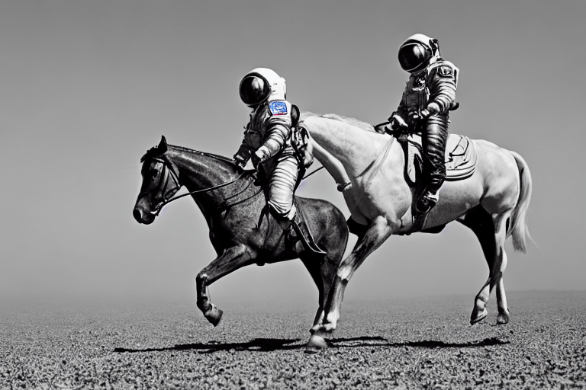
AMCC5160 / LECTURE 03
Inside the
generator
Why does it produce this?
Harry Yang
15 September 2026
75-minute lecture
01 AMCC5160 / Lecture 03
Notes:
Timing: 0:00–0:37 (0.6134969325153374 minutes).
Image generators make a series of numerical choices. A prompt describes part of the target, a random state supplies a starting point, and a trained model guides the output. Changing any of those can change the picture.
This lecture connects those mechanisms to image-making decisions. We will cover diffusion, compressed representations, attention, seeds, guidance, sampling, and editing. The later section extends the same ideas to video, assistants, world models, and robot actions.
The art content is equally specific: camera perspective, depth cues, lightness and color, character continuity, and local image repair. Small calculations will show what a setting changes. Published figures will provide examples, and controlled comparisons will separate a setting effect from a lucky result.
Background and sources:
Open with the practical problem: you type the same sentence twice and receive different pictures. Today we will explain the machinery well enough to make deliberate choices. Connect to Lecture 2: last week we directed edits, and this week we ask what happens inside the generator. This is a 75-minute lesson including discussion. The illustration is a published Stable Diffusion v1-4 output from 2022, used to make the mechanism visible, not to represent the best image quality available today.
Patil et al. (2022), Stable Diffusion with Diffusers. Published SD v1-4 examples. https://huggingface.co/blog/stable_diffusion
AMCC5160 Fall 2026/27 course website. https://hyang.org/amcc5160/; CMU Generative AI Spring 2026 syllabus. https://www.cs.cmu.edu/~mgormley/courses/10423/

Slide 2
Three questions for today
Why does the same prompt give different pictures?
Why can stronger guidance make a picture worse?
Which setting should we change for the result we want?
02 AMCC5160 / Lecture 03
Notes:
Timing: 0:37–1:16 (0.6452295324730273 minutes).
The first question is why one prompt can produce many images. The answer involves both incomplete instructions and randomness. A sentence rarely specifies every position, surface, and lighting condition, so many images may fit it.
The second question is why stronger guidance can reduce quality. Guidance changes how predictions are combined. It can strengthen requested features while exaggerating unwanted ones or reducing variation. We will calculate a simple example before looking at actual sample grids.
The third question is which control matches a problem. A wrong layout, a damaged local detail, and an inconsistent character are different failures. Seeds, reference images, spatial controls, masks, and trained adapters act at different parts of the system. Knowing that difference makes a test more informative.
Background and sources:
Frame the lecture around the three generator questions. Five discussion breaks connect mechanisms to visual decisions. Keep one frustrating generation in mind. Throughout the lesson, a fictional animated-short scene goal connects composition, drawing style and character continuity to the controls introduced earlier.

Slide 3
Content, layout, and appearance
Part of the image | Example instruction
Content | One person, one coat, one suitcase
Layout | Small figure on the left; open space on the right
Appearance | Soft edges and a limited color palette
Intended use | Animation frame, poster, or installation image
One prompt can leave some of these choices unspecified.
03 AMCC5160 / Lecture 03
Notes:
Timing: 1:16–1:53 (0.6240744658345674 minutes).
An image request has several parts. Content names the objects and their relations. Layout specifies where they appear and how much space they occupy. Appearance covers edges, color, light, and material. Intended use determines which details need to remain clear.
For example, a poster may need open space for a title. An animation frame may need a character whose costume matches the previous shot. A small thumbnail may need a simple silhouette. These can use similar subjects while requiring different compositions.
The station image is one example for a few comparisons. Its yellow coat, red prop, and long platform make color, identity, and perspective easy to identify. They are separate variables that can be specified, changed, and checked.
Background and sources:
A simple design analysis, using the station image as one example. Content, spatial arrangement, visual treatment and intended use are different constraints. No continuing fictional storyline is required.
Original AMCC5160 teaching brief and visual critique examples. Concept boards generated with the built-in image-generation tool on 15 September 2026. These are illustrative art-direction studies, not controlled tests of seeds, guidance, or model settings.

Slide 4
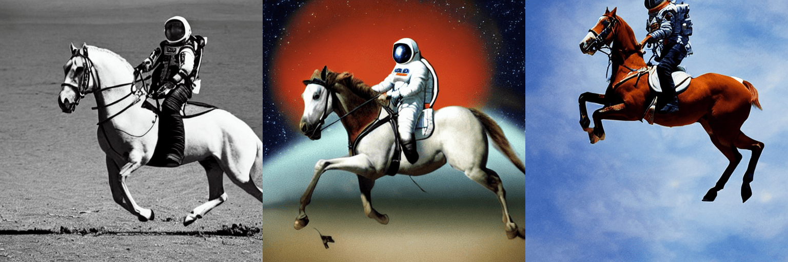
One prompt can produce many pictures
Published SD v1-4 outputs using the same prompt: “a photograph of an astronaut riding a horse”
04 AMCC5160 / Lecture 03
Notes:
Timing: 1:53–2:35 (0.692828432409562 minutes).
Look at these three pictures for a moment. They came from the same description of an astronaut riding a horse.
The subject stays roughly the same, but many choices change. Look at the horse’s pose, the background, and where the rider sits in the frame.
The words don’t settle all of those choices. So there can be several different pictures that fit the request.
These are older published examples, but the question they raise is still useful: what did the prompt actually specify?
Try describing the differences without saying better or worse yet. One image may place the traveler near the edge. Another may make the platform wider. If we first name the changes, we can later decide which ones matter for the story, instead of choosing only by first impression.
Background and sources:
Allow 30 seconds of silent looking before discussing. Ask students to identify three visual decisions that vary: framing, pose, background, lighting, or the relation of rider to horse. The words specify a subject and activity but leave many valid possibilities. These are published outputs for repeated prompts. Their individual seed values are not reported here, so do not assign seed numbers to them. Transition: a prompt describes a family of acceptable results, while the generation procedure selects a particular result.
Patil et al. (2022), Stable Diffusion with Diffusers. Published SD v1-4 examples. https://huggingface.co/blog/stable_diffusion

Slide 5
Recognizing an image and making an image
A classifier might label a picture “person at a station.”
A generator must choose the person, viewpoint, light, and background.
05 AMCC5160 / Lecture 03
Notes:
Timing: 2:35–3:08 (0.5553204992595727 minutes).
Recognizing a picture and making a picture are different jobs. If I show you a chair, you might say, “That’s a red chair.”
But if I ask you to draw one, you need to choose its shape, the viewing angle, the light, and what sits behind it.
A generator has to fill in those missing choices too.
Recognition can leave many details undecided. A label doesn't need to describe every window in the station. Generation has to put something there, even when we never asked about the windows. This is one reason a short prompt leaves so much room for the model to make choices.
Background and sources:
Use a red chair as an example. Recognition may output one label, but generation must choose the chair shape, camera angle, light, background and material. A model learns statistical patterns that support such choices. It can still produce implausible or biased results; plausibility is not the same as truth. Return to the traveler: recognizing a raincoat is simpler than choosing the viewpoint and visual weight of a whole scene.
Adapted from Nayebi & Gormley, CMU Generative AI, Spring 2026, Lecture 8: Diffusion II + VAE, PDF pp. 7–25. https://www.cs.cmu.edu/~mgormley/courses/10423/slides/lecture8-diffusion-vae.pdf

Slide 6
The prompt leaves choices open
“A traveler at a station” does not say where the camera should be.
It also leaves the pose, light, and colors open.
The model chooses one of many possible pictures.
06 AMCC5160 / Lecture 03
Notes:
Timing: 3:08–3:45 (0.6134969325153374 minutes).
“A traveler at a station” leaves a lot open. Are we close enough to see their face? Is it morning or evening? Is the station busy?
The model has learned patterns from training examples, and those patterns influence what it produces. Adding more words can narrow the possibilities.
It still doesn’t describe every part of the picture, and the model may miss some of what we ask for.
Suppose we add the words quiet and lonely. Those words might influence color, empty space, posture, or lighting. They don't specify one exact arrangement. If one arrangement matters, describe it directly. We can then judge whether the image follows that request and whether it creates the intended feeling.
Background and sources:
Explain distribution as a pattern of what results are more or less likely. There is no need for probability calculus. Adding constraints can narrow possibilities, but language remains incomplete and the model may not represent every constraint accurately. Two acceptable pictures can differ without either being an error.
Adapted from Nayebi & Gormley, CMU Generative AI, Spring 2026, Lecture 8: Diffusion II + VAE, PDF pp. 7–25. https://www.cs.cmu.edu/~mgormley/courses/10423/slides/lecture8-diffusion-vae.pdf

Slide 7
How words and reference images help
Words can describe what we want to see.
A reference image can show where things should go.
The model uses these inputs, but may still miss details.
These extra inputs are called conditions.
07 AMCC5160 / Lecture 03
Notes:
Timing: 3:45–4:21 (0.5976306325364925 minutes).
Words are useful for saying what we want. A reference image can be useful for showing it.
For example, “make the traveler small” leaves room for interpretation. A sketch with a small figure in the corner gives more direct information about the layout.
We call these extra inputs conditions. They guide generation, but they don’t guarantee that every detail will stay exactly as supplied.
Words and references also have to agree. If the reference shows a close-up while the prompt asks for a distant figure, the system receives competing directions. Before adding more words, check whether your inputs are asking for the same picture. Sometimes simplifying the input makes the test much clearer.
Background and sources:
Read the vertical bar as given. A pose may constrain the body arrangement more directly than a broad text description, while leaving texture and lighting open. Distinguish the information supplied from how strongly the system uses it. We return to that distinction when discussing guidance. For the station scene, separate emotional intention from concrete layout. Both matter, but they provide different kinds of information to the generator.
CMU Generative AI, Spring 2026, Lecture 12: DPO + Text-to-Image, text/image section. https://www.cs.cmu.edu/~mgormley/courses/10423/slides/lecture12-dpo-text2img.pdf
Rombach et al. (2022), High-Resolution Image Synthesis with Latent Diffusion Models. https://arxiv.org/abs/2112.10752

Slide 8

Camera distance changes perspective
A Far away
B Eye level
C Looking up
Illustrations made for this class. Framing, pose, and light vary across the pictures.
Moving the camera changes perspective. Cropping changes framing.
08 AMCC5160 / Lecture 03
Notes:
Timing: 4:21–5:06 (0.7562936323249418 minutes).
Perspective depends on the camera's position relative to the scene. A nearby object occupies more of the image than an otherwise similar object farther away. Moving the camera changes those distance relationships. That is why a close viewpoint can exaggerate a face, a hand, or the front of a building.
In a simple pinhole camera, projected size is proportional to focal length and inversely proportional to distance. If the object and focal length stay fixed, doubling the distance halves its projected size. This is a geometric relationship, not an artistic rule.
Changing the crop at one fixed viewpoint changes framing but preserves perspective. Moving backward and choosing a longer lens can keep the foreground subject similar in size while changing its relation to the background. Generated images may imitate these effects, but a camera word in a prompt does not guarantee calibrated optics.
Background and sources:
Compare near and distant camera positions. In a pinhole camera x=fX/Z: image size depends on focal length and distance. At one fixed viewpoint, cropping changes framing but preserves perspective. Moving the viewpoint changes relative near/far sizes. Generated camera words are instructions, not guarantees of calibrated optics.
Original AMCC5160 teaching brief and visual critique examples. Concept boards generated with the built-in image-generation tool on 15 September 2026. These are illustrative art-direction studies, not controlled tests of seeds, guidance, or model settings.
Stanford CS148, Color, Images, and Cameras. https://web.stanford.edu/class/cs148/fall25/summer25/materials/class_04_color_images_and_cameras.pdf — Color representation and camera geometry.

Slide 9
Three depth cues for a flat picture
Cue
Station example
Overlap: one shape blocks another.
Place the traveler in front of a bench.
Relative size: repeated objects get smaller.
Let roof columns shrink toward the distance.
Converging lines add another cue: rails meet toward a vanishing point.
09 AMCC5160 / Lecture 03
Notes:
Timing: 5:06–5:60 (0.8938015654749313 minutes).
A flat image can suggest depth without containing an explicit three-dimensional model. Overlap establishes a front-to-back relationship: if one shape blocks another, we usually read the blocking shape as closer. The cue gives an ordering, not a measured distance.
Relative size supplies another cue when we assume objects have similar real-world sizes. Repeated columns that get smaller can suggest distance. If the objects are actually different sizes, that inference can be wrong. The cue depends on both image geometry and our expectation about the objects.
Linear perspective adds a directional structure. Projections of parallel lines can converge toward a vanishing point. Rails, floor edges, and roof beams can organize a picture around those directions. Different sets of parallel lines may have different vanishing points.
In a generated scene, these cues can disagree. A prop may overlap correctly while its scale changes implausibly. A visually attractive corridor can have inconsistent convergence. Checking overlap, scale, and line directions separately gives a more precise geometric critique than saying the space looks strange.
Background and sources:
Depth cues are compositional and projective cues. Relative size assumes comparable real-world sizes. Linear perspective describes projections of parallel lines; not every line in a scene shares one vanishing point. Overlap supplies an ordinal front/back relation without a metric distance.
Stanford CS178, Composition, Marc Levoy, Spring 2009. https://graphics.stanford.edu/courses/cs178-09/lectures/composition-07may09.pdf — Composition, figure/background and visual organization. These art principles are established background, not 2026 advances.
Stanford CS148, Color, Images, and Cameras. https://web.stanford.edu/class/cs148/fall25/summer25/materials/class_04_color_images_and_cameras.pdf — Color representation and camera geometry.

Slide 10
What to save with an image
Save this | Why it matters
Prompt and reference images | What you asked the model to make
Model and any LoRA | Which learned weights you used
Seed | How the random numbers started
Sampler and steps | How the image changed during generation
Guidance and image size | Other settings that can change the result
10 AMCC5160 / Lecture 03
Notes:
Timing: 5:60–6:42 (0.703405965728792 minutes).
When you get a picture you want to keep, save how you made it. The prompt is only part of the record.
You also need the model, any reference images, the seed, and the generation settings.
Think about sending the picture to a classmate and asking them to continue the work.
If all they have is your sentence, they’ll have to guess much of the setup.
A model checkpoint just means a saved version of the model’s learned values. Keep its name too.
A record is most useful when another person can follow it. Give the image a version number, save the exact prompt, and keep the unedited output as well as your final edit. Otherwise, you may later compare a raw model result with a picture that has already been heavily changed.
Background and sources:
Compare the generation recipe to a photographic setup. A subject description does not record the lens, exposure, position, or processing. For reproducibility, identify every input that could change the result. A model checkpoint is a particular saved set of learned weights. Emphasize that a seed is interpreted by a random-number generator and the pipeline. Ask: if your collaborator receives only your prompt, which parts of the process do they still need? This table is a practical record-keeping framework, not an exhaustive implementation specification.
Hugging Face Diffusers, Reproducibility. Accessed 15 Sep 2026. https://huggingface.co/docs/diffusers/using-diffusers/reusing_seeds
Hugging Face Diffusers, Schedulers. Accessed 15 Sep 2026. https://huggingface.co/docs/diffusers/using-diffusers/schedulers

Slide 11
Learning and making an image
Training: learning
Sampling: making one image
Use many examples.
Use the trained model.
Change the model’s weights.
Change the noisy image, usually keeping weights fixed.
More sampling steps do not train the model again.
11 AMCC5160 / Lecture 03
Notes:
Timing: 6:42–7:22 (0.6716733657711021 minutes).
Before we go further, we need to separate training from making one image. During training, the model’s internal values change as it learns from examples.
During normal image generation, those values usually stay fixed. What changes is the image being generated.
So, if you increase the sampling steps, you haven’t taught the model more about hands or faces. You’ve given the generation process more updates.
That can affect the result, but it’s a different kind of change.
The two stages also run on different timescales. Training can involve a large collection of images and many updates. Making one image uses the trained model for a much shorter computation. When you change a seed in an ordinary generation tool, you aren't asking it to learn the subject again.
Background and sources:
Make the distinction concrete with a music analogy: practice changes a musician’s skill, while a performance uses that skill to produce a particular interpretation. In a conventional diffusion pipeline, training adjusts weights, and sampling adjusts a noisy image or latent representation. A standard generation request does not retrain the network. Some products add personalization or other services, but those are separate operations. Ask students whether doubling inference steps teaches the model anatomy. The answer is no: it changes the numerical generation process.
Ho, Jain & Abbeel (2020), Denoising Diffusion Probabilistic Models. https://arxiv.org/abs/2006.11239

Slide 12
What happens when we add noise?
Forward noising of one image. Source: The Annotated Diffusion Model (2022).
12 AMCC5160 / Lecture 03
Notes:
Timing: 7:22–8:04 (0.692828432409562 minutes).
Read this strip from left to right. We start with a recognizable picture and add more and more noise.
Eventually, it becomes difficult to tell what was there. Here, noise means random changes in the image values. We add it deliberately during training.
Why create this problem? Because we have the original picture, and we know the noise we added.
That gives us something we can ask the model to predict, and an answer we can compare its prediction with.
At a small amount of noise, you can still recognize the station. At a large amount, it becomes difficult to say what was there. The learning problem changes with the noise level. Recovering a tiny edge detail is different from making a useful prediction when almost all visual evidence is gone.
Background and sources:
Read the strip from left to right. The recognizable cats disappear as the noise level increases. In training, we deliberately create this problem from an image we already possess, so the computer can know the corruption it introduced. A useful question for students: at which stage could a person still reconstruct the original photograph exactly? At high noise, many originals could be plausible. The learning problem depends on patterns across a dataset, rather than on an ability to uncover a hidden photograph in arbitrary random noise. Ask students which information matters to their work: recognizable silhouettes, material texture, or spatial arrangement. Avoid presenting these as rigid stages that always disappear in the same order.
Rogge & Rasul (2022), The Annotated Diffusion Model. https://huggingface.co/blog/annotated-diffusion

Slide 13
Clean image plus noise
xₜ = aₜ x₀ + bₜ ε
x₀: the clean image
ε: random noise
aₜ and bₜ: how much image and noise to mix
13 AMCC5160 / Lecture 03
Notes:
Timing: 8:04–8:55 (0.8620689655172413 minutes).
This equation describes adding noise to a clean image. Read it as: a weighted amount of the clean image, plus a weighted amount of random noise. The letters a and b control how much of each we use at this noise level. If the image weight is zero and the noise weight is one, we have only noise. If the noise weight is small, more of the image remains visible. This is a useful formula for the diffusion setup we discussed. Other generation methods may describe their states differently.
For one coordinate, suppose the clean value is point eight and the sampled noise value is minus point two. With weights point six and point eight, the noisy value is point six times point eight, plus point eight times minus point two. The result is point three two. These weights have squared values that sum to one, a common normalization for this example. The arithmetic applies to every coordinate, not just one visible pixel.
Background and sources:
Read the equation aloud as noisy image equals weighted clean image plus weighted random noise. There is no need to derive the schedule. Early in forward noising, the signal weight is large. Late in forward noising, the noise weight dominates. In DDPM notation, aₜ is the square root of alpha-bar and bₜ is the square root of one minus alpha-bar. Ask: what would you see if aₜ were zero and bₜ were one? Answer: only noise. This is a standard parameterization, not a definition covering every generative model.
Ho, Jain & Abbeel (2020), Denoising Diffusion Probabilistic Models. https://arxiv.org/abs/2006.11239

Slide 14
We can choose how noisy a training image is
Choose an image and a noise level.
Add a known amount of random noise.
The noisy training example is ready.
14 AMCC5160 / Lecture 03
Notes:
Timing: 8:55–9:32 (0.6082081658557225 minutes).
We can choose how noisy each training example should be. One example might have a little noise. Another might be almost entirely noise.
We don’t have to create every earlier stage first. We can calculate a noisy example at the level we want.
That lets the model practice across different noise levels. It doesn’t mean that making a finished image will always take only one step.
The noise level is information the network needs. Without it, a small fuzzy patch might be interpreted differently at different stages. Think of the level as telling the model how much damage to expect. It still has to work out a prediction from the image and any other inputs.
Background and sources:
CMU Lecture 8 derives the closed-form noisy marginal. Translate that result into a practical point: we can create a training pair at a chosen noise level directly. The network gets practice across noise levels. This shortcut describes the forward training construction, not a claim that normal generation can jump from pure noise to a perfect image in one step.
Adapted from Nayebi & Gormley, CMU Generative AI, Spring 2026, Lecture 8: Diffusion II + VAE, PDF pp. 7–25. https://www.cs.cmu.edu/~mgormley/courses/10423/slides/lecture8-diffusion-vae.pdf

Slide 15
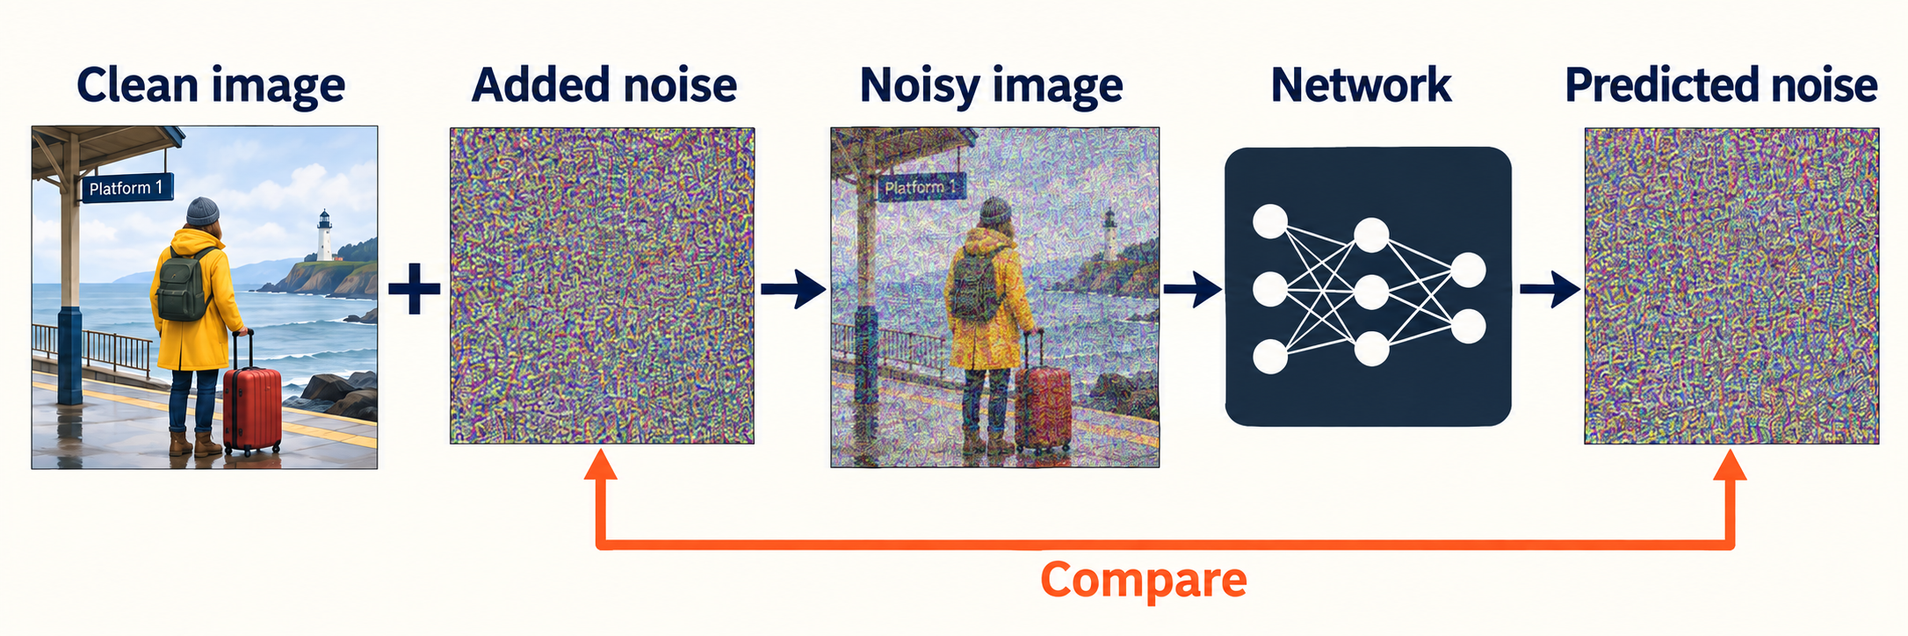
How the model learns to predict noise
We add the noise ourselves, so we know the answer.
The model tries to predict that noise.
Simplified training example. The noise pictures are illustrations.
15 AMCC5160 / Lecture 03
Notes:
Timing: 9:32–10:15 (0.719272265707637 minutes).
Let’s follow this figure. Start with the clean picture on the left. Add noise, and give the noisy picture to the network.
In this version of the training task, the network tries to predict the noise we added. Then we compare its answer with the actual noise.
When the prediction is wrong, training adjusts the model’s internal values. This happens over many examples. The model also gets information about the noise level.
I’ve left that input out of the drawing so the main sequence is easier to see.
Across training examples, the network sees many ways that useful image structure survives under noise. It changes its internal numbers when its prediction is wrong. No one writes a separate rule for every coat or platform. The behavior comes from learning patterns across the examples it was given.
Background and sources:
Read the figure in order. Start from a clean training image. Add noise that we generated and therefore know. Give the noisy image, its noise level, and any conditions to the network. Compare its noise prediction with the noise we added. Training changes weights to reduce errors across many examples. At generation time, the network has no clean target photograph to recover. The figure leaves out the time input and condition input to focus on the learning task.
Adapted from Nayebi & Gormley, CMU Generative AI, Spring 2026, Lecture 8: Diffusion II + VAE, PDF pp. 7–25. https://www.cs.cmu.edu/~mgormley/courses/10423/slides/lecture8-diffusion-vae.pdf
Ho, Jain & Abbeel (2020), Denoising Diffusion Probabilistic Models. https://arxiv.org/abs/2006.11239
Original classroom illustrations generated with the built-in image-generation tool. Diagrams are simplified explanations. Image comparisons illustrate possible choices and are not measurements of particular seed, strength, or model settings.

Slide 16
How we measure a prediction error
loss = average[(ε − predicted ε)²]
Compare the added noise with the predicted noise.
Larger differences receive a larger penalty.
Average the errors across many training examples.
This error score does not directly judge composition or mood.
16 AMCC5160 / Lecture 03
Notes:
Timing: 10:15–10:59 (0.735138565686482 minutes).
During noise-prediction training, we know the noise that was added. We subtract the model’s prediction from that known answer, square the differences, and average them. Squaring makes large errors count more strongly. Training tries to bring this error down across examples. Notice what this score measures. It measures the noise-prediction error. It doesn’t directly score whether the picture tells a good story or whether its composition suits this image. Those need separate judgments.
For a two-coordinate example, let the known noise be one and minus one. Suppose the prediction is point eight and minus point five. The errors are point two and minus point five. Squaring gives point zero four and point two five, and their mean is point one four five. Training uses many coordinates and examples, but this small calculation shows exactly what the error score measures.
Background and sources:
CMU Lecture 8, PDF page 18, presents noise-prediction training. Describe the loss as a score that penalizes larger prediction errors more strongly. Average it across coordinates and examples. This learning signal does not directly grade composition, originality or narrative intent. Those require separate evaluation.
Adapted from Nayebi & Gormley, CMU Generative AI, Spring 2026, Lecture 8: Diffusion II + VAE, PDF pp. 7–25. https://www.cs.cmu.edu/~mgormley/courses/10423/slides/lecture8-diffusion-vae.pdf

Slide 17
Where does the finished image come from?
At high noise, many different clean images could fit.
The model uses patterns it learned from training images.
During generation, there is no original picture hidden in the noise.
17 AMCC5160 / Lecture 03
Notes:
Timing: 10:59–11:37 (0.6240744658345674 minutes).
There’s an important difference between this training example and generating a new picture. During training, we began with a known image.
During generation, we can begin with random noise. There isn’t a particular photograph hidden inside it, waiting to be uncovered.
The model uses patterns it learned to help produce a possible image.
That doesn’t rule out copying or memorization; it just explains what this generation process is doing.
This is why generation is more than uncovering a picture that was waiting inside the noise. At the start, many outcomes are possible. The learned model and the inputs guide a sequence of choices. By the end, those choices have become one particular arrangement of objects, surfaces, and light.
Background and sources:
Contrast removing a small amount of noise from a known photograph with starting generation from random noise. At inference there is no hidden target photograph that the sampler is supposed to reveal. This mechanism also does not rule out memorization: a model can learn or reproduce particular training examples. Mechanism and provenance are different questions.
Ho, Jain & Abbeel (2020), Denoising Diffusion Probabilistic Models. https://arxiv.org/abs/2006.11239
Adapted from Nayebi & Gormley, CMU Generative AI, Spring 2026, Lecture 8: Diffusion II + VAE, PDF pp. 7–25. https://www.cs.cmu.edu/~mgormley/courses/10423/slides/lecture8-diffusion-vae.pdf

Slide 18
Discussion: training or sampling?
Training on a new image set: which values change?
Generating with a new seed: which values change?
Which action can change learned subject behavior?
Distinguish learned weights from the state being generated.
18 AMCC5160 / Lecture 03
Notes:
Timing: 11:37–12:17 (0.6716733657711021 minutes).
Separate these two actions. In the first, a model is trained using a new collection of images. In the second, the same trained model generates another image with a different seed. Which values change in each case?
Training changes learned weights. Generation changes the current sampled state while normally keeping those weights fixed. A new seed changes the random starting process. It does not add the new output to the training set or teach the model a new subject by itself.
This distinction matters when choosing an intervention. A different sample may solve a particular composition by chance. Subject adaptation aims to change learned behavior across future samples. They have different costs and different purposes. The later LoRA and reference-conditioning examples will make that difference more specific.
Background and sources:
Run a three-minute discussion. Give students thirty seconds silently, ninety seconds in pairs and sixty seconds to hear two answers. Listen for confusion between updating weights and updating the noisy state. Do not demand exact diffusion notation. The question is whether the mechanism they describe explains the setting. Use the traveler scene: better texture may leave the figure too large or the composition too busy. Expected answers distinguish a sampling budget from composition, conditioning and training.
Adapted from Nayebi & Gormley, CMU Generative AI, Spring 2026, Lecture 8: Diffusion II + VAE, PDF pp. 7–25. https://www.cs.cmu.edu/~mgormley/courses/10423/slides/lecture8-diffusion-vae.pdf

Slide 19
What changes during generation?
Training changes the model’s weights.
Sampling changes the noisy image or its smaller representation.
A sharper picture can still have the wrong composition.
19 AMCC5160 / Lecture 03
Notes:
Timing: 12:17–12:54 (0.6187856991749524 minutes).
The main distinction is this: training changes the model. Sampling uses the model to change the current image.
More steps may change how the result develops, but they don’t directly tell the model to move the traveler farther away.
For that, a wider-view instruction or a layout reference may be a better thing to test.
A sharper version of the wrong composition is still the wrong composition.
The word update can make these stages sound alike. In training, it means changing what the network has learned. In sampling, it usually means changing the current state being generated. Keep asking what is being updated. That small question prevents a lot of confusion when you read a technical diagram.
Background and sources:
Expected answer: a longer sampling run uses the same learned weights but a different numerical procedure and set of visited noise levels. It may better follow the learned process, yet an underlying modeling limitation can remain. Accept students noting that some tools have separate personalization or online adaptation, then distinguish those from ordinary sampling.
Adapted from Nayebi & Gormley, CMU Generative AI, Spring 2026, Lecture 8: Diffusion II + VAE, PDF pp. 7–25. https://www.cs.cmu.edu/~mgormley/courses/10423/slides/lecture8-diffusion-vae.pdf

Slide 20
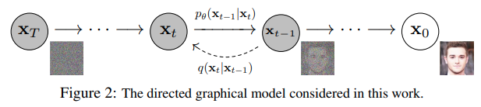
From noise to an image
DDPM forward and reverse processes. Read the arrow labels: generation proceeds from noise toward an image.
20 AMCC5160 / Lecture 03
Notes:
Timing: 12:54–13:38 (0.735138565686482 minutes).
Now let’s run the process toward an image. In this diagram, the noisy state is on the left and the cleaner image is on the right.
We start with noise, ask the model for a prediction, and use that prediction to make an update. Then we repeat.
You don’t need to follow every symbol here. Follow the changing state.
Each prediction depends on what is currently there and where we are in the process.
There is no finished target picture supplied at the end for the model to copy.
Don't expect every intermediate image to be a useful draft. Some states are hard to interpret, especially early on. For a design review, finished samples are often easier to compare. Intermediate pictures are useful when we specifically want to understand how the computation changes over the course of a run.
Background and sources:
Explain the diagram carefully because this figure orders its states with noise at the left and the clean image at the right. Forward corruption travels toward noise. Generation travels back toward the image side. The sampler uses the network prediction to update the current state and may also introduce randomness, depending on the method. It does not know a target photograph to recover at inference. Ask students to describe the process without equations: begin with noise, use learned structure, and repeatedly update a candidate.
Ho, Jain & Abbeel (2020), Denoising Diffusion Probabilistic Models. https://arxiv.org/abs/2006.11239
Rogge & Rasul (2022), The Annotated Diffusion Model. https://huggingface.co/blog/annotated-diffusion

Slide 21
The model predicts. The sampler takes a step.
The model predicts from the current noisy image.
The sampler uses that prediction to calculate the next image.
The process repeats until generation finishes.
21 AMCC5160 / Lecture 03
Notes:
Timing: 13:38–14:12 (0.5658980325788027 minutes).
The model and the sampler have different jobs. The model makes a prediction from the current noisy state.
The sampler uses that prediction to calculate the next state.
That calculation is why changing the sampler can change the result even when we keep the model.
We’re using the same learned network, but changing how we follow its predictions.
Imagine the network says which direction to move, while the sampler decides how to take that move. If we change the sampler, the network can remain the same, but the route through intermediate states can differ. So two tools can use similar models and still behave differently during generation.
Background and sources:
CMU Lecture 8, PDF pages 21–25, separates the learned reverse distribution from the sampling algorithm. The prediction is not usually pasted directly onto the screen as the next image. The algorithm uses the current state, time and coefficients to construct an update. Keep this distinction for later comparisons of samplers.
Adapted from Nayebi & Gormley, CMU Generative AI, Spring 2026, Lecture 8: Diffusion II + VAE, PDF pp. 7–25. https://www.cs.cmu.edu/~mgormley/courses/10423/slides/lecture8-diffusion-vae.pdf

Slide 22
Different steps use different noise levels
Near pure noise, little image information remains.
Near the end, the picture is much easier to recognize.
The schedule chooses which noise levels to visit.
22 AMCC5160 / Lecture 03
Notes:
Timing: 14:12–14:49 (0.6240744658345674 minutes).
The amount of noise changes during generation. Near the noisy end, very little image information is visible.
Near the end of the process, the picture is easier to recognize. A schedule chooses which noise levels we visit.
So step ten in one setup may not mean the same thing as step ten in another.
Don’t assume every model follows a fixed “composition first, details later” sequence.
Equal numbers of steps don't necessarily mean equal spacing along the noise levels. One schedule may spend more updates near a particular part of the process. That changes where the model's predictions are evaluated. When a tool offers a schedule option, it is changing more than the label on the step counter.
Background and sources:
Avoid claiming that every model always paints composition first and details last. That is a useful observation in many examples, not a strict division of labor. Different schedules allocate effort differently. Training noise levels and the subset visited during inference can differ. The displayed step number alone is insufficient to compare two pipelines.
Adapted from Nayebi & Gormley, CMU Generative AI, Spring 2026, Lecture 8: Diffusion II + VAE, PDF pp. 7–25. https://www.cs.cmu.edu/~mgormley/courses/10423/slides/lecture8-diffusion-vae.pdf
Hugging Face Diffusers, Schedulers. Accessed 15 Sep 2026. https://huggingface.co/docs/diffusers/using-diffusers/schedulers

Slide 23
What can the model predict?
Some models predict the noise.
Others predict a clean image.
Others predict a direction of change, often called velocity.
The sampling method must match what the model was trained to predict.
23 AMCC5160 / Lecture 03
Notes:
Timing: 14:49–15:26 (0.6134969325153374 minutes).
We’ve explained this using a model that predicts noise. That’s one common training choice.
Other models can predict a clean image, or a direction in which the current state should change. You don’t need to memorize all the versions.
The useful point is that the sampler has to use the prediction in the way the model was trained for. These outputs aren’t interchangeable labels.
These prediction targets can sometimes be converted into one another when we know the noise level and the formula connecting them. But the network was trained for a particular target. Copying a formula from another model without checking that target can give an update that doesn't mean what you think it means.
Background and sources:
CMU Lecture 8 compares parameterizations. We have focused on noise prediction for intuition. Other trained targets are possible and need compatible inference equations. The velocity parameterization used in some diffusion systems and a flow-matching velocity field are related ideas but should not be treated as identical formulas. Never switch target interpretation as if it were merely a visual preference.
Adapted from Nayebi & Gormley, CMU Generative AI, Spring 2026, Lecture 8: Diffusion II + VAE, PDF pp. 7–25. https://www.cs.cmu.edu/~mgormley/courses/10423/slides/lecture8-diffusion-vae.pdf
Lipman et al. (2023), Flow Matching for Generative Modeling. https://arxiv.org/abs/2210.02747

Slide 24
Working with a smaller representation
512 × 512 × 3
64 × 64 × 4
Original image in Stable Diffusion v1
Smaller working representation in that model
A latent is a learned representation of an image.
It has fewer values for the denoising model to process.
24 AMCC5160 / Lecture 03
Notes:
Timing: 15:26–16:10 (0.724561032367252 minutes).
Working directly on every pixel can take a lot of computation. Some models do most of the work in a smaller representation of the image.
That representation is called a latent. It’s a collection of learned numerical values.
In this older Stable Diffusion example, the image and its working representation have the sizes shown here. There are far fewer values in the smaller one.
That reduces the amount of information the image model has to handle, though it doesn’t give us an exact speedup from the numbers alone.
The smaller representation saves work, but it changes where that work happens. We still need an encoder for images we supply and a decoder for visible output. A fast denoising loop doesn't remove those other parts. For an interactive artwork, measure the whole wait that a visitor actually experiences.
Background and sources:
A latent is a learned numerical representation that can preserve useful structure with fewer values than the original pixels. Compare 786,432 pixel-channel values with 16,384 latent values in this particular architecture, roughly a 48-fold reduction in value count. Do not call this a 48-fold runtime improvement: actual computation depends on the network. Compression is lossy, so a decoder cannot guarantee perfect preservation of every small detail. Students only need to understand why much of the generation happens in a compact space they cannot directly view.
Rombach et al. (2022), High-Resolution Image Synthesis with Latent Diffusion Models. https://arxiv.org/abs/2112.10752

Slide 25
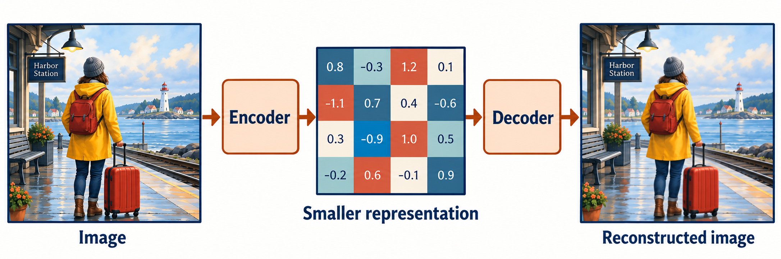
How an image gets compressed
The encoder makes a smaller representation.
The decoder turns it back into pixels.
Conceptual diagram. The colored grid is not real latent data.
25 AMCC5160 / Lecture 03
Notes:
Timing: 16:10–16:51 (0.6822508990903321 minutes).
The encoder turns an image into that smaller representation. The decoder turns it back into pixels. Look at the middle of the figure.
The little grid is just a way to show that the model works with numbers.
It isn’t actual data from this picture, and there isn’t one square meaning “coat” and another meaning “suitcase.”
In a latent diffusion model, the repeated generation steps happen in this smaller form. We use the decoder to get the image we can see.
A useful way to picture the decoder is as a learned way of turning compact information into visible structure. It doesn't simply enlarge each colored square in this drawing. The actual representation spreads information across numbers, and the decoder combines them using patterns learned during its own training.
Background and sources:
Use the familiar idea of a compact working representation, while emphasizing this is learned compression rather than a conventional JPEG file. A latent coordinate does not usually correspond to one named object. In latent diffusion, the denoiser works on this representation and the decoder produces the final pixels.
Rombach et al. (2022), High-Resolution Image Synthesis with Latent Diffusion Models. https://arxiv.org/abs/2112.10752
Kingma & Welling (2014), Auto-Encoding Variational Bayes. https://arxiv.org/abs/1312.6114
Original classroom illustrations generated with the built-in image-generation tool. Diagrams are simplified explanations. Image comparisons illustrate possible choices and are not measurements of particular seed, strength, or model settings.

Slide 26
Rebuilding an image and making a new one
Reconstruction: start with an image and try to rebuild it.
Generation: start with a sampled state and make a new image.
A good reconstruction does not guarantee that random latents look good.
26 AMCC5160 / Lecture 03
Notes:
Timing: 16:51–17:26 (0.5870530992172626 minutes).
Rebuilding an existing image and making a new image test different things.
If I encode this picture and decode it again, I can check how much survives. That tests the compression part.
It doesn’t show that any random set of numbers will turn into a good picture.
The generation model still has to produce a useful representation for the decoder to work with.
Try the two checks separately. First, pass an existing image through compression and reconstruction. Then examine newly generated samples. If the first test loses thin lettering, that gives one possible cause of poor lettering in the second test. It doesn't explain every failure, but it narrows the question.
Background and sources:
A good reconstruction demonstrates that the encoder and decoder can preserve information for an input. It does not automatically mean that arbitrary random latent vectors decode well. Latent diffusion supplies the learned generative process in the compressed space. Separate testing of reconstruction and generation helps locate bottlenecks.
Kingma & Welling (2014), Auto-Encoding Variational Bayes. https://arxiv.org/abs/1312.6114
Rombach et al. (2022), High-Resolution Image Synthesis with Latent Diffusion Models. https://arxiv.org/abs/2112.10752

Slide 27
What does a VAE add?
A VAE is a variational autoencoder.
Its encoder describes a range of possible latent values.
Training balances image reconstruction with a constraint on those values.
This is one way to organize a space of compressed images.
27 AMCC5160 / Lecture 03
Notes:
Timing: 17:26–18:19 (0.8885127988153163 minutes).
A VAE is a variational autoencoder. The full name matters less than the extra idea it adds to compression. Its encoder describes a range of possible values for the smaller representation. Training asks it to reconstruct images while also keeping those values organized in a way that supports sampling. Those two aims can pull in different directions. Keeping every detail and making a useful space of representations aren’t exactly the same task. Image models can use related autoencoders with additional training losses, so this is an introduction to the idea rather than a description of every system.
The reconstruction term asks whether the decoded image resembles the input. The regularization term compares the encoder's distribution with a chosen prior distribution. That second term discourages every image from being encoded into an arbitrary isolated region. The balance affects the usefulness of the latent space. In image-generation systems, additional perceptual or adversarial losses may change the reconstruction behavior, so the simple VAE objective is a starting model of the idea.
Background and sources:
Keep the mathematics light. A VAE balances a reconstruction objective with a KL-divergence term that regularizes an approximate posterior toward a prior. Do not claim every latent image model uses exactly the original VAE objective: latent-diffusion autoencoders can use perceptual and adversarial losses and other regularization choices.
Kingma & Welling (2014), Auto-Encoding Variational Bayes. https://arxiv.org/abs/1312.6114
Rombach et al. (2022), High-Resolution Image Synthesis with Latent Diffusion Models. https://arxiv.org/abs/2112.10752

Slide 28
Which details survive compression?
Fine lines and small details can disappear during compression.
Try encoding and decoding an image to see what survives.
Look closely at the suitcase handle and coat outline.
28 AMCC5160 / Lecture 03
Notes:
Timing: 18:19–18:57 (0.6293632324941824 minutes).
Think about a thin railing, a tiny logo, or the handle of our suitcase.
If that detail disappears when we simply encode and decode the picture, changing the prompt won’t tell us much about the cause.
We already know some information is being lost in that part of the system.
It helps to check where a problem appears, rather than treating every failure as a wording problem.
This matters for work that people view at different sizes. A tiny suitcase handle might disappear in a projection even if it survived generation. Check the actual display size as well as the original file. Image quality is partly about whether the important details remain visible where the work will be shown.
Background and sources:
Imagine a tiny logo or a thin architectural railing. If an encode-decode reconstruction already loses it, that points to the representation or decoder as a bottleneck. It does not prove the denoiser is perfect. The useful habit is to isolate stages rather than attribute every visible failure to prompt wording.
Rombach et al. (2022), High-Resolution Image Synthesis with Latent Diffusion Models. https://arxiv.org/abs/2112.10752

Slide 29

Edges and texture: paper, paint, and ink
A Cut paper
B Soft paint
C Ink lines
Illustrations made for this class. The pictures are similar, but not identical.
Hard edges separate shapes; soft edges can merge them.
29 AMCC5160 / Lecture 03
Notes:
Timing: 18:57–19:39 (0.703405965728792 minutes).
Edges help organize an illustration. A hard edge creates a clear boundary. A soft edge allows neighboring shapes or tones to merge. A lost edge occurs where the boundary becomes difficult to separate from its surroundings. Artists can use all three within one image.
The cut-paper example emphasizes separate shapes. The paint example uses softer transitions. The ink example emphasizes line weight and marks. These differences affect which forms remain readable at a small size and which areas attract attention through contrast.
A style prompt can influence several of these properties at once. If the goal is a clear silhouette, simply adding more surface detail may work against it. Specify the edge behavior or value separation that the image needs. The three illustrations are teaching examples, not controlled measurements of a style setting.
Background and sources:
Compare visual language through properties students can name. In the paper treatment, look at silhouette and separation of shapes. In gouache, look at softened edges and atmospheric depth. In ink, look at line weight and contrast. These are intended treatments in generated illustrations, not authentic physical artworks. The boards are not exact composition-preserving transformations. For an animation project, also ask whether a treatment will remain readable during movement and whether its texture can stay coherent across shots.
Original AMCC5160 teaching brief and visual critique examples. Concept boards generated with the built-in image-generation tool on 15 September 2026. These are illustrative art-direction studies, not controlled tests of seeds, guidance, or model settings.

Slide 30
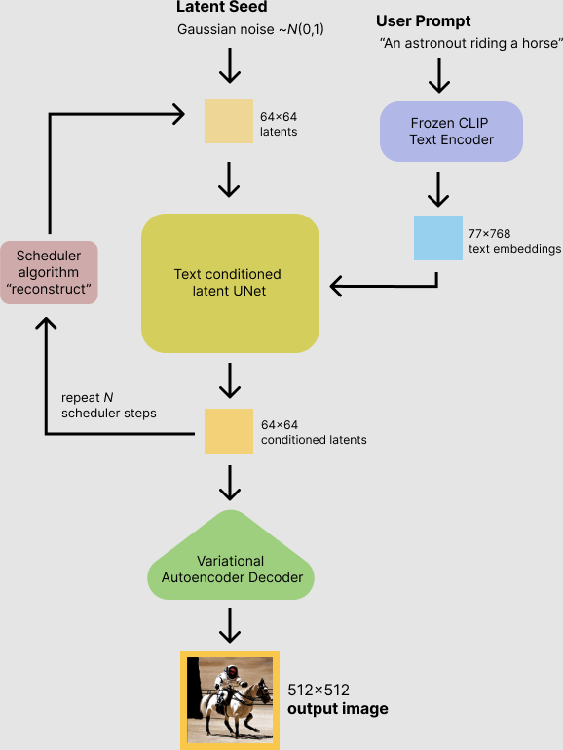
The parts of an image generator
The seed starts the random numbers.
The text encoder turns words into features.
The network predicts each update.
The sampler applies the update.
The decoder turns the result into pixels.
SD v1 pipeline diagram, Patrick von Platen / Hugging Face.
30 AMCC5160 / Lecture 03
Notes:
Timing: 19:39–20:23 (0.729849799026867 minutes).
Here is how the parts fit together in one image generator. The random starting values come from the seeded random-number generator.
The text encoder turns the prompt into information the image network can use. The network makes predictions, and the sampler applies updates.
At the end, the decoder produces pixels. Follow the loop in the middle. That’s the repeated work. Later models can replace some of these parts.
This diagram is useful because it shows where the controls enter, not because every current product has exactly this structure.
When a result fails, this diagram gives us places to investigate. A prompt misunderstanding may involve text conditioning. Lost tiny detail may involve compression or decoding. An unstable comparison may involve the random setup. We won't diagnose everything from one picture, but we can choose a more focused next test.
Background and sources:
Walk once around the loop and then connect each user control to its location. The seed enters before the repeated loop. Prompt information influences network predictions inside the loop. Step count changes how many updates the schedule takes. The decoder comes at the end. The diagram shows a U-Net and the specific dimensions of SD v1. Later models can replace components. Avoid spending time on every number printed inside the original figure: its purpose here is to connect controls to mechanisms.
Patil et al. (2022), Stable Diffusion with Diffusers. Published SD v1-4 examples. https://huggingface.co/blog/stable_diffusion

Slide 31
How a model uses words
The prompt is split into small pieces called tokens.
A text encoder turns those pieces into numbers.
The image model uses those numbers to help make the picture.
31 AMCC5160 / Lecture 03
Notes:
Timing: 20:23–21:01 (0.6293632324941824 minutes).
The model can’t use a sentence in the same form that we read it. First, the sentence is divided into small pieces called tokens.
A token can be a word or part of a word. A text encoder turns those pieces into numerical features. The image model uses those features.
But having information about “red” and “suitcase” doesn’t guarantee that red will end up on the right object.
Adding words also changes the input representation. More words don't always make the request clearer. If several phrases repeat the same idea while another phrase conflicts with it, the result can be hard to interpret. Start with the subject, placement, and appearance that matter, then add a detail for a reason.
Background and sources:
Use a short original example: a red cup beside a blue book. The system has to represent both objects, bind the correct color to each, and capture the spatial relation. Recognizing individual words does not ensure the complete relationship will appear correctly. Tokenization may split a word into smaller pieces. The text encoder converts the sequence into numerical features, and a conditioning mechanism makes those features available to the image generator. Ask which part of the example students predict will be hardest to maintain after adding three more objects.
Rombach et al. (2022), High-Resolution Image Synthesis with Latent Diffusion Models. https://arxiv.org/abs/2112.10752
Vaswani et al. (2017), Attention Is All You Need. https://arxiv.org/abs/1706.03762

Slide 32
How CLIP links pictures and words
CLIP learns from paired pictures and captions.
It gives matching pairs similar numerical features.
Some image generators use its text encoder.
CLIP connects pictures and words. It does not draw the picture itself.
32 AMCC5160 / Lecture 03
Notes:
Timing: 21:01–21:41 (0.6769621324307171 minutes).
CLIP is one way to connect words and pictures. It learns from pictures paired with captions.
During training, it learns to give a matching picture and caption similar numerical descriptions, compared with pairs that don’t match.
Some image generators use CLIP’s text encoder to help interpret a prompt. Other systems use different encoders. CLIP itself isn’t drawing the image.
It helps connect what the words describe with visual information. The generator still has to make the picture.
Matching pictures and captions teaches useful associations, but the captions are not complete descriptions of everything in a picture. They may mention the person and leave out the railing. That helps explain why a system can recognize the overall topic while missing a precise relation that was never easy to describe.
Background and sources:
CMU’s text-to-image material introduces CLIP as a bridge between modalities. Use a batch of pictures and captions: each caption should select its paired picture over the alternatives. This objective teaches alignment, not pixel generation. Some image generators use a CLIP text encoder, while others use different or multiple encoders.
Radford et al. (2021), Learning Transferable Visual Models From Natural Language Supervision. https://arxiv.org/abs/2103.00020
CMU Generative AI, Spring 2026, Lecture 12: DPO + Text-to-Image, text/image section. https://www.cs.cmu.edu/~mgormley/courses/10423/slides/lecture12-dpo-text2img.pdf

Slide 33
A similar-looking image can still be wrong
The picture may show a station and a traveler.
It may still put the suitcase on the wrong side.
Check specific details, not just the overall resemblance.
33 AMCC5160 / Lecture 03
Notes:
Timing: 21:41–22:17 (0.5870530992172626 minutes).
A picture can be broadly similar to the prompt and still be wrong in a way that matters.
We might get a station, a traveler, and a suitcase, but the suitcase could be on the wrong side.
Or we ask for two objects and get three. So don’t stop at “it looks about right.” Check the particular details the work depends on.
For a poster, a small relation can decide whether the image is usable. A hand holding a ticket is different from a ticket floating beside the hand. When you write your checks, include the relations that carry the meaning, not only a list of nouns that should appear somewhere.
Background and sources:
Use “a red cube beside two blue spheres.” A broadly similar picture could still swap colors or contain one sphere. Do not claim these errors happen in every system; capabilities vary. The lesson is that a similarity score or a convincing overall impression is not a complete test of compositional correctness.
Radford et al. (2021), Learning Transferable Visual Models From Natural Language Supervision. https://arxiv.org/abs/2103.00020
CMU Generative AI, Spring 2026, Lecture 12: DPO + Text-to-Image, text/image section. https://www.cs.cmu.edu/~mgormley/courses/10423/slides/lecture12-dpo-text2img.pdf

Slide 34
How attention shares information
Self-attention
Cross-attention
Parts of the same input share information.
One input uses information from another input.
For example, one image area uses information from another.
For example, image areas use information from prompt words.
34 AMCC5160 / Lecture 03
Notes:
Timing: 22:17–22:58 (0.6875396657499471 minutes).
Attention is a way for the model to use information from different places. With self-attention, parts of the same input share information.
One area of an image can use information from another area. That can matter for things like an object and its reflection.
With cross-attention, information comes from another input. An image area can use information from the prompt.
The names sound complicated, but the distinction is simple: information from within the same input, or information from another input.
Attention doesn't make the model conscious of an object. Here it names a calculation that selects and mixes information. The useful design connection is that a local feature can depend on distant features or words. Changing one instruction can therefore influence more than the small area you had in mind.
Background and sources:
Describe attention as a learned way to weight relevant information. A token forms a query, compares it with keys, and mixes the corresponding values. Keep those words optional and emphasize the act of selecting information. Self-attention works within a sequence. Cross-attention can connect image and text sequences. A region representing a cup may draw on features of the word red, but this is not a hard symbolic assignment. Ask why distant parts of an image may need to communicate: an object and its reflection, two hands holding one object, or a consistent background.
Vaswani et al. (2017), Attention Is All You Need. https://arxiv.org/abs/1706.03762
Rombach et al. (2022), High-Resolution Image Synthesis with Latent Diffusion Models. https://arxiv.org/abs/2112.10752

Slide 35
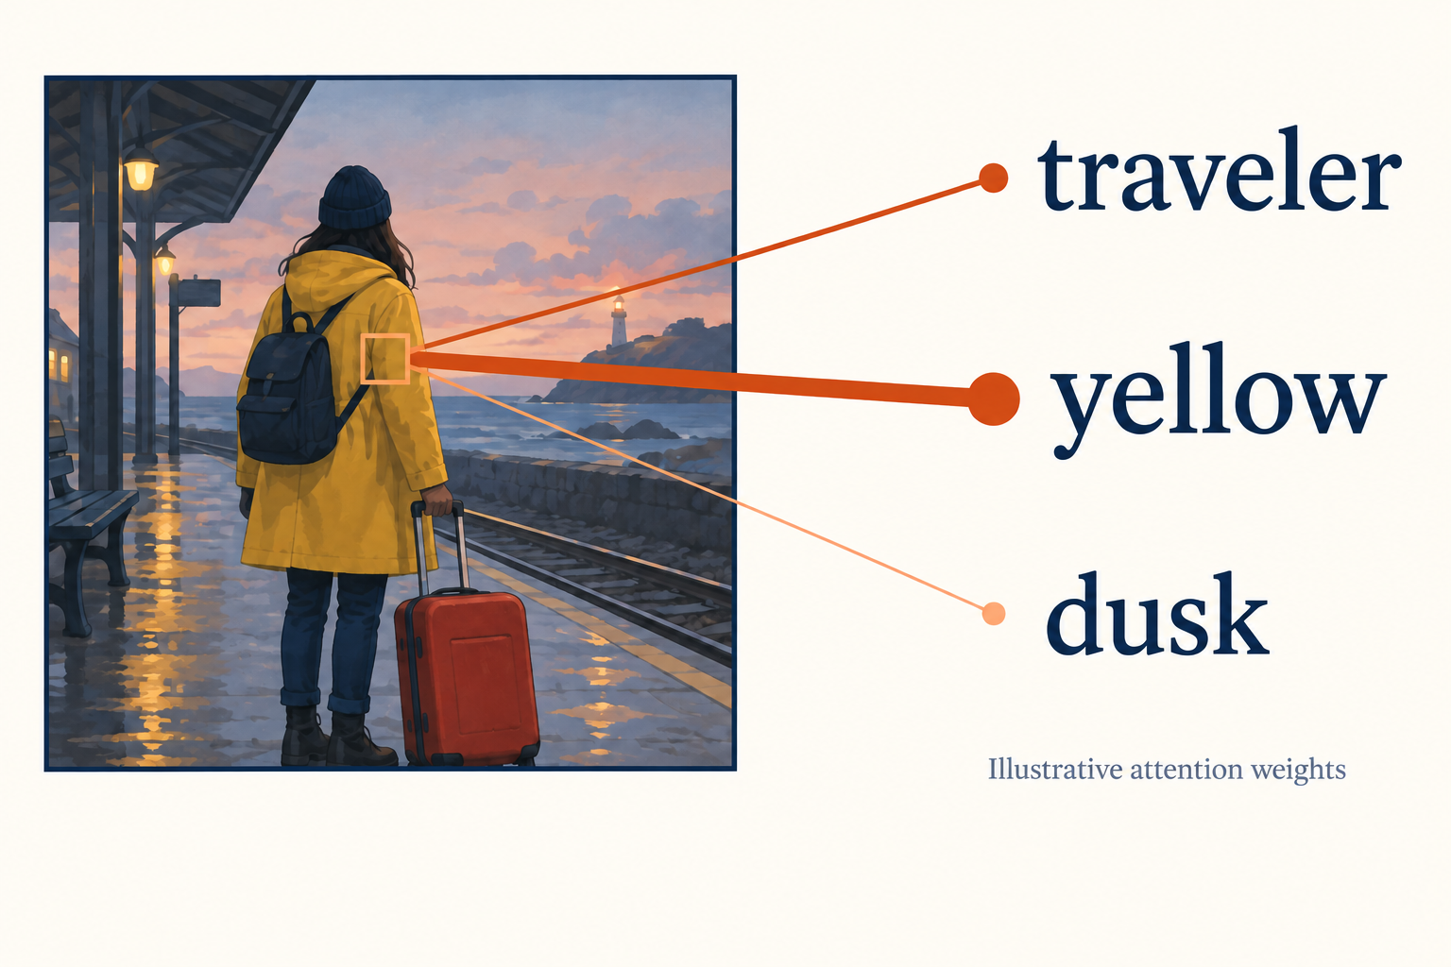
An image area can use information from words
This coat area can use information about “yellow.”
Attention gives different weights to different features.
Illustrative connections, not a measured attention map.
35 AMCC5160 / Lecture 03
Notes:
Timing: 22:58–23:48 (0.8409138988787814 minutes).
This drawing gives us a rough picture of cross-attention.
The area around the coat can use information linked to “yellow,” along with other words in the prompt. Different information receives different weights in the calculation.
The lines here are drawn to explain the idea.
They aren’t measurements from a model, and we can’t use them to prove which word caused a particular pixel.
What matters for now is that the text can influence image features during generation. It isn’t just read once and then put aside.
The word coat does not need to control only the pixels inside the coat. It can influence shape, shadows, and nearby areas through later layers. A cross-attention map is therefore a clue about a calculation, not a clean selection mask. If we need to edit just the coat, an explicit region mask gives a different kind of control. That distinction matters when a small wording change unexpectedly alters the face or the background.
Background and sources:
The picture gives an intuition for cross-attention. Image-region features form queries, text features form keys and values, and learned scores determine how information is mixed. The lines are invented for teaching. They are not measurements, and an attention weight alone does not prove which word caused a particular pixel. The model works with vectors rather than literal labels attached to objects.
Vaswani et al. (2017), Attention Is All You Need. https://arxiv.org/abs/1706.03762
CMU Generative AI, Spring 2026, Lecture 14: LDM, cross-attention, DiT, prompt-to-prompt. https://www.cs.cmu.edu/~mgormley/courses/10423/slides/lecture14-ldm-dit-p2p.pdf
Original classroom illustrations generated with the built-in image-generation tool. Diagrams are simplified explanations. Image comparisons illustrate possible choices and are not measurements of particular seed, strength, or model settings.

Slide 36
Attention as a weighted mix
attention = weighted sum of values
Example weights: traveler 0.70, yellow 0.20, dusk 0.10
Multiply each value vector by its weight, then add them.
The weights add up to one.
The numbers are invented to show how weighted mixing works.
36 AMCC5160 / Lecture 03
Notes:
Timing: 23:48–24:37 (0.8038925322614766 minutes).
Here is attention as a weighted mix. Suppose the weights are point seven, point two, and point one. We multiply each corresponding set of features by its weight, then add the results. The weights here sum to one. The model is mixing numerical information. It isn’t necessarily choosing one word and ignoring all the others. These numbers are invented to make the arithmetic easy to follow. They aren’t measurements from the coat image. In a real network, many such calculations happen across different parts and layers.
Using scalar values makes the mixing easy to calculate. Let the three values be ten, twenty, and thirty. With weights point seven, point two, and point one, the result is seven plus four plus three, which is fourteen. A neural network usually mixes feature vectors instead of these three scalars. The weights come from comparisons involving queries and keys; the weighted information comes from the values.
Background and sources:
The weights here are invented solely to illustrate weighted mixing. In scaled dot-product attention, softmax converts scaled query-key scores into these weights. Each value is a vector, so the result mixes features rather than choosing a single word. Multiple heads and layers repeat this operation. High attention to a word alone does not prove its causal importance.
Vaswani et al. (2017), Attention Is All You Need. https://arxiv.org/abs/1706.03762

Slide 37
Why position matters
“Dog bites person” differs from “person bites dog.”
In an image, left and right are different places.
The model needs information about word order and image position.
37 AMCC5160 / Lecture 03
Notes:
Timing: 24:37–25:19 (0.713983499048022 minutes).
Order matters. “Dog bites person” and “person bites dog” use the same words but describe different events. Position matters in images too.
A suitcase on the viewer’s left isn’t in the same place as one on the right. The model needs information about word order and image position.
Having that information helps it represent relationships, though it can still get a relationship wrong.
For a camera, left and right are usually screen coordinates. For a character, left and right can refer to their own body. A character facing us has their right hand on our left. This simple reversal is a common source of ambiguous instructions. Write the viewpoint into the request when it matters, such as the suitcase on the viewer's left, held in the traveler's right hand. Then check those two relations separately.
Background and sources:
Attention by itself does not automatically encode sequence order. Transformer systems inject position information through positional embeddings or other position-aware mechanisms. Image tokens also need spatial organization. This enables the representation of relationships but does not guarantee that every requested relationship will be rendered correctly.
Vaswani et al. (2017), Attention Is All You Need. https://arxiv.org/abs/1706.03762
Peebles & Xie (2023), Scalable Diffusion Models with Transformers. https://arxiv.org/abs/2212.09748

Slide 38
Discussion 2: Does it match the instructions?
Goal: yellow coat, red suitcase on the left, station roof on the right.
90 sec: list the details you would check.
90 sec: could the picture look good and still get these details wrong?
38 AMCC5160 / Lecture 03
Notes:
Timing: 25:19–26:05 (0.7668711656441718 minutes).
Here’s our next check. We want a yellow coat, a red suitcase on the left, and the station roof on the right.
With a partner, make a short list of what you would inspect in the result. Be specific enough that another person could use your list.
Now compare your lists. Could an image look beautiful and still fail one of those checks?
Also, when we said “on the left,” whose left did we mean?
A useful answer could contain four checks: one traveler, a yellow coat, one red suitcase, and the roof on the requested side. A fifth check could describe the relation between the hand and handle. These are observable requirements. Quietness is different: we might discuss empty space, low contrast, or posture as evidence. Keeping those categories separate lets a group disagree about mood without losing track of a clear object error.
Background and sources:
Give pairs ninety seconds to make a checklist and ninety seconds for comparison and sharing. Ask for one failure a global similarity judgment might overlook. Encourage precise descriptions: two spheres, both blue, and cube on the viewer’s left. The ambiguity of “left” is itself a productive observation. Use the station scene instead of the cube example. Check whose left is meant, whether the suitcase is visible, and whether the canopy occupies the requested area.
Radford et al. (2021), Learning Transferable Visual Models From Natural Language Supervision. https://arxiv.org/abs/2103.00020

Slide 39
Hue, lightness, and figure–background separation
Two different properties
A coat against a wall
Hue: yellow, red, blue.
Different hues can have similar lightness.
Lightness: how light or dark a color appears.
Change the background value to separate the silhouette.
Try a grayscale check before adding texture.
39 AMCC5160 / Lecture 03
Notes:
Timing: 26:05–26:48 (0.713983499048022 minutes).
Hue and lightness describe different properties of color. Yellow and red name different hues. Lightness describes how light or dark a color appears. Two visibly different hues can still be similar in lightness, making their boundary less clear in some viewing conditions.
A grayscale version can help inspect the value structure of a composition. If a coat and the wall behind it become nearly the same gray, the silhouette may need another form of separation. Possible changes include a darker background, a lighter figure, or a controlled edge of light.
This is a diagnostic, not a rule that every artwork must have strong contrast. Low contrast can be intentional. The useful distinction is between an intended soft boundary and a boundary that disappears accidentally. More saturated color alone does not necessarily solve a value problem.
Background and sources:
Lightness and hue are distinct. The coat example is a proposed design test. Grayscale is a diagnostic for value structure, not a complete model of visual attention. Do not claim one color always conveys one emotion.
Stanford CS148, Color, Images, and Cameras. https://web.stanford.edu/class/cs148/fall25/summer25/materials/class_04_color_images_and_cameras.pdf — Color representation and camera geometry.
Stanford CS178, Composition, Marc Levoy, Spring 2009. https://graphics.stanford.edu/courses/cs178-09/lectures/composition-07may09.pdf — Composition, figure/background and visual organization. These art principles are established background, not 2026 advances.

Slide 40
A transformer can remove noise
DiT architecture, Peebles & Xie (2023), Figure 3. Original DiT uses class conditioning.
40 AMCC5160 / Lecture 03
Notes:
Timing: 26:48–27:39 (0.8409138988787814 minutes).
A transformer can be part of a diffusion model. Look mainly at the left side of this figure. The noisy representation is split into patches.
The patches become tokens, pass through transformer layers, and are turned into a prediction. “Transformer” names the kind of network. “Diffusion” describes the generation approach.
They can work together. This published diagram used class labels, such as an object category. It wasn’t originally a text-prompt model.
We’re using it to understand the network structure, rather than every detail of its original task.
The patch sequence carries both image information and position information. Without position, the same collection of patches could describe several different layouts. Transformer layers then exchange information across that sequence. This is why a transformer denoiser can connect distant parts of the picture. But full attention becomes expensive as the sequence grows. The cost is especially important for video, where adding frames also adds a time dimension to the tokens being processed.
Background and sources:
Focus on the left part of the published diagram. A noisy latent is divided into patches, converted to tokens, processed by transformer blocks, and mapped back to an output prediction. Do not try to teach all conditioning variants on the right. The important distinction is that transformer names an architecture, while diffusion describes a generative modeling procedure. They can coexist. The original DiT paper uses ImageNet class labels, not text prompts. Modern text-conditioned systems can adapt the broader architecture idea, but this figure should retain its original scope.
Peebles & Xie (2023), Scalable Diffusion Models with Transformers. https://arxiv.org/abs/2212.09748

Slide 41
Smaller patches mean more work
The image representation is split into patches.
Smaller patches create more tokens.
Full self-attention compares every token with every other token.
Twice as many tokens means four times as many pairwise scores.
41 AMCC5160 / Lecture 03
Notes:
Timing: 27:39–28:20 (0.692828432409562 minutes).
Smaller patches give the model more tokens to process. In full self-attention, each token is compared with every other token.
That means the number of comparisons grows quickly. Twice as many tokens gives four times as many pairwise scores.
That doesn’t mean the whole program always takes exactly four times longer. It explains why this part of the calculation can become expensive.
Take a square latent grid with sixty-four positions along each side. With four-by-four patches, it becomes sixteen by sixteen, or two hundred and fifty-six tokens. With two-by-two patches, it becomes thirty-two by thirty-two, or one thousand and twenty-four tokens. That is four times as many tokens and sixteen times as many pairwise scores in full attention. These numbers describe one attention calculation, not the total runtime of the model.
Background and sources:
For dense self-attention with N tokens, the pairwise score matrix has N squared entries. This is a statement about that component, not an exact prediction of total runtime. The token count depends on latent resolution and patch size. Efficient attention implementations and alternative architectures can change practical costs.
Peebles & Xie (2023), Scalable Diffusion Models with Transformers. https://arxiv.org/abs/2212.09748
CMU Generative AI, Spring 2026, Lecture 14: LDM, cross-attention, DiT, prompt-to-prompt. https://www.cs.cmu.edu/~mgormley/courses/10423/slides/lecture14-ldm-dit-p2p.pdf

Slide 42
The network and the generation method
Autoregressive generation
Diffusion generation
Predict the next token.
Predict an update to a noisy state.
Use the tokens already generated.
Repeat at different noise levels.
42 AMCC5160 / Lecture 03
Notes:
Timing: 28:20–29:08 (0.7986037656018616 minutes).
There are also different ways to generate the output. An autoregressive model predicts the next token using the tokens that came before it.
You’ve seen that idea with text: “The cup is on the…” and then a possible next word.
A diffusion model instead updates a noisy state over several steps. Both can use transformers.
So when you read a model description, separate the network it uses from the order in which it generates the result. Those names answer different questions.
Think of these as answers to two different engineering questions. The network describes how information is processed at one call. The generation method describes how those calls are arranged to produce an output. A transformer can predict the next text token, the next image token, or an update to a noisy image. Seeing the word transformer on a model page is not enough to know which process the product uses.
Background and sources:
For autoregression, say: the red cup is on the ... and let the audience suggest a next word. A model predicts a distribution over continuations. For diffusion, return to a noisy canvas that gets revised. These descriptions concern generation order, not the entire architecture. Avoid claiming that all image models generate pixels from left to right, or that all transformer models are language models. Ask a quick check: if a product says diffusion transformer, is that a contradiction? Answer: no, it describes a compatible architecture and generation process.
Vaswani et al. (2017), Attention Is All You Need. https://arxiv.org/abs/1706.03762
Peebles & Xie (2023), Scalable Diffusion Models with Transformers. https://arxiv.org/abs/2212.09748
Ho, Jain & Abbeel (2020), Denoising Diffusion Probabilistic Models. https://arxiv.org/abs/2006.11239

Slide 43
Making an image one token at a time
Turn an image into a sequence of tokens.
Predict the next token from the earlier ones.
Turn the completed sequence back into pixels.
43 AMCC5160 / Lecture 03
Notes:
Timing: 29:08–29:49 (0.6875396657499471 minutes).
An image can also be represented as a sequence of tokens.
One kind of image generator predicts those tokens one after another, using the earlier ones as context.
Once it has the sequence, another part turns it into pixels. That’s the basic idea here.
It doesn’t mean all image generators draw from the top-left corner to the bottom-right, pixel by pixel.
A sequence model learns a conditional distribution for the next token. At each position, it assigns different probabilities to possible choices. Sampling selects among those choices according to a rule. Taking the highest-probability token every time is another rule and can reduce variation. In image systems, the tokens may describe learned visual units rather than ordinary words. The order of prediction and the meaning of the tokens both matter.
Background and sources:
Explain this as an image counterpart to next-token text generation. The image tokenizer and ordering matter. This is one family of autoregressive image models; hybrid and masked-token methods also exist. The important distinction is between the network architecture and the procedure used to generate an output.
CMU Generative AI, Spring 2026, Lecture 12: DPO + Text-to-Image, text/image section. https://www.cs.cmu.edu/~mgormley/courses/10423/slides/lecture12-dpo-text2img.pdf

Slide 44
Flow matching: learning how to move
xₜ = (1 − t) z + t x
A simple training path joins noise z to an image x.
The model learns the direction of change along that path.
At generation time, a solver follows the learned directions.
44 AMCC5160 / Lecture 03
Notes:
Timing: 29:49–30:45 (0.9308229320922361 minutes).
Flow matching gives us another way to describe learning a generation process. For this simple training example, imagine a path joining noise to a known image. We can pick a point on the path and ask the model to predict the direction of movement there. At generation time, the final image isn’t supplied. The model has learned directions from many training examples, and we follow its predictions. In this equation, time starts at noise and ends at the image. That is the opposite direction from the earlier equation where we added noise to an image. Keep that change of convention in mind.
For a straight training path, write the state as one minus time multiplied by the starting noise, plus time multiplied by the target data. Differentiating with respect to time gives target data minus starting noise. That supplies a known direction for a training example. The learned field combines information across many examples; it is not handed the desired final image during generation. The choice of path and target is part of the training design.
Background and sources:
This is an illustrative linear conditional path, not a claim that every flow model uses the same path. Here t equals zero at noise and one at data, the opposite orientation to the forward-noising slide. A training pair supplies a direction of movement, and the network learns a velocity depending on state and time. During sampling the destination data image is unknown. The learned field combines information across many training pairs, so generated trajectories can curve. Flow matching supports a family of probability paths, including diffusion-related ones. Keep the mathematical discussion to these distinctions.
Lipman et al. (2023), Flow Matching for Generative Modeling. https://arxiv.org/abs/2210.02747

Slide 45
Following the model’s direction
Ask the model which direction to move at the current time.
Take a small step in that direction.
Repeat to move from noise toward an image.
Example: next state = current state + step size × predicted direction
45 AMCC5160 / Lecture 03
Notes:
Timing: 30:45–31:36 (0.8409138988787814 minutes).
Once the model predicts a direction, we need a method for following it. A simple update takes the current state and adds the predicted direction multiplied by a small step size. Then we ask for another direction from the new state and repeat. That is the idea behind the example on this slide. Real systems can use more involved solvers. The important point is the same one we saw earlier: the model makes a prediction, and a numerical method uses it to calculate the next state.
Suppose the current coordinate is two, the predicted velocity is three, and the step size is point one. Euler's update gives two plus point one times three, or two point three. Then the model evaluates the direction again at the new point. A large step can miss curvature in the field. Smaller steps can reduce that numerical error, but they require more evaluations and cannot remove an error in the learned direction itself.
Background and sources:
For the simple path introduced on the previous slide, time runs from noise at zero to data at one. That differs from our forward-noising convention. The displayed update is Euler’s method as an intuition, not a universal implementation. A trained velocity field must work across sampled states; the exact target endpoint is unavailable at inference.
Lipman et al. (2023), Flow Matching for Generative Modeling. https://arxiv.org/abs/2210.02747

Slide 46
Where does randomness enter?
A run can start with random noise.
Some samplers also add random noise during the run.
Others follow a fixed path once the starting state is fixed.
46 AMCC5160 / Lecture 03
Notes:
Timing: 31:36–32:17 (0.692828432409562 minutes).
Randomness can enter in more than one place. There may be random noise at the start. Some samplers also add random noise during the run.
Others follow a fixed calculation once the starting state is fixed.
So a fixed sampling procedure can still produce different images if it begins from different starting values.
We need to know the full setup to repeat a result.
We can distinguish random initialization from random movement. An ordinary differential equation sampler can start at random noise and then follow a deterministic path. A stochastic sampler also injects randomness along the path. Both can make varied images. Deterministic here describes the path after the initial state is fixed; it does not mean that every run must start at the same state or produce the same picture.
Background and sources:
DDIM provides an example of deterministic sampling under a specified setting. Deterministic refers to the algorithm given its full inputs. Different initial states still lead to different results. Hardware and implementation can affect exact reproducibility even when an algorithm is deterministic in theory.
Song, Meng & Ermon (2021), Denoising Diffusion Implicit Models. https://arxiv.org/abs/2010.02502
Hugging Face Diffusers, Reproducibility. Accessed 15 Sep 2026. https://huggingface.co/docs/diffusers/using-diffusers/reusing_seeds

Slide 47
Four terms that describe different parts
Term | What it describes
Transformer or U-Net | The network used to process information
Pixels or latents | The representation the network works on
Diffusion or flow matching | How we train the model to generate
Sampler or solver | How we calculate the next step
47 AMCC5160 / Lecture 03
Notes:
Timing: 32:17–33:08 (0.8409138988787814 minutes).
This table puts the terms in order. Transformer or U-Net tells us about the network. Pixels or latents tells us what representation it works on.
Diffusion or flow matching tells us about the generation training approach. The sampler or solver tells us how updates are calculated.
Take a moment and explain one row to the person beside you. You don’t have to remember every name today.
I want you to recognize that these are different parts of a system, rather than competing names for the same thing.
A useful model description might say: transformer network, latent representation, flow-matching training, and a particular numerical solver. Those four phrases can all be true at the same time. Another model can keep three of those choices and change the fourth. This vocabulary helps us compare systems without assuming every new name describes a completely new invention. It also explains why a setting borrowed from one system may not transfer directly to another.
Background and sources:
Use this slide to organize terminology that students will encounter on product pages and research papers. A latent diffusion transformer with a particular sampler is a coherent combination. These labels describe different decisions and should not be treated as mutually exclusive product categories. Give students 20 seconds to explain one row to a neighbor. If somebody asks which combination is best, explain that architecture alone does not establish quality. Training data, scale, objective, conditioning, and the intended task all matter.
Peebles & Xie (2023), Scalable Diffusion Models with Transformers. https://arxiv.org/abs/2212.09748
Rombach et al. (2022), High-Resolution Image Synthesis with Latent Diffusion Models. https://arxiv.org/abs/2112.10752
Lipman et al. (2023), Flow Matching for Generative Modeling. https://arxiv.org/abs/2210.02747
Song, Meng & Ermon (2021), Denoising Diffusion Implicit Models. https://arxiv.org/abs/2010.02502

Slide 48

Different seeds can give different pictures
A Figure on the left
B Figure in the distance
C Figure on the right
Illustrative alternatives. These are not outputs from a measured seed comparison.
A seed starts the random numbers. It does not specify a camera position.
48 AMCC5160 / Lecture 03
Notes:
Timing: 33:08–33:59 (0.8462026655383964 minutes).
A seed sets the starting point for a repeatable sequence of random numbers.
Changing it can give us a different starting state, and that can lead to a different picture.
These illustrations show the kind of composition changes we might care about. They aren’t measured outputs from particular seed values.
A seed number has no fixed artistic meaning. Seed forty-two doesn’t mean “wide shot,” and forty-three doesn’t mean “slightly wider.” Use seeds to explore alternatives.
Use instructions or references when you need a particular layout.
A seed is an address into a repeatable random process, not an instruction about appearance. Adjacent seed numbers do not have to produce adjacent compositions. If we want to study guidance, the useful arrangement is several guidance values crossed with the same seed list. Each seed then supplies a matched starting condition. If we only change the seed until one image looks good, we have selected a result rather than measured the effect of guidance.
Background and sources:
A pseudo-random generator can produce a repeatable sequence when initialized in the same way. A different seed changes that sequence. The mapping from random numbers to an image depends on the pipeline. Changing image dimensions, model, sampler, or implementation can change that mapping. Seeds 42 and 43 are not neighboring locations on an artistic style slider. Explain the practical habit: choose seeds to explore alternatives, and hold them fixed when testing a change. Identity continuity usually needs stronger conditions than a reused seed.
Hugging Face Diffusers, Reproducibility. Accessed 15 Sep 2026. https://huggingface.co/docs/diffusers/using-diffusers/reusing_seeds
Original classroom illustrations generated with the built-in image-generation tool. Diagrams are simplified explanations. Image comparisons illustrate possible choices and are not measurements of particular seed, strength, or model settings.

Slide 49
How to repeat a result
Save the model, prompt, references, and settings.
Reset the random generator before each comparison.
Use the same software and hardware when exact matching matters.
49 AMCC5160 / Lecture 03
Notes:
Timing: 33:59–34:39 (0.6769621324307171 minutes).
To repeat a result, keep more than the seed. Save the model, prompt, references, and other settings.
If you’re doing a comparison in code, reset the random generator before each matched run. Otherwise, it may simply continue to the next random numbers.
Exact matching can also depend on the software and hardware. The seed is part of the record, not the whole record.
Software can change the sequence even when a displayed seed stays the same. A new sampler, another model revision, or a different random-number implementation can alter the computation. For a class experiment, a saved workflow file is often more useful than a screenshot of the seed box. Record the model version and the full input settings, then keep the actual outputs together with that record.
Background and sources:
Point out a subtle trap: a generator has state. If the same generator object is consumed repeatedly without resetting it, its next call uses different random numbers. Record all relevant parameters and reset the seed when making paired comparisons. Numerical operations may behave differently across devices, precision modes, kernels, or software releases, so a seed alone is not a cross-platform guarantee. Ask what a useful submission record would contain besides the final JPEG. Expected answer: enough of the recipe for another person to understand and attempt the comparison.
Hugging Face Diffusers, Reproducibility. Accessed 15 Sep 2026. https://huggingface.co/docs/diffusers/using-diffusers/reusing_seeds

Slide 50
Character continuity: shape, costume, and props
Keep the same
Change when needed
Coat, hair, and suitcase design.
Camera angle and distance.
Which hand holds the suitcase.
Pose and expression.
The light and colors in the scene.
How much detail the shot needs.
50 AMCC5160 / Lecture 03
Notes:
Timing: 34:39–35:24 (0.7404273323460969 minutes).
For a story, we often need the same character in several shots.
Decide which features must stay: the coat, the hair, the suitcase, perhaps which hand is holding it.
The camera angle and pose can change while those features remain recognizable. A repeated seed doesn’t provide a full character description.
References can help, but we still need to compare the actual images and catch changes that break the scene.
Character continuity has several levels. The silhouette can stay recognizable while the face changes. The face can remain similar while the coat gains an extra pocket. A prop can keep its color but switch hands between shots. A character sheet makes those separate requirements visible. It is especially useful before a sequence is generated, because it defines what must remain stable instead of leaving every shot to invent those details again.
Background and sources:
Treat this as a compact art-direction checklist. Continuity is more specific than generating another attractive traveler. Compare approved reference images across shots, and record both visual identity and scene relationships. An adapter or reference condition may help, but inspect the actual outputs. A shared seed is a reproducibility input, not a complete character identity system.
Original AMCC5160 teaching brief and visual critique examples. Concept boards generated with the built-in image-generation tool on 15 September 2026. These are illustrative art-direction studies, not controlled tests of seeds, guidance, or model settings.
Hugging Face Diffusers, Reproducibility. Accessed 15 Sep 2026. https://huggingface.co/docs/diffusers/using-diffusers/reusing_seeds

Slide 51
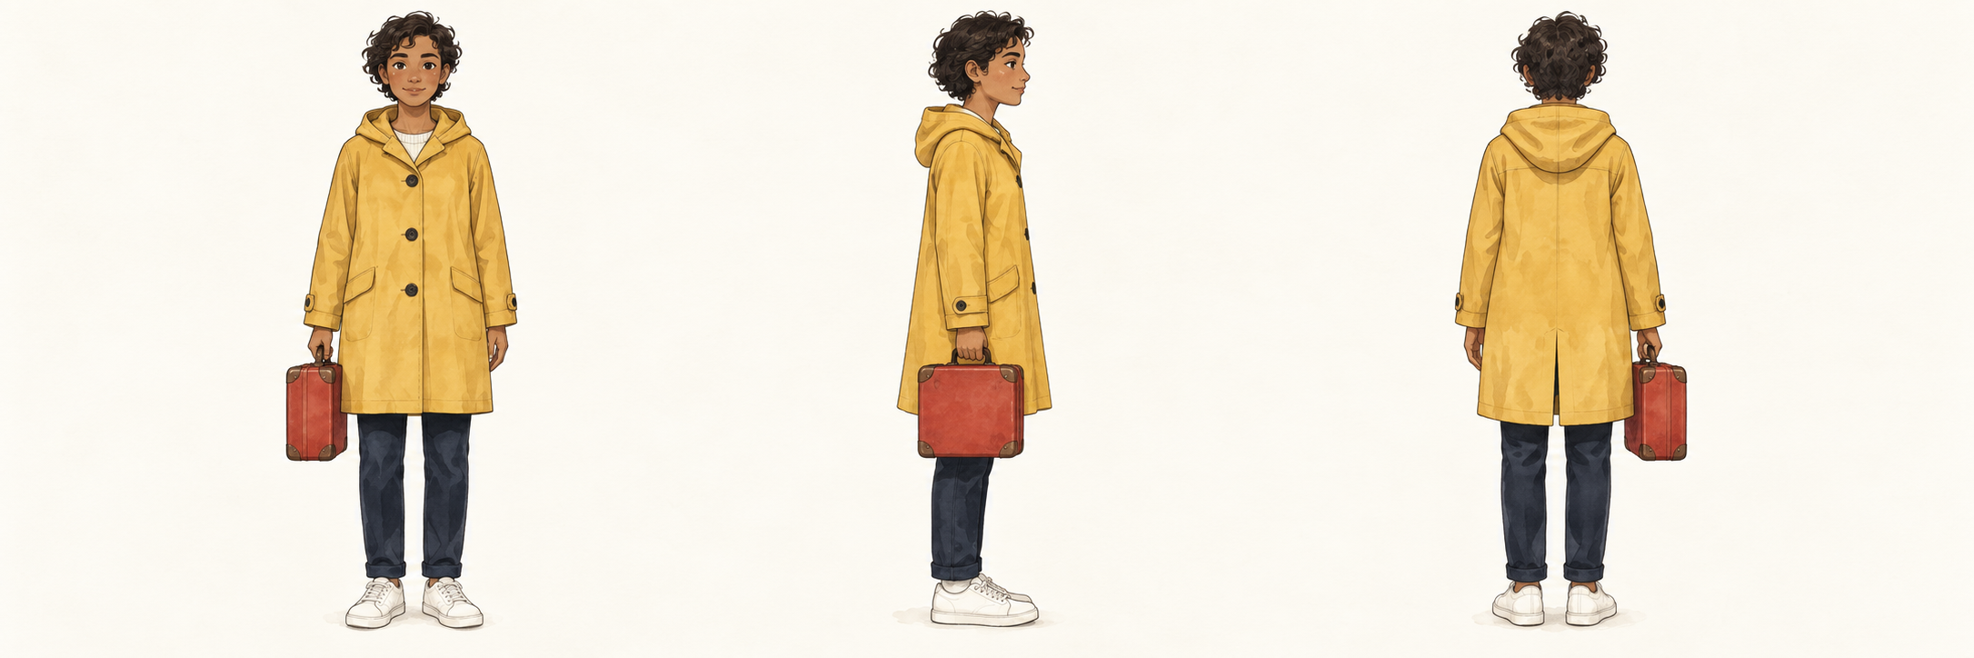
A character sheet defines what must stay
Classroom illustration • Three views of one costume and prop
Record silhouette, coat length, buttons, hair, and carrying hand.
51 AMCC5160 / Lecture 03
Notes:
Timing: 35:24–36:18 (0.9043790987941612 minutes).
A character sheet defines the stable features of a subject across views. This illustration shows one costume and prop from three directions. Its purpose is to make the requirements visible before generating a sequence, rather than inventing those requirements after the shots are complete.
The silhouette includes coat length, shoulder shape, and overall proportions. Surface details include buttons, pockets, hair, and the prop's shape. Ownership includes which hand carries the prop. These features have different visibility in a front view, side view, and back view.
A reference method can help preserve these features, but the reference should also be internally consistent. If two source images disagree about the costume, the generator receives conflicting evidence. A clean reference set reduces that ambiguity. It does not guarantee that every new view will be correct.
For evaluation, distinguish legitimate view changes from identity drift. The visible side of a suitcase should change when the camera moves. Its handle should not switch construction for no reason. This distinction allows variation while keeping the subject recognizable.
Background and sources:
A character sheet is a design reference for a repeated character. The generated sheet is an illustration, not a benchmark. A stable silhouette and a list of invariant details make checking a sequence more concrete. Pose and camera view can vary while costume and identity features remain stable.
Original classroom illustrations generated with the built-in image-generation tool. Diagrams are simplified explanations. Image comparisons illustrate possible choices and are not measurements of particular seed, strength, or model settings.

Slide 52
Guidance: how strongly to follow the prompt
Make a prediction with the prompt.
Make a prediction without the prompt.
Guidance increases the difference between them.
52 AMCC5160 / Lecture 03
Notes:
Timing: 36:18–37:04 (0.7774486989634017 minutes).
Now we can look at guidance. In classic classifier-free guidance, we compare a prediction made with the condition to one made without it.
The condition might be a text prompt or a category label. Guidance pushes the result further in the direction of that difference.
This can make the requested subject more obvious. But turning up the strength doesn’t make the instruction more precise.
If the model’s direction is imperfect, a stronger push can make that problem more visible too.
During the classic training setup, the condition is sometimes dropped. That allows the same network to learn predictions with and without that information. At sampling time, the difference between those predictions supplies a direction for guidance. This connects a training choice to a user-facing control. The strength slider is not a universal measure of how well a model understands language; it controls a particular combination of predictions.
Background and sources:
Frame this as comparing what the network predicts generally with what it predicts when a condition is present. The condition can be text or a class label. The extra push emphasizes the condition-dependent component. In classic classifier-free guidance, the same network can learn both modes by sometimes dropping the condition during training. Ask students to imagine an instruction becoming stronger without becoming more precise. This prepares the next slide: increasing a strength parameter can amplify imperfect directions as well as useful ones.
Ho & Salimans (2022), Classifier-Free Diffusion Guidance. https://arxiv.org/abs/2207.12598

Slide 53
How guidance combines two predictions
prediction = u + s (c − u)
u: prediction without the prompt
c: prediction with the prompt
s: guidance scale in this formula
At s = 1, the result is c. Above 1, we push beyond c.
53 AMCC5160 / Lecture 03
Notes:
Timing: 37:04–37:54 (0.8197588322403215 minutes).
You can read this formula in words. Start with the prediction without the prompt. Then add a scaled difference between the prompted and unprompted predictions.
At a scale of one, this formula gives us the prompted prediction. Above one, we push beyond it. We aren’t simply averaging two answers.
Different papers and tools sometimes use different numbering.
In the paper we’ll use for the later exercise, their guidance number is shifted by one compared with this formula.
That’s why we should check the definition before comparing values.
The direction in this formula lives in a high-dimensional numerical space. It is not a single slider for yellow, sharpness, or realism. Several visual properties can change together when the scale changes. The one-number example on the next slide is useful precisely because it shows extrapolation clearly: we start from one prediction and continue past the other. In a full image, that happens across many coordinates at once.
Background and sources:
Use a one-dimensional toy calculation, explicitly a numerical analogy rather than measured model output. If u equals 2 and c equals 3, then s equals 1 gives 3, s equals 2 gives 4, and s equals 5 gives 7. More guidance moves farther along the difference direction. The original Ho and Salimans paper writes (1+w)c minus wu, so its w corresponds to s minus 1 here. This conversion matters for the exercise. Also clarify that some software skips the unconditional branch when guidance is disabled, so exposed zero values should not be interpreted mechanically from this equation.
Ho & Salimans (2022), Classifier-Free Diffusion Guidance. https://arxiv.org/abs/2207.12598

Slide 54
A small guidance calculation
guided prediction = u + s(c − u)
Let u = 2 and c = 3 for one prediction coordinate.
At s = 1: 2 + 1 × (3 − 2) = 3
At s = 4: 2 + 4 × (3 − 2) = 6
54 AMCC5160 / Lecture 03
Notes:
Timing: 37:54–38:43 (0.8250475988999365 minutes).
Let’s make the guidance formula concrete with one number. Suppose the unprompted prediction is two and the prompted prediction is three. Their difference is one. At guidance scale one, we get two plus one, which is three. At scale four, we get two plus four, which is six. We have moved beyond the prompted prediction rather than taking an average between two and three. Those are made-up values for one coordinate, not actual image measurements. They show why a larger guidance scale can exaggerate a direction.
The scale-four result is outside the interval between two and three. That is why guidance can amplify a feature rather than merely blend two plausible answers. The numerical space has many coordinates, so several properties can be amplified together. A lower scale can be useful when that amplification damages color or detail. The actual setting still depends on the model's training and the exact guidance convention used by the software.
Background and sources:
These scalar values are an original toy example, not actual pixel values or a measured model run. The point is geometric: guidance can move beyond the conditional output rather than simply average two outputs. At scale zero this formula returns u; at scale one it returns c. Some papers and interfaces use a shifted convention.
Ho & Salimans (2022), Classifier-Free Diffusion Guidance. https://arxiv.org/abs/2207.12598

Slide 55
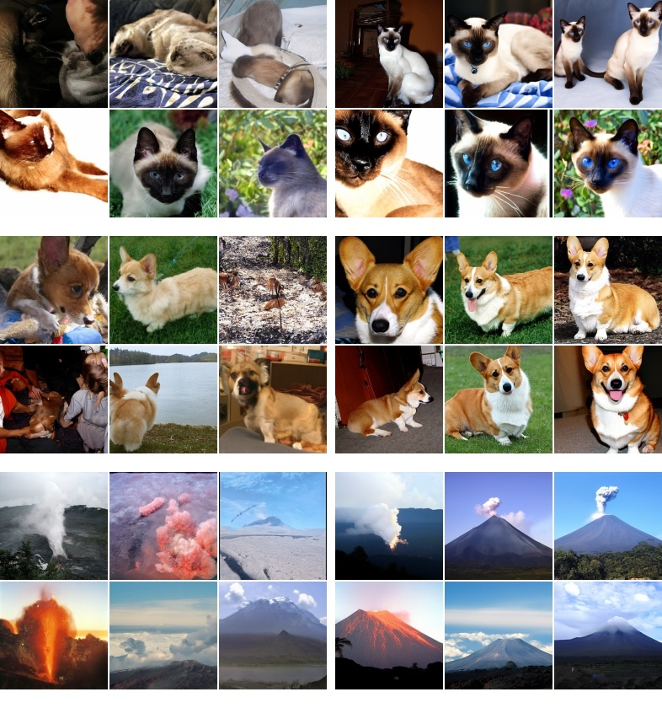
What can go wrong with strong guidance?
The subject may become easier to recognize.
Colors may become too strong.
Different results may start to look alike.
Ho & Salimans, Figure 3: unguided samples at left, guided samples at right.
55 AMCC5160 / Lecture 03
Notes:
Timing: 38:43–39:30 (0.7880262322826317 minutes).
Look at what happens to appearance when guidance becomes stronger. The subject may be easier to recognize.
But colors can become too strong, some details can look strange, and different samples may become more alike. Whether that is useful depends on the work.
A bold poster and a quiet scene may need different choices. These are examples from a published study using image categories.
They show a tradeoff worth checking. They don’t give us one best number for every current image model.
In an illustration, exaggerated contrast can make the silhouette read clearly at a small size. The same contrast may destroy a soft transition needed for fog or dusk. We should therefore distinguish an artifact from an intentional graphic effect. The problem is not strong color by itself. The problem is losing control over which shapes are emphasized and whether the effect remains consistent with the intended image.
Background and sources:
Invite students to look first at the visual changes, then explain the mechanism. Stronger guidance extrapolates model predictions and can overemphasize particular features. The source paper reports saturation under strong guidance and a tradeoff between sample variety and fidelity. It does not establish a universal best setting for text-to-image tools. Ask whether a saturated, iconic image could still be desirable for a poster. Yes: technical fidelity and artistic usefulness are related but distinct judgments. Preserve the context that these are class-conditioned ImageNet samples.
Ho & Salimans (2022), Classifier-Free Diffusion Guidance. https://arxiv.org/abs/2207.12598

Slide 56
How a negative prompt can help
prediction = n + s (c − n)
c: prediction with the positive prompt
n: prediction with the negative prompt
Some systems push away from n and toward c.
A negative prompt cannot guarantee that an object disappears.
56 AMCC5160 / Lecture 03
Notes:
Timing: 39:30–40:22 (0.8514914321980114 minutes).
A negative prompt changes the comparison in some image generators.
Instead of comparing with an empty prompt, the system can compare with the words in the negative prompt.
The calculation then pushes away from that prediction and toward the positive one. But it isn’t an exact removal tool.
Writing “people” in a negative prompt doesn’t guarantee an empty room. If something unwanted remains, inspect it and try a clear change.
Adding a very long list of negative words can make it harder to tell which part helped.
A negative prompt changes a conditioning input; a mask defines a spatial region. They solve different problems. If the unwanted element is one sign in the corner, a local edit may give more direct control than a long list of negative terms. If the unwanted tendency appears across the entire picture, changing the prompt or the model settings may be more relevant. Choose the control that matches the location and scale of the problem.
Background and sources:
In a common Stable Diffusion implementation, negative-prompt features replace the empty-condition features in the other branch. This changes the comparison direction. It is not a word-filtering system and does not guarantee that an unwanted object vanishes. Use an original example: asking for an empty room while adding people to the negative prompt may influence the result, but one should still inspect it. Long negative lists can also introduce interactions that make diagnosis harder. This slide describes one common mechanism, and students should check their chosen pipeline rather than assume universal support.
Hugging Face Diffusers, Text-to-image. Accessed 15 Sep 2026. https://huggingface.co/docs/diffusers/using-diffusers/conditional_image_generation

Slide 57
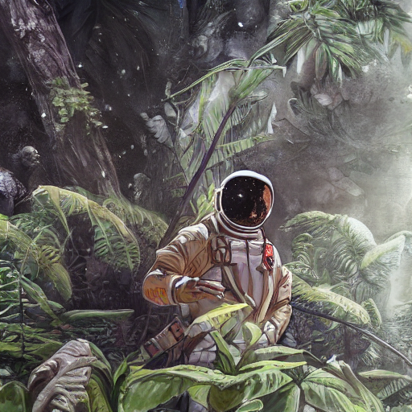
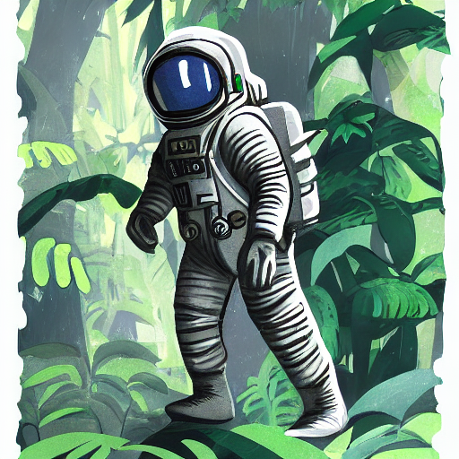

Three guidance settings
Scale 2.5
Scale 7.5
Scale 10.5
Hugging Face documentation examples. Seed control is not documented for this displayed comparison.
57 AMCC5160 / Lecture 03
Notes:
Timing: 40:22–41:10 (0.8091812989210916 minutes).
Here are three published examples at different guidance settings. The request describes an astronaut in a jungle, with cold, muted colors.
Look at the color, the size of the subject, and the feeling of the surroundings.
There’s something missing from this comparison: the displayed examples don’t document matched seeds.
So we can describe the differences, but we can’t confidently say that guidance caused every one of them. Keep that distinction in mind.
A useful-looking comparison still needs a clear record of what changed.
This is also a useful lesson about published figures. A page can show striking differences without providing every setting needed to reproduce them. We should not fill those gaps with assumptions. We can say that one example has stronger color or a larger subject. To attribute those differences to a single variable, we would need the missing controls. Description is valid evidence of appearance; causal explanation requires a stronger comparison.
Background and sources:
The published prompt asks for an astronaut in a jungle with a cold, muted color choices. Ask the class to compare color, subject prominence, and atmosphere. Crucially, the documentation does not show a seeded generator for these displayed examples. Treat them as illustrations of settings, not a verified paired causal experiment. Ask what is missing before attributing every compositional difference to guidance. Expected answer: common random initialization and confirmation of the other settings. The later paper grid provides a stronger controlled comparison. This is a deliberate evidence-literacy moment.
Hugging Face Diffusers, Text-to-image. Accessed 15 Sep 2026. https://huggingface.co/docs/diffusers/using-diffusers/conditional_image_generation

Slide 58
Discussion 3: Clear subject, wrong mood
The coat is yellow, but the picture feels harsh and crowded.
90 sec: how would you compare guidance settings fairly?
90 sec: how would you judge the colors and mood?
58 AMCC5160 / Lecture 03
Notes:
Timing: 41:10–41:54 (0.7404273323460969 minutes).
The coat is yellow, but the picture feels harsh and crowded.
It shows the right object, yet the mood is wrong. With a partner, describe how you would test different guidance settings. What would you keep fixed?
What would you look for in the results? Now talk about judgment. How would you explain that one version feels quieter or less crowded?
Name something visible, such as contrast, figure size, or the space around the traveler.
Consider two possible changes. Lowering guidance tests whether the harsh colors depend on that prediction combination. Making the traveler smaller tests composition instead. If we do both at once, the result may improve, but the explanation becomes unclear. A useful pair exercise is to give each person one of those changes, keep the starting conditions matched, and compare which visible problem each change actually addresses.
Background and sources:
Run a three-minute paired discussion. Ask students to test several guidance values under the same model, prompt, sampler, dimensions and matched seeds. They should separate prompt accuracy from visual quality and variety. A single attractive picture is weak evidence about a general setting. Remind them that supported ranges depend on the pipeline.
Ho & Salimans (2022), Classifier-Free Diffusion Guidance. https://arxiv.org/abs/2207.12598

Slide 59
What should we compare?
Keep the same model, prompt, and other settings.
Use the same set of seeds at each guidance value.
Compare prompt accuracy, appearance, and variety.
59 AMCC5160 / Lecture 03
Notes:
Timing: 41:54–42:42 (0.7986037656018616 minutes).
For that test, keep the model, prompt, image size, sampler, and step count fixed. Change guidance, and use the same set of seeds at each value.
Several seeds are better than one, because a setting may work well for one starting point and poorly for another.
Then compare separate things: whether the image shows what we asked for, whether we like its appearance, and whether the set gives us useful variety.
You may find that no single setting wins on every question.
A small two-factor experiment might use three guidance values and four seeds, giving twelve images. Every guidance value appears with every seed. That layout separates a setting effect from a lucky starting point more clearly than three unrelated favorite images. We can then mark prompt errors, visible artifacts, and composition changes in separate columns. Twelve is only a classroom example, not a statistically sufficient sample for every research claim.
Background and sources:
Matching several seeds makes comparisons less dependent on one fortunate output. It does not guarantee identical compositions after guidance changes. Look for a systematic pattern and acknowledge exceptions. Guidance affects a trajectory through a nonlinear model, so no universal scale follows from the simple linear combination formula.
Ho & Salimans (2022), Classifier-Free Diffusion Guidance. https://arxiv.org/abs/2207.12598
Hugging Face Diffusers, Reproducibility. Accessed 15 Sep 2026. https://huggingface.co/docs/diffusers/using-diffusers/reusing_seeds

Slide 60
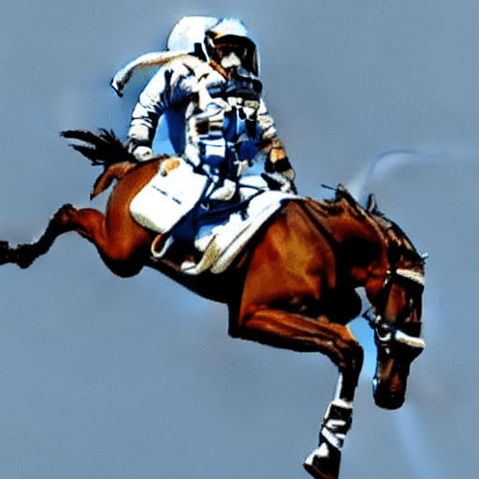
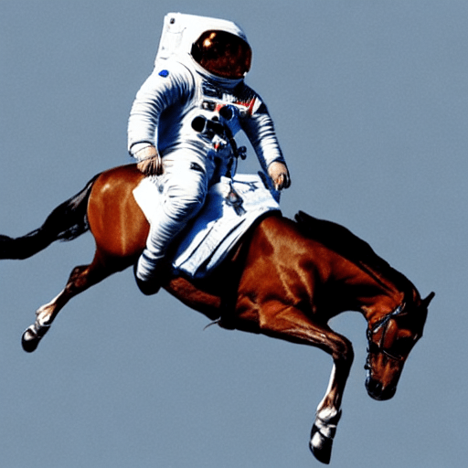
15 steps and 50 steps
15 inference steps
50 inference steps
Published SD v1-4 pair: seed 1024, guidance 7.5, same prompt. Hugging Face (2022).
Which details changed? Did they improve the picture?
60 AMCC5160 / Lecture 03
Notes:
Timing: 42:42–43:33 (0.8514914321980114 minutes).
Now compare fifteen steps with fifty steps. These are two completed runs from an older Stable Diffusion example. The prompt and seed were kept the same.
They aren’t two snapshots taken during one run. Look at the horse and the astronaut’s clothing. What changed? Which changes would you actually call improvements?
More steps give a different generation path. They can help, but they don’t guarantee that every object becomes more correct.
And this older example doesn’t tell us that a newer model should use fifty steps.
More updates can reduce numerical approximation error for a suitable solver and model. But the learned prediction can still be wrong. Taking a more accurate route through an imperfect learned field does not guarantee the object count or anatomy is correct. This separates two sources of error: how well we follow the model, and how well the model represents the desired images. Increasing steps mainly addresses the first computation, not every limitation of the second.
Background and sources:
These published examples reset the generator to seed 1024 and use guidance 7.5. Ask students to compare the suit and horse anatomy, without declaring every difference an improvement. The 50-step run is the source pipeline default in this historical example. It is evidence for this particular comparison, not a recommendation that every modern model needs 50 steps. Additional sampling changes the trajectory but cannot necessarily repair an underlying modeling weakness. The images represent separate completed runs with different step counts, not two saved moments from one run.
Patil et al. (2022), Stable Diffusion with Diffusers. Published SD v1-4 examples. https://huggingface.co/blog/stable_diffusion

Slide 61
Steps and sampler: two different settings
Step count
Sampler and schedule
How many updates to take.
How to calculate each update.
Usually affects how long generation takes.
Which noise levels to visit.
61 AMCC5160 / Lecture 03
Notes:
Timing: 43:33–44:23 (0.8197588322403215 minutes).
Step count tells us how many updates to take.
The sampler tells us how to calculate those updates, and the schedule tells us which noise levels to visit.
Those are related choices, but they aren’t the same choice. Think about following a route.
The number of stops doesn’t tell you where the stops are or how you travel between them. If you’re comparing speed, measure the actual time.
A displayed step can involve different amounts of work in different systems, so step count alone isn’t enough.
Some numerical methods ask for more than one model prediction to calculate a single update. Others reuse information from earlier predictions. This is why a comparison based only on a visible step count can be misleading. For an experiment, report both the settings and elapsed time. For a software implementation, the number of network evaluations is another useful measure because the network often accounts for much of the work.
Background and sources:
Use a route-planning analogy. Choosing the number of stops is different from choosing the navigation method and where those stops occur. Both can change the resulting path. Some samplers are deterministic conditional on the initial state, while others introduce more randomness. More steps can reduce numerical approximation error, but image quality is not guaranteed to improve monotonically. Solver stages and classifier-free guidance can also require multiple network evaluations per displayed step. If students want to compare speed, suggest measuring wall-clock time in a fixed setup.
Song, Meng & Ermon (2021), Denoising Diffusion Implicit Models. https://arxiv.org/abs/2010.02502
Hugging Face Diffusers, Schedulers. Accessed 15 Sep 2026. https://huggingface.co/docs/diffusers/using-diffusers/schedulers

Slide 62
A progress picture or a finished result?
A progress image comes from the middle of one run.
A step comparison uses finished images from separate runs.
Changing the step count can also change the schedule.
62 AMCC5160 / Lecture 03
Notes:
Timing: 44:23–45:11 (0.7986037656018616 minutes).
A progress image comes from partway through one run. A step-count comparison uses separate runs that each finish.
That difference matters because changing the total step count may also change the schedule from the beginning.
A finished fifteen-step image isn’t necessarily what a fifty-step run looks like after its fifteenth step.
So, when you show a comparison in your work, label it clearly. Are we watching a single image develop, or comparing finished results from different settings?
Those pictures answer different questions.
Imagine one run visits twenty noise levels and another visits fifty. Their fifteenth updates may occur at different noise levels, so comparing those intermediate states does not compare equal points in the process. A progress sequence should identify its own run. A final-result grid should identify the full settings of each completed run. This makes the figure answer a clear question rather than mixing two different kinds of evidence.
Background and sources:
A changed step budget can change the schedule and all visited noise levels. An intermediate latent may also need a decoder or an estimated clean image to be displayed. Label such demonstrations carefully. The historical pair we just saw consists of separate completed generations, not snapshots from a single run.
Hugging Face Diffusers, Schedulers. Accessed 15 Sep 2026. https://huggingface.co/docs/diffusers/using-diffusers/schedulers
Patil et al. (2022), Stable Diffusion with Diffusers. Published SD v1-4 examples. https://huggingface.co/blog/stable_diffusion

Slide 63
Generation cost: count model evaluations
20 steps × 2 predictions = 40 evaluations
Classic CFG uses conditional and unconditional predictions.
Batching can compute the pair together.
Latency also depends on image size, model, and hardware.
This arithmetic is a simple CFG example, not a timing benchmark.
63 AMCC5160 / Lecture 03
Notes:
Timing: 45:11–45:52 (0.692828432409562 minutes).
Step count is not always the same as computational cost. In classic classifier-free guidance, one update uses a conditional prediction and an unconditional prediction. With twenty sampling steps and one pair per step, the simple count is forty network evaluations.
An implementation may batch the pair together. That can reduce elapsed time compared with two separate calls, but it does not turn the calculation into one unconditioned prediction. A different solver may request more evaluations, while a distilled model may implement guidance differently.
For an interactive display, the relevant time is the complete wait from input to visible result. It includes text encoding, sampling, decoding, and any additional processing. Image size, model size, and hardware also affect that wait. Report measured seconds when comparing speed, alongside the sampler and step settings.
Background and sources:
A sampling step and a network evaluation are different units. This example assumes one conditional and one unconditional evaluation per step. Batching changes implementation and elapsed time. Higher-order solvers and distilled guidance may change this count. Include encoding, decoding and tool overhead when measuring interactive latency.
Ho & Salimans (2022), Classifier-Free Diffusion Guidance. https://arxiv.org/abs/2207.12598
MIT 6.S184, 2026 course, Lecture 3. https://diffusion.csail.mit.edu/2026/docs/20260123_Lecture_03.pdf — Score matching and classifier-free guidance.

Slide 64
Some models need only a few steps
1–4 steps
Guidance disabled
SD-Turbo’s documented operating range
SD-Turbo’s standard text-to-image setup
Distillation changes the trained model.
Settings from an older base model may no longer apply.
64 AMCC5160 / Lecture 03
Notes:
Timing: 45:52–46:45 (0.8726464988364714 minutes).
Some models are trained specifically to work with very few steps. SD-Turbo is an example.
Its documented text-to-image setup uses one to four steps and turns off the usual classifier-free guidance.
That is a property of this trained model and its intended setup.
We can’t take those settings and assume they work the same way in an older model.
The training process called distillation helps a model learn a shorter generation process.
For our purposes, remember this: a model trained for one step is different from simply stopping another model after one step.
Distillation changes what the model learns to do in a limited number of calls. It may train a student using information from a more expensive teacher or use related objectives to shorten generation. The resulting model can have a different recommended sampler and guidance behavior. We should use its documented operating range first. A one-step model and a fifty-step model are different trained systems, not simply the same system with different patience.
Background and sources:
Use SD-Turbo as a concrete counterexample to the belief that a large step count is always better. Its training uses a distillation method to support one to four steps, and the standard text-to-image instructions disable classifier-free guidance. It does not use the negative-prompt control in that setup. Do not generalize this to all fast or flow-based models. The broader lesson is to read the documented operating regime of the exact checkpoint. A one-step distilled model is different from taking an arbitrary one-step shortcut through an older model.
Stability AI, SD-Turbo model card. Accessed 15 Sep 2026. https://huggingface.co/stabilityai/sd-turbo

Slide 65
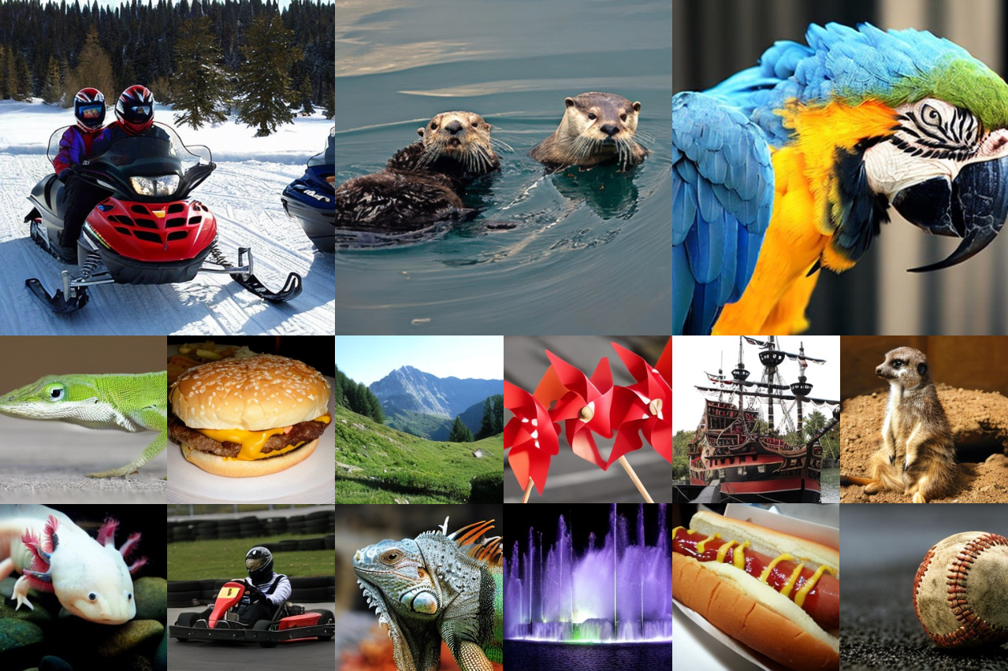
Changing the model
Different training images can lead to different results.
The network and training method also matter.
The same settings may behave differently in another model.
Selected class-conditioned DiT samples, Peebles & Xie (2023), Figure 1.
65 AMCC5160 / Lecture 03
Notes:
Timing: 46:45–47:35 (0.8409138988787814 minutes).
Changing the model can change much more than the appearance. The training images, network, text encoder, and training method may all differ.
Even a setting with the same name may behave differently. For your own work, decide what you’re comparing.
Are you asking which complete tool helps you make the scene? Or are you asking which technical change caused an improvement?
The first is a useful design question. The second needs a more careful experiment.
One favorite picture from each model won’t tell us very much about either.
There is also a difference between comparing models and comparing complete workflows. A workflow may include a better reference interface, automatic resizing, a face repair stage, or an upscaler. Those extra stages can matter to a designer even if the base model is unchanged. If the question is which tool helps finish the poster, include them. If the question is which network change improved quality, separate them from the model comparison.
Background and sources:
The sample collage illustrates the range of one published DiT model, not a ranking against another system. A model comparison changes more than one variable when architecture, data, text encoder, resolution, and defaults differ. Ask students what they want to learn from a comparison: which complete product serves a scene goal, or which technical component causes a change? Those are different experiments. For creative evaluation, several prompts and several samples are more informative than one favorite output. Document the supported settings of each model rather than forcing incompatible values.
Peebles & Xie (2023), Scalable Diffusion Models with Transformers. https://arxiv.org/abs/2212.09748
Rombach et al. (2022), High-Resolution Image Synthesis with Latent Diffusion Models. https://arxiv.org/abs/2112.10752
Hugging Face Diffusers, Reproducibility. Accessed 15 Sep 2026. https://huggingface.co/docs/diffusers/using-diffusers/reusing_seeds

Slide 66
LoRA: change fewer model parameters
ΔW = B A
Full 1,000 × 1,000 update: 1,000,000 values.
Rank 8: (1,000 × 8) + (8 × 1,000) = 16,000.
The small learned update is added to the base weight.
Example dimensions • Rank controls the size of the update.
66 AMCC5160 / Lecture 03
Notes:
Timing: 47:35–48:21 (0.7668711656441718 minutes).
LoRA represents a weight update as the product of two smaller matrices. The base weight remains available, and the learned product supplies an adjustment. The rank sets the intermediate size of that factorization. A smaller rank reduces the number of values being trained, but also limits the form of the update.
For one weight matrix of one thousand by one thousand, a full update contains one million values. With rank eight, the two factors contain eight thousand values each. Their total is sixteen thousand, which is sixty-two and a half times fewer for this particular matrix.
That calculation does not describe every parameter in a real model. It explains the saving for one adapted weight. A style or subject LoRA must still match the base model it was trained for. Rank, training data, and where the update is applied can all affect what it learns.
Background and sources:
For one square 1000-dimensional weight, a rank-8 factorization has 16000 trained values instead of 1000000 for a full update, ignoring scale factors and biases. This is a worked arithmetic example, not the total parameter count of a product. LoRA does not guarantee identity consistency or compatibility across different base models.
CMU Generative AI, Spring 2026, Lecture 10: Parameter-Efficient Fine-Tuning, PDF pp. 32–43. https://www.cs.cmu.edu/~mgormley/courses/10423/slides/lecture10-peft.pdf
Hu et al. (2022), LoRA: Low-Rank Adaptation of Large Language Models. https://arxiv.org/abs/2106.09685

Slide 67
Reference input or learned subject adaptation?
Method | Where the change happens
Text / image prompt | Conditioning during generation
IP-Adapter | Image features enter separate attention
LoRA | A low-rank update changes selected weights
DreamBooth | Subject examples are used for finetuning
Conditioning and weight updates are different forms of control.
67 AMCC5160 / Lecture 03
Notes:
Timing: 48:21–49:05 (0.729849799026867 minutes).
Reference conditioning and subject adaptation are different approaches. IP-Adapter supplies image features through a learned image-conditioning pathway, with text and image attention separated. Once the adapter is trained, supplying a new reference image does not require training a new adapter for that subject.
DreamBooth instead fine-tunes a text-to-image model using examples of a particular subject. It associates that subject with a special identifier so the subject can be requested in other contexts. The training step is part of the method, rather than just a reference supplied during one generation.
LoRA names a compact way to parameterize a weight update. It is not itself a particular character or style. These ideas can be combined, so the categories are not always mutually exclusive. The important distinction is which information enters during generation and which information has changed the learned weights.
Background and sources:
IP-Adapter is a trained image-conditioning adapter; a user supplying a reference at inference need not train it per subject. DreamBooth is a subject-finetuning method and can be implemented with different adaptation schemes. LoRA names the weight-update parameterization, not a particular subject or style.
Ye et al., IP-Adapter, 2023. https://arxiv.org/abs/2308.06721 — Separate text and image cross-attention for image-prompt conditioning.
Ruiz et al., DreamBooth, 2022. https://arxiv.org/abs/2208.12242 — Subject-specific finetuning from a small reference set.
CMU Generative AI, Spring 2026, Lecture 10: Parameter-Efficient Fine-Tuning, PDF pp. 32–43. https://www.cs.cmu.edu/~mgormley/courses/10423/slides/lecture10-peft.pdf
Hu et al. (2022), LoRA: Low-Rank Adaptation of Large Language Models. https://arxiv.org/abs/2106.09685

Slide 68
ControlNet: edges, depth, and pose
Control input | What it helps specify
Edges | Building outline and object boundaries
Depth | Near/far arrangement of surfaces
Pose | Locations of body joints
Text prompt | Appearance, subject, and other requested details
Spatial controls can specify structure more directly than style words.
68 AMCC5160 / Lecture 03
Notes:
Timing: 49:05–49:47 (0.7086947323884071 minutes).
ControlNet adds spatial conditioning to a pretrained text-to-image diffusion model. The original paper studies controls such as edges, depth, segmentation, and human pose. These maps specify structure in a form that is more explicit than a general appearance description.
An edge map can preserve a building outline without fixing its material. A depth map can communicate near and far surfaces without specifying exact color. A pose map can locate joints while leaving costume and facial detail open. The choice of map depends on which property needs control.
The added network is trained to use that spatial information alongside the text condition. A control image is not simply pasted into the output. It affects the learned generation process. Structure can become easier to specify, while identity, texture, and fine geometry still need their own checks.
Background and sources:
ControlNet adds learned spatial conditioning to a pretrained diffusion model. The original work studies edges, depth, segmentation and pose, among other controls. Control maps constrain different aspects of structure; they do not guarantee texture, identity or exact physical geometry.
Zhang, Rao and Agrawala, Adding Conditional Control to Text-to-Image Diffusion Models, ICCV 2023. https://arxiv.org/abs/2302.05543 — Edge, depth, segmentation and pose conditioning.

Slide 69

Starting with a drawing
A Starting drawing
B Similar layout
C Larger changes
Illustrations of editing choices, not measured outputs at specific strength settings.
What must stay the same: the pose, the layout, or only the subject?
69 AMCC5160 / Lecture 03
Notes:
Timing: 49:47–50:40 (0.8779352654960864 minutes).
We don’t always have to begin with random noise. We can begin with a drawing.
In one common approach, the system represents the drawing, adds some noise, and then generates from that starting point.
The original image still gives it some structure to work with. One stays close to the starting layout. Another makes larger changes.
Before choosing a result, decide what you wanted to preserve. Was it the pose? The roof line? The empty space?
A more detailed image may still lose the part of the drawing you cared about most.
A sketch is especially useful for shape and placement because it can show relations that would take many words to describe. The outline of a roof, the size of the figure, and the gap between the suitcase and bench can be visible at once. However, a rough sketch may not specify lighting or material. The generator still makes choices in those areas. Preserving structure and inventing appearance are therefore different parts of this task.
Background and sources:
SDEdit provides the central intuition: corrupt a supplied guide and then use a generative process to produce a plausible result. In latent implementations, noising often happens after encoding. This is one common image-to-image mechanism; reference-image conditioning can also be implemented in other ways. Do not treat every product’s reference image feature as the same algorithm.
Meng et al. (2022), SDEdit: Guided Image Synthesis and Editing with Stochastic Differential Equations. https://arxiv.org/abs/2108.01073
Original classroom illustrations generated with the built-in image-generation tool. Diagrams are simplified explanations. Image comparisons illustrate possible choices and are not measurements of particular seed, strength, or model settings.

Slide 70
Editing strength: preservation and change
Less added noise often preserves more of the starting drawing.
More noise usually allows larger changes.
The prompt and model still affect what survives.
70 AMCC5160 / Lecture 03
Notes:
Timing: 50:40–51:29 (0.8250475988999365 minutes).
In this kind of image editing, less added noise often leaves more of the starting image in place. More noise usually allows larger changes.
But the prompt and model still matter, and the meaning of a “strength” setting depends on the tool.
For our sketch, I would first decide what must stay.
If the traveler’s position is important, I’d compare that position across results before judging the clothing texture.
That gives me a clear reason to keep or reject an edit, instead of just choosing the most detailed one.
There is a tension between fidelity to the starting drawing and freedom to change it. If the starting pose is wrong, preserving it too strongly can preserve the mistake. If the pose is right, adding too much noise may remove the feature we wanted to keep. A useful comparison uses the same drawing at several strengths and names the exact structures to preserve before choosing a result.
Background and sources:
Strength is an interface parameter whose exact mapping depends on the implementation. Discuss a storyboard sketch: large changes may improve realism while replacing a pose or object. Define what must survive before choosing strength. Evaluate identity and composition independently instead of assuming that greater realism means a better edit.
Meng et al. (2022), SDEdit: Guided Image Synthesis and Editing with Stochastic Differential Equations. https://arxiv.org/abs/2108.01073

Slide 71
Local editing starts with a mask
Final = mask × edit + (1 − mask) × original
Mask = 1: use the edited region.
Mask = 0: keep the original region.
Soft edges blend the transition.
A repair to the suitcase should not require a new face.
71 AMCC5160 / Lecture 03
Notes:
Timing: 51:29–52:25 (0.9308229320922361 minutes).
A mask specifies where an image edit is allowed to appear. In simple compositing, a value of one selects the edited image and a value of zero selects the original. Values between zero and one blend the two. The formula on the slide describes this blending operation.
For a pixel with a mask value of one quarter, the composite uses one quarter of the edit and three quarters of the original. This can create a soft transition at an edge. But a wide soft boundary can also create a halo or mix incompatible lighting.
An inpainting model uses a region specification as part of generation. That is different from directly compositing a finished edit with the original pixels. Some tools may alter unmasked areas internally. If exact preservation matters, compare the output outside the region or explicitly retain the original there.
The art problem remains at the boundary. The repaired region needs compatible perspective, edge treatment, color, and light. A technically correct mask can still produce an obvious pasted-on result if those properties do not agree.
Background and sources:
The equation describes simple image compositing with a scalar mask per pixel, not the internal algorithm of every inpainting model. A hard mask can make seams visible; feathering blends edges but may create halos. A generation mask may not guarantee exact preservation, while external compositing can explicitly retain original pixels.
Meng et al. (2022), SDEdit: Guided Image Synthesis and Editing with Stochastic Differential Equations. https://arxiv.org/abs/2108.01073

Slide 72
A layered image-editing workflow
Set composition with a sketch or spatial reference.
Repair a local region with a mask.
Finish color and lettering in editable layers.
Save the generated base, edited regions, and final composite.
72 AMCC5160 / Lecture 03
Notes:
Timing: 52:25–53:08 (0.703405965728792 minutes).
A layered workflow assigns different tasks to different operations. Composition can begin with a sketch, depth map, or other spatial reference. Image generation supplies appearance and detail. A local mask can repair one region. Color adjustment and typography can remain in editable layers.
This is particularly useful when exact lettering or alignment matters. A poster title can be typeset independently of its background. An edited prop can be composited over a generated base. The final image may therefore combine generated and directly controlled elements.
The technical connection is preservation. If every revision regenerates the whole image, all regions can change. A layered edit limits the scope of the revision. It still requires checking edge seams, lighting, and color consistency. Keeping the base, masks, and final composite makes the work easier to revise later.
Background and sources:
This is a proposed production workflow using familiar compositing operations. Keep typography editable when exact wording or alignment matters. Alpha masks blend foreground and background; edge quality and lighting must be checked. A model does not have to solve every part of the final image in one pass.
Meng et al. (2022), SDEdit: Guided Image Synthesis and Editing with Stochastic Differential Equations. https://arxiv.org/abs/2108.01073
Zhang, Rao and Agrawala, Adding Conditional Control to Text-to-Image Diffusion Models, ICCV 2023. https://arxiv.org/abs/2302.05543 — Edge, depth, segmentation and pose conditioning.
Stanford CS178, Composition, Marc Levoy, Spring 2009. https://graphics.stanford.edu/courses/cs178-09/lectures/composition-07may09.pdf — Composition, figure/background and visual organization. These art principles are established background, not 2026 advances.

Slide 73
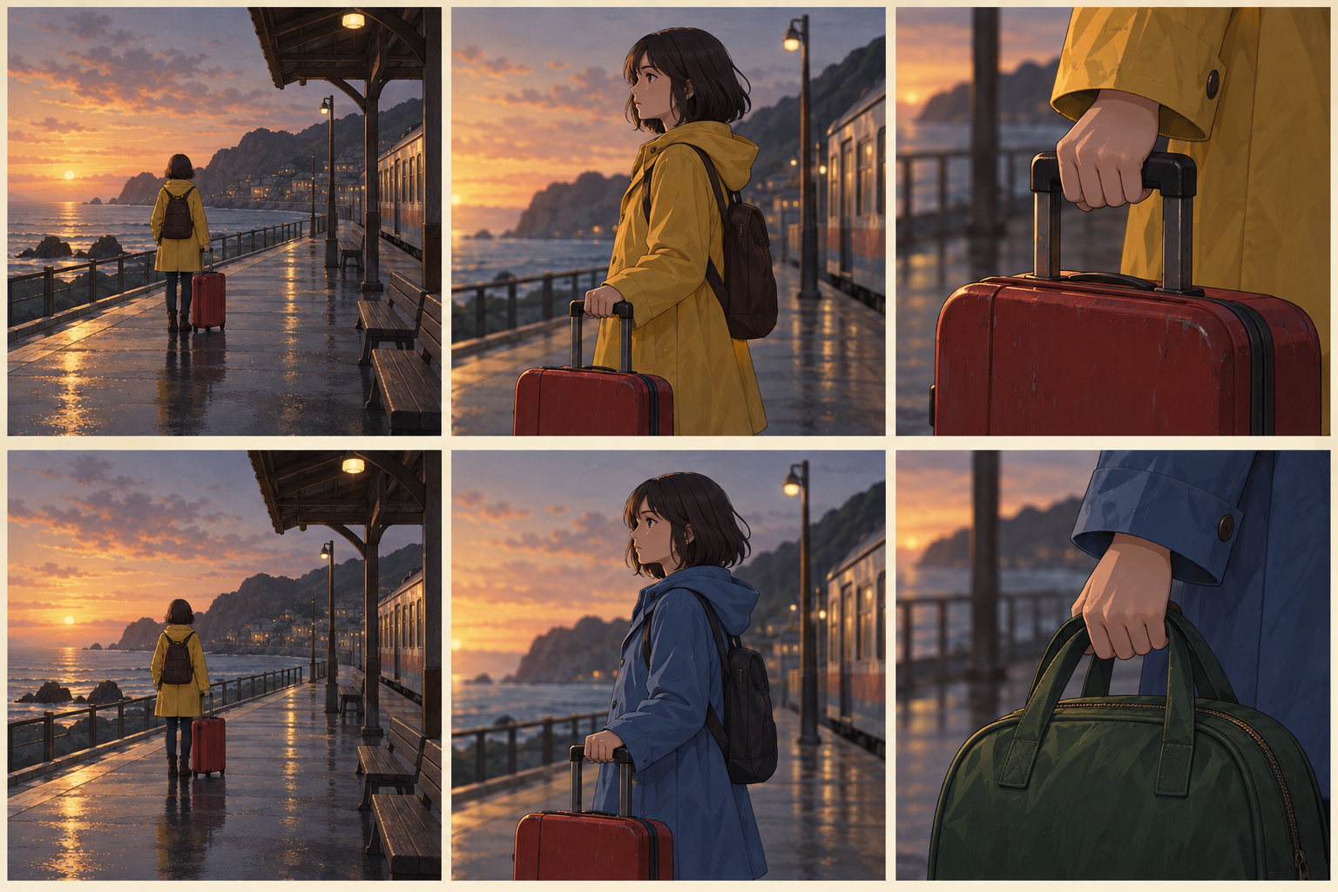
A video needs to stay consistent
Top: the coat and suitcase stay the same.
Bottom: the coat and bag change between shots.
Illustrated examples. These are not frames from a tested video model.
73 AMCC5160 / Lecture 03
Notes:
Timing: 53:08–54:02 (0.9043790987941612 minutes).
A video adds another problem: things need to remain consistent over time. In the top row, the coat and suitcase keep their appearance across shots.
In the bottom row, they change. Each frame could look acceptable on its own, but together they break the scene.
Video models can use information across frames.
Even so, you still need to watch for disappearing objects, changing faces, or walls that bend during a camera move.
These rows are illustrations of those problems. They aren’t test results from a particular video model.
The question is what we would check when watching a real output.
Temporal consistency has several meanings. Object identity concerns whether the same person or prop stays recognizable. Geometric consistency concerns whether surfaces keep their shape and position. Motion consistency concerns how positions change between frames. A model can succeed at one and fail at another. For example, a face can remain recognizable while the wall behind it bends. Separating those errors makes a video comparison more informative than a single realism score.
Background and sources:
CMU Lecture 25 discusses spatial-temporal attention and video diffusion. Give concrete failures: a jacket changes color, an object disappears, or a camera move bends a wall. Generating frames independently does not enforce consistency. Video models can attend across time, but their mechanisms do not guarantee physically correct motion or persistent identity.
CMU Generative AI, Spring 2026, Lecture 25: Video Generation, PDF pp. 7–12. https://www.cs.cmu.edu/~mgormley/courses/10423/slides/lecture25-video.pdf
Ho et al. (2022), Video Diffusion Models. https://arxiv.org/abs/2204.03458
Original classroom illustrations generated with the built-in image-generation tool. Diagrams are simplified explanations. Image comparisons illustrate possible choices and are not measurements of particular seed, strength, or model settings.

Slide 74
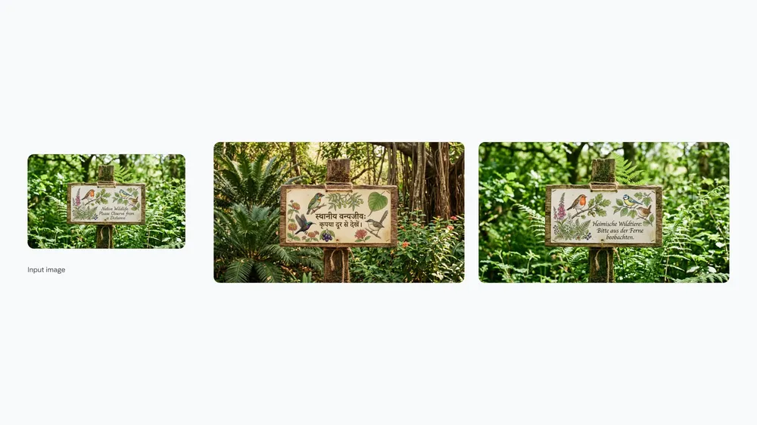
2026: Text inside pictures
Nano Banana 2 can place and translate words in an image.
Design use: try a poster in another language.
Check every word and the spacing.
Google demonstration • Nano Banana 2 • 26 February 2026
74 AMCC5160 / Lecture 03
Notes:
Timing: 54:02–54:54 (0.8779352654960864 minutes).
Let’s look at some examples from 2026. Google’s Nano Banana 2 includes image text and translation features.
This published example shows a sign being changed for another language. For a designer, that could help when trying different poster versions.
But changing the language can also change the length of the text, the line breaks, and how the page feels.
So I would check more than whether letters appeared. I’d read every word, check the meaning, and look at the spacing.
In a station scene, the same issue applies to signs, tickets, and notices.
Typography has both language requirements and visual requirements. A sign can spell the words correctly but use poor spacing. It can also look balanced while changing an important word. For a poster, separate text accuracy, line breaks, alignment, and hierarchy. Generating lettering inside an image can help develop a concept. For a final layout that needs exact wording, editable text remains useful because a correction does not require generating the entire image again.
Background and sources:
Google reports improved text rendering and translation. The image is its published wildlife-sign example, not a result we generated or independently tested. Ask students whether translated words also require changes to layout. For our station scene, a possible use is a sign in a second language. Readability still needs human review.
Google, Nano Banana 2, 26 February 2026. https://blog.google/innovation-and-ai/technology/ai/nano-banana-2/ — Official announcement and demonstration images. Capabilities are developer reports, not an independent class test.

Slide 75
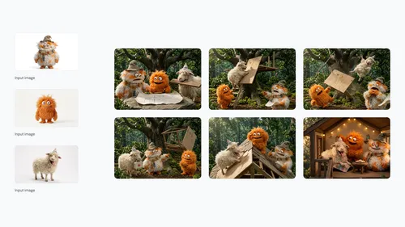
2026: Keeping characters recognizable
Nano Banana 2 supports character consistency across images.
Design use: build a short storyboard.
Check faces, clothes, and props in every shot.
Google demonstration • Nano Banana 2 • 26 February 2026
75 AMCC5160 / Lecture 03
Notes:
Timing: 54:54–55:47 (0.8779352654960864 minutes).
Another useful development is keeping characters recognizable across a sequence. This is Google’s published storyboard example.
Look at the recurring characters as their poses and positions change. That’s closer to what we need for a story than making one attractive image.
We need enough variation for different shots while keeping the character recognizable.
For the character, I’d compare the shape of the coat, the hair, and the suitcase. Google reports improved consistency, but we should still inspect each shot.
A character can look similar at first glance while a small change becomes distracting when we cut between images.
Subject consistency is also different from pixel identity. A character viewed from behind should not have the same pixels as a front view. The goal is to preserve the features that identify the subject while allowing a physically and visually plausible change of view. In a storyboard, compare costume construction, body proportions, and prop ownership. A repeated face alone is not enough to make the whole sequence continuous.
Background and sources:
The source shows a sequence with fluffy characters building a treehouse. Google reports stronger subject consistency; this does not promise identical details in every output. For our traveler, compare the coat shape and red suitcase across wide shots and close-ups. Character consistency and speed are separate properties; faster iteration lets us test more alternatives, but does not by itself prove better results.
Google, Nano Banana 2, 26 February 2026. https://blog.google/innovation-and-ai/technology/ai/nano-banana-2/ — Official announcement and demonstration images. Capabilities are developer reports, not an independent class test.

Slide 76
September 2026: GPT Image 2.5
Sunburst
Flare
OpenAI’s most capable image model.
Designed for faster everyday image work.
Image generation and editing.
Image generation and editing.
8 September 2026 snapshots • Compare the same task and references.
76 AMCC5160 / Lecture 03
Notes:
Timing: 55:47–56:31 (0.724561032367252 minutes).
The official OpenAI documentation lists September eighth, twenty twenty-six snapshots of GPT Image two point five Sunburst and Flare. Sunburst is described as the most capable image model, while Flare is aimed at faster everyday image work. Both are image generation and editing models.
For a design comparison, use the same task and reference images. A product label about capability does not tell us whether it will preserve a particular logo, maintain a character across shots, or reproduce exact lettering in our layout. Those require output-level checks.
Speed also matters differently at different stages. Fast alternatives can help during composition selection. A slower result may be worthwhile for a demanding final edit, but only if the difference is visible and useful. The public model descriptions do not establish an independent ranking or reveal every internal architectural choice.
Background and sources:
The official OpenAI model pages list the September 8 snapshots and distinguish most-capable Sunburst from fastest everyday Flare. These are product descriptions. They do not establish an independent quality ranking, the exact private architecture, or availability in a specific account. In an art workflow, compare typography, edit preservation and iteration time on the same inputs.
OpenAI official model pages, GPT Image 2.5 Sunburst and Flare; dated snapshots 8 September 2026. https://developers.openai.com/api/docs/models/gpt-image-2.5-sunburst and https://developers.openai.com/api/docs/models/gpt-image-2.5-flare — Developer descriptions of capability and speed, not an independent ranking.

Slide 77
2026: Give the video model examples
What changed
For our station scene
Seedance 2.0 accepts text, pictures, sound, and video as inputs.
Use a character picture and a camera-movement clip.
It can generate short video with sound.
Check whether the movement fits the story.
A reference can show a movement that is hard to describe in words.
77 AMCC5160 / Lecture 03
Notes:
Timing: 56:31–57:23 (0.8726464988364714 minutes).
Video tools are also accepting more kinds of reference. Seedance 2.0, announced in February 2026, can use text, images, sound, and video as inputs.
It can generate short video with sound.
Suppose we like the traveler’s appearance in one picture, and we have a separate clip showing the camera movement we want.
Those references communicate different parts of the scene. This could be useful when movement is difficult to describe in words.
We would still need to check the result. Did it follow the movement, and did that movement create the feeling we wanted?
Different references specify different variables. A character image can describe appearance. A motion clip can describe timing and camera behavior. Audio can describe rhythm or an event sequence. Combining references is useful when these roles are clear. Conflicting references still need a decision: a slow camera reference and a rapid musical beat may suggest different editing choices. The model cannot determine the intended relationship from the existence of the files alone.
Background and sources:
Seedance 2.0 was announced on 12 February 2026. Its release supports mixed text, image, audio and video references and up to 15-second multi-shot audiovisual output. These are developer-reported capabilities. The proposed station example is a classroom application, not a demonstrated output. A reference does not guarantee precise copying of timing or camera motion. Do not infer present access in a particular country from the launch announcement.
ByteDance Seed, Seedance 2.0 Official Launch, 12 February 2026. https://seed.bytedance.com/en/blog/seedance-2-0-official-launch — Official release description.

Slide 78
2026: Edit a video by describing a change
What changed
For our station scene
Gemini Omni Flash supports video editing with words.
“Keep the traveler. Make the station lights warmer.”
Examples include changing lighting or replacing an object.
Check what changed in the background too.
Review the whole clip after an edit, including its sound.
78 AMCC5160 / Lecture 03
Notes:
Timing: 57:23–58:17 (0.8938015654749313 minutes).
Another change is being able to describe an edit to an existing video. Google introduced Gemini Omni Flash in public preview in June 2026.
Its examples include changing lighting and replacing objects through spoken or written instructions. For this image, we might say, “Keep the traveler.
Make the station lights warmer.” Then we need to watch the whole result. Did the face change? Did an object disappear? Did the sound stay right?
An edit that works in one frame may cause problems elsewhere.
Also, available controls can differ between a demonstration and the version of a tool you can access.
Video editing introduces a preservation problem. The request specifies what should change, but the rest of the clip also matters. Relighting should be checked across moving surfaces and shadows, not only at the first frame. Object replacement should preserve occlusion when something passes in front of it. These are concrete tests of edit behavior. They are more useful than assuming that a fluent natural-language instruction guarantees a localized change.
Background and sources:
Google Cloud announced Gemini Omni Flash in public preview on 30 June 2026. The post describes conversational edits such as relighting and object swaps, as well as audiovisual output. It also states that some reference and extension controls would come later through that API. The station instruction is a suggested exercise, not a verified model result. Avoid presenting all platform features as universally available.
Google Cloud, Gemini Omni Flash and Nano Banana 2 Lite, 30 June 2026. https://cloud.google.com/blog/products/ai-machine-learning/nano-banana-2-lite-and-gemini-omni-flash-available — Omni Flash entered public preview; some API controls were listed as forthcoming.

Slide 79
Video review: frame, motion, sound
Pass | A concrete test
Individual frames | Count objects and inspect faces and lettering
Motion across frames | Track the suitcase; check walls during camera motion
Sound with picture | Compare footsteps, door motion, and sound onset
At the cut | Check screen direction and prop position
A convincing frame is only one part of a convincing sequence.
79 AMCC5160 / Lecture 03
Notes:
Timing: 58:17–59:13 (0.9361116987518511 minutes).
Video quality needs tests at more than one timescale. At the frame level, inspect object count, anatomy, lettering, and composition. These are similar to still-image checks. At the sequence level, inspect whether objects persist and whether their motion remains continuous.
Camera motion is a useful stress test for geometry. A wall can look plausible in one frame and bend as the viewpoint changes. Occlusion is another test: an object passing behind a foreground shape should reappear with a consistent identity and position.
Sound adds event timing. A visible impact and its sound should have a deliberate relationship. Dialogue needs a relationship between speech timing and mouth movement. The goal is not simply to have an audio track, but to make the audiovisual events agree with the intended scene.
At an edit, screen direction and prop position affect continuity. An object moving to the right in one shot and left in the next can imply a reversal. That may be intentional, but it should be a choice supported by the spatial setup rather than an accidental generation change.
Background and sources:
This is a proposed review method for generated video. Screen direction and continuity are editing conventions that can be intentionally broken, but accidental reversal can confuse spatial relations. Separate per-frame quality from temporal consistency and audiovisual synchronization.
Ho et al. (2022), Video Diffusion Models. https://arxiv.org/abs/2204.03458
Stanford CS178, Composition, Marc Levoy, Spring 2009. https://graphics.stanford.edu/courses/cs178-09/lectures/composition-07may09.pdf — Composition, figure/background and visual organization. These art principles are established background, not 2026 advances.

Slide 80
2026: Video, sound, and keyframe control
FLUX 3 Video: up to 20 seconds with native audio.
Keyframes can specify important moments.
Check motion, dialogue timing, and continuity.
Initial video release: 4 August 2026 • BFL developer report
80 AMCC5160 / Lecture 03
Notes:
Timing: 59:13–59:57 (0.7404273323460969 minutes).
FLUX 3 illustrates the move from separate image and sound generation toward joint audiovisual generation. Black Forest Labs released an initial version of FLUX 3 Video on August fourth, twenty twenty-six. Its announcement describes clips up to twenty seconds with audio, image inputs, keyframes, and continuation.
Keyframes specify important visible moments, while the model generates the transition between them. They can provide more concrete temporal control than a style adjective. They still leave intermediate motion to be generated, so a correct first and last frame do not establish that the movement between them is correct.
The same company's August upscaling announcement provides another useful example of a tradeoff: a more creative repair mode can change identity. Higher resolution and stronger reconstruction are therefore separate choices from preservation. These are developer descriptions; an independent comparison needs matched inputs and recorded outputs.
Background and sources:
Update from the July early-access announcement: the August 4 official release describes an initial generally available video version. It supports text/image generation, keyframes and continuation; 1080p output uses upscaling. Do not confuse all research capabilities of FLUX 3 with the controls in one released API.
Black Forest Labs, FLUX 3 Video, 4 August 2026. https://bfl.ai/blog/flux-3-video — General availability of an initial video-generation version, up to 20 seconds, native audio and keyframe inputs. Developer-reported capabilities.
Black Forest Labs, FLUX 3 x mimic, 23 July 2026. https://bfl.ai/blog/flux-3-mimic — Official description of joint image, video, and audio training and a robot-control adaptation.

Slide 81
GPT-6 Astra: Help build an interactive scene
What it can help with
Try it for our station scene
Works with text and image inputs.
Build a scene that responds to a visitor.
Can write code and use tools across several steps.
Review the result, then ask for a specific change.
Describe → build with tools → inspect → revise
81 AMCC5160 / Lecture 03
Notes:
Timing: 59:57–60:40 (0.713983499048022 minutes).
OpenAI's GPT-six Astra is a general assistant model for reasoning, coding, and work with tools. It can accept text and image inputs. In a design workflow, the relevant example is building an interactive artifact from a specification, then inspecting and revising the result.
An assistant might write the code for a light transition, inspect a screenshot, and change the timing after feedback. The image-generation tool used within that workflow can be a separate model. It is useful to distinguish the assistant that coordinates the work from the specialized tool that produces an image.
This is also different from a world model predicting the next view, or a VLA producing robot commands. Those systems have different outputs and different tests. The next example makes the assistant's role concrete by turning an interaction request into observable behavior.
Background and sources:
This slide is about OpenAI GPT-6 Astra, the Astra the user means in ChatGPT. The official model page describes reasoning, coding, computer use, research and document creation. It accepts text and image inputs and supports tools including image generation. Distinguish model input and output from what connected tools can do. The station scene is a proposed design exercise, not a tested result. An assistant can help implement an interactive scene through code and tools. The world model on the next slides predicts future views; a VLA produces robot actions.
OpenAI, GPT-6 Astra model documentation, accessed 15 September 2026. https://developers.openai.com/api/docs/models/gpt-6-astra — Text and image inputs; reasoning, coding and tool use. Design example below is a proposed classroom application.

Slide 82
Astra: turn a design instruction into a test
Describe the behavior
Check the built result
“Click the suitcase to fade the lights in two seconds.”
Does one click start one fade?
“Keep the traveler and the camera fixed.”
Do repeated clicks leave the scene in a clear state?
Use code and tools to build, run, inspect, and revise the interaction.
82 AMCC5160 / Lecture 03
Notes:
Timing: 60:40–61:34 (0.9043790987941612 minutes).
An interaction can be specified as an input, a state change, and an output over time. Here the input is a click on a prop. The intended output is a light fade lasting two seconds. The camera and character should remain fixed while that change occurs.
Astra can help write and revise the code for that behavior using tools. The important test is the built artifact. Does one click start one transition? Does the final light level match the instruction? Does a second click restart the transition, reverse it, or do nothing?
Those alternatives are design decisions about state. They should be stated explicitly. Otherwise, a generated implementation can look correct in a screenshot while behaving unpredictably during repeated use. A static image cannot show all the states of an interaction.
The assistant's role is to help construct and inspect the implementation. The test still needs observable input and output. This separates a convincing explanation of an interaction from a working interaction, and connects language-based assistance to a concrete design workflow.
Background and sources:
This is a proposed use of OpenAI GPT-6 Astra for coding and tool-assisted work. The click interaction is not an evaluated output. Define input, state, output and timing. Passing one visual check does not demonstrate all interaction paths. Do not describe the assistant as a world model or a robot controller.
OpenAI, GPT-6 Astra model documentation, accessed 15 September 2026. https://developers.openai.com/api/docs/models/gpt-6-astra — Text and image inputs; reasoning, coding and tool use. Design example below is a proposed classroom application.

Slide 83
World models: what is being predicted?
Representation | Example output
State | Next position or a learned numerical state
Pixels | Next video frames conditioned on actions
3D scene | A scene representation that can be rendered
Action condition | The proposed movement affects the prediction
The representation determines which questions the model can answer.
83 AMCC5160 / Lecture 03
Notes:
Timing: 61:34–62:18 (0.735138565686482 minutes).
A world model predicts how an environment changes, often conditioned on an action. The representation can differ. One model predicts a compact state, another generates future video, and another works with an explicit three-dimensional scene that can be rendered from different viewpoints.
CMU's world-model lecture separates these approaches because they support different operations. A learned latent state can be useful for control without producing a picture. An interactive video model produces visible views but may not expose editable three-dimensional geometry. A scene representation can support rendering, while its physical behavior still needs a model.
The term world model therefore does not name one fixed architecture. The practical question is what state it represents, what action it accepts, and what it predicts. A plausible image is evidence about appearance, not automatically evidence of accurate distance, dynamics, or a persistent environment.
Background and sources:
CMU Lecture 26 distinguishes generated 3D scenes, interactive video and latent world representations. The first row combines explicit and learned states as a broad category. These are representations, not a claim that all world models implement the same algorithm. Accuracy must be tested for the intended prediction and action range.
CMU 10-423/623/723, Lecture 26: World Models, Spring 2026. https://www.cs.cmu.edu/~mgormley/courses/10423/slides/lecture26-world-models.pdf — Learned environment prediction and actions.
Ha and Schmidhuber, World Models, 2018. https://arxiv.org/abs/1803.10122 — A learned predictive representation can support a controller. A world model and a controller have different roles.

Slide 84
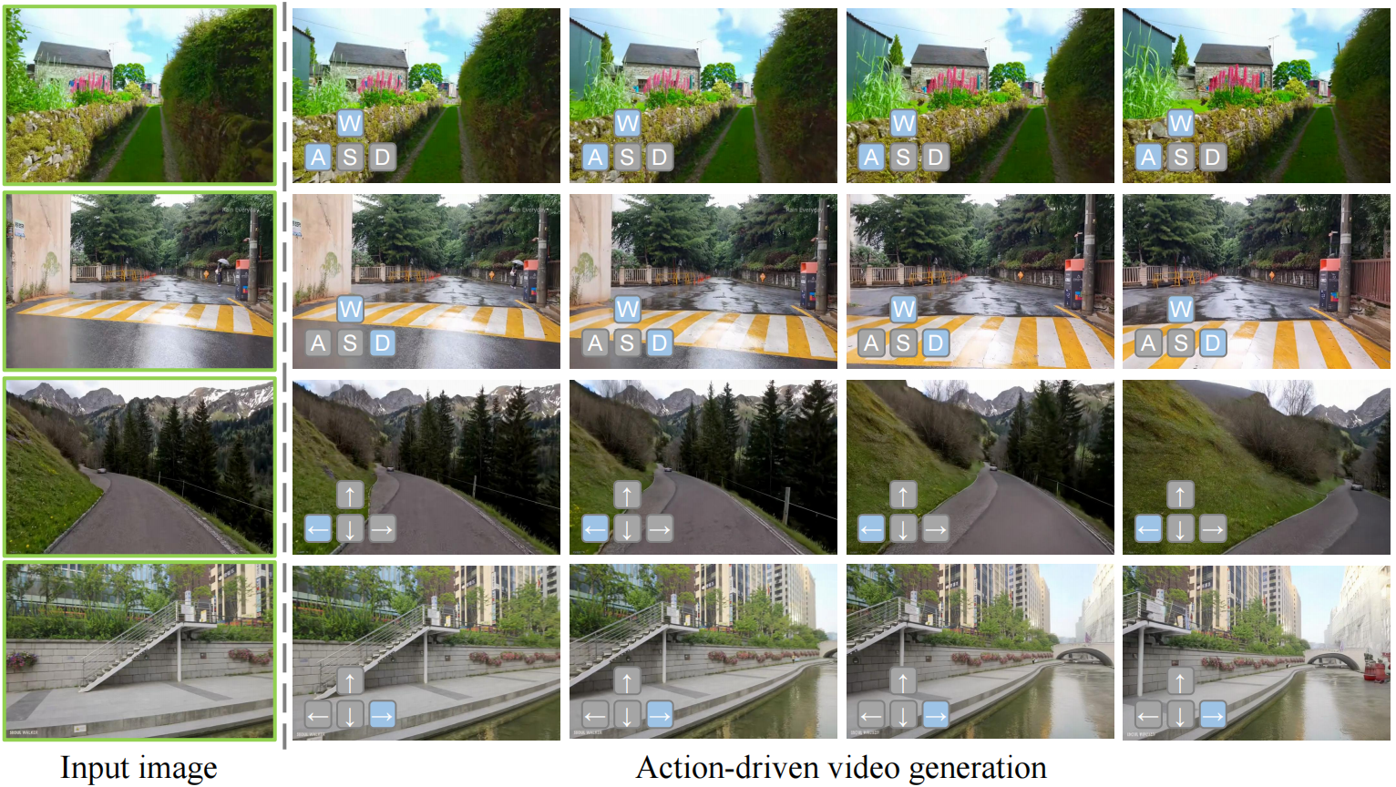
Astra: A picture that responds to movement
Give it a starting image and movement controls.
It predicts the next part of the video.
Astra authors’ examples • ICLR 2026 • Preprint: December 2025
84 AMCC5160 / Lecture 03
Notes:
Timing: 62:18–63:15 (0.946689232071081 minutes).
This Astra is the world-model research project presented at ICLR 2026. Its first preprint appeared in December 2025. It’s separate from OpenAI’s GPT-6 Astra.
Look at the green-bordered pictures on the left. Those are starting images. The later columns show generated views, with movement controls marked on them.
The model uses earlier observations and action inputs to predict the next part of the video.
That connects to our earlier discussion of conditions: now a movement command helps guide generation. For an interactive scene, we care about both response and consistency.
Does the view change when we ask, and does the place still make sense afterward?
An action-conditioned video model receives information about intended movement, along with earlier observations. That input changes the prediction task: it must produce a plausible continuation that also responds to the action. A prerecorded video only needs to play its next frame. An interactive model must handle different possible actions from the same current view. Evaluation therefore needs response tests as well as visual tests, including repeated actions and movement back toward an earlier view.
Background and sources:
This is the Astra research project from Tsinghua University and Kuaishou Technology, separate from OpenAI GPT-6 Astra. The green-bordered images are starting views; later columns are generated frames with movement controls. The method generates video in short chunks using earlier observations and action signals. An action adapter feeds controls into denoising. This connects to our earlier diffusion explanation: action is another condition. The authors study camera movement, driving and manipulation. These shown samples do not prove perfect long-term geometry or universal physical accuracy.
Zhu et al., Astra: General Interactive World Model with Autoregressive Denoising, ICLR 2026; preprint first posted December 2025. https://proceedings.iclr.cc/paper_files/paper/2026/hash/7fc516909e0b90c96bcc75a16ebee6a2-Abstract-Conference.html — Figure and demonstrations: https://eternalevan.github.io/Astra-project/

Slide 85
World models: test a round trip
Action | What should remain consistent?
Enter a doorway | Opening size and wall position
Turn to look away | Objects outside the view still matter
Turn back | The doorway returns in the same place
Leave the room | The route agrees with the starting scene
A plausible next frame can still lead to an inconsistent place.
85 AMCC5160 / Lecture 03
Notes:
Timing: 63:15–64:09 (0.8938015654749313 minutes).
A round trip tests whether a generated environment stays consistent over time. Begin outside a doorway, enter, turn away, turn back, and leave again. The sequence revisits earlier geometry rather than continually generating new views that never need to agree with the past.
A model can generate a plausible next frame while gradually changing the doorway's size or location. If its own generated frames become later inputs, small errors can accumulate. Short-term realism and long-term consistency are therefore different evaluation targets.
Object persistence is related. A chair that moves outside the camera view should not automatically cease to exist. Turning back provides a test of what the model retains. An explicit three-dimensional scene, a video history, and a learned hidden state can support persistence in different ways.
This test does not establish all aspects of physics. It specifically checks spatial and temporal agreement under a short sequence of actions. Additional tests would be needed for contact, material behavior, or control accuracy. The test should match the capability being claimed.
Background and sources:
A proposed test of long-horizon spatial consistency and object persistence, not a reported result from the Astra paper. Predicting a plausible next observation does not imply a globally consistent geometry. Errors can accumulate when generated observations become input to later predictions.
CMU 10-423/623/723, Lecture 26: World Models, Spring 2026. https://www.cs.cmu.edu/~mgormley/courses/10423/slides/lecture26-world-models.pdf — Learned environment prediction and actions.
Zhu et al., Astra: General Interactive World Model with Autoregressive Denoising, ICLR 2026; preprint first posted December 2025. https://proceedings.iclr.cc/paper_files/paper/2026/hash/7fc516909e0b90c96bcc75a16ebee6a2-Abstract-Conference.html — Figure and demonstrations: https://eternalevan.github.io/Astra-project/

Slide 86
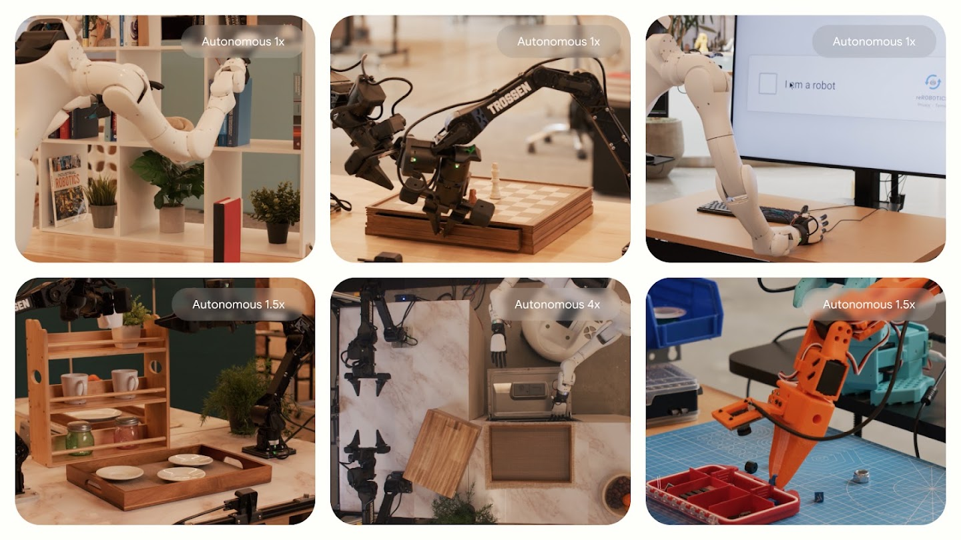
VLA: See the scene, read the task, act
Vision + language → robot actions.
Gemini Robotics 2 adds whole-body control.
Google DeepMind examples • Gemini Robotics 2 • 30 July 2026
86 AMCC5160 / Lecture 03
Notes:
Timing: 64:09–65:03 (0.8990903321345463 minutes).
VLA stands for vision-language-action. The model receives visual information and an instruction, often along with information about the robot’s current position.
It produces actions for the robot, such as moving an arm or closing a gripper. Gemini Robotics 2, announced in July 2026, is one example.
It includes whole-body control, so movement can involve more than an arm at a table.
For an installation, we might imagine a robot moving props as visitors interact. That would require a complete working system.
The model’s action output is one part; observing the result and dealing with mistakes also matter.
Robot actions can be represented in several ways, such as joint targets, end-effector movement, or a sequence of future controls. The model's output must match the robot interface. A language instruction saying pick up the cup is much less specific than those low-level actions. A complete system needs observations, a policy, motor execution, and updated feedback. The VLA is the learned link between visual-language information and the action representation used by that system.
Background and sources:
VLA means vision-language-action. A camera observation and a language instruction, often with robot-state information, are mapped to actions such as gripper or joint movements. Gemini Robotics 2 is a 2026 example. It should not be confused with Robotics ER 2, which supports higher-level reasoning and planning. Design example: a robot arranges props for a changing installation; this is our proposed application, not a tested feature. A complete system observes again after movement and handles errors. The official examples include clips shown at different playback speeds, labeled in the figure.
Google DeepMind, Gemini Robotics 2, 30 July 2026. https://deepmind.google/blog/gemini-robotics-2-brings-whole-body-intelligence-to-robots/ — VLA and on-device models were offered to early-access partners. ER 2 is a separate vision-language reasoning model.

Slide 87
Robot actions need a coordinate system
What the camera sees
What the robot must do
The prop appears 40 pixels left of center.
Move relative to a defined robot or world frame.
The image alone does not specify a distance in meters.
Observe again after the movement.
“Move left” needs a viewpoint, a distance, and a stopping condition.
87 AMCC5160 / Lecture 03
Notes:
Timing: 65:03–66:01 (0.9678442987095409 minutes).
An image location and a robot movement use different coordinate systems. A prop appearing forty pixels left of the image center does not directly specify how many centimeters a robot hand should move. The relationship depends on camera geometry, depth, and the robot's current configuration.
A command also needs a reference frame. Left can mean the camera's left, the robot's left, or a direction in the workspace. A movement can be expressed as a change in joint angles or as a target for the end effector. The controller must interpret the representation correctly.
A VLA learns a mapping from observations and language into actions, often with robot-state information. The surrounding system still determines which action representation is used and how the motor commands are executed. A model that predicts the right-looking motion is not by itself a calibrated physical installation.
After movement, new observations close the feedback loop. For a prop-handling installation, the stopping condition might be reaching a marked location or achieving a stable grasp. Defining the frame, distance, feedback, and stop condition turns a vague movement request into a testable task.
Background and sources:
The 40-pixel value is an invented teaching example. Camera coordinates, robot coordinates and world coordinates differ. Calibration, depth or a learned mapping and robot state may help connect perception to actions. This is background for understanding VLA deployment, not an assertion that all VLAs explicitly compute metric geometry.
CMU 10-423/623/723, Lecture 26: World Models, Spring 2026. https://www.cs.cmu.edu/~mgormley/courses/10423/slides/lecture26-world-models.pdf — Learned environment prediction and actions.
Google DeepMind, Gemini Robotics 2, 30 July 2026. https://deepmind.google/blog/gemini-robotics-2-brings-whole-body-intelligence-to-robots/ — VLA and on-device models were offered to early-access partners. ER 2 is a separate vision-language reasoning model.

Slide 88
Predicting an action’s result and taking action
System | In an interactive exhibition
Assistant | Helps write code for an interactive scene
World model | Predicts what a proposed movement might look like
VLA | Produces commands to move a real object
Combined system | May compare predictions, act, then observe again
A VLA does not have to contain a separate world model.
88 AMCC5160 / Lecture 03
Notes:
Timing: 66:01–66:44 (0.719272265707637 minutes).
These systems have different jobs. An assistant might write code for the suitcase interaction. A world model might predict what would happen if it moved.
A VLA might produce commands to move a real suitcase. A system could combine those jobs, then look again after acting.
But a VLA doesn’t necessarily contain a separate world model. And generating a video of an action doesn’t mean a robot has actually performed it.
A planner may ask a world model to predict several candidate outcomes before choosing an action. That is one possible arrangement. Another policy can map observations directly to action commands without generating future images. Neither architecture is proved by watching a successful demonstration. We need a system description to know which components are present, and a task test to know whether their combination works reliably.
Background and sources:
This is a conceptual comparison, not a diagram of one existing product. A planner can use a predictive model to compare possible actions. A controller or VLA can execute actions, followed by new observations. Other VLAs map observations and instructions to actions without explicitly generating future images. A realistic predicted video is not evidence that a physical robot completed the action.
OpenAI, GPT-6 Astra model documentation, accessed 15 September 2026. https://developers.openai.com/api/docs/models/gpt-6-astra — Text and image inputs; reasoning, coding and tool use. Design example below is a proposed classroom application.
Ha and Schmidhuber, World Models, 2018. https://arxiv.org/abs/1803.10122 — A learned predictive representation can support a controller. A world model and a controller have different roles.
Google DeepMind, Gemini Robotics 2, 30 July 2026. https://deepmind.google/blog/gemini-robotics-2-brings-whole-body-intelligence-to-robots/ — VLA and on-device models were offered to early-access partners. ER 2 is a separate vision-language reasoning model.

Slide 89
Discussion: Design an experience that responds
Imagine a visitor moves the red suitcase in our station scene.
Should the system explain, predict a new scene, or move a real prop?
What should happen if it misunderstands the visitor?
60 seconds • Choose one response and explain how the visitor controls it.
89 AMCC5160 / Lecture 03
Notes:
Timing: 66:44–67:23 (0.6505182991326423 minutes).
Let’s turn that into a design choice. Imagine a visitor moves the red suitcase in a station scene. What should the experience do?
Explain something, generate a changed scene, or move a real prop? Choose one with your partner.
Say what the visitor does and what they should notice in response. Include what happens if the system misunderstands them.
For an installation, specify four things: the visitor input, the visible response, the response time, and the recovery behavior. A click that changes light is different from a camera movement that generates a new view, and both differ from moving a physical prop. The input and output determine which technology is needed. This is the point where interaction design becomes a concrete system requirement.
Background and sources:
Give pairs 30 seconds to choose a response and 30 seconds to explain it. Look for a clear input, a visible response, and a way for the visitor to correct or stop it. This is a design discussion. No robot or live model demonstration is required.
OpenAI, GPT-6 Astra model documentation, accessed 15 September 2026. https://developers.openai.com/api/docs/models/gpt-6-astra — Text and image inputs; reasoning, coding and tool use. Design example below is a proposed classroom application.
Zhu et al., Astra: General Interactive World Model with Autoregressive Denoising, ICLR 2026; preprint first posted December 2025. https://proceedings.iclr.cc/paper_files/paper/2026/hash/7fc516909e0b90c96bcc75a16ebee6a2-Abstract-Conference.html — Figure and demonstrations: https://eternalevan.github.io/Astra-project/
Google DeepMind, Gemini Robotics 2, 30 July 2026. https://deepmind.google/blog/gemini-robotics-2-brings-whole-body-intelligence-to-robots/ — VLA and on-device models were offered to early-access partners. ER 2 is a separate vision-language reasoning model.

Slide 90
Which setting might help?
What looks wrong? | What could you try?
The traveler is too large | Ask for a wider view or give a layout reference
The look changes between images | Use the same style reference and color instructions
The colors look too strong | Compare lower guidance values, if supported
The character keeps changing | Use character references and inspect each result
One small area looks wrong | Try a local edit and check the surrounding area
90 AMCC5160 / Lecture 03
Notes:
Timing: 67:23–68:10 (0.7880262322826317 minutes).
If the traveler is too large, try a wider-view instruction or a layout reference.
If the colors feel too strong, guidance may be worth testing where the model supports it.
If one small area is wrong, a local edit may be enough. These are starting points for a test. They aren’t guaranteed fixes.
Describe the visible problem first.
That makes it easier to choose a change that could actually address it, rather than changing everything and hoping the next image works.
The location of an error helps select a control. A wrong global viewpoint may call for a layout reference. A correct scene with one broken hand may call for a local region edit. A repeated style across a large collection may justify a trained adapter. These choices differ in scope and cost. Starting with the smallest relevant intervention makes it easier to preserve the parts that already work.
Background and sources:
Connect the art section back to the generator controls. This is a set of hypotheses to test, not guaranteed outcomes. Seeds are useful for exploring variations. Guidance changes conditional influence. References and adapters supply different kinds of information. Editing may be more efficient when one small region needs work. Separate a composition problem from a style problem before changing several settings together. Tool support varies, so use the mechanism available in the chosen pipeline.
Original AMCC5160 teaching brief and visual critique examples. Concept boards generated with the built-in image-generation tool on 15 September 2026. These are illustrative art-direction studies, not controlled tests of seeds, guidance, or model settings.
Ho & Salimans (2022), Classifier-Free Diffusion Guidance. https://arxiv.org/abs/2207.12598
Rombach et al. (2022), High-Resolution Image Synthesis with Latent Diffusion Models. https://arxiv.org/abs/2112.10752
Hu et al. (2022), LoRA: Low-Rank Adaptation of Large Language Models. https://arxiv.org/abs/2106.09685
Meng et al. (2022), SDEdit: Guided Image Synthesis and Editing with Stochastic Differential Equations. https://arxiv.org/abs/2108.01073

Slide 91
How to make a fair comparison
Part of the test | Example
Question | Does guidance change variety and subject clarity?
Keep fixed | Model, prompt, size, sampler, steps
Change | Guidance only
Repeat | Use the same set of seeds at each value
Judge | Subject clarity, appearance, and variety
91 AMCC5160 / Lecture 03
Notes:
Timing: 68:10–68:60 (0.8250475988999365 minutes).
Here is a simple comparison we could run. Our question is whether guidance changes subject clarity and variety.
We keep the model, prompt, size, sampler, and steps fixed. We try different guidance values using the same set of seeds at each value.
Then we judge the results using questions we chose beforehand. That last part matters.
If we decide what counts as success only after seeing the images, it’s easy to favor the result we happened to like.
A clear test helps us explain our choice to someone else.
Write the comparison as a small table before running it. The rows can be seeds and the columns guidance values. Every cell gets the same prompt and model. Record failures as well as successful images, because omitting failures changes what the grid represents. If image generation fails for a cell, mark it as missing and rerun that condition rather than silently replacing it with a different seed.
Background and sources:
Explain the logic of a paired design. Using corresponding random starts reduces one source of variation when comparing settings, but several starts are still necessary because a parameter can interact with initialization. Ask students to distinguish an observable criterion such as a visible object from a preference such as mysterious atmosphere. Both are legitimate, but they answer different questions. The next slide uses a published seeded comparison and works offline. Students need no account, GPU, or new generation credits.

Slide 92
Content, form, and variation
Question | Concrete evidence
Content | Correct count, objects, colors, and relations
Form | Silhouette, lightness, edges, and focal point
Variation | Different usable views across the matched seeds
Purpose | A clear poster and a dream sequence may differ
Describe one visible fact before giving a preference.
92 AMCC5160 / Lecture 03
Notes:
Timing: 68:60–69:39 (0.6558070657922572 minutes).
Image evaluation can separate content, form, variation, and purpose. Content includes object count, attributes, and relationships. These can often be checked directly against the request. A hand holding a cup is a different relation from a hand merely appearing near a cup.
Form concerns how the image is organized: silhouette, value structure, edge contrast, and the main focus. These properties connect technical output to art decisions. They can be described specifically even when people prefer different compositions.
Variation concerns the group rather than one image. A set can contain one attractive result and many nearly identical alternatives. Purpose determines which of those properties matter most. A clear instructional poster and an ambiguous dream sequence can reasonably favor different results without making the comparison meaningless.
Background and sources:
A classroom evaluation rubric, not an automatic quality metric. Count and relation checks answer task compliance. Formal analysis describes how shapes and tones organize the image. Diversity concerns a group of outputs rather than one favorite sample.
Ho & Salimans (2022), Classifier-Free Diffusion Guidance. https://arxiv.org/abs/2207.12598
Stanford CS178, Composition, Marc Levoy, Spring 2009. https://graphics.stanford.edu/courses/cs178-09/lectures/composition-07may09.pdf — Composition, figure/background and visual organization. These art principles are established background, not 2026 advances.

Slide 93
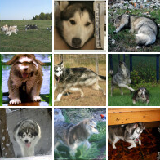
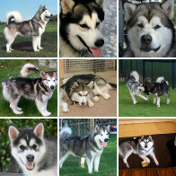
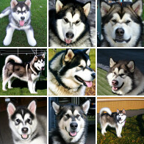
Discussion 4: Compare the pictures
No extra guidance: w = 0
Guidance: w = 1
Guidance: w = 3
Matched details from Ho & Salimans, Figure 6. ImageNet 64 × 64, malamute class, shared random seed.
Which pictures would you choose for a clear introduction? For a strange dream?
93 AMCC5160 / Lecture 03
Notes:
Timing: 69:39–70:29 (0.8250475988999365 minutes).
We’ll spend six minutes on these grids. They come from a published study of guidance using dog images.
This was generation from a category label, rather than a written prompt. Corresponding positions use matched seeds, so compare the same position across the groups.
First, look silently. Then choose two corresponding sets and write down what changes. Look at recognizable features, unwanted details, and variety within each group.
Finally, choose a group for a particular use. Would your choice change for a clear introduction compared with a strange dream scene?
The task is to make a defensible comparison, not to guess the setting with the biggest number. Select corresponding positions, describe shape and color changes, and then inspect variation across each group. A picture can become more recognizable while losing unusual but useful alternatives. That tradeoff is central to generative design: the setting that helps one final image may not be the best setting for exploring possibilities.
Background and sources:
Six-minute exercise using published paired dog grids from the classifier-free guidance paper. The displayed details show the same seed positions at original paper weights w=0,1,3, corresponding to s=1,2,4 in our formula. Minute 1: inspect silently. Minutes 2–3: compare corresponding cells across settings and record two observations. Minutes 4–5: compare prompt accuracy, visual quality and within-grid variety. Minute 6: each pair states a preferred setting for one explicit scene goal and one limitation of the evidence. The task is class-conditional dog generation, not a text-prompt benchmark. No live generation or paid tool is needed.
Ho & Salimans (2022), Classifier-Free Diffusion Guidance. https://arxiv.org/abs/2207.12598

Slide 94
Reading a guidance grid
Compare across a row
Compare within a column
Same seed: follow changes in the face and outline.
Different seeds: compare pose and composition.
Mark colors or edges that become exaggerated.
Record repeated patterns and usable variation.
A row isolates settings; a column shows variation across seeds.
94 AMCC5160 / Lecture 03
Notes:
Timing: 70:29–71:10 (0.6822508990903321 minutes).
A controlled grid supports two kinds of reading. Across guidance conditions, follow the same seed and describe what changes. Within one guidance condition, compare different seeds and describe the range of outputs. The first comparison focuses on the setting; the second focuses on variation.
For a face, useful observations include outline, eye placement, texture, and exaggerated edges. For a full scene, include camera distance, figure size, and repeated layout patterns. Record what is visible rather than assuming that a stronger setting improved every property.
A grid is strongest when its labels make the comparison unambiguous. Keep model, prompt, and sampling settings beside it. If images have been selected or cropped, state that too. Otherwise, the display can appear more controlled or more diverse than the underlying experiment really was.
Background and sources:
For the displayed controlled grid, compare corresponding seed positions across guidance conditions. Here row and column are a reading strategy for organizing a new experiment; the source figure has grouped image blocks. Avoid presenting visual differences as a universal monotonic law. Discuss the actual marked examples.
Ho & Salimans (2022), Classifier-Free Diffusion Guidance. https://arxiv.org/abs/2207.12598

Slide 95
Discussion 5: Choose a look for our scene
30 sec: choose a camera view and drawing style for our scene.
60 sec: explain your choice using two details in the pictures.
30 sec: name one change you would try next.
95 AMCC5160 / Lecture 03
Notes:
Timing: 71:10–71:54 (0.735138565686482 minutes).
For this last discussion, choose a camera view and a drawing style for a station scene.
Think back to the wide and close views, and the paper, paint, and ink examples. Take thirty seconds to choose.
Then explain your choice to your partner using two details you can point to in the pictures. Finish by naming one change you would try next.
Keep the change specific enough that you could recognize whether it worked.
Use a formal reason for the choice. A low camera position can increase the apparent scale of a nearby figure. A diagonal edge can connect two regions or create tension. A large quiet area can reserve space for text. These are specific compositional effects. A style label such as cinematic is less useful unless it is translated into decisions about camera, light, color, or editing.
Background and sources:
Keep this a two-minute discussion rather than a generation task. Students refer back to the composition and style boards. Use thirty seconds for a silent choice, sixty seconds for a paired explanation, and thirty seconds for a proposed revision. Several answers can be defensible. For example, a wide view may emphasize uncertainty, while a medium view may make a subtle expression readable. Require evidence about space, value, edge, or posture. Ask whether the revision is local enough to test without changing every aspect of the image.
Original AMCC5160 teaching brief and visual critique examples. Concept boards generated with the built-in image-generation tool on 15 September 2026. These are illustrative art-direction studies, not controlled tests of seeds, guidance, or model settings.

Slide 96
Three questions before we finish
Why can the same prompt give different pictures?
Why might stronger guidance make the picture worse?
What would you save so you can repeat a result?
96 AMCC5160 / Lecture 03
Notes:
Timing: 71:54–72:32 (0.6346519991537973 minutes).
Before we finish, write a short answer to each of these questions. Why can the same prompt give different pictures?
Why might stronger guidance make a picture worse? And what would you save so you could try to repeat a result? Use your own words.
You don’t need an equation. If it helps, explain each answer using the character and station.
A complete answer should name a mechanism and its consequence. For seed, name the changed random state and the resulting variation. For guidance, name the combined predictions and the risk of exaggeration. For reproducibility, name the inputs and model settings that must be recorded. This is a short check that the terms connect to something the system actually does.
Background and sources:
Ask students to write a short answer to each question. Focus on the source of variation, the possible side effects of stronger guidance, and the settings needed to repeat a result. Show the suggested answers on the next slide.

Slide 97
Suggested answers
Different random starting states can lead to different pictures.
Strong guidance can reduce variety or create harsh colors and other problems.
Save the model, prompt, references, seed, and generation settings.
97 AMCC5160 / Lecture 03
Notes:
Timing: 72:32–73:23 (0.8462026655383964 minutes).
Here are the main answers. Different random starting states can lead to different pictures, even with the same prompt.
Depending on the sampler, randomness can also enter later. Stronger guidance pushes harder along the difference between predictions.
That may make the subject clearer, but it can also create unwanted colors or details and reduce variety.
To repeat a result, save the full setup: the model, prompt, references, seed, and generation settings. Include any adapters.
Exact matching can still depend on software and hardware. Your wording can be different. What matters is whether your explanation connects the setting to what happens.
These answers also explain why a beautiful result is not enough to understand a model. One sample shows an outcome. A matched comparison shows how a controlled change affects outcomes. A saved setup makes that comparison repeatable. Together, these give us a method for discussing generation in concrete terms rather than relying on impressions about a tool's personality or creativity.
Background and sources:
Different seeds change the random starting state. Strong guidance changes the generation direction and can reduce variety or produce unwanted visual effects. To repeat a result, record the full setup, including any adapters and references. Exact matching can still depend on software and hardware.
Ho & Salimans (2022), Classifier-Free Diffusion Guidance. https://arxiv.org/abs/2207.12598
Hugging Face Diffusers, Reproducibility. Accessed 15 Sep 2026. https://huggingface.co/docs/diffusers/using-diffusers/reusing_seeds

Slide 98
A method for the next image
Choose the structure.
Control the change.
Check the result.
Prompt and references describe the target.
Seed, guidance, and sampler shape the output.
Art decisions determine what makes the image useful.
98 AMCC5160 / Lecture 03
Notes:
Timing: 73:23–74:03 (0.6716733657711021 minutes).
The main controls now have distinct meanings. A prompt and references describe conditions. A seed fixes a random starting process. Guidance combines predictions. A sampler calculates updates. Adapters and fine-tuning change learned behavior. Masks and compositing limit where an edit appears.
The art decisions are just as concrete. Camera position changes perspective. Overlap and converging lines provide depth cues. Hue and lightness affect separation. Edge treatment controls which shapes remain clear. Character and motion continuity connect individual images into a sequence.
A useful experiment changes a relevant variable, preserves the other conditions, and records the results. That method applies to an image edit, a video comparison, or an interactive system. The following source slides point to the university lectures, papers, and official announcements used in this lesson.
Background and sources:
Close by returning to the frustration from the opening. The aim is not to memorize an ideal guidance value. It is to explain how a setting acts, make a meaningful comparison, and connect the result to an artistic purpose. Remind students that the source slides after this one are optional reading and do not extend the 75-minute timing. Invite remaining questions during the rest of the class. This deck makes no change to assignments, grading, or the published course schedule.

Slide 99
University lectures behind this lesson
CMU 10-423 / 623 / 723
Generative AI · Spring 2026
Diffusion, text-to-image, adaptation and world models
MIT 6.S184
Flow and Diffusion Models · 2026
Sampling, flow matching, guidance and latent spaces
Stanford CS231n
Generative Models · Lecture 14, 2025
Generative modeling and diffusion
Stanford CS148 / CS178
Color, cameras and composition
Established art and imaging foundations
99 AMCC5160 / Lecture 03
Notes:
Timing: 74:03–74:31 (0.46541146604611805 minutes).
The technical structure draws on CMU's Generative AI course, including diffusion, text-to-image generation, parameter-efficient adaptation, and world models. MIT's flow and diffusion course provides a clear connection between training targets and numerical sampling. The small numerical examples in this lecture were written for this class.
Stanford's generative-model lectures provide additional technical context. Its graphics and photography materials support the discussion of color, cameras, and composition. These established art and imaging principles are presented alongside recent tools because they explain decisions that remain useful when the product names change.
Background and sources:
Teaching sequence and explanations adapted for AMCC5160. This is an original lecture deck, not a reproduction of the CMU slides. Exact source URLs appear below. Added classroom numerical examples are illustrative. Historical model examples retain their source labels.
CMU Generative AI, Spring 2026. https://www.cs.cmu.edu/~mgormley/courses/10423/schedule.html — Lectures 8, 10, 12, 14, 25 and 26.
MIT 6.S184, 2026 course, Lecture 1. https://diffusion.csail.mit.edu/2026/docs/20260120_Lecture_01.pdf — Numerical ODE/SDE sampling and Euler updates.
MIT 6.S184, 2026 course, Lecture 2: Flow Matching. https://diffusion.csail.mit.edu/2026/docs/20260122_Lecture_02.pdf — Probability paths, prediction targets and flow matching. Numerical examples here are our classroom examples.
MIT 6.S184, 2026 course, Lecture 3. https://diffusion.csail.mit.edu/2026/docs/20260123_Lecture_03.pdf — Score matching and classifier-free guidance.
MIT 6.S184, 2026 course, Lecture 4. https://diffusion.csail.mit.edu/2026/docs/20260128_Lecture_04_edited.pdf — Latent spaces, VAEs and diffusion architectures.
Stanford CS231n, Lecture 14: Generative Models, May 2025. https://cs231n.stanford.edu/slides/2025/lecture_14.pdf — Classification, generation and diffusion context.
Stanford CS148, Color, Images, and Cameras. https://web.stanford.edu/class/cs148/fall25/summer25/materials/class_04_color_images_and_cameras.pdf — Color representation and camera geometry.
Stanford CS178, Composition, Marc Levoy, Spring 2009. https://graphics.stanford.edu/courses/cs178-09/lectures/composition-07may09.pdf — Composition, figure/background and visual organization. These art principles are established background, not 2026 advances.
CMU 10-423/623/723, Lecture 26: World Models, Spring 2026. https://www.cs.cmu.edu/~mgormley/courses/10423/slides/lecture26-world-models.pdf — Learned environment prediction and actions.

Slide 100
Papers, demonstrations, and further reading
Generation and editing
DDPM · LDM · CFG · LoRA · SDEdit · ControlNet
Sources are linked in the notes of the relevant slides
2026 image and video
Nano Banana 2 · Seedance 2.0 · Omni Flash · FLUX 3
Developer demonstrations and classroom design examples
Assistants and world models
OpenAI GPT-6 Astra · Astra world-model paper
Two separate systems with different tasks
Robotics
Vision-language-action · Gemini Robotics 2
Perception and instructions mapped to robot actions
100 AMCC5160 / Lecture 03
Notes:
Timing: 74:31–75:00 (0.48656653268457795 minutes).
The primary papers explain the mechanisms behind diffusion, latent representations, guidance, LoRA, image-to-image editing, and spatial conditioning. Related methods such as IP-Adapter and DreamBooth show different ways to use reference information. Their publication dates are kept distinct from the twenty twenty-six product updates.
The recent section uses official model documentation and developer announcements. Those sources establish what was announced and how the developer describes it. They are not independent proof that a model is best for every task. A practical comparison still needs a defined task, matched inputs, and the actual outputs.
Background and sources:
Sources for individual claims and images are attached to their relevant slides. Published image comparisons are not newly generated experiments. The guidance documentation illustration is not a verified paired-seed comparison; the classifier-free paper exercise is paired across displayed settings.
OpenAI, GPT-6 Astra model documentation, accessed 15 September 2026. https://developers.openai.com/api/docs/models/gpt-6-astra — Text and image inputs; reasoning, coding and tool use. Design example below is a proposed classroom application.
Zhu et al., Astra: General Interactive World Model with Autoregressive Denoising, ICLR 2026; preprint first posted December 2025. https://proceedings.iclr.cc/paper_files/paper/2026/hash/7fc516909e0b90c96bcc75a16ebee6a2-Abstract-Conference.html — Figure and demonstrations: https://eternalevan.github.io/Astra-project/
Google DeepMind, Gemini Robotics 2, 30 July 2026. https://deepmind.google/blog/gemini-robotics-2-brings-whole-body-intelligence-to-robots/ — VLA and on-device models were offered to early-access partners. ER 2 is a separate vision-language reasoning model.
Zhang, Rao and Agrawala, Adding Conditional Control to Text-to-Image Diffusion Models, ICCV 2023. https://arxiv.org/abs/2302.05543 — Edge, depth, segmentation and pose conditioning.

