Slide 1
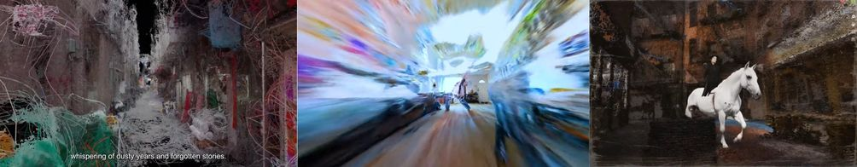
Generative AI for art, images, and video
AMCC5160
Lecture 04
22 September 2026
Zhang et al., Film Creation, CVPR Workshop 2025, Fig. 6
01
Notes:
TRANSCRIPT
Welcome to Lecture Four of AI-Driven Animation and Video Generation. Today we move from understanding an image generator to making deliberate choices across an artwork or a film. We will follow five survey papers. Surveys are useful because they organize many individual methods into a map of the field. Our purpose is to read that map and connect it to creative work. Throughout the lecture, ask two questions. What information does a method need? And what decision does it help an artist make? The figures come from the papers, while the studio example we develop together is a classroom exercise.
SOURCE AND FIGURE NOTES
Today we connect the mechanisms of video generation with the choices artists make. The artwork comes from the filmmaking survey, Figure 6. The sequence follows five surveys rather than a product ranking.
Primary reading: https://arxiv.org/abs/2504.08296
Figure source: https://arxiv.org/html/2504.08296v1
Image URL: https://arxiv.org/html/2504.08296v1/figs/AI_Volumography.jpg
Original caption: Figure 6 : Volumography scenes in Former Garden [ 103 ] , Metanoia [ 42 ] and Dressage Marching Through Memories [ 114 ]

Slide 2
Five readings, one creative process
01
Video models
02
Visual art
03
Filmmaking
04
Visual computing
05
Creative industries
Wang et al., Video Diffusion Survey, rev. 2026
02
Notes:
TRANSCRIPT
Here is our route. We begin with video models and the problem of generating a sequence that holds together through time. We then consider visual art, where the intended experience determines which controls matter. The filmmaking survey shows how creators combine these tools in actual production workflows. Visual computing connects images and video to objects, scenes, and movement data. Finally, the creative-industries review places generation within a wider production process. You do not need to memorize every model name. By the end, you should be able to choose an appropriate kind of input, explain a likely limitation, and describe how you would judge the result.
SOURCE AND FIGURE NOTES
The order moves from model behavior to artistic intention, film production, shared techniques, and the wider production process. We will revisit the same question: what can the maker decide?
Primary reading: https://arxiv.org/abs/2504.16081v3

Slide 3
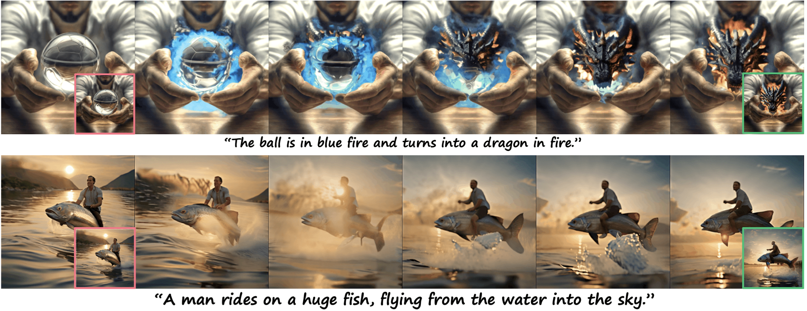
What changes when an image moves?
A still image leaves time open.
A video chooses what happens next.
Wang et al., Video Diffusion Survey, rev. 2026, Fig. 13
03
Notes:
TRANSCRIPT
What changes when an image starts to move? A still image suggests possibilities, but it leaves the next moment open. A video commits to a sequence of events. If a character raises a hand, that hand needs to belong to the same person as it moves. If the camera passes a chair, the chair should remain in a plausible position. These requirements involve appearance, movement, and spatial relationships. They also involve meaning. Holding on an empty room for ten seconds creates a different experience from showing it for one second. Time therefore adds both technical demands and artistic choices. A sequence can fail in either respect.
SOURCE AND FIGURE NOTES
Use the illustrated sequences as examples of changing appearance and motion. Ask students to name decisions beyond the first frame: duration, object movement, viewpoint, and the ending. The still sequence does not let us assess playback smoothness.
Primary reading: https://arxiv.org/abs/2504.16081v3
Figure source: https://arxiv.org/html/2504.16081v3
Image URL: https://arxiv.org/html/2504.16081v3/figs_and_tabs/makepixdance.png
Original caption: Figure 13: Make Pixel Dance Zeng et al. (2024a) shows that by conditioning both on the first and last frame, the model implicitly learns to generate large-scale motion.

Slide 4
Our running example
An empty studio.
A painting begins to move.
Someone returns.
Classroom exercise · inspired by the readings
04
Notes:
TRANSCRIPT
We will use a simple studio scene throughout the lecture. The room is empty. A painting begins to move. Then someone returns. This is an invented teaching example, so there is no correct finished version to reproduce. You might imagine a frightening scene, a quiet memory, or a playful animation. Start by picturing what should stay stable. Perhaps the room layout and painting frame remain fixed while only the painted surface changes. Then consider what the returning person should notice. These decisions will help us compare methods. A tool becomes useful when we can say which part of this scene it should control.
SOURCE AND FIGURE NOTES
This is an instructor-created exercise, not an example from a paper. Students can imagine realism, collage, or dream imagery. Keep the story simple enough that a change in style or motion remains easy to discuss.
Primary reading: https://arxiv.org/abs/2504.16081v3

Slide 5
01
Video generation models
Wang et al.
Survey of Video Diffusion Models
2025, revised February 2026
Wang et al., Video Diffusion Survey, rev. 2026
05
Notes:
TRANSCRIPT
Our opening reading is Wang and colleagues' Survey of Video Diffusion Models, first posted in 2025 and revised in February 2026. It covers foundations, implementations, and applications. We will follow its progression from the generation mechanism to inputs, control, editing, and connections with three-dimensional scenes. A survey figure often contains several methods at once. Read such a figure as a set of relationships, rather than as one model you must implement. Also pay attention to dates. A survey can contain important earlier examples alongside newer research. Its publication or revision date does not make every comparison a current ranking of available systems.
SOURCE AND FIGURE NOTES
Opening source: https://arxiv.org/abs/2504.16081v3. The arXiv record lists acceptance by TMLR. We use selected foundations and applications rather than attempting to cover the entire survey.
Primary reading: https://arxiv.org/abs/2504.16081v3

Slide 6
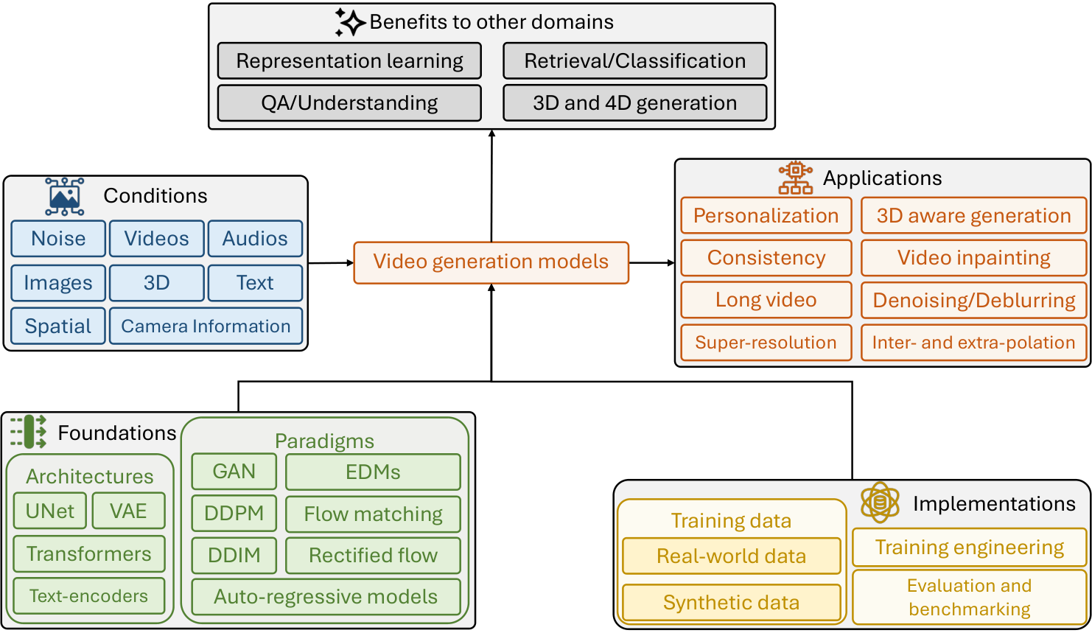
The field at a glance
Inputs guide a model.
The model produces a sequence.
Wang et al., Video Diffusion Survey, rev. 2026, Fig. 1
06
Notes:
TRANSCRIPT
At a high level, video generation connects inputs to a model and then to a sequence. The inputs might include a sentence, an image, a source video, sound, or camera information. Each input supplies a different kind of constraint. A sentence can describe a mood or action, but it usually leaves many visible details unspecified. An image supplies more exact information about appearance. A source video can supply a performance or a movement pattern. When reading the overview, look for what enters the model and what comes out. This simple habit makes a complicated architecture easier to understand and helps you recognize what a demonstration actually controls.
SOURCE AND FIGURE NOTES
Read the center of Figure 1 first. Then look left at the inputs and right at the applications. Students do not need to memorize all of the model names. This is the survey authors’ taxonomy.
Primary reading: https://arxiv.org/abs/2504.16081v3
Figure source: https://arxiv.org/html/2504.16081v3
Image URL: https://arxiv.org/html/2504.16081v3/teaser.png
Original caption: Figure 1: Overview of video generation methods. Generally, the input conditions can be noises, images, videos, audios, texts, and 3D point clouds. The architectures (UNet, VAE, and/or Transformers) are trained using GAN or diffusion models with training data of real-world data or synthetic data with different paradigms. The applications are in several folds, e.g. , video personalization, consistency-aware generation, and long video generalization. On the other side, video generation models can also benefit other video tasks, such as, video retrieval, understanding, and representation learning.

Slide 7
Three routes to a video
Text describes a scene.
An image fixes a starting appearance.
A video supplies existing movement.
Wang et al., Video Diffusion Survey, rev. 2026
07
Notes:
TRANSCRIPT
Consider three routes to the studio scene. With text-to-video, we describe the room and the moving painting, and the model invents much of their appearance. With image-to-video, we first choose a picture of the room, then ask for movement from that starting appearance. With video-to-video, we begin with an existing sequence and change selected properties, such as its visual style. None of these routes automatically solves every production problem. An initial image does not guarantee stable identity later in the shot. A source video does not guarantee exact motion preservation. Choose the route according to the information you already have and the properties you need to retain.
SOURCE AND FIGURE NOTES
Text-to-video, image-to-video, and video-to-video are different input setups. An image constrains appearance but does not fully determine motion. Existing footage can guide timing and structure. These are task distinctions, not mutually exclusive architectures.
Primary reading: https://arxiv.org/abs/2504.16081v3

Slide 8
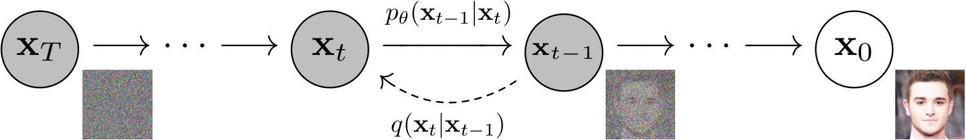
Diffusion in one picture
Training teaches noise removal.
Generation refines a noisy sample.
Wang et al., Video Diffusion Survey, rev. 2026, Fig. 2
08
Notes:
TRANSCRIPT
Diffusion is easiest to understand by separating training from generation. During training, a system encounters examples with added noise and learns how to predict information needed to remove that noise. During generation, it starts with a noisy sample and repeatedly refines it using the learned model. The diagram shows a succession of states, rather than a film of a face changing over time. The prompt or another condition influences the refinement. The model does not learn a new set of weights every time you generate an image. It uses what training has already established. This distinction helps explain why changing a prompt differs from adapting the model.
SOURCE AND FIGURE NOTES
Figure 2 illustrates the forward and reverse processes. Read x as the current noisy representation and t as a noise step. A noise step is not a frame of video. Generation starts from noise and repeatedly refines a sample.
Primary reading: https://arxiv.org/abs/2504.16081v3
Figure source: https://arxiv.org/html/2504.16081v3
Image URL: https://arxiv.org/html/2504.16081v3/pgm_diagram_xarrow_small.png
Original caption: Figure 2: The directed graphical model for DDPM ( Ho et al., 2020 )

Slide 9
A video has two kinds of time
Frame time: when an event happens.
Denoising time: how a sample improves.
Wang et al., Video Diffusion Survey, rev. 2026
09
Notes:
TRANSCRIPT
Video diffusion has two different meanings of time. Frame time is the time inside the represented event: a person enters, walks across the studio, and looks at the painting. Denoising time is the sequence of computational refinement steps that produces the sample. A denoising step is not an extra frame in the finished video. Depending on the architecture, one step may update information for many frames together. Confusing these two timelines makes diagrams difficult to read. Whenever you see a time index, ask whether it identifies a moment in the scene or a stage in noise removal. The answer tells you what relationship the model is trying to represent.
SOURCE AND FIGURE NOTES
This distinction prevents a common misunderstanding. A model can refine many frames together across denoising steps. The sequence of denoising steps is not the sequence of events in the finished movie.
Primary reading: https://arxiv.org/abs/2504.16081v3

Slide 10
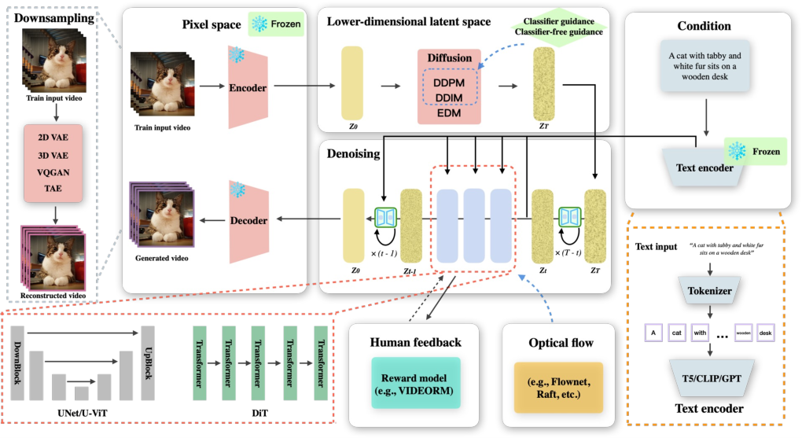
The generation pipeline
A prompt guides refinement in a compressed space.
Wang et al., Video Diffusion Survey, rev. 2026, Fig. 4
10
Notes:
TRANSCRIPT
The generation pipeline often works in a compressed space. First, a text encoder converts the prompt into a representation that the model can use. The generative network then refines a noisy representation under that condition. A decoder converts the result into visible frames. This division reduces the amount of information processed by the most expensive part of the system. It also means that the final image depends on several components. A problem with fine texture may involve compression or decoding as well as generation. For our studio scene, the prompt supplies an instruction, while the latent representation carries the evolving visual content during refinement.
SOURCE AND FIGURE NOTES
Read Figure 4 at a high level. The text encoder represents the instruction. The generative network refines a latent representation. A decoder returns viewable frames. Skip the small architectural alternatives on a first pass.
Primary reading: https://arxiv.org/abs/2504.16081v3
Figure source: https://arxiv.org/html/2504.16081v3
Image URL: https://arxiv.org/html/2504.16081v3/video_gen_foundation.png
Original caption: Figure 4: A pipeline for diffusion-based visual content generation leverages a pre-trained variational autoencoder (VAE), such as 2D VAE, 3D VAE, VQGAN, or TAE, to encode input images or videos into a lower-dimensional latent representation. Within this latent space, diffusion models (e.g., DDPM, DDIM, EDM) iteratively introduce noise and employ neural architectures, such as U-Net or Transformer-based models, to learn a denoising process that reconstructs high-fidelity outputs. User-provided textual prompts undergo refinement through large language models (e.g., T5, CLIP, GPT) before being mapped into an embedding space via a trained text encoder. This embedding space serves as a conditioning mechanism, guiding the diffusion process to ensure semantic coherence with the input prompt. Furthermore, the framework integrates optical flow estimation methods (e.g., FlowNet, Raft) to enhance motion consistency in generated video sequences and incorporates human feedback mechanisms (e.g., VIDEORM) to iteratively improve generation quality.

Slide 11
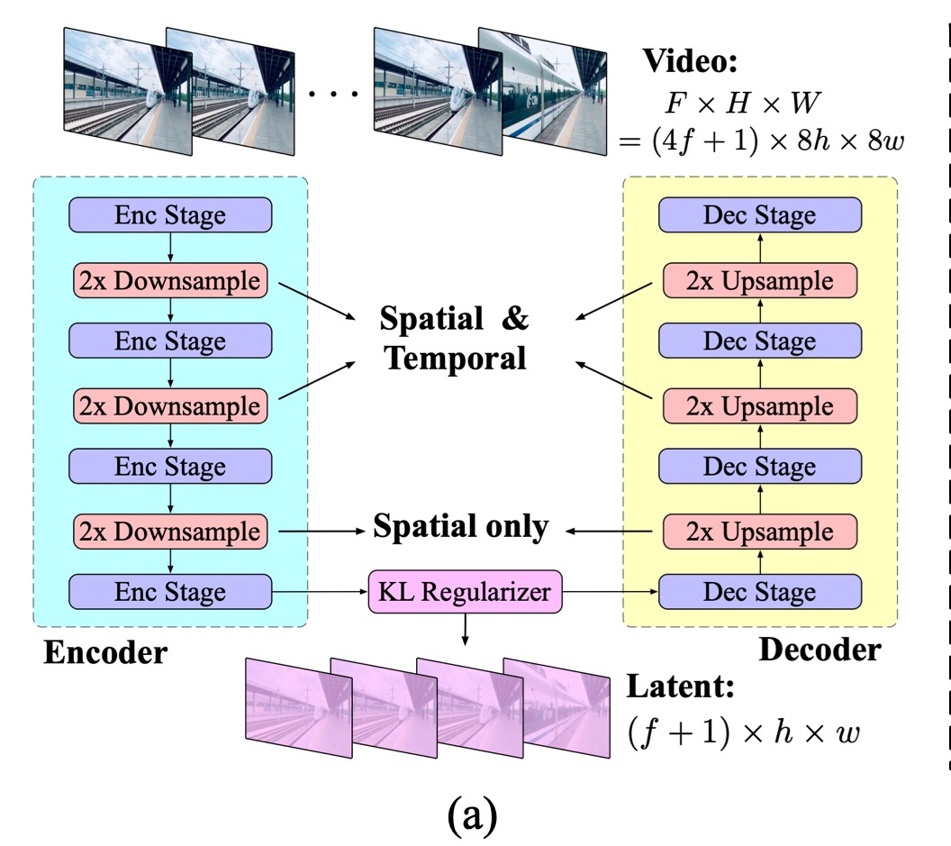
A latent is a compressed representation
The model works with fewer values than raw pixels.
Wang et al., Video Diffusion Survey, rev. 2026, Fig. 7 (detail)
11
Notes:
TRANSCRIPT
A latent is a compressed representation of the data. Imagine describing the essential structure of a room with fewer values than you would need to list every colored pixel in every frame. The encoder maps the original material into that representation, and the decoder maps it back. The figure shows compression across space and, in some stages, across time. Compression makes a large video more manageable, but it can also discard detail. A latent is not a miniature image that we can always interpret directly. It is a learned representation. Keep the practical tradeoff in mind: less computation can come with limits on small details and reconstruction fidelity.
SOURCE AND FIGURE NOTES
Figure 7 shows a video autoencoder. The encoder compresses space and time, and the decoder reconstructs frames. Compression helps computation but can discard fine detail. A latent is a learned representation, not a small ordinary photograph.
Primary reading: https://arxiv.org/abs/2504.16081v3
Figure source: https://arxiv.org/html/2504.16081v3
Image URL: https://arxiv.org/html/2504.16081v3/figs_and_tabs/3dvae_combined.jpg
Original caption: Figure 7: 3D causal VAE structure in CogVideoX ( Yang et al., 2024j ) .
(a) The encoder compresses spatial and temporal features, followed by spatial-only layers and a KL regularizer to generate latent representations. The decoder mirrors this structure in reverse.
(b) Temporally causal 3D convolutions are applied so each output frame depends only on the current and earlier frames, maintaining motion consistency.
Figure detail enlarged for teaching. Repeated figure supports a progressive explanation.

Slide 12
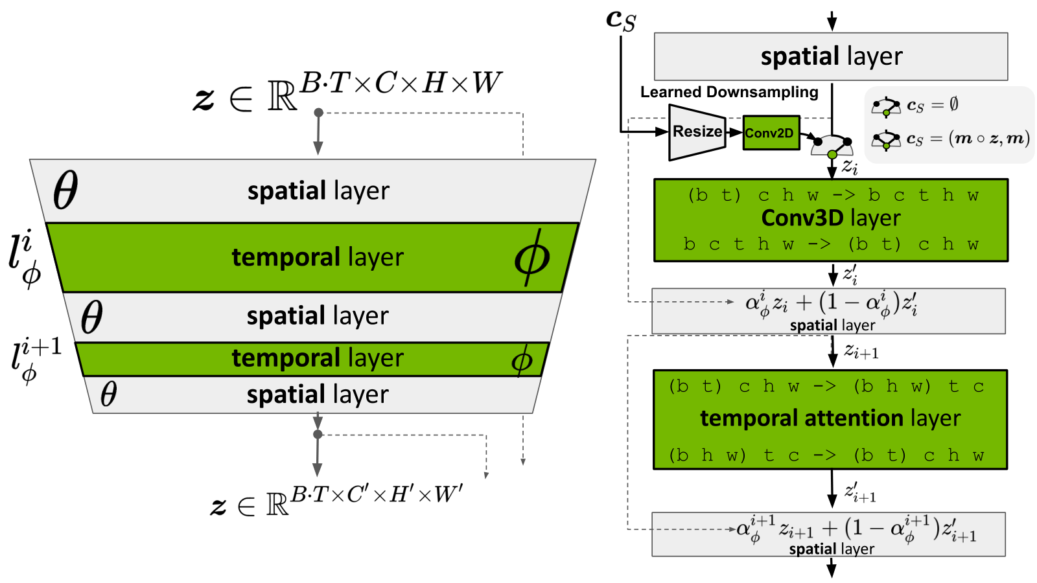
Spatial attention and temporal attention
Spatial: relationships within a frame.
Temporal: relationships across frames.
Wang et al., Video Diffusion Survey, rev. 2026, Fig. 5
12
Notes:
TRANSCRIPT
Spatial relationships occur within a frame. They include the position of a person relative to a door, or the relationship between a hand and the object it holds. Temporal relationships connect different frames. They help a model relate the hand now to the hand a moment later. The diagram separates spatial and temporal processing to make those roles visible. Attention is one way to connect relevant features, but it does not guarantee correct understanding of the scene. For the studio example, spatial processing helps organize the room at a particular instant. Temporal processing helps the painting and furniture maintain meaningful relationships as the sequence develops.
SOURCE AND FIGURE NOTES
Figure 5 alternates spatial and temporal processing. Ask students to follow the colored temporal layers. Their role is to exchange information over the sequence. The figure includes tensor notation that is not necessary for this lecture.
Primary reading: https://arxiv.org/abs/2504.16081v3
Figure source: https://arxiv.org/html/2504.16081v3
Image URL: https://arxiv.org/html/2504.16081v3/video_merge_block2.png
Original caption: Figure 5: Classic temporal attention design from ( Blattmann et al., 2023b ) , showing how temporal attention mechanisms improve video generation quality by maintaining temporal coherence across frames.

Slide 13
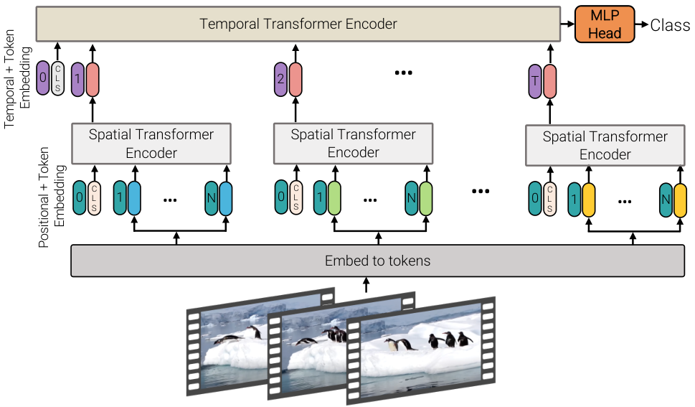
A second way to connect frames
A frame encoder handles appearance.
A temporal encoder connects the sequence.
Wang et al., Video Diffusion Survey, rev. 2026, Fig. 6
13
Notes:
TRANSCRIPT
This figure illustrates another way to connect frames: encode information within each frame, then connect those representations across the sequence. The pictured architecture is a video-understanding example with a classification output, rather than a complete video generator. We are using it to understand an architectural idea. The lower part handles appearance within individual frames. The upper part combines information through time. Separating these roles can make processing easier to organize. When you encounter a research diagram, check the output label before assuming its task. Similar building blocks can appear in recognition and generation systems, even though their training objectives and outputs differ substantially.
SOURCE AND FIGURE NOTES
The survey reproduces a ViViT architecture in Figure 6. ViViT is a video-understanding architecture used here to illustrate factorized spatial and temporal processing. Do not present it as a standalone video generator.
Primary reading: https://arxiv.org/abs/2504.16081v3
Figure source: https://arxiv.org/html/2504.16081v3
Image URL: https://arxiv.org/html/2504.16081v3/ViViT_fac_1.png
Original caption: Figure 6: Factorized encoder (Model 2) in ViViT ( Arnab et al., 2021 ) . The first transformer encoder models spatial interactions within each frame. The second transformer encoder captures temporal dependencies between frames. This factorized structure enables a late fusion of spatial and temporal information, which supports temporally consistent video generation.

Slide 14
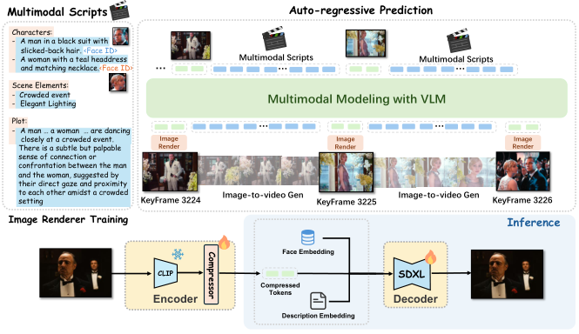
Predicting a sequence in parts
Autoregressive methods build on earlier outputs.
Wang et al., Video Diffusion Survey, rev. 2026, Fig. 21
14
Notes:
TRANSCRIPT
Some approaches build a sequence in parts, using earlier outputs to guide what comes next. This is the basic idea of autoregressive prediction. The diagram includes script information, keyframes, and a rendering process. You can think of the earlier material as context for the next decision. This can help extend a sequence, but errors in the context may also carry forward. If a character's coat changes in one generated part, later parts may preserve the new coat instead of the original one. For filmmaking, that makes checkpoints valuable. Inspect important keyframes and transitions before treating a longer generated sequence as a finished shot.
SOURCE AND FIGURE NOTES
Figure 21 illustrates MovieDreamer. Script information supports keyframe token prediction and later rendering. Explain autoregression as building on earlier units. Its long-video strategy differs from refining an entire sequence at once.
Primary reading: https://arxiv.org/abs/2504.16081v3
Figure source: https://arxiv.org/html/2504.16081v3
Image URL: https://arxiv.org/html/2504.16081v3/longvideo_model.png
Original caption: Figure 21: The framework of MovieDreamer. The autoregressive model takes multimodal scripts
as input and predicts the tokens for keyframes. These tokens are then rendered into images, forming
anchor frames for extended video generation. MovieDreamer ensures long-term coherence and short term fidelity in visual storytelling with the character’s identity well preserved.

Slide 15
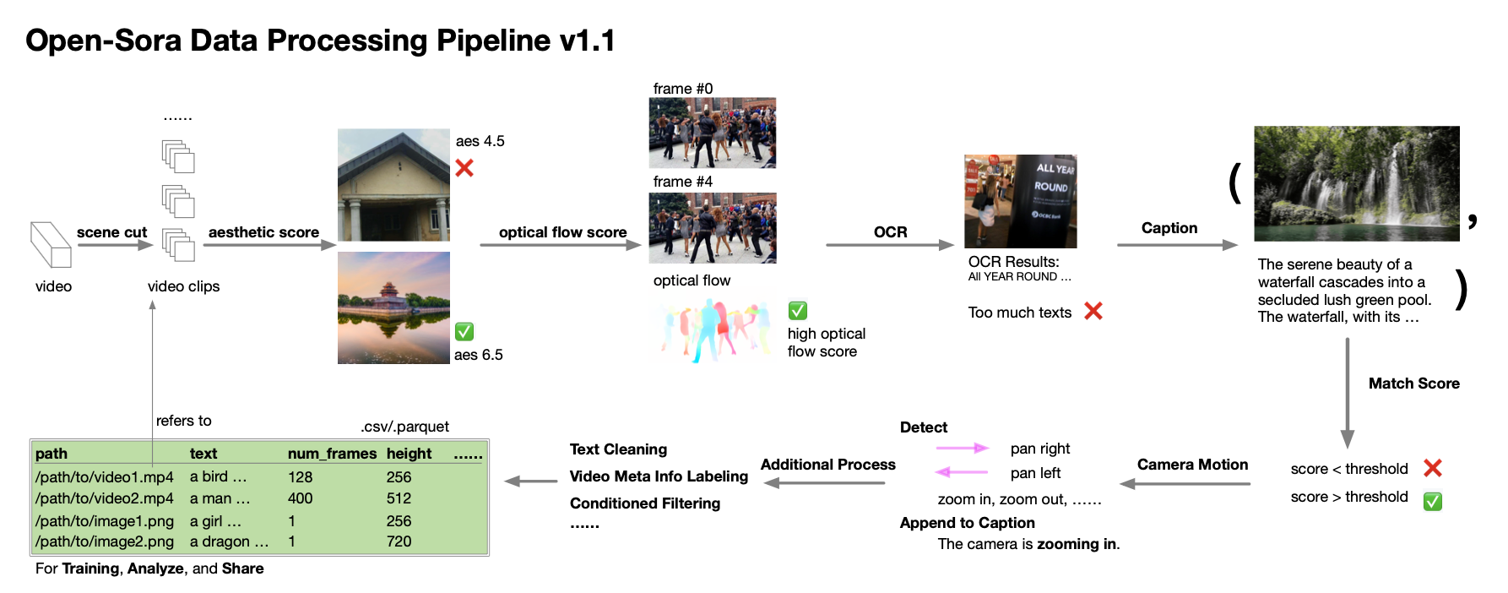
Training data shapes the result
Selection and captions affect what a model can learn.
Wang et al., Video Diffusion Survey, rev. 2026, Fig. 8
15
Notes:
TRANSCRIPT
Training data shapes the kinds of results a model can produce. The figure shows a pipeline that selects clips, filters them, and attaches descriptions. Each stage changes what reaches training. A caption can describe an object, an action, or a camera movement. If the caption misses an important event, the model receives a weaker connection between language and that event. Filtering can remove unusable clips, but it also reflects decisions about what counts as desirable material. An artist should therefore avoid treating model behavior as a neutral view of all possible images. It reflects the material, labels, and objectives used to train the system.
SOURCE AND FIGURE NOTES
Figure 8 shows Open-Sora data preparation. Follow one clip through selection and captioning. A training collection has choices about subject, motion, quality, and language. A larger collection does not remove every bias.
Primary reading: https://arxiv.org/abs/2504.16081v3
Figure source: https://arxiv.org/html/2504.16081v3
Image URL: https://arxiv.org/html/2504.16081v3/figs_and_tabs/open_sora_data.png
Original caption: Figure 8: The data preprocessing pipeline of Open-Sora ( Zheng et al., 2024c ) .

Slide 16
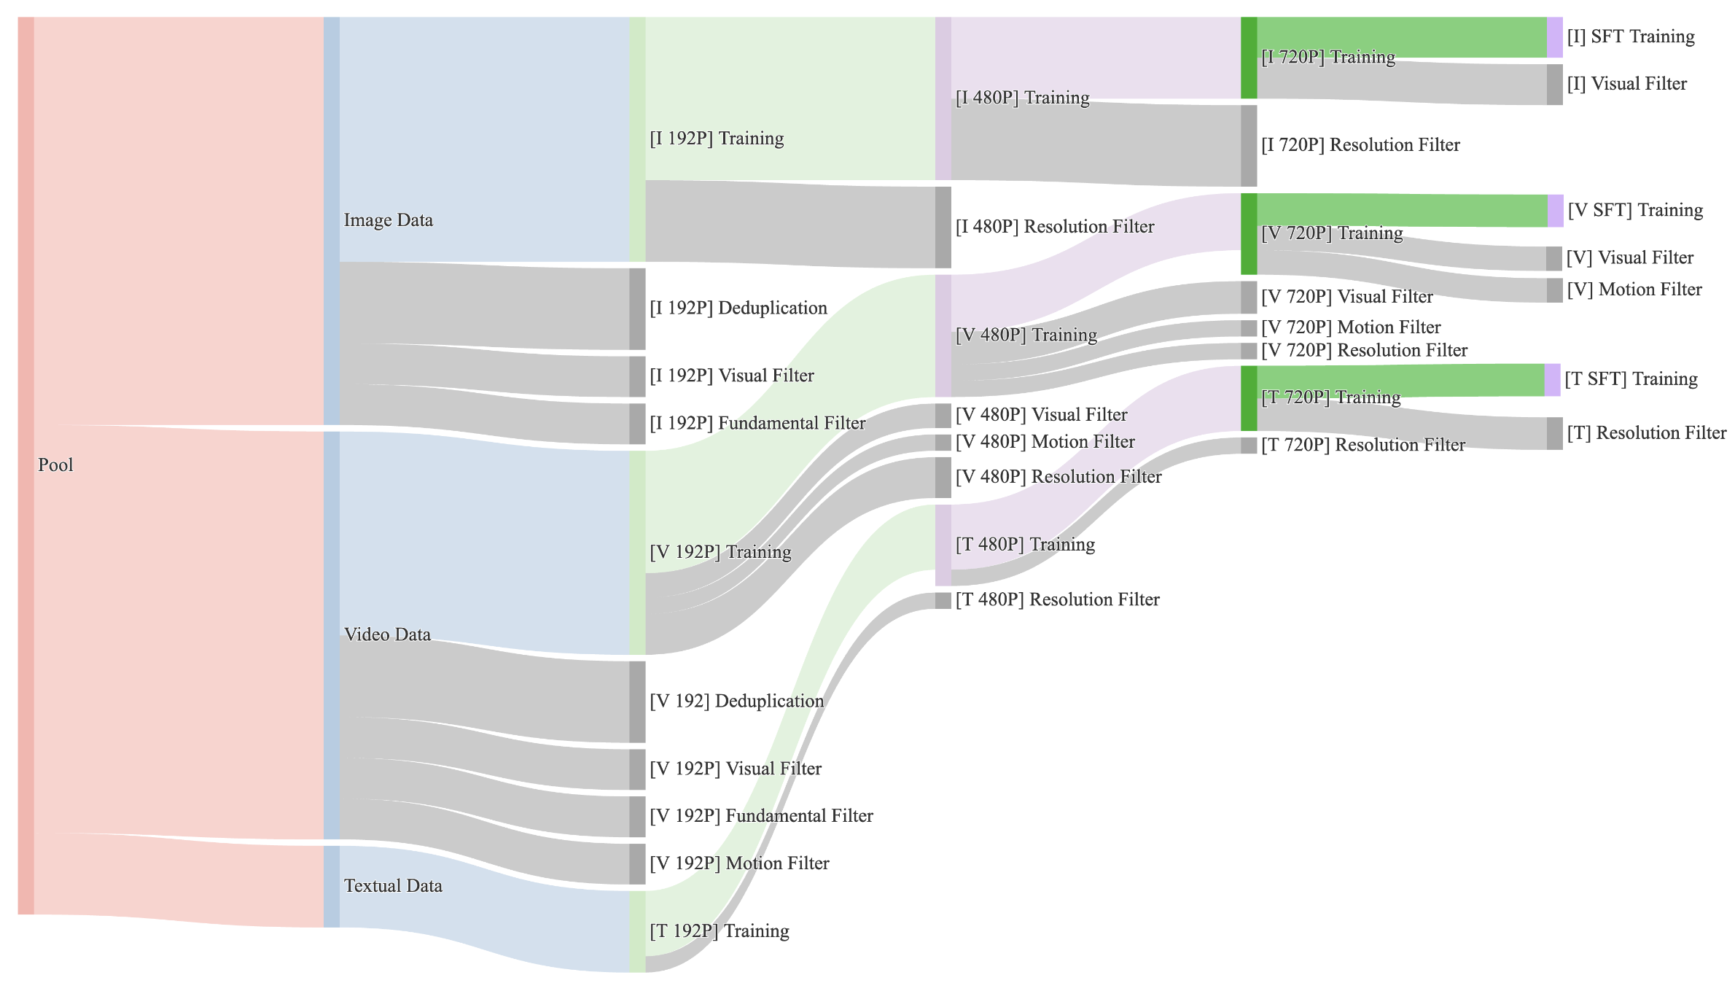
A closer look at data filtering
Filtering trades coverage against usable training examples.
Wang et al., Video Diffusion Survey, rev. 2026, Fig. 9
16
Notes:
TRANSCRIPT
The branching diagram makes filtering visible. A broad pool of material becomes smaller groups suited to particular training stages. Some examples may have adequate resolution but little movement. Others may have useful movement but poor captions or visual quality. The important point is that filtering trades coverage against usable examples. Removing difficult material may improve average training quality while leaving gaps in certain actions or styles. This matters when your project depends on an unusual visual language. If a model struggles with that language, repeatedly rewriting the prompt may not address the underlying limitation. The required examples or relationships may be poorly represented in training.
SOURCE AND FIGURE NOTES
Figure 9 traces the Wan data pipeline. Explain that rejecting poor examples can improve quality, while also changing which scenes survive. The widths reflect the paper figure and should not be treated as a current cross-model comparison.
Primary reading: https://arxiv.org/abs/2504.16081v3
Figure source: https://arxiv.org/html/2504.16081v3
Image URL: https://arxiv.org/html/2504.16081v3/figs_and_tabs/wan_data_pipeline.png
Original caption: Figure 9: The data preprocessing pipeline of WAN ( Wan et al., 2025 ) .
WAN first splits data into image, video, and text data.
Then, different stages of filters are applied to the data for further proprocessing.
Fianlly, the data is splited into pretraining data and SFT data for imrpoving the quality of generated video data.

Slide 17
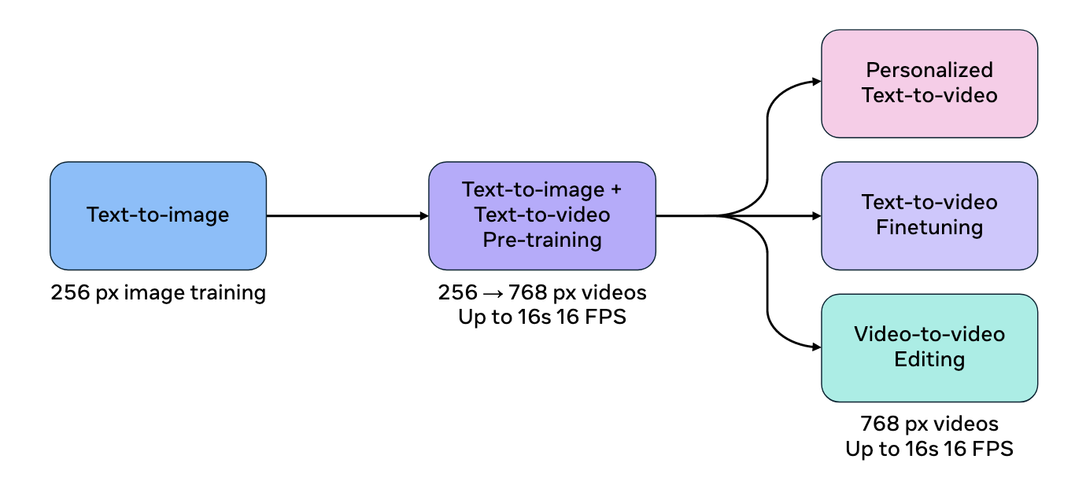
One foundation, several tasks
Generation, personalization, and editing can share a base.
Wang et al., Video Diffusion Survey, rev. 2026
17
Notes:
TRANSCRIPT
A single foundation can support several tasks. The figure moves from image training toward video training and then toward specialized applications such as personalization or editing. Shared foundations let researchers reuse learned visual knowledge instead of starting from nothing for every task. However, task support still depends on the model and the way it is adapted. Generating a new character and preserving a particular existing character are different requirements. For our studio scene, a general model might create an attractive room, while a specialized workflow might better preserve the same painting across shots. Shared origins do not make those capabilities interchangeable in practice.
SOURCE AND FIGURE NOTES
The Movie Gen training schematic in Figure 10b illustrates shared pretraining followed by task-specific adaptation. It does not imply that every capability comes from one unchanged set of weights. The dimensions are historical details from the cited system.
Primary reading: https://arxiv.org/abs/2504.16081v3
Figure source: https://arxiv.org/html/2504.16081v3
Image URL: https://arxiv.org/html/2504.16081v3/figs_and_tabs/movie_gen_training.png
Original caption: (b) Training pipeline of Movie Gen ( teamMeta, 2024 ) .

Slide 18
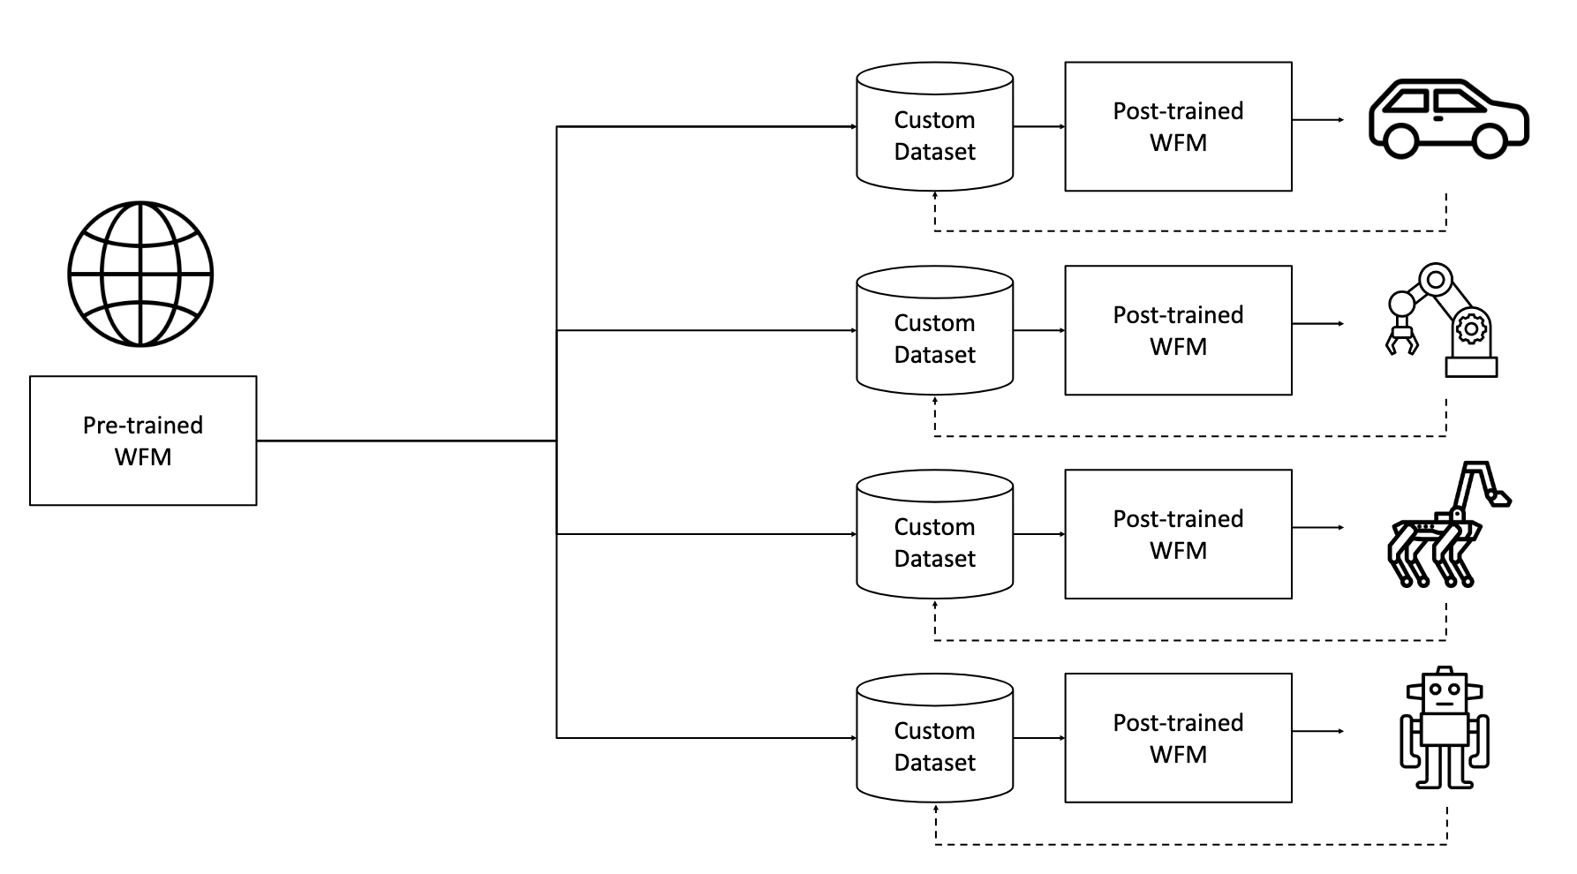
A foundation model can adapt to a domain
Further training specializes a general model.
Wang et al., Video Diffusion Survey, rev. 2026
18
Notes:
TRANSCRIPT
This diagram from the Cosmos discussion shows a pretrained foundation model branching into domain-specific adaptations. The custom datasets concern physical settings such as vehicles and robots. Follow the diagram from the common base toward the separate applications. Further training helps specialize the model to the material and tasks of a domain. Adapting a model to an artistic style is a related idea, but this particular figure does not report an art experiment. The general lesson is that specialization requires suitable evidence. A small, carefully chosen dataset may teach a useful pattern, while an inconsistent collection may introduce unwanted associations or reduce the usefulness of the adaptation.
SOURCE AND FIGURE NOTES
The Cosmos training diagram illustrates adaptation of a world foundation model, abbreviated WFM. Trace the common base and the domain-specific datasets. This example concerns physical domains. Adapting to an artistic domain is an analogy, not an experiment reported by this figure. Training data determines what the adaptation can teach.
Primary reading: https://arxiv.org/abs/2504.16081v3
Figure source: https://arxiv.org/html/2504.16081v3
Image URL: https://arxiv.org/html/2504.16081v3/figs_and_tabs/cosmos_training.png
Original caption: (a) Training pipeline of Cosmos ( NVIDIA et al., 2025 ) .

Slide 19
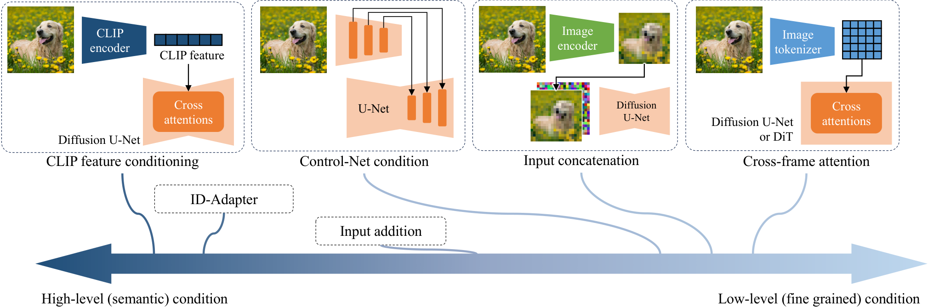
References carry different information
A reference can suggest meaning, layout, or appearance.
Wang et al., Video Diffusion Survey, rev. 2026, Fig. 12
19
Notes:
TRANSCRIPT
A reference image can communicate several kinds of information. It may suggest broad meaning, such as a dog in a garden. It may specify appearance, such as the exact markings of one dog. Or it may constrain structure, such as the location and outline of the subject. Different conditioning methods preserve these properties to different degrees. The figure organizes several ways to introduce image information. You do not need to memorize every connection. Instead, ask what you want the reference to contribute. For the studio scene, a mood image and a precise room-layout reference serve different purposes, even if both enter the workflow as pictures.
SOURCE AND FIGURE NOTES
Figure 12 places image conditions along a semantic-to-structural spectrum. Explain the distinction using a cat photo: identity and appearance versus an edge map that constrains outlines. These control mechanisms offer different levels of precision.
Primary reading: https://arxiv.org/abs/2504.16081v3
Figure source: https://arxiv.org/html/2504.16081v3
Image URL: https://arxiv.org/html/2504.16081v3/image_condition.png
Original caption: Figure 12: Methods for controlling video generation using image-based conditions. We categorize these methods along a spectrum ranging from high-level semantic conditions to low-level conditions. Additionally, we illustrate four classic approaches commonly used to condition input images.

Slide 20
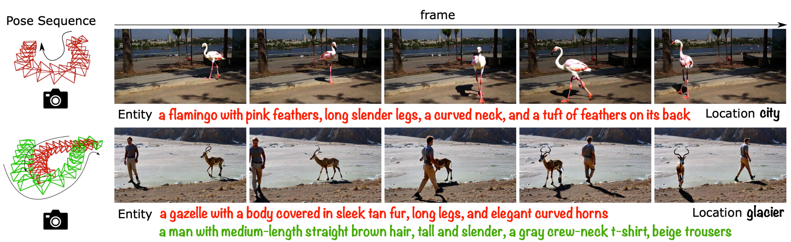
Motion and camera control
An actor can move while the camera stays still.
A camera can move around a still actor.
Wang et al., Video Diffusion Survey, rev. 2026, Fig. 14
20
Notes:
TRANSCRIPT
Object motion and camera motion are distinct. A person can cross the studio while the camera remains still. The camera can also move around a person who does not move. In the resulting images, both situations produce changing pixel positions. A system therefore needs useful constraints if we want to control them separately. The figure combines scene descriptions with camera information. When planning a shot, specify the intended camera behavior independently from the action. Then inspect whether the output respects both. A visually energetic result may still fail if the camera moves when the scene requires a stable viewpoint, or if the subject freezes during the intended action.
SOURCE AND FIGURE NOTES
Figure 14 combines pose and scene information. Separate object movement from camera movement before discussing the outputs. The frame sequence provides visual examples, not a guarantee of accurate physical geometry.
Primary reading: https://arxiv.org/abs/2504.16081v3
Figure source: https://arxiv.org/html/2504.16081v3
Image URL: https://arxiv.org/html/2504.16081v3/CameraCondition.png
Original caption: Figure 14: An example of integrating camera poses and object motion control for video generation ( Fu et al., 2024a ) .

Slide 21
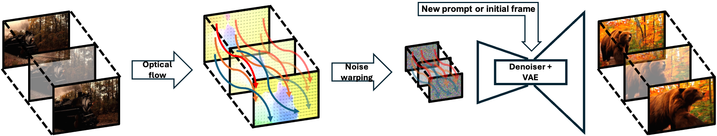
Motion as a field
Optical flow describes how image locations move.
Wang et al., Video Diffusion Survey, rev. 2026, Fig. 3
21
Notes:
TRANSCRIPT
Optical flow describes how locations in one image correspond to locations in another. The colored paths in the figure represent a movement field. Such information can help transfer movement or guide the evolution of a generated sequence. Optical flow describes apparent image movement, so it can reflect both object motion and camera motion. It is not a complete reconstruction of the physical world. Occlusion creates additional difficulty because something visible in one frame may disappear behind another object. For creative work, a movement field can offer more specific guidance than a sentence such as move naturally. Its reliability still depends on the source and the scene.
SOURCE AND FIGURE NOTES
Figure 3 uses flow-related conditioning. Define optical flow as apparent image motion between frames. It does not directly reveal the true 3D path of every object. Avoid the survey caption’s broader depth-accuracy comparison without checking the original study.
Primary reading: https://arxiv.org/abs/2504.16081v3
Figure source: https://arxiv.org/html/2504.16081v3
Image URL: https://arxiv.org/html/2504.16081v3/figs_and_tabs/framework_diagram.png
Original caption: Figure 3: An example for optical flow usage in video scenario, Go-with-the-Flow ( Burgert et al., 2025 ) , a novel framework that predicts 3D scene dynamics across sequential frames, outperforming conventional single-frame approaches. By integrating multi-frame spatial-temporal relationships, it improves depth accuracy and visual fidelity in scene reconstruction.

Slide 22
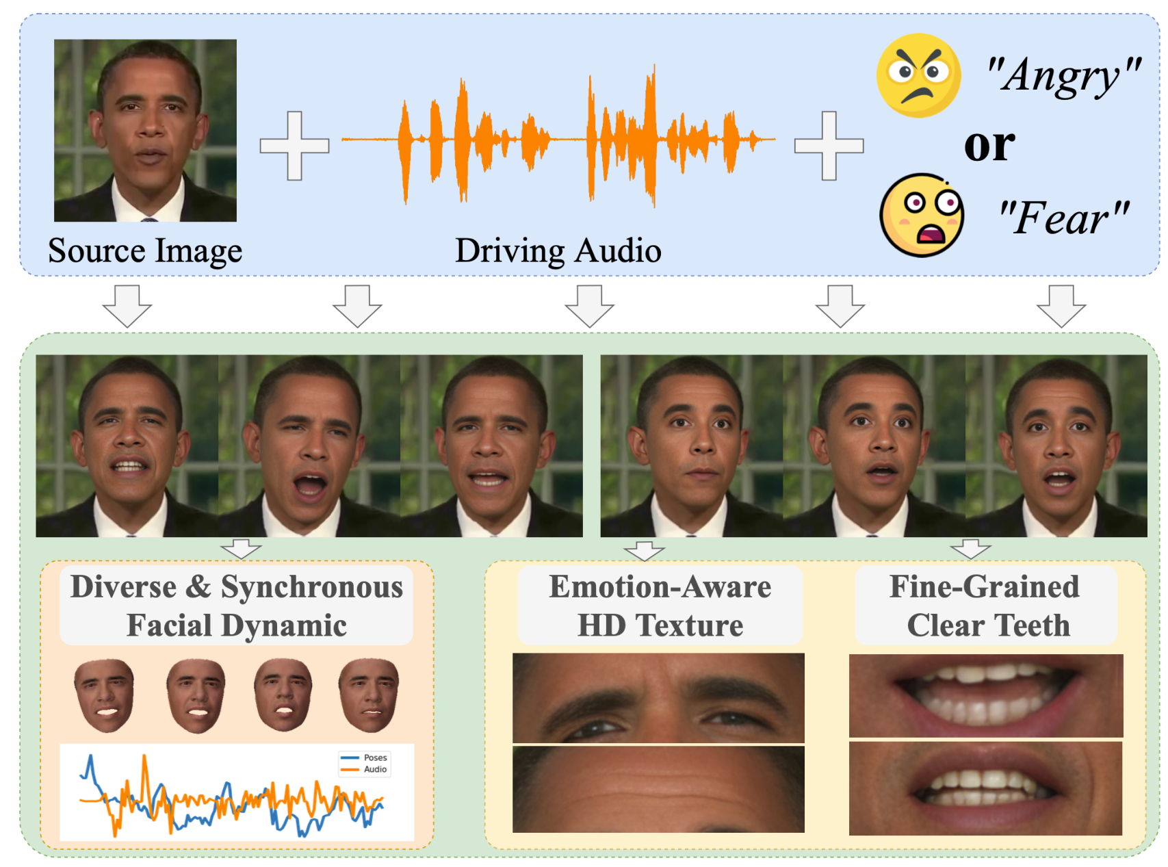
Sound can guide a performance
Audio can constrain mouth movement and timing.
Wang et al., Video Diffusion Survey, rev. 2026, Fig. 15
22
Notes:
TRANSCRIPT
Sound can guide a visual performance. In this example, a source image and audio help determine a speaking face, with additional information related to expression. Audio supplies timing that a still image cannot provide. A voice has pauses, stressed syllables, and changing rhythm. Mouth movement should relate to those events if the result is meant to depict speaking. A convincing portrait alone does not establish accurate lip synchronization or a coherent performance. Watch transitions and listen at the same time. In a film workflow, this is also a reminder to plan sound early when it controls the timing of the visible action.
SOURCE AND FIGURE NOTES
Figure 15 demonstrates audio-driven facial animation. The source image anchors identity and audio guides dynamics. A synchronized mouth is one part of performance. Emotion, gaze, and body movement also matter.
Primary reading: https://arxiv.org/abs/2504.16081v3
Figure source: https://arxiv.org/html/2504.16081v3
Image URL: https://arxiv.org/html/2504.16081v3/audio.png
Original caption: Figure 15: In audio-conditioned video generation, in conjunction with traditional conditions (e.g., image, text), audio information is usually adopted to augment synchronization with talking motion (facial expressions, head movements, lip and teeth dynamics) to create a more realistic and emotionally expressive animation ( Tan et al., 2024a ) .

Slide 23
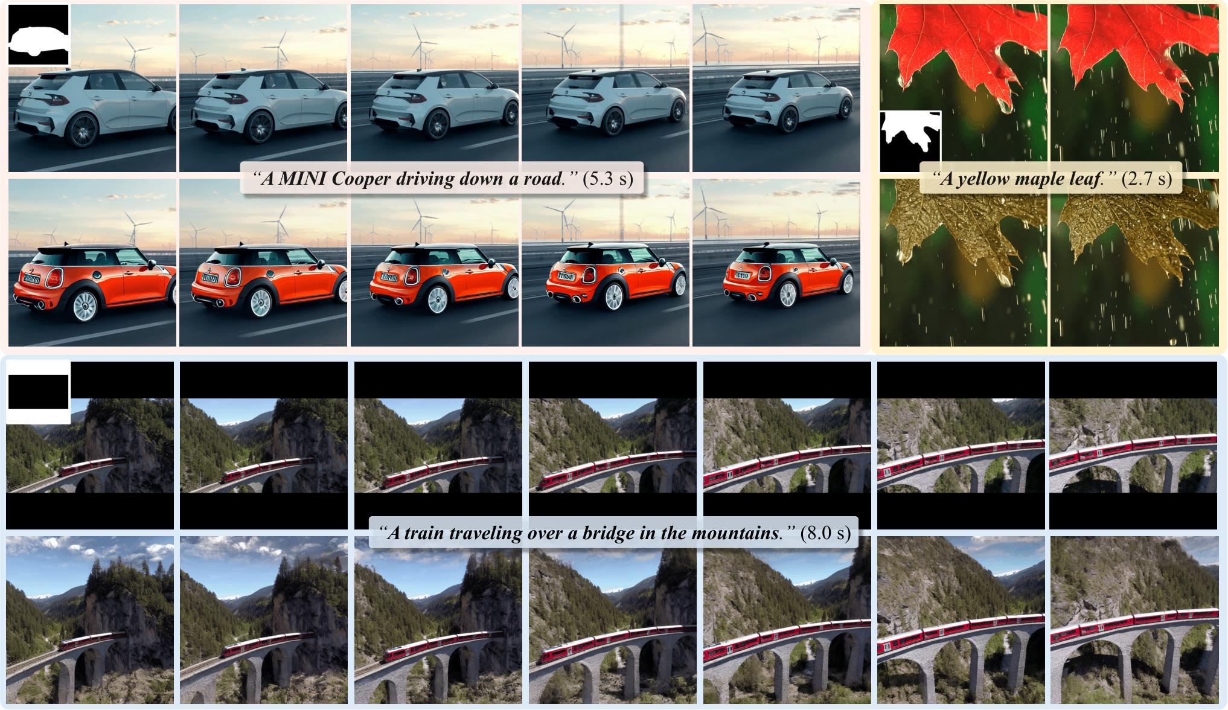
Editing a region through time
The selected change must persist across frames.
Wang et al., Video Diffusion Survey, rev. 2026, Fig. 16
23
Notes:
TRANSCRIPT
Editing a video region adds a temporal requirement to a familiar image-editing task. If we change the color of a car, that change should remain attached to the car across the sequence. The background should also behave consistently. The examples show local changes and reconstruction of selected areas. A mask identifies a region, but the region may move, change shape, or become partly hidden. This makes a single successful frame insufficient evidence. For the studio exercise, imagine changing only the painting while preserving the wall and frame. Inspect the boundary as the camera moves, because that is where small inconsistencies often become noticeable.
SOURCE AND FIGURE NOTES
Figure 16 reproduces AVID examples. Compare the original and edited car sequences. A mask indicates where editing is allowed, but the model still needs temporal consistency. Discuss unwanted changes to the rest of a shot.
Primary reading: https://arxiv.org/abs/2504.16081v3
Figure source: https://arxiv.org/html/2504.16081v3
Image URL: https://arxiv.org/html/2504.16081v3/avid_teaser.png
Original caption: Figure 16: Example of video inpainting with text instructions for video generation. The contents in the masked regions are inpainted under text instrubtions. Original figure from AVID ( Zhang et al., 2024i )

Slide 24
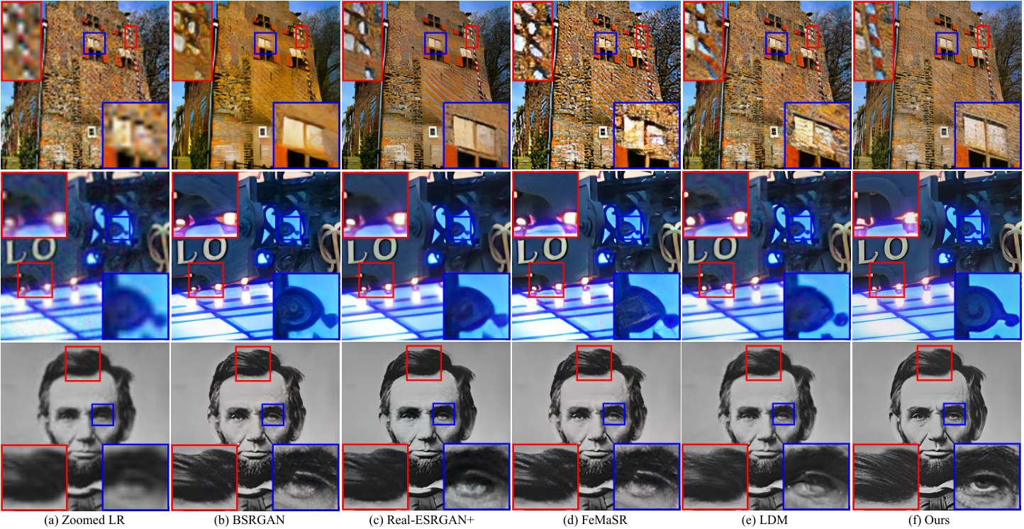
Sharper detail can change what we see
Plausible texture may differ from the original scene.
Wang et al., Video Diffusion Survey, rev. 2026, Fig. 18
24
Notes:
TRANSCRIPT
Super-resolution methods can make details look sharper. These examples compare restoration methods on still images, even though the figure appears in a video survey. Read the columns as methods, not successive moments in time. Compare the brick texture and the facial details. A generated texture can be plausible without matching the original high-resolution scene. That difference matters if your aim is faithful restoration. It may matter differently if you are designing a new artwork. For video, an additional question remains: do the added details stay stable across frames? These still comparisons alone cannot answer that question. Sharpness and temporal consistency require separate inspection.
SOURCE AND FIGURE NOTES
Figure 18 reproduces StableSR image restoration comparisons within the video survey. Read the columns as different methods, not consecutive video frames. Compare brick texture and facial detail. A sharp output is not proof that the method recovered the true high-resolution scene. These stills do not evaluate temporal stability.
Primary reading: https://arxiv.org/abs/2504.16081v3
Figure source: https://arxiv.org/html/2504.16081v3
Image URL: https://arxiv.org/html/2504.16081v3/stablesr.png
Original caption: Figure 18: Video super-resolution examples of latest methods. Original figure from StableSR ( Wang et al., 2024c )

Slide 25
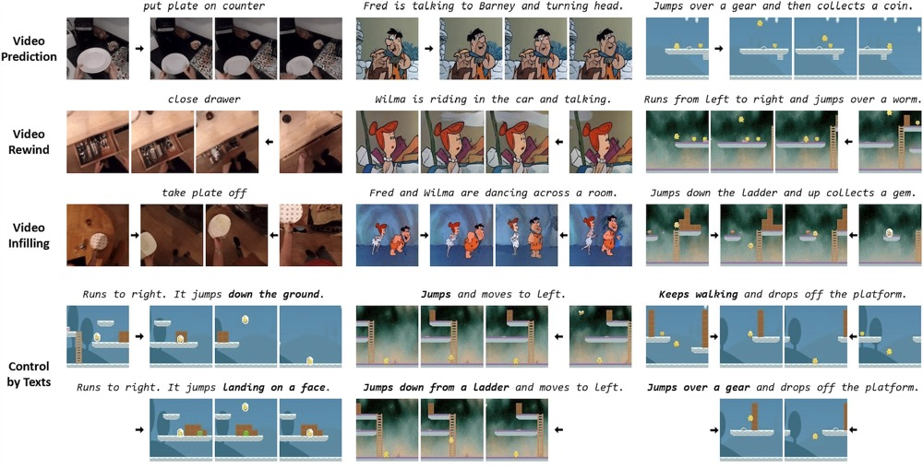
Before, between, and after
Prediction extends a sequence.
Interpolation fills a gap.
Wang et al., Video Diffusion Survey, rev. 2026, Fig. 17
25
Notes:
TRANSCRIPT
Prediction and interpolation answer different questions. Prediction extends a sequence beyond what we already observe. Interpolation fills a gap between known moments. The examples also include generating earlier content, which asks what might have happened before the available sequence. These outputs are plausible constructions, rather than recovered facts about an unseen event. For our studio film, interpolation might help connect two chosen keyframes, while prediction might extend a shot after the painting starts moving. Both methods can produce unexpected intermediate actions. Check the whole path between important moments, because getting the beginning and ending right does not guarantee that the transition serves the scene.
SOURCE AND FIGURE NOTES
Figure 17 contrasts prediction and interpolation with text control. Explain the difference between providing only earlier frames and providing endpoints. Neither automatically creates the exact motion a director intended.
Primary reading: https://arxiv.org/abs/2504.16081v3
Figure source: https://arxiv.org/html/2504.16081v3
Image URL: https://arxiv.org/html/2504.16081v3/figs_and_tabs/tell_me_what_happened.jpg
Original caption: Figure 17: Examples of video extrapolation/prediction (Row 1&2) and interpolation (Row 3). For diffusion models, it is possible to add text instructions for a better control. Original figure from Fu et al. (2023)

Slide 26
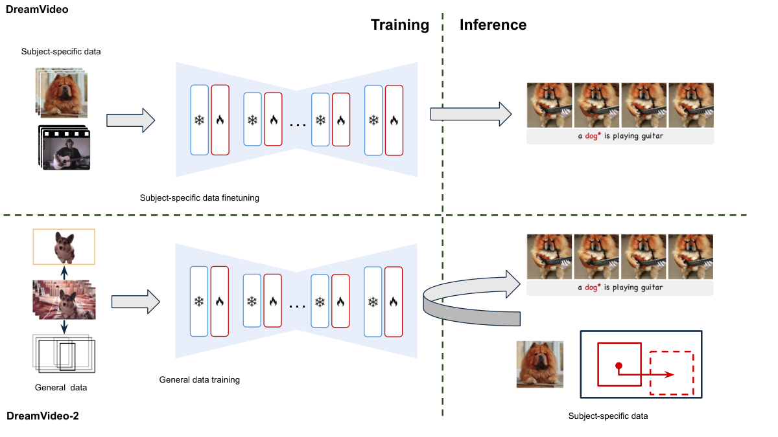
A subject that stays recognizable
Identity needs to survive changes in pose and view.
Wang et al., Video Diffusion Survey, rev. 2026, Fig. 19
26
Notes:
TRANSCRIPT
A recognizable subject needs to survive changes in pose, lighting, and viewpoint. The figure compares approaches that use subject-specific information during adaptation or inference. The technical details differ, but the creative requirement is easy to state. We want to recognize the same subject when the camera angle changes. A general description such as a small brown dog leaves many identifying features unspecified. References can provide those details more directly. For a film, evaluate identity across the shots you actually need, rather than only in a favorable close-up. A method may preserve a face from the front while struggling with a profile or an unusual expression.
SOURCE AND FIGURE NOTES
Figure 19 contrasts subject-specific adaptation with reference-driven inference. Finetuning changes model parameters for the subject. Reference-driven inference supplies the subject at generation time. Both approaches can fail under difficult views.
Primary reading: https://arxiv.org/abs/2504.16081v3
Figure source: https://arxiv.org/html/2504.16081v3
Image URL: https://arxiv.org/html/2504.16081v3/personalization.png
Original caption: Figure 19: A high-level comparison of two personalization paradigms—subject-specific finetuning and subject-specific-driven inference—illustrated by DreamVideo ( Wei et al., 2024c ) and DreamVideo-2 ( Wei et al., 2024b ) . In DreamVideo, each new subject (its images and desired motion) is used to finetune the model. In contrast, DreamVideo-2 leverages a pretrained diffusion model trained on general videos (decomposed into subjects and bounding boxes); it then generates videos for a new subject based on a single image and bounding boxes—without requiring additional finetuning.

Slide 27
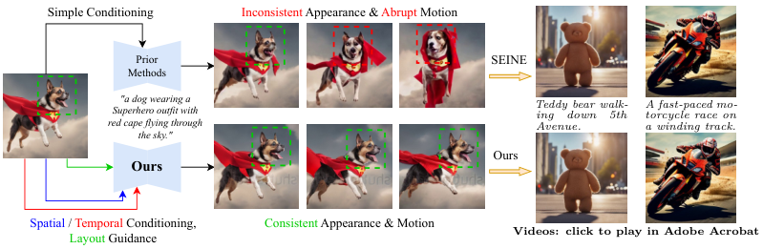
Continuity needs more than a good first frame
Check appearance and movement across the whole shot.
Wang et al., Video Diffusion Survey, rev. 2026, Fig. 20
27
Notes:
TRANSCRIPT
A good first frame is only the beginning of continuity. Look at appearance and movement throughout the shot. Does the subject keep its recognizable features? Does its motion develop smoothly and plausibly for the intended style? The figure presents examples intended to illustrate more consistent conditioning. Treat them as selected demonstrations, not proof that every output will remain stable. Also separate a deliberate transformation from an accidental drift. If our painting is meant to change, specify what may change and what must remain stable. The picture inside the frame might transform while the frame itself keeps the same shape and position.
SOURCE AND FIGURE NOTES
Figure 20 compares examples from SEINE and ConsistI2V. Treat these as selected paper examples, not a present-day leaderboard. Ask students to track one attribute across the columns. A still montage cannot establish temporal smoothness.
Primary reading: https://arxiv.org/abs/2504.16081v3
Figure source: https://arxiv.org/html/2504.16081v3
Image URL: https://arxiv.org/html/2504.16081v3/consistency_model.png
Original caption: Figure 20: Comparison of image-to-video generation results obtained from SEINE and ConsistI2V. SEINE shows degenerated appearance and motion as the video progresses, while ConsistI2V maintains visual consistency utilizing spatial and temporal conditions.

Slide 28
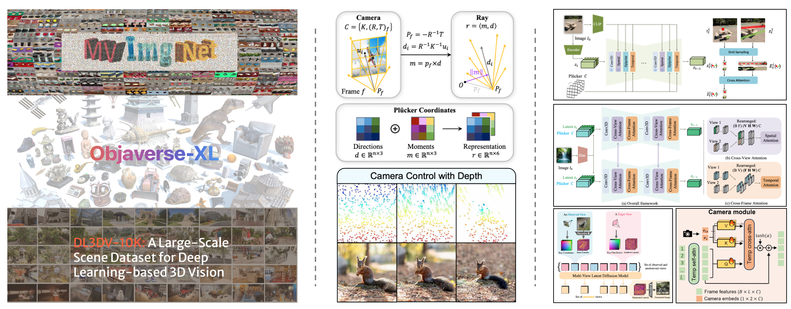
Video models can incorporate 3D information
Camera information links an image to a viewpoint.
Wang et al., Video Diffusion Survey, rev. 2026, Fig. 22
28
Notes:
TRANSCRIPT
Video models can incorporate explicit three-dimensional information. The figure groups examples involving training datasets, camera representations, and architectural changes. The middle column connects a camera to rays through image locations. You can understand a ray as a direction from which the camera observes the scene. This provides more specific spatial information than a verbal instruction alone. The right column shows ways models incorporate such information. We are interested in the principle: viewpoint information can help connect images of the same scene. It still does not guarantee perfect geometry. Unseen surfaces and difficult camera paths remain important places to look for mistakes.
SOURCE AND FIGURE NOTES
Figure 22 organizes 3D-aware video modeling around training data, camera control, and architecture. Read the three columns at a high level. Camera position and direction supply explicit information beyond a verbal camera instruction. This is a research taxonomy, not a guarantee of perfect spatial consistency.
Primary reading: https://arxiv.org/abs/2504.16081v3
Figure source: https://arxiv.org/html/2504.16081v3
Image URL: https://arxiv.org/html/2504.16081v3/figs_and_tabs/teaser3d.jpg
Original caption: Figure 22: For a video diffusion model to be 3D aware, the general paradigm includes training on 3D dataset, adding camera control to the model, and introducing 3D-aware model architectures.

Slide 29
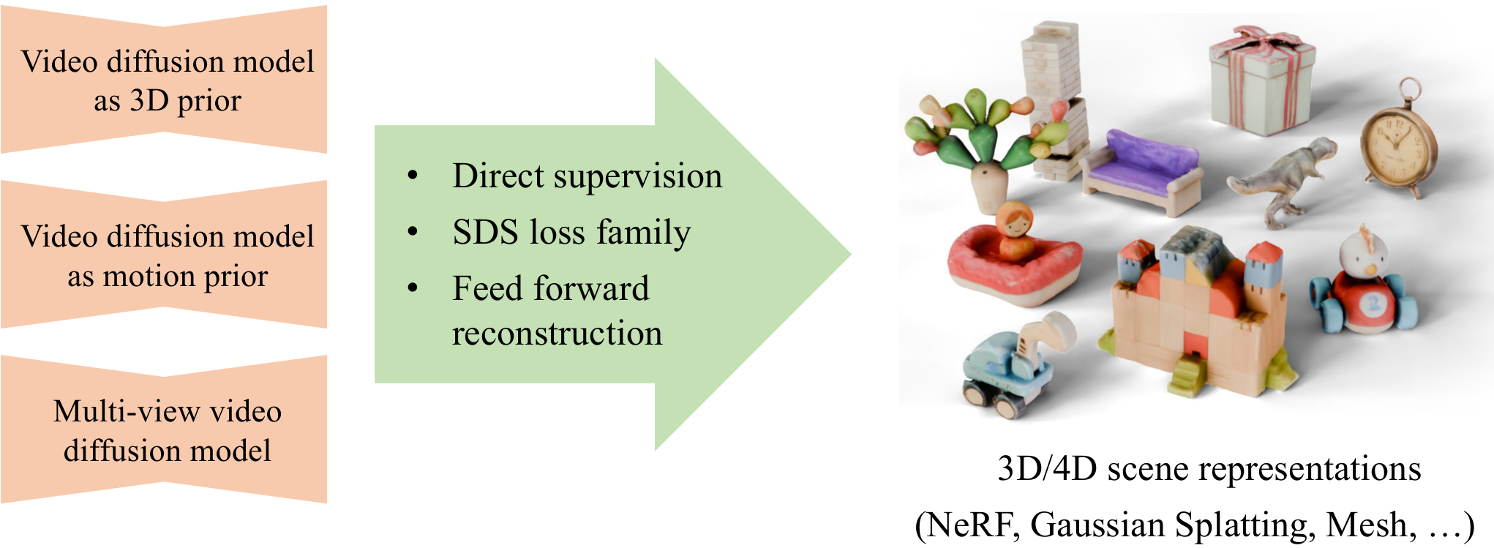
Video knowledge can guide a scene representation
A generated sequence can help build a 3D scene.
Wang et al., Video Diffusion Survey, rev. 2026, Fig. 24
29
Notes:
TRANSCRIPT
A video model can also provide knowledge for constructing a scene representation. The left side of the diagram identifies sources of visual or motion information. The middle describes ways to transfer that information. The right shows representations such as meshes, neural fields, and Gaussian splats. A video is a set of images over time. A scene representation aims to support rendering under chosen viewpoints, and sometimes at chosen moments. Moving from one to the other requires reconstruction or optimization. This matters to artists because a reusable scene can support later camera decisions, while a finished video usually commits you to the views already present in its frames.
SOURCE AND FIGURE NOTES
Figure 24 describes transferring knowledge from video models into scene representations. Explain 4D as a 3D scene that changes through time. A video is a sequence of images. A scene representation supports rendering from specified viewpoints. A separate reconstruction or optimization process connects them.
Primary reading: https://arxiv.org/abs/2504.16081v3
Figure source: https://arxiv.org/html/2504.16081v3
Image URL: https://arxiv.org/html/2504.16081v3/3d_4d_gen.png
Original caption: Figure 24: A common paradigm for 3D and 4D generation is by distilling 3D or motion knowledge from video generation models to 3D and 4D scene representation.

Slide 30
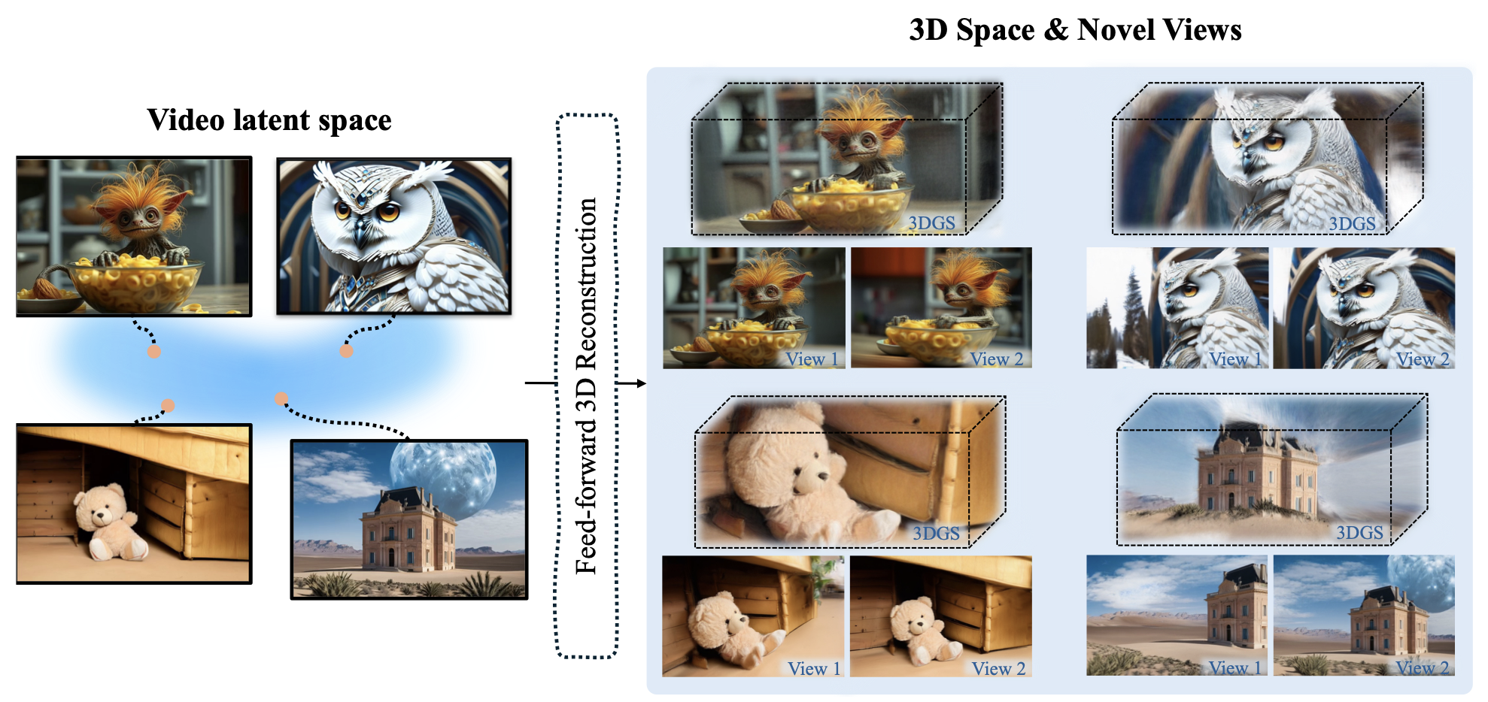
Wonderland connects video and reconstruction
A reconstruction model predicts a scene with new views.
Wang et al., Video Diffusion Survey, rev. 2026, Fig. 25
30
Notes:
TRANSCRIPT
Wonderland illustrates a connection between video representations and scene reconstruction. Follow the diagram from the latent space on the left to the three-dimensional outputs on the right. The small paired views help show the purpose of reconstruction: we can render related views of a scene rather than simply display one image. The examples use Gaussian splats as a scene representation. We will revisit that idea later. For now, ask what additional freedom this creates for a filmmaker. You may gain some camera flexibility, but selected views do not demonstrate unrestricted movement or complete hidden geometry. Test the camera path your project actually requires.
SOURCE AND FIGURE NOTES
Figure 25 illustrates Wonderland. Start on the left with video latent representations and follow the reconstruction step into 3D Gaussian splats. On the right, compare the two rendered viewpoints of a subject. Selected examples illustrate the method and do not prove complete geometry or unrestricted camera movement.
Primary reading: https://arxiv.org/abs/2504.16081v3
Figure source: https://arxiv.org/html/2504.16081v3
Image URL: https://arxiv.org/html/2504.16081v3/figs_and_tabs/wonderland.png
Original caption: Figure 25: By training a feed-forward reconstruction model from a video generative model, Wonderland Liang et al. (2024b) achieves remarkable 3D scene generation results.

Slide 31
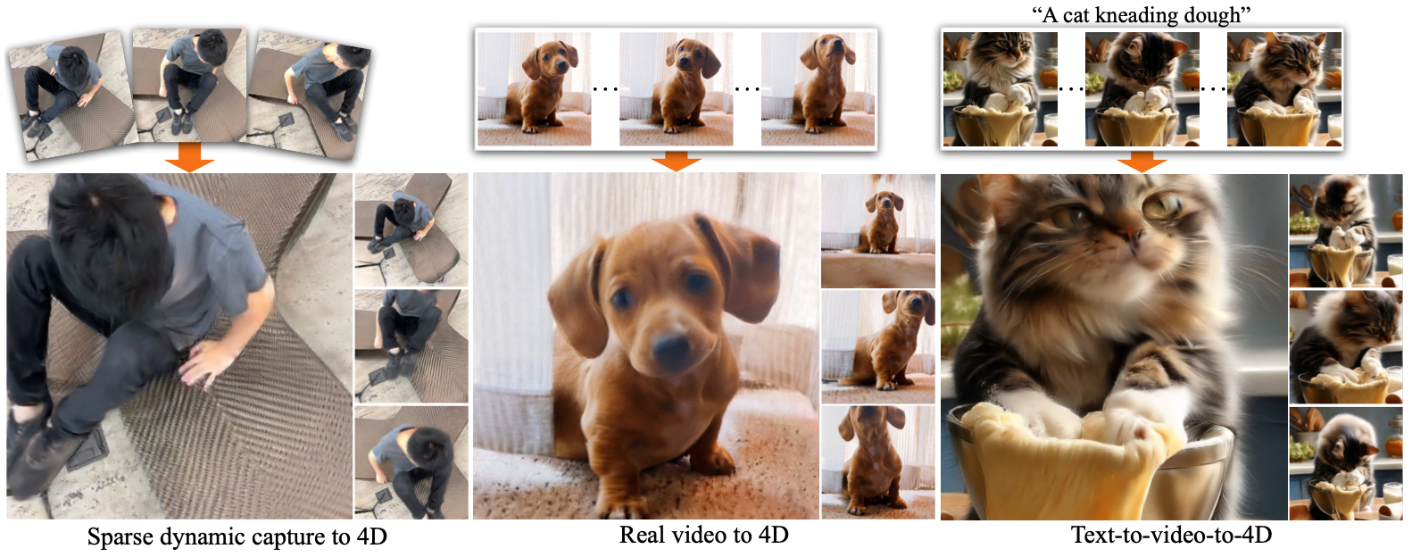
A moving scene varies in viewpoint and time
CAT4D models both dimensions.
Wang et al., Video Diffusion Survey, rev. 2026, Fig. 26
31
Notes:
TRANSCRIPT
A dynamic scene changes in two ways: the viewpoint can change, and the action can advance through time. CAT4D addresses this combination. The examples include captured and generated source material connected to dynamic scene reconstruction. Imagine freezing a dancer at one moment and walking around them. Now imagine keeping the camera still while the dancer continues. These are different operations. A model that represents both needs to infer appearances across viewpoint and time. Much of that material may never have been observed directly. For creative work, this offers flexibility, but it also means that the quality of inferred regions and motions needs deliberate evaluation.
SOURCE AND FIGURE NOTES
Figure 26 illustrates CAT4D. A monocular video observes a changing scene from one camera at each moment. The method uses a multi-view video diffusion model to synthesize additional observations. Explain the difference between moving the camera around a moment and advancing the action in time. Unseen content remains inferred.
Primary reading: https://arxiv.org/abs/2504.16081v3
Figure source: https://arxiv.org/html/2504.16081v3
Image URL: https://arxiv.org/html/2504.16081v3/figs_and_tabs/cat4d.png
Original caption: Figure 26: CAT4D ( Wu et al., 2024e ) trains a multi-view video diffusion model conditioned on a monocular video, which enables 4D view synthesis from casually captured monocular videos.

Slide 32
Video-model checkpoint
What fixes appearance?
What controls movement?
What still needs inspection?
Wang et al., Video Diffusion Survey, rev. 2026
32
Notes:
TRANSCRIPT
Let us pause and apply the video survey to our studio. What fixes the appearance of the room? An initial image or a scene representation might help. What controls the movement? A motion reference, audio signal, camera instruction, or other condition might supply useful information. What still needs inspection? The painting boundary, the person's identity, and the continuity of the room are possible answers. Choose one requirement and explain why a particular input helps. Then identify a failure that the input cannot rule out. This exercise is more useful than naming a fashionable model, because it connects the method to evidence you can actually inspect.
SOURCE AND FIGURE NOTES
Ask students to choose an input setup for the moving painting. Suggested answer: a reference image for appearance, an explicit motion cue or source clip for movement, and a review of identity, background, and timing.
Primary reading: https://arxiv.org/abs/2504.16081v3

Slide 33
02
Visual art creation
Wang, Chen, and Wang
Diffusion-Based Visual Art Creation
ACM Computing Surveys, 2025
Wang, Chen & Wang, Visual Art Creation, 2025
33
Notes:
TRANSCRIPT
Our next reading is Diffusion-Based Visual Art Creation by Wang, Chen, and Wang, published in ACM Computing Surveys in 2025. This paper shifts the emphasis from generating sequences to understanding artistic tasks and intentions. We will consider how technical choices relate to the kind of artwork someone wants to make. A system may generate a polished image while giving the artist too little control over its meaning or structure. Conversely, an imperfect result may become useful material for further work. Keep the studio example in mind. We now ask what the changing painting should express, and how that intention changes the way we judge its output.
SOURCE AND FIGURE NOTES
Source: https://arxiv.org/abs/2408.12128. The preprint dates to 2024. We focus on artistic requirements, task design, and human involvement.
Primary reading: https://arxiv.org/abs/2408.12128

Slide 34
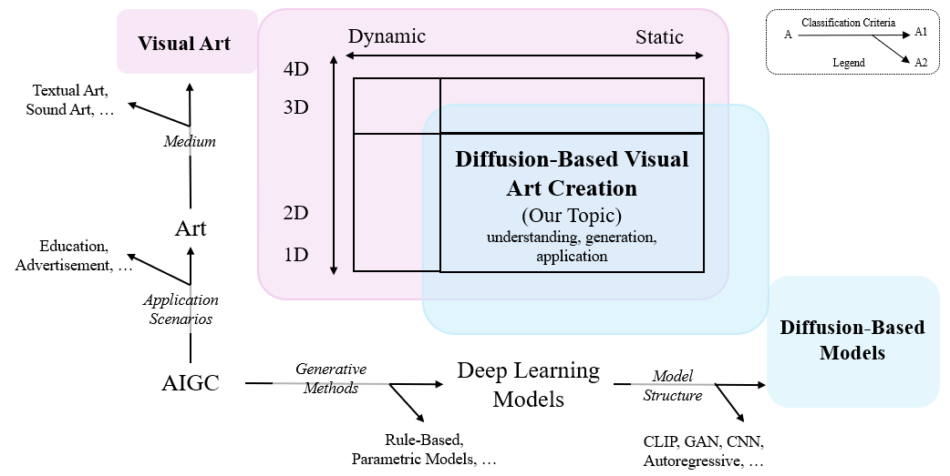
Artistic goals and technical methods
The survey studies where these two perspectives meet.
Wang, Chen & Wang, Visual Art Creation, 2025, Fig. 1
34
Notes:
TRANSCRIPT
The figure places diffusion-based visual art at the intersection of several categories. Art can use different media, serve different purposes, and exist as static or changing material. Technical methods also vary in what they represent and how they generate it. The survey studies where these perspectives meet. This is useful because a technical task label rarely describes the whole artistic problem. Text-to-image tells us something about inputs and outputs, but little about why the image matters. For our studio, an illustration, an installation, and a film might use related generated imagery while requiring different forms of control and different ways of evaluating the audience experience.
SOURCE AND FIGURE NOTES
Figure 1 defines the scope. The survey emphasizes static 2D art with some animation and 3D coverage. Use this qualification when connecting it to video. Its artistic and technical taxonomies are distinct.
Primary reading: https://arxiv.org/abs/2408.12128
Figure source: https://arxiv.org/html/2408.12128v1
Image URL: https://arxiv.org/html/2408.12128v1/fig/framework.png
Original caption: Figure 1. Identifying the scope of this survey. We adopt two independent taxonomies to determine the research scope. For visual arts (creative targets), we primarily include 2D static visual content, supplemented by a small amount of animation, 3D, and cartoons. Regarding diffusion models (generative methods), we mainly cover aspects such as model design, task applications, and human-computer interaction.

Slide 35
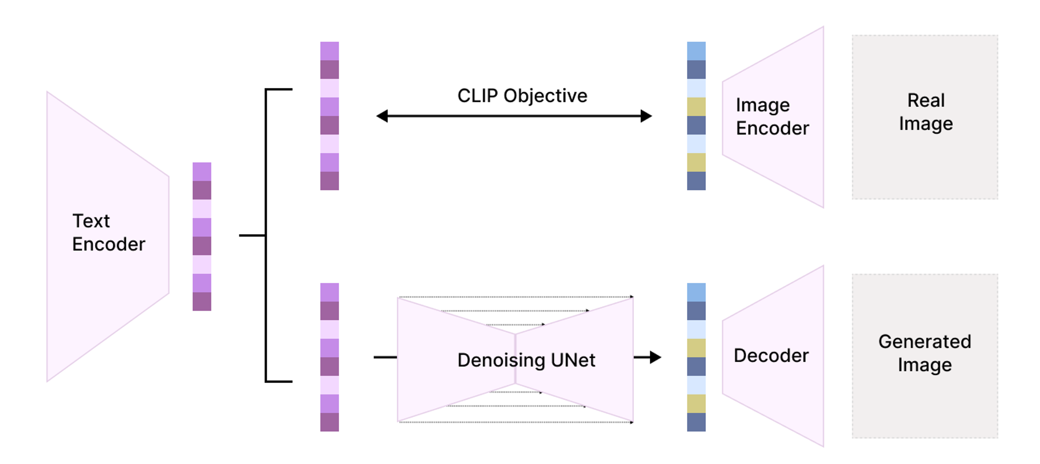
Text becomes a condition for generation
A text encoder turns words into a model representation.
Wang, Chen & Wang, Visual Art Creation, 2025, Fig. 2
35
Notes:
TRANSCRIPT
Text becomes usable conditioning through an encoder. The diagram shows a conceptual connection between text representations, image representations, and a denoising network. CLIP is associated with learning relationships between image and text representations. In a diffusion workflow, text information can then influence the refinement of visual content. This simplified figure combines ideas and should not be treated as the exact architecture of every generator. The important point is that a sentence becomes a numerical representation, rather than a complete set of drawing instructions. A phrase such as uneasy memory therefore leaves many visible decisions open. References and editing can help make those decisions more specific.
SOURCE AND FIGURE NOTES
Figure 2 is a simplified schematic combining ideas from CLIP and diffusion systems. Walk through the text encoder, denoising network, and decoder. CLIP learns relationships between image and text representations. The schematic is conceptual and should not be treated as the exact architecture of every model. The prompt conditions the process rather than specifying every pixel.
Primary reading: https://arxiv.org/abs/2408.12128
Figure source: https://arxiv.org/html/2408.12128v1
Image URL: https://arxiv.org/html/2408.12128v1/fig/model_structure.png
Original caption: Figure 2. Diffusion-based generative structures suggested by Stable Diffuson ( Rombach et al., 2022 ) and DALL·E-2 ( Ramesh et al., 2022 ) . The image illustrates how the diffusion model integrates with the CLIP model to form the pipeline for generative tasks. The upper half shows the training process, and the lower half shows the inference process with the internal mechanism of diffusion models.

Slide 36
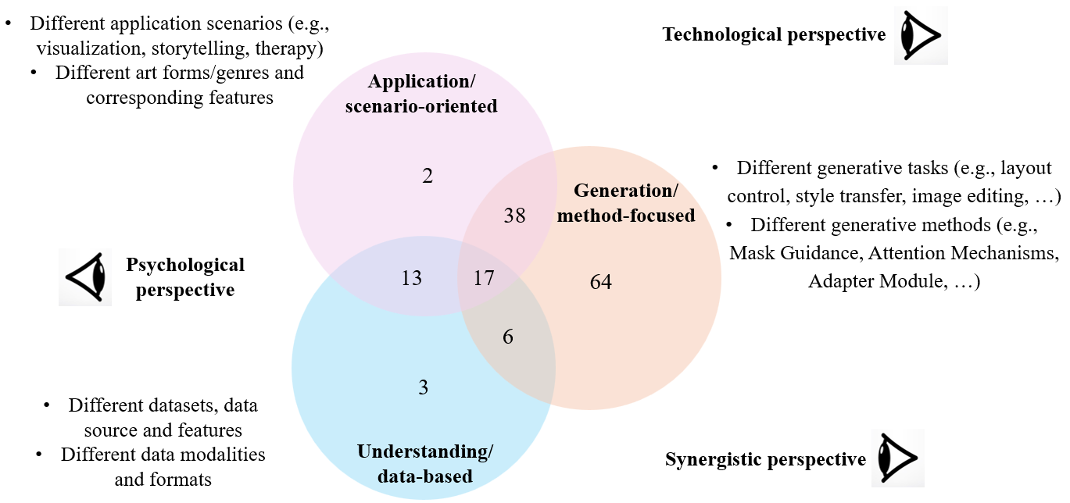
Three research perspectives
Creating images is one part of the picture.
Wang, Chen & Wang, Visual Art Creation, 2025, Fig. 3
36
Notes:
TRANSCRIPT
The survey identifies three research perspectives: applications, generation methods, and understanding or data. The overlapping circles show that a paper may belong to more than one perspective. Work on an artistic application can also introduce a generation method or study how people interpret images. The numbers describe the authors' selected research corpus, not all possible work in the field. When reading a paper, identify which question it primarily answers. Does it introduce a tool, study an audience, or analyze material? This helps you avoid expecting a technical benchmark to answer an artistic question that the researchers did not set out to investigate.
SOURCE AND FIGURE NOTES
Figure 3 distinguishes application-oriented, generation-focused, and understanding-focused research. Explain that understanding art and generating art are different tasks. Counts describe the authors’ selected corpus, not all research.
Primary reading: https://arxiv.org/abs/2408.12128
Figure source: https://arxiv.org/html/2408.12128v1
Image URL: https://arxiv.org/html/2408.12128v1/fig/venn_chart.png
Original caption: Figure 3. Venn Chart for Topics in Visual Art Creation. The chart is summarized from data distribution and annotations in our dataset. This framework is used to categorize and distinguish the blueprints of relevant research (Sec. 5.1 ) and to analyze the development and current state of this field (Sec. 5.2 ). In Sec. 6 , we further provide technological, synergistic, and application perspectives as extensions of these three categories for development trends and future work.

Slide 37
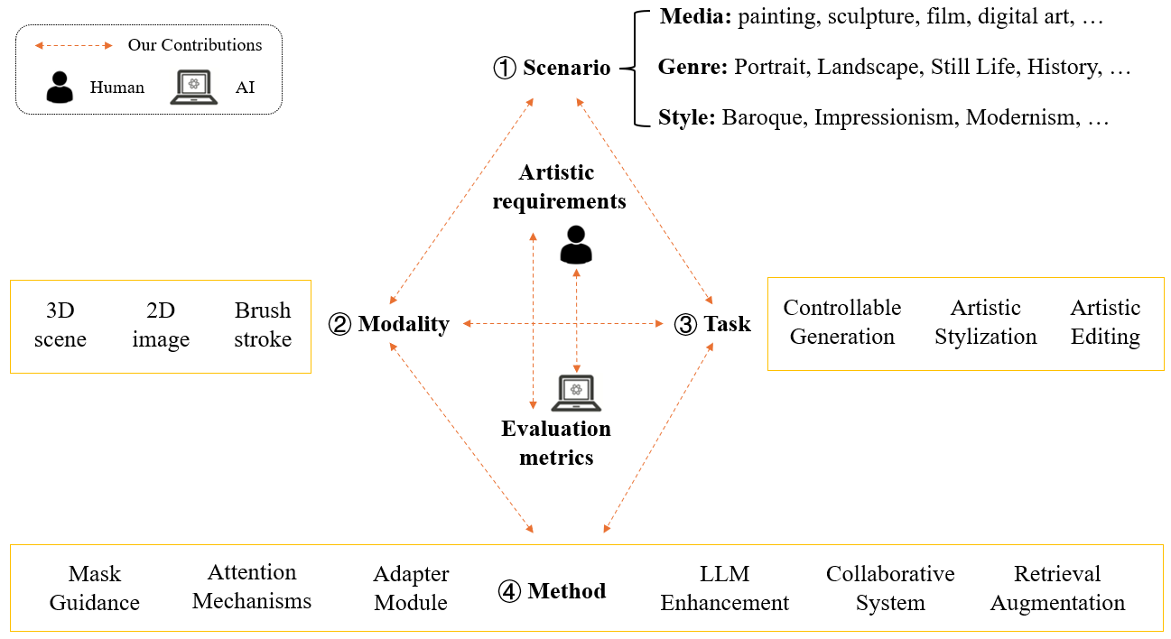
The artist’s intention comes first
A feeling becomes a set of visible decisions.
Wang, Chen & Wang, Visual Art Creation, 2025, Fig. 4
37
Notes:
TRANSCRIPT
An artistic intention becomes useful when we connect it to visible decisions. The survey's framework links scenario, modality, task, and method to artistic requirements and evaluation. Suppose our intention is an uneasy memory. We could use delayed movement, missing details, or a familiar room with one altered object. Each choice suggests different controls. A general request to make the scene more artistic does not tell us what to change or how to judge success. Start with the intended experience, identify a visible decision, and choose a method that gives you some control over it. The framework is a way to organize that reasoning.
SOURCE AND FIGURE NOTES
Figure 4 connects scenario, modality, task, and method. Walk through only the main path. Our proposed example is unease in an empty studio. The mood could involve lighting, spacing, texture, or motion rather than a longer prompt alone.
Primary reading: https://arxiv.org/abs/2408.12128
Figure source: https://arxiv.org/html/2408.12128v1
Image URL: https://arxiv.org/html/2408.12128v1/fig/paradigm.png
Original caption: Figure 4. An Overall Framework for Diffusion-Based Visual Art Creation. The main contributions of this paper lie in establishing the connections between scenario, modality, task, and method, as well as outlining a general roadmap from artistic requirements (human perspective) to technical problems (AI perspective). This framework is then used to analyze each individual paper in our dataset (Sec. 5.3 and Sec. 5.4 ).

Slide 38
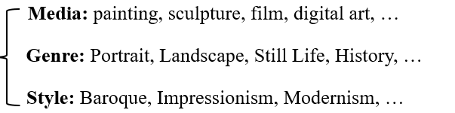
A scenario gives the work a purpose
A portrait, an installation, and a film ask different things.
Wang, Chen & Wang, Visual Art Creation, 2025, Fig. 4 (detail)
38
Notes:
TRANSCRIPT
A scenario gives the work a purpose. The enlarged figure distinguishes medium, genre, and style. A portrait concentrates attention differently from a landscape. A film unfolds over time, while an installation may respond to where a visitor stands or how long they remain. These distinctions affect both production and evaluation. The same generated image might be a finished print, a storyboard reference, or one frame in an animation. For the studio example, decide whether the audience watches a fixed sequence or discovers changes while moving through a space. That choice changes the kinds of continuity and control the work needs.
SOURCE AND FIGURE NOTES
Enlarged detail of Figure 4. The scenario includes medium, genre, and style. Ask what changes if the studio scene is an installation loop instead of a short narrative. Revisit the same figure deliberately to focus on its first component.
Primary reading: https://arxiv.org/abs/2408.12128
Figure source: https://arxiv.org/html/2408.12128v1
Image URL: https://arxiv.org/html/2408.12128v1/fig/paradigm.png
Original caption: Figure 4. An Overall Framework for Diffusion-Based Visual Art Creation. The main contributions of this paper lie in establishing the connections between scenario, modality, task, and method, as well as outlining a general roadmap from artistic requirements (human perspective) to technical problems (AI perspective). This framework is then used to analyze each individual paper in our dataset (Sec. 5.3 and Sec. 5.4 ).
Figure detail enlarged for teaching. Repeated figure supports a progressive explanation.

Slide 39
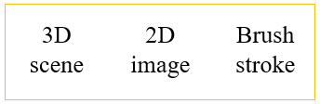
A modality is the form of the material
Pixels, brush strokes, and 3D scenes support different edits.
Wang, Chen & Wang, Visual Art Creation, 2025, Fig. 4 (detail)
39
Notes:
TRANSCRIPT
A modality is the form of the material you work with. The figure names a three-dimensional scene, a two-dimensional image, and a brush stroke. These forms support different kinds of intervention. Editing pixels gives direct access to an image surface. Working with a scene may give access to camera position and spatial relationships. A stroke representation may preserve information about how a mark is constructed. None is universally best. Ask what you want to revise later. If you need to move the camera around the studio, a single finished image may be restrictive. If you need a fixed composition, its simplicity may be helpful.
SOURCE AND FIGURE NOTES
Detail of the modality examples in Figure 4. Define modality here as the representation of the creative material. A brush-stroke representation can expose mark-making decisions that a flat image does not.
Primary reading: https://arxiv.org/abs/2408.12128
Figure source: https://arxiv.org/html/2408.12128v1
Image URL: https://arxiv.org/html/2408.12128v1/fig/paradigm.png
Original caption: Figure 4. An Overall Framework for Diffusion-Based Visual Art Creation. The main contributions of this paper lie in establishing the connections between scenario, modality, task, and method, as well as outlining a general roadmap from artistic requirements (human perspective) to technical problems (AI perspective). This framework is then used to analyze each individual paper in our dataset (Sec. 5.3 and Sec. 5.4 ).
Figure detail enlarged for teaching. Repeated figure supports a progressive explanation.

Slide 40
Four useful creative tasks
Generate content
Control a result
Change a style
Edit selected content
Wang, Chen & Wang, Visual Art Creation, 2025
40
Notes:
TRANSCRIPT
Four useful creative tasks are generating content, controlling a result, changing style, and editing selected content. These tasks often occur together, but distinguishing them helps diagnose a workflow. If the room is missing, you need content generation. If the room exists but the door is in the wrong place, you need control or editing. If the composition is suitable but the material should resemble charcoal, you may need stylization. Describe the problem before choosing the tool. Repeating full generation for every small correction can discard successful decisions that you would rather preserve. A local intervention may be a better fit for the actual need.
SOURCE AND FIGURE NOTES
These are teaching labels for task distinctions discussed in the art survey. They can overlap within one workflow. Ask students whether changing a palette preserves the original content, and how replacing a character differs.
Primary reading: https://arxiv.org/abs/2408.12128

Slide 41
An edit needs a boundary
A mask specifies where a change may occur.
The surrounding image provides context.
Wang, Chen & Wang, Visual Art Creation, 2025
41
Notes:
TRANSCRIPT
A mask specifies a region where an edit may occur. The surrounding image provides context for making the change fit. In our studio, we might mask the inside of the painting while leaving its frame and the wall outside the selected region. This makes the request more precise than asking for a different painting in an entirely new room. However, a mask is not a guarantee that every unselected detail will remain identical. The behavior depends on the method and settings. Inspect the edge of the edit, the lighting, and nearby textures. A successful local change should also make sense within the larger composition.
SOURCE AND FIGURE NOTES
Teaching explanation connected to the visual-art survey discussion of mask guidance and artistic editing. In the studio example, changing the painting while preserving the wall is a local editing task. A mask does not guarantee that all unmasked content remains perfectly unchanged. Inspect the result at boundaries.
Primary reading: https://arxiv.org/abs/2408.12128

Slide 42
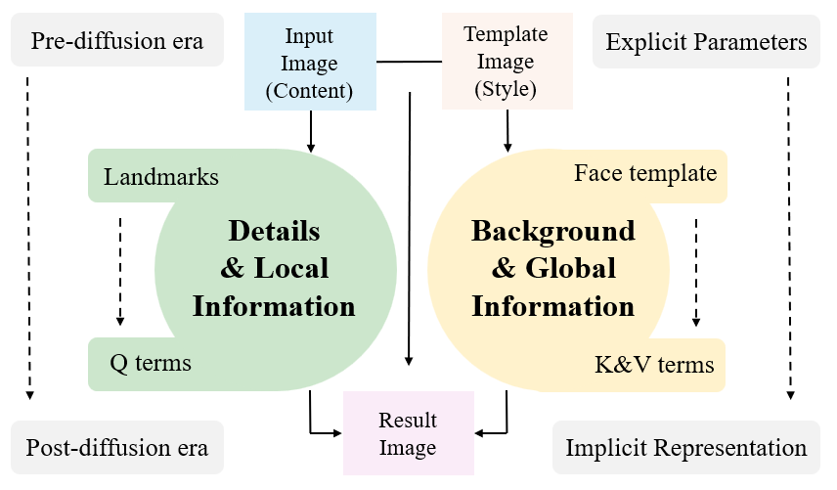
Style includes structure
Shape and composition matter alongside color.
Wang, Chen & Wang, Visual Art Creation, 2025, Fig. 8
42
Notes:
TRANSCRIPT
Style includes more than color or surface texture. The diagram connects local details with global information and shows how different parts of a method can influence a result. Think about the difference between a face painted with loose brushwork and a face whose proportions have also changed. Both may appear stylistic, but they alter different relationships. Composition, shape, and rhythm can be part of the visual language. When you request a style transfer, identify which of those properties may change. Otherwise, a method might produce the intended texture while removing a structural feature that was important to the identity or meaning of the original.
SOURCE AND FIGURE NOTES
Figure 8 compares portrait-stylization mechanisms. Discuss content and style as useful but imperfect distinctions. A style can affect proportions and spatial arrangement as well as surface texture. Avoid reading the schematic as a universal architecture.
Primary reading: https://arxiv.org/abs/2408.12128
Figure source: https://arxiv.org/html/2408.12128v1
Image URL: https://arxiv.org/html/2408.12128v1/fig/comparison.png
Original caption: Figure 8. Comparison Between Different Methods on Similar Tasks Before and After the Diffusion Era. We select the task of portrait stylization as an example. We compare traditional methods based on image blending ( Chiang et al., 2018 ) and the model structure of the newly-proposed Portrait Diffusion ( Liu et al., 2023a ) . Based on them, we abstract a unified paradigm for portrait stylization.

Slide 43
Content and style need separate decisions
Keep the subject recognizable.
Choose which aspects of appearance may change.
Wang, Chen & Wang, Visual Art Creation, 2025
43
Notes:
TRANSCRIPT
Let us separate content and style as a practical exercise. Imagine that a character must remain recognizable while the image changes from photographic to painted. Which features should stay stable? You might choose the silhouette, facial proportions, or pose. Which features may vary? Brushwork and palette are possible answers. This separation is useful, but it is not universal. Some styles depend on changing proportions or spatial relationships. Explain your own boundary rather than assuming the software will infer it. For the studio painting, decide whether its subject remains recognizable during the transformation, or whether losing recognition is part of the intended experience.
SOURCE AND FIGURE NOTES
Teaching discussion based on the survey treatment of artistic stylization. Ask students to distinguish the identity and pose of a portrait from its brushwork, palette, and composition. Style transfer can change structure as well as color. There is no universal separation between content and style.
Primary reading: https://arxiv.org/abs/2408.12128

Slide 44
A technical score answers a narrow question
Matching a prompt does not establish artistic success.
Wang, Chen & Wang, Visual Art Creation, 2025
44
Notes:
TRANSCRIPT
A technical score answers a particular question. It may estimate prompt alignment, visual similarity, or some aspect of perceptual quality. It cannot automatically establish whether an artwork succeeds. A deliberately ambiguous image might receive a weaker score for literal prompt matching while producing the intended experience. That does not make technical evaluation useless. It means we need to state what each measure is supposed to assess. For the studio, you might separately evaluate whether the room remains stable and whether the change in the painting feels unsettling. One concerns a visible constraint. The other concerns interpretation, which may require viewers and discussion rather than a single automated number.
SOURCE AND FIGURE NOTES
The survey connects artistic goals and evaluation metrics. Discuss why semantic alignment, fidelity, and personal response answer different questions. An artwork can deliberately disturb expectations or use ambiguity. Ask students to propose their own criterion.
Primary reading: https://arxiv.org/abs/2408.12128

Slide 45
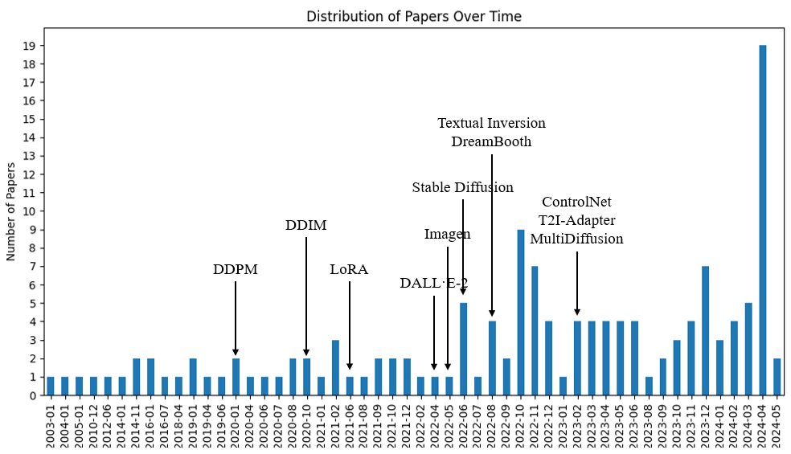
The literature changed after diffusion
The survey records growth in its selected research corpus.
Wang, Chen & Wang, Visual Art Creation, 2025, Fig. 5
45
Notes:
TRANSCRIPT
This chart records changes in the survey's selected literature over time. The labels connect the distribution to influential developments such as diffusion models and methods for adaptation or control. Read it as a historical view of the corpus the authors assembled. It is not a complete census of AI-art research, and its final dates do not extend to today. The useful question is how new methods changed the kinds of tasks researchers could attempt. Greater access to generation can shift attention toward control, editing, and applications. To understand the strength of that claim, we would still need to examine the actual papers and selection process.
SOURCE AND FIGURE NOTES
Figure 5 is a historical distribution from the authors’ selected dataset. Its final dates do not extend to the present. It supports discussion of the survey’s coverage, not a precise count of all AI-art research.
Primary reading: https://arxiv.org/abs/2408.12128
Figure source: https://arxiv.org/html/2408.12128v1
Image URL: https://arxiv.org/html/2408.12128v1/fig/data_distribution.png
Original caption: Figure 5. Temporal Distribution of the Number of Papers in Our Selected Dataset. We also labeled the timestamps when major models are proposed ( Ho et al., 2020 ; Song et al., 2020a ; Hu et al., 2021a ; Ramesh et al., 2022 ; Saharia et al., 2022 ; Rombach et al., 2022 ; Gal et al., 2022 ; Ruiz et al., 2023 ; Zhang et al., 2023c ; Mou et al., 2024 ; Bar-Tal et al., 2023 ) .

Slide 46
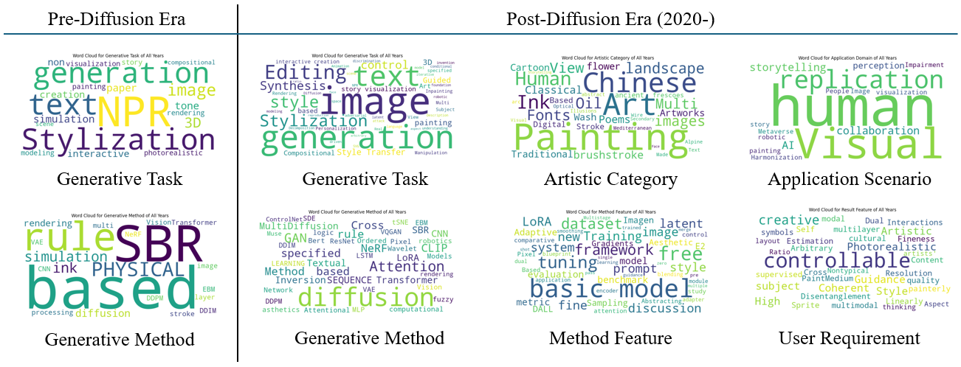
The vocabulary of art research also changed
The survey compares tasks, methods, and artistic concerns.
Wang, Chen & Wang, Visual Art Creation, 2025, Fig. 7
46
Notes:
TRANSCRIPT
The word clouds offer another view of the authors' research collection. Larger words indicate prominence within the coded material, rather than artistic importance or current popularity. Compare task terms such as generation and editing with method terms such as diffusion. Then look at the artistic categories and user requirements. These are different kinds of vocabulary, and mixing them can make a project description vague. If you say your project uses diffusion, you have named a method. If you say it explores fragmented memory through changing portraits, you have begun to describe an artistic purpose. A clear proposal explains the connection between those two descriptions.
SOURCE AND FIGURE NOTES
Figure 7 contains word clouds derived from the authors’ coded research corpus. Larger words represent prominence in that corpus. They are not measures of artistic importance or a current popularity ranking. Ask students to find a task word such as editing and distinguish it from a method word such as diffusion.
Primary reading: https://arxiv.org/abs/2408.12128
Figure source: https://arxiv.org/html/2408.12128v1
Image URL: https://arxiv.org/html/2408.12128v1/fig/word_cloud_chart.png
Original caption: Figure 7. Multi-Dimensional Word Clouds in Our Selected Dataset. By coding each paper and collecting keywords from different perspectives, we derive multiple word clouds of our dataset for both before and after the diffusion era (2020).

Slide 47
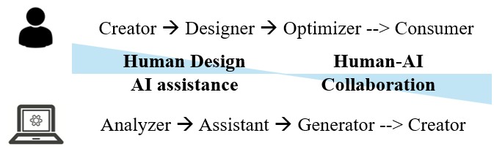
Human involvement changes across a workflow
Choosing, revising, and judging remain creative acts.
Wang, Chen & Wang, Visual Art Creation, 2025, Fig. 9
47
Notes:
TRANSCRIPT
Human involvement changes across a workflow. The figure presents possible roles for people and AI, from assistance and analysis toward more extensive generation. Treat this as a conceptual perspective, not an inevitable sequence in which one role replaces another. Choosing references, rejecting outputs, setting constraints, and deciding when to stop are all meaningful parts of creative work. Their importance may increase when generating more candidates becomes easy. For your own project, identify a decision that you would keep under direct human control. Then explain what evidence you would want from a tool before accepting its contribution to that decision.
SOURCE AND FIGURE NOTES
Figure 9 presents possible changes in human and AI roles. Discuss it as the authors’ conceptual perspective, not an inevitable replacement sequence. Who decides when a result is finished?
Primary reading: https://arxiv.org/abs/2408.12128
Figure source: https://arxiv.org/html/2408.12128v1
Image URL: https://arxiv.org/html/2408.12128v1/fig/paradigm_shift.png
Original caption: Figure 9. New perspectives on the emerging frontiers and future work of diffusion-based visual art creation. From a synergistic perspective, we inspect a continuous paradigm shift in the roles of human and AI.

Slide 48
Our studio scene as an artwork
Intention: an uneasy memory.
Decision: the painting changes before the room does.
Classroom exercise · inspired by the readings
48
Notes:
TRANSCRIPT
Return to the studio as an artwork. Our intention is an uneasy memory, and our chosen intervention is that the painting changes before the room does. The order directs attention. At first, the viewer may wonder whether they noticed anything. Later, a second change can confirm that something is wrong. A different version might use abrupt movement and loud sound to create surprise instead. Both could use similar generation tools while producing different experiences. Describe the intended effect in terms that can guide production. We need to know where the change begins, how quickly it develops, and which stable details help the audience notice it.
SOURCE AND FIGURE NOTES
Instructor-created example. Ask students how the decision directs attention. Alternatives could use a warmer palette, repeated objects, or a different duration. There is no single technically optimal realization of a mood.
Primary reading: https://arxiv.org/abs/2408.12128

Slide 49
One intention, one intervention
Choose a visual decision.
Explain how an audience might read it.
Classroom exercise · inspired by the readings
49
Notes:
TRANSCRIPT
Choose one artistic intention and one visible intervention. For example, you might want the studio to feel welcoming, and decide that light gradually enters through the window. Or you might want it to feel unfamiliar, and change the scale of an object between shots. Explain how an audience could read the intervention. Then propose a way to judge whether it works, perhaps by showing two versions to classmates and asking what changed their interpretation. Pause the recording if you want time to work through an example. The aim is to connect a controllable property to an intended experience, rather than simply to request a more impressive output.
SOURCE AND FIGURE NOTES
Two-minute paired activity. Each student names an intention, one controllable variable, and a criterion for judging the result. Encourage concrete descriptions such as a slower reveal rather than generic claims about making it cinematic.
Primary reading: https://arxiv.org/abs/2408.12128

Slide 50
Art becomes a sequence
The next question is how the choices survive across shots.
Wang, Chen & Wang, Visual Art Creation, 2025
50
Notes:
TRANSCRIPT
Once art becomes a sequence, decisions have to survive across shots and moments. A visual style may need to remain recognizable. A character may need to carry identity from a close-up into a wider view. The sequence also creates relationships through ordering, duration, and sound. Some art videos deliberately disrupt continuity, so consistency is not an absolute artistic rule. What matters is whether a change supports the work. We now move from the visual-art framework to filmmaking cases. As you look at each case, identify the intended effect, the tools that support it, and the human choices that connect the outputs into a finished experience.
SOURCE AND FIGURE NOTES
Transition to filmmaking. A coherent visual system becomes more demanding when characters recur and events unfold. Some art videos intentionally break continuity, so ask whether each change serves the work.
Primary reading: https://arxiv.org/abs/2408.12128

Slide 51
03
Film creation
Zhang et al.
Generative AI for Film Creation
CVPR CVEU Workshop, 2025
Zhang et al., Film Creation, CVPR Workshop 2025
51
Notes:
TRANSCRIPT
The filmmaking survey by Zhang and colleagues appeared in the 2025 CVPR workshop on Computer Vision for the Creative Industries. It combines observations from an AI film hackathon with case studies and feedback from artists. This gives us a useful view of how people combine methods in practice. It also sets limits on the evidence. Hackathon participants are a selected group, and the tools reflect the period studied. We should not treat their behavior as a complete picture of the film industry. Focus on what the cases reveal about workflow: where generation helps, where creators intervene, and why a film still needs decisions beyond individual shots.
SOURCE AND FIGURE NOTES
Source: https://arxiv.org/abs/2504.08296. This workshop survey combines MIT AI Film Hack evidence with case studies. Its observations are valuable but do not represent the entire film industry.
Primary reading: https://arxiv.org/abs/2504.08296

Slide 52
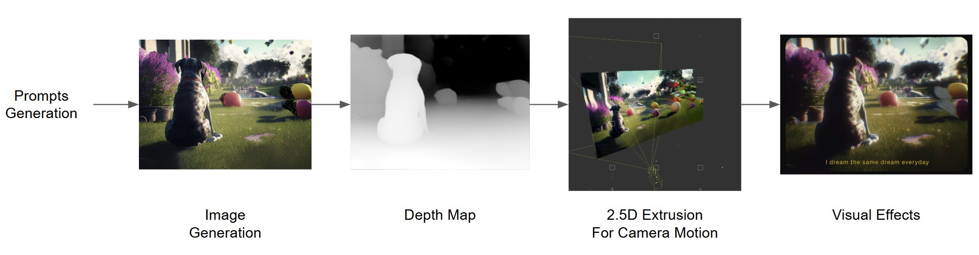
A film combines several kinds of work
Images become part of a production workflow.
Zhang et al., Film Creation, CVPR Workshop 2025, Fig. 7
52
Notes:
TRANSCRIPT
This workflow comes from DOG: Dream of Galaxy. Follow the sequence from an image toward a depth map, a shallow spatial construction, and visual effects. The generated image is one contribution to the production process. Later stages create movement and shape the final presentation. This is a useful correction to the idea that making an AI film means asking one model for a finished movie. A creator may combine generation with familiar tools for composition, camera work, and editing. When evaluating a workflow, identify the contribution of each stage. Otherwise, you may attribute an effect to the generator that actually comes from later production work.
SOURCE AND FIGURE NOTES
Figure 7 shows DOG: Dream of Galaxy. Identify the image, depth, camera, and effects stages. Explain the role of each input without implying that these tools make every artistic choice automatically.
Primary reading: https://arxiv.org/abs/2504.08296
Figure source: https://arxiv.org/html/2504.08296v1
Image URL: https://arxiv.org/html/2504.08296v1/figs/DOG_Workflow.jpg
Original caption: Figure 7 : DOG: Dream of Galaxy [ 40 ] workflow

Slide 53
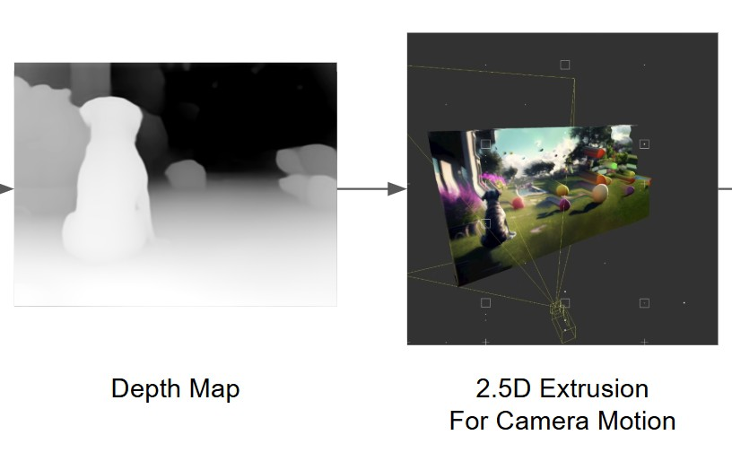
Depth can turn an image into a camera move
Near and far regions move differently as the camera shifts.
Zhang et al., Film Creation, CVPR Workshop 2025, Fig. 7 (detail)
53
Notes:
TRANSCRIPT
Depth helps distinguish near and far regions in an image. If those regions are lifted into a shallow spatial arrangement, moving a virtual camera can create different amounts of apparent motion across the picture. This is one reason depth can make a still image feel more spatial. However, the original image does not show what is behind each object. A large camera movement may expose gaps or stretched regions. The figure's two-and-a-half-dimensional construction is therefore useful within a range of views. For the studio scene, a small camera drift might work well, while a complete orbit around furniture would demand much more information.
SOURCE AND FIGURE NOTES
Enlarged detail of Figure 7 from DOG: Dream of Galaxy. Compare the depth map and the 2.5D extrusion. Depth estimates lift image regions into a shallow scene. Moving the camera can reveal missing information behind objects. This workflow therefore has a limited useful range of motion.
Primary reading: https://arxiv.org/abs/2504.08296
Figure source: https://arxiv.org/html/2504.08296v1
Image URL: https://arxiv.org/html/2504.08296v1/figs/DOG_Workflow.jpg
Original caption: Figure 7 : DOG: Dream of Galaxy [ 40 ] workflow
Figure detail enlarged for teaching. Repeated figure supports a progressive explanation.

Slide 54
Film Hack evidence has a context
2023: 8 films
2024: 67 films
2025: 118 films
Zhang et al., Film Creation, CVPR Workshop 2025
54
Notes:
TRANSCRIPT
The survey's Film Hack samples contain eight films from 2023, sixty-seven from 2024, and one hundred eighteen from 2025. These numbers provide context for the observations that follow. The sample size changed, and the participants chose an event devoted to AI filmmaking. Adoption rates in this group therefore cannot directly estimate adoption across the whole industry. The earliest group is especially small. A useful reading habit is to ask who supplied the evidence and how they were selected. This does not dismiss the survey. It helps us use it appropriately, as a detailed account of a particular creative setting rather than a universal industry census.
SOURCE AND FIGURE NOTES
Table 1 reports adoption for these samples. Participants chose an AI filmmaking event, so their adoption rates cannot estimate ordinary industry use. The small 2023 sample makes comparisons especially sensitive.
Primary reading: https://arxiv.org/abs/2504.08296

Slide 55
Creators combined tools
The 2025 sample averaged 3.14 video-generation tools per film.
Zhang et al., Film Creation, CVPR Workshop 2025
55
Notes:
TRANSCRIPT
The 2025 sample used an average of 3.14 video-generation tools per film. This describes the sample, rather than recommending that every film use three tools. Creators may combine tools because different stages have different requirements. One method may produce a useful starting look, another may preserve a performance, and an editing application may assemble the results. Additional tools also introduce coordination work and opportunities for mismatch. For your project, add a tool when you can identify the problem it solves. A workflow with fewer tools can be effective if it provides the controls you need and lets you preserve decisions that already work.
SOURCE AND FIGURE NOTES
Table 3 reports mean 3.14 and standard error 0.136 for MIT AI Film Hack 2025. This is a description of the sample, not a recommendation to use exactly three tools. Discuss choosing a tool for a specific bottleneck.
Primary reading: https://arxiv.org/abs/2504.08296

Slide 56
What filmmakers wanted
Importance exceeded reported performance in each selected task.
Artist ratings on a 0–7 scale. n = 100. Selected tasks from Table 5.
Zhang et al., Film Creation, CVPR Workshop 2025
56
Notes:
TRANSCRIPT
The chart compares importance with perceived performance for four selected tasks. The green bars represent how important artists considered the task. The gold bars represent their assessment of current performance during the survey period. Character identity, body movement, camera control, and local editing all show a gap. These are ratings from one hundred respondents on a zero-to-seven scale, not objective model benchmark scores. The result suggests that attractive generation alone did not satisfy all production needs. Notice how the tasks concern control over specific properties. For an artist, being able to repeat or revise a decision can matter as much as obtaining an impressive first output.
SOURCE AND FIGURE NOTES
Table 5, n=100. Values are artist ratings, not objective benchmark scores. Selected categories show importance versus perceived current performance. Results reflect the survey period.
Primary reading: https://arxiv.org/abs/2504.08296

Slide 57

A visual style can begin with a drawing
A Dream About to Awaken
Zhang et al., Film Creation, CVPR Workshop 2025, Fig. 1
57
Notes:
TRANSCRIPT
A Dream About to Awaken illustrates a workflow in which drawings help establish the visual language. The survey describes interpreting hand-drawn storyboards and remixing color and style. Look at the strong shapes and the repeated use of bright color in the examples. The drawings give the process a more specific starting point than a broad style label alone. They also preserve a place for the creator's composition decisions. When using a generator, you can begin with material you made yourself and ask it to develop selected aspects. The important question is which qualities of that starting material should survive through interpretation and animation.
SOURCE AND FIGURE NOTES
Figure 1 presents visual-style examples. The case study describes using image interpretation of hand-drawn storyboards and remixing color and style. The source figure is small, so use it as an aesthetic reference rather than a fine-detail comparison.
Primary reading: https://arxiv.org/abs/2504.08296
Figure source: https://arxiv.org/html/2504.08296v1
Image URL: https://arxiv.org/html/2504.08296v1/figs/A_Dream_About_to_Awaken.jpg
Original caption: Figure 1 : A Dream About to Awaken [ 76 ] visual style

Slide 58
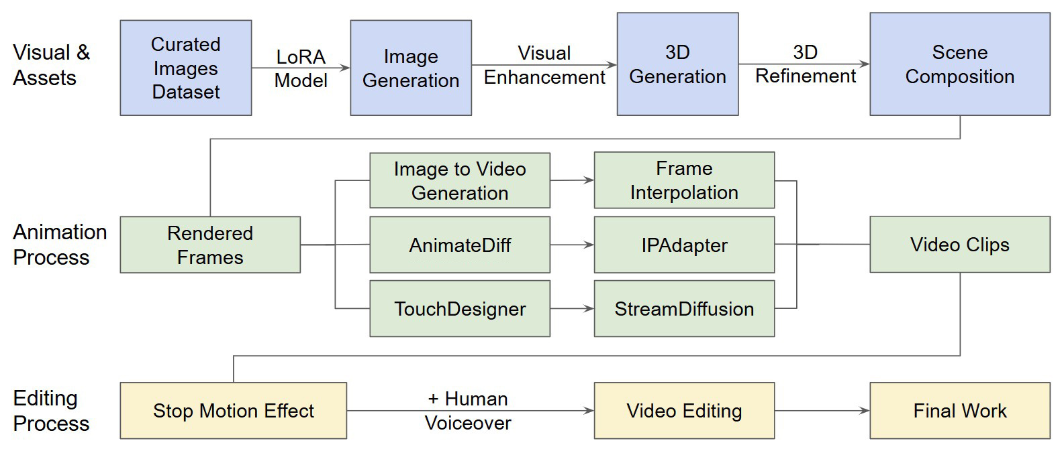
Overthinking
A deliberately nostalgic visual language
Zhang et al., Film Creation, CVPR Workshop 2025, Fig. 2
58
Notes:
TRANSCRIPT
Overthinking uses a deliberately nostalgic visual language. The workflow diagram includes image adaptation, asset creation, animation, and editing. Read the branches as parts of this particular production, rather than a mandatory recipe. Several techniques contribute to the final style, and their contributions occur at different stages. This matters because viewers experience the finished sequence as a whole. They do not separate an image model's contribution from a timing decision in the edit. For our own work, we can still separate those contributions analytically. Doing so helps us decide where to intervene when the final sequence feels wrong, even though the individual images look suitable.
SOURCE AND FIGURE NOTES
Figure 2 summarizes the workflow. The case study connects a custom style model, animation tools, and editing. Read it as a sequence of creative decisions. Its branches are alternatives within the reported workflow, not steps every student must follow.
Primary reading: https://arxiv.org/abs/2504.08296
Figure source: https://arxiv.org/html/2504.08296v1
Image URL: https://arxiv.org/html/2504.08296v1/figs/Overthinking_Workflow_Final.jpg
Original caption: Figure 2 : Overthinking [ 8 ] workflow [ 22 ] [ 17 ] [ 37 ] [ 14 ] [ 32 ]

Slide 59
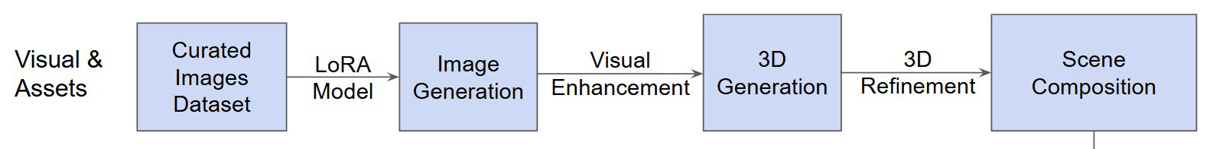
Style begins before animation
Overthinking builds assets before it builds movement.
Zhang et al., Film Creation, CVPR Workshop 2025, Fig. 2 (detail)
59
Notes:
TRANSCRIPT
The upper branch of Overthinking begins with a curated image collection and adaptation of an image model. The paper discusses imagery associated with mid-century toys. A LoRA is a compact set of learned changes that can adapt a larger model to particular material. The later stages build and refine assets for the scene. The important creative decision happens before movement: the team chooses a visual world and prepares material that supports it. If you want a coherent art video, collecting references and deciding what belongs in that world can be more productive than generating unrelated shots and trying to make them match afterward.
SOURCE AND FIGURE NOTES
Detail of Figure 2, the visual and asset branch. Explain a LoRA as a compact set of learned changes used to adapt a base model. The paper reports training on mid-century toy imagery. This is a case-specific choice.
Primary reading: https://arxiv.org/abs/2504.08296
Figure source: https://arxiv.org/html/2504.08296v1
Image URL: https://arxiv.org/html/2504.08296v1/figs/Overthinking_Workflow_Final.jpg
Original caption: Figure 2 : Overthinking [ 8 ] workflow [ 22 ] [ 17 ] [ 37 ] [ 14 ] [ 32 ]
Figure detail enlarged for teaching. Repeated figure supports a progressive explanation.

Slide 60
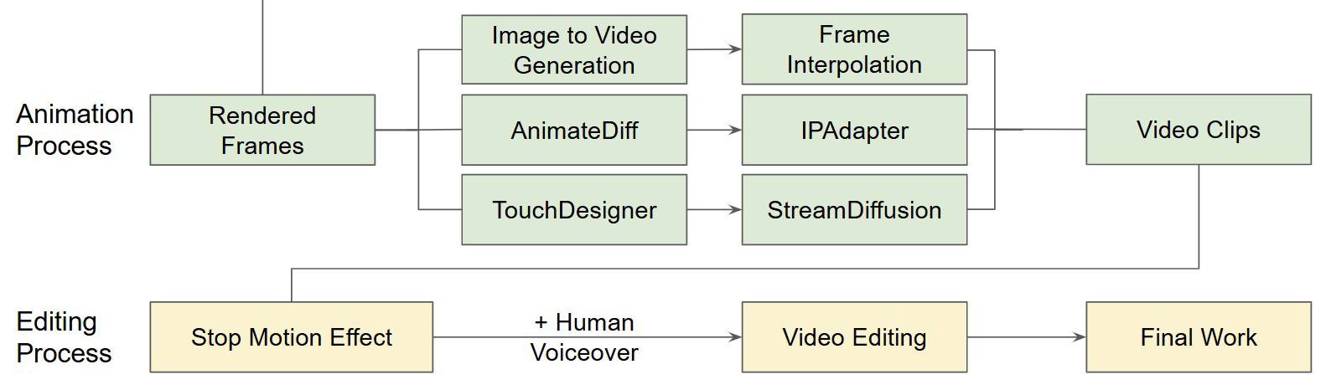
Timing can carry a style
Overthinking also shapes its motion during editing.
Zhang et al., Film Creation, CVPR Workshop 2025, Fig. 2 (detail)
60
Notes:
TRANSCRIPT
The lower branches of the workflow show animation and editing. The survey describes adjusting playback cadence to evoke a stop-motion quality. This is a reminder that style has a temporal dimension. Two sequences can use similar images and still feel different because of how movement is sampled or paced. Smooth motion is appropriate for some intentions, while a stepped rhythm may suit another. For the studio painting, ask whether its movement should flow continuously or arrive in small unsettling changes. That choice may involve editing as well as generation. It should be judged against the intended experience, rather than against smoothness as a universal goal.
SOURCE AND FIGURE NOTES
Detail of Figure 2, animation and editing branches. The paper describes changing playback cadence to evoke stop-motion. Temporal treatment contributes to style, alongside palette and character design.
Primary reading: https://arxiv.org/abs/2504.08296
Figure source: https://arxiv.org/html/2504.08296v1
Image URL: https://arxiv.org/html/2504.08296v1/figs/Overthinking_Workflow_Final.jpg
Original caption: Figure 2 : Overthinking [ 8 ] workflow [ 22 ] [ 17 ] [ 37 ] [ 14 ] [ 32 ]
Figure detail enlarged for teaching. Repeated figure supports a progressive explanation.

Slide 61
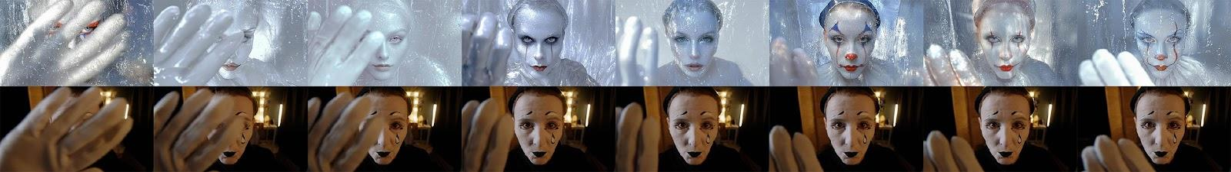
Clown
Variation becomes part of the character’s expression.
Zhang et al., Film Creation, CVPR Workshop 2025, Fig. 3
61
Notes:
TRANSCRIPT
Clown provides a different relationship to consistency. The survey discusses frame-by-frame style transformation and interprets visual variation as supporting a fragmented identity. Look at how the character's appearance changes while the performance remains related across the sequence. An inconsistency can become expressive material, but that does not make every accidental change meaningful. We need an account of how it affects the viewer. This case is useful because it challenges a simple rule that all AI artifacts must be removed. Instead, ask whether a particular variation supports the work, distracts from it, or communicates something the creator did not intend.
SOURCE AND FIGURE NOTES
Figure 3 shows frame-by-frame style transfer. The authors interpret variation as supporting fragmented identity. Distinguish a deliberate expressive reading from the claim that every inconsistency is artistically meaningful.
Primary reading: https://arxiv.org/abs/2504.08296
Figure source: https://arxiv.org/html/2504.08296v1
Image URL: https://arxiv.org/html/2504.08296v1/figs/Clown.jpeg
Original caption: Figure 3 : Clown [ 26 ] frame by frame style transfer

Slide 62
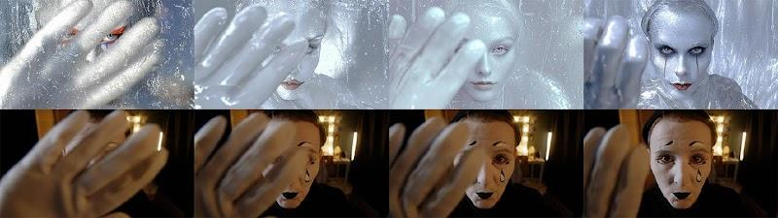
A source performance can survive a change of style
Compare the hand gesture across both rows.
Zhang et al., Film Creation, CVPR Workshop 2025, Fig. 3 (detail)
62
Notes:
TRANSCRIPT
Here we enlarge part of the comparison so that the hand gesture is easier to follow. Compare corresponding moments across the two rows. Which features of the performance remain legible even when the appearance changes? The position of a hand or the direction of a gaze can carry an action through stylization. At the same time, small changes around the face may alter the character's expression. These stills help us examine correspondence, but they cannot establish how smooth the full sequence feels. For that, we need playback. In your own project, compare both individual frames and the moving result before deciding that a transformation preserves the performance.
SOURCE AND FIGURE NOTES
Detail of Figure 3 from Clown. The two rows compare corresponding performances with different appearances. Point to the hand position and facial changes. Selected stills help discuss movement correspondence, but judging temporal smoothness requires viewing the sequence.
Primary reading: https://arxiv.org/abs/2504.08296
Figure source: https://arxiv.org/html/2504.08296v1
Image URL: https://arxiv.org/html/2504.08296v1/figs/Clown.jpeg
Original caption: Figure 3 : Clown [ 26 ] frame by frame style transfer
Figure detail enlarged for teaching. Repeated figure supports a progressive explanation.

Slide 63
Continuity can be a choice
Would a stable face or a changing face serve this scene?
Zhang et al., Film Creation, CVPR Workshop 2025
63
Notes:
TRANSCRIPT
Would a stable face or a changing face better serve this scene? There is no answer without an artistic intention. A conventional dialogue scene may depend on stable identity so that the audience follows the conversation. A work about unstable memory may use changing appearance as part of its meaning. Propose one intention for each version, and explain what the viewer should notice. Then identify a limit. Even a film about instability might need a consistent gesture, setting, or sound to hold the sequence together. Pause here if you want to discuss alternatives. The goal is to make continuity a considered choice rather than an automatic slogan.
SOURCE AND FIGURE NOTES
Discussion inspired by Clown. Ask students to propose two intentions for the same sequence. For one, identity consistency might be essential. For another, changing appearance might express a psychological state. Require an explanation of audience effect.
Primary reading: https://arxiv.org/abs/2504.08296

Slide 64
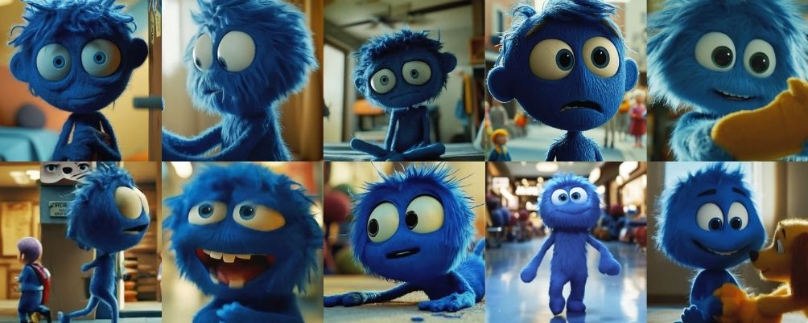
For Pixi
A recurring character needs recognizable features.
Zhang et al., Film Creation, CVPR Workshop 2025, Fig. 4
64
Notes:
TRANSCRIPT
For Pixi illustrates a case where a recurring character needs recognizable features. Look across the selected images. The blue material, large eyes, proportions, and general silhouette help establish continuity, although the appearances are not identical. The survey describes iterative generation and region editing as parts of the workflow. This is a production process that includes selecting and correcting, rather than expecting one instruction to guarantee every shot. The stills show the kinds of identity cues the creators work with. They do not prove perfect consistency across the entire film. As a viewer or researcher, keep the difference between a selected example and a complete evaluation clear.
SOURCE AND FIGURE NOTES
Figure 4 shows character design and consistency control. Ask students to compare eyes, silhouette, material, and proportions. The paper describes iterative generation and region editing. These selected stills do not prove consistency throughout the film.
Primary reading: https://arxiv.org/abs/2504.08296
Figure source: https://arxiv.org/html/2504.08296v1
Image URL: https://arxiv.org/html/2504.08296v1/figs/For_Pixi_Character.jpg
Original caption: Figure 4 : For Pixi [ 21 ] character design and consistency control

Slide 65
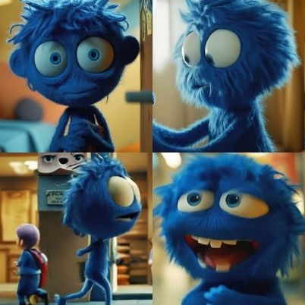
A character reference is specific
Which features make this character recognizable?
Zhang et al., Film Creation, CVPR Workshop 2025, Fig. 4 (detail)
65
Notes:
TRANSCRIPT
The enlarged examples let us be more specific about a character reference. A phrase such as blue puppet supplies a category, but it leaves the shape of the eyes, the head proportions, and the material open. A reference can communicate these details more directly. Identify two features that must survive changes in view and expression. Then decide which variations are acceptable. Lighting should be allowed to change, for example, without changing what the character is made of. This exercise turns a vague request for consistency into a set of visible criteria. Those criteria can guide reference selection, local editing, and the rejection of unsuitable shots.
SOURCE AND FIGURE NOTES
Detail from Figure 4. Invite students to identify stable features that should survive pose and lighting changes. A general phrase such as blue puppet may leave many identity details unspecified.
Primary reading: https://arxiv.org/abs/2504.08296
Figure source: https://arxiv.org/html/2504.08296v1
Image URL: https://arxiv.org/html/2504.08296v1/figs/For_Pixi_Character.jpg
Original caption: Figure 4 : For Pixi [ 21 ] character design and consistency control
Figure detail enlarged for teaching. Repeated figure supports a progressive explanation.

Slide 66
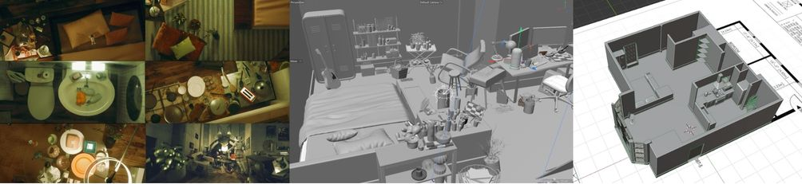
Fish Tank
Generated assets still enter a 3D production process.
Zhang et al., Film Creation, CVPR Workshop 2025, Fig. 5
66
Notes:
TRANSCRIPT
Fish Tank connects generated material to a three-dimensional production workflow. The figure places finished scenes beside assets and a scene model. Notice that the final image depends on how objects are arranged and rendered, rather than only on their individual appearance. The case study reports manual work on UV mapping and topology. Those are ordinary production requirements that do not disappear when generation supplies an initial asset. For a filmmaker, the useful output is something that can participate in the intended scene. A beautiful preview may still require substantial work before the object can be lit, placed, or animated as the production demands.
SOURCE AND FIGURE NOTES
Figure 5 shows final scenes, assets, and scene models. The case study reports manual work on UV mapping and topology. Explain topology as how a mesh connects, which matters when the object must bend or animate.
Primary reading: https://arxiv.org/abs/2504.08296
Figure source: https://arxiv.org/html/2504.08296v1
Image URL: https://arxiv.org/html/2504.08296v1/figs/Fish_Tank.jpg
Original caption: Figure 5 : Fish Tank [ 109 ] final scenes, 3D assets and models

Slide 67
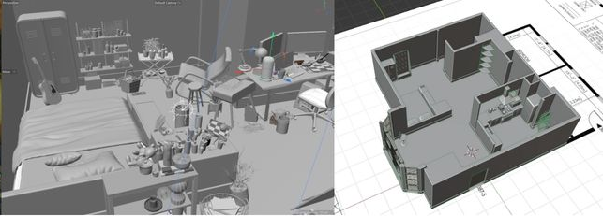
A generated asset still needs production work
A scene needs usable geometry and consistent placement.
Zhang et al., Film Creation, CVPR Workshop 2025, Fig. 5 (detail)
67
Notes:
TRANSCRIPT
Look more closely at the scene construction. Geometry determines the shape and placement of surfaces. Topology describes how a mesh connects, which matters when it needs to deform. UV mapping associates locations on that surface with texture information. A generated asset may need correction in any of these areas. This is why it helps to decide how an asset will be used before judging it. A background object seen briefly from one angle has different requirements from a character that bends in a close-up. In the studio, a chair that the returning person sits on needs more dependable structure than a distant decorative object.
SOURCE AND FIGURE NOTES
Detail of Figure 5 from Fish Tank. Compare the asset collection with the scene layout. The paper describes manual UV mapping and topology work. UV mapping connects surface locations to textures. Topology describes mesh connectivity. These matter when assets must render or animate reliably.
Primary reading: https://arxiv.org/abs/2504.08296
Figure source: https://arxiv.org/html/2504.08296v1
Image URL: https://arxiv.org/html/2504.08296v1/figs/Fish_Tank.jpg
Original caption: Figure 5 : Fish Tank [ 109 ] final scenes, 3D assets and models
Figure detail enlarged for teaching. Repeated figure supports a progressive explanation.

Slide 68
Volumography
A captured scene can support later camera decisions.
Zhang et al., Film Creation, CVPR Workshop 2025, Fig. 6
68
Notes:
TRANSCRIPT
Volumography refers here to creating moving images through spatial capture and rendering. The survey presents examples including Former Garden, Metanoia, and Dressage: Marching Through Memories. Instead of recording only a fixed sequence of frames, a spatial representation can permit later decisions about the viewpoint. This opens a different kind of creative process. Camera movement can become something explored after capture. The freedom is still limited by what the representation contains and how accurately it reconstructs the scene. Missing surfaces, reflective materials, and insufficient observations may produce gaps or distortions. Such effects can be production problems or, in some cases, material for artistic interpretation.
SOURCE AND FIGURE NOTES
Figure 6 includes Former Garden, Metanoia, and Dressage Marching Through Memories. Explain volumography as spatial scene capture and rendering. The methods have limits in visibility, reconstruction quality, and supported viewpoints.
Primary reading: https://arxiv.org/abs/2504.08296
Figure source: https://arxiv.org/html/2504.08296v1
Image URL: https://arxiv.org/html/2504.08296v1/figs/AI_Volumography.jpg
Original caption: Figure 6 : Volumography scenes in Former Garden [ 103 ] , Metanoia [ 42 ] and Dressage Marching Through Memories [ 114 ]

Slide 69
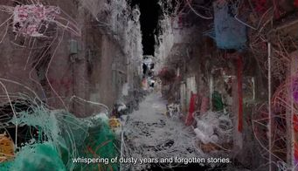
Fragmented space as an aesthetic
Gaps and distortions can suggest a memory.
Zhang et al., Film Creation, CVPR Workshop 2025, Fig. 6 (detail)
69
Notes:
TRANSCRIPT
This enlarged image shows a fragmentary spatial appearance. Parts of the scene seem incomplete, stretched, or loosely connected. In the cases discussed by the survey, such qualities can contribute to an experience of memory or uncertain space. We should avoid assuming that every visible gap was individually designed. The artistic decision may instead involve selecting and framing the behavior of a reconstruction process. Ask what the fragments direct your attention toward. Do they suggest loss, movement, or an unstable viewpoint? Then consider whether a more complete reconstruction would strengthen or weaken that reading. Technical fidelity and expressive effect can point toward different choices.
SOURCE AND FIGURE NOTES
Selected detail from Figure 6. The survey discusses spatial artifacts as expressive material in these films. Ask what the fragmentary look communicates. Avoid claiming that every gap was individually designed.
Primary reading: https://arxiv.org/abs/2504.08296
Figure source: https://arxiv.org/html/2504.08296v1
Image URL: https://arxiv.org/html/2504.08296v1/figs/AI_Volumography.jpg
Original caption: Figure 6 : Volumography scenes in Former Garden [ 103 ] , Metanoia [ 42 ] and Dressage Marching Through Memories [ 114 ]
Figure detail enlarged for teaching. Repeated figure supports a progressive explanation.

Slide 70
A short film still needs decisions
What changes?
When does it change?
What should the audience feel?
Classroom exercise · inspired by the readings
70
Notes:
TRANSCRIPT
A short film still needs decisions about what changes, when it changes, and what the audience should feel. Return to the empty studio. Perhaps the painting moves only after the viewer has had time to notice its stillness. Perhaps the returning person never sees what happened. These choices shape the audience's knowledge and expectation. A generator can help produce the required material, but the relationship between moments still needs planning. This does not mean every art video must use conventional narrative. A work organized through repetition or rhythm also makes decisions about change and duration. Describe those decisions clearly enough that you can evaluate alternatives.
SOURCE AND FIGURE NOTES
Return to the instructor-created studio example. Ask students to specify an opening, a change, and an ending. This is a simple exercise, not a claim that every art video requires conventional narrative.
Primary reading: https://arxiv.org/abs/2504.08296

Slide 71
A shot plan makes the next step concrete
Opening: establish the empty studio.
Change: reveal movement inside the painting.
Ending: show who returns.
Classroom exercise · inspired by the readings
71
Notes:
TRANSCRIPT
Here is one possible shot plan. The opening establishes the empty room. The next shot reveals movement inside the painting. The ending shows someone returning. Now make the plan more concrete. Is the first view wide enough to establish the door and painting together? Does the reveal use a camera move, an edit, or movement inside a fixed frame? Does the returning person's expression need to be readable? Each answer creates a technical requirement. You can then decide where to use an initial image, a motion reference, or local editing. The shot plan helps connect an artistic idea to manageable production tasks without determining every detail in advance.
SOURCE AND FIGURE NOTES
Instructor-created continuation of the running example. Ask students to choose shot duration and camera position for each moment. Then identify which shots require image generation, motion control, or editing. This is one possible narrative plan. An experimental art video could organize the same material by rhythm or repetition.
Primary reading: https://arxiv.org/abs/2504.08296

Slide 72
Film-making checkpoint
A generated shot becomes useful when it serves the sequence.
Zhang et al., Film Creation, CVPR Workshop 2025
72
Notes:
TRANSCRIPT
The filmmaking cases show several ways to turn generated material into useful shots and sequences. Some creators establish style through adapted image models. Others preserve a source performance, construct three-dimensional assets, or use spatial capture. Editing connects these decisions through timing and order. A generated shot becomes useful when it serves that larger sequence. Before moving on, choose one case that relates to a project you might make. Name the production problem it addresses and one limitation you would test. We will now examine shared technical ideas behind these workflows, including conditioning, scene representations, and the difference between generating pixels and generating movement data.
SOURCE AND FIGURE NOTES
Summarize the cases through decisions about style, motion, identity, and spatial control. Ask which case most closely matches a student project and why. Move next to the common techniques behind these workflows.
Primary reading: https://arxiv.org/abs/2504.08296

Slide 73
04
Visual computing
Po et al.
State of the Art on Diffusion Models
Computer Graphics Forum, 2024
Po et al., Visual Computing, 2024
73
Notes:
TRANSCRIPT
Our fourth reading is State of the Art on Diffusion Models for Visual Computing by Po and colleagues, published in Computer Graphics Forum in 2024. It connects diffusion methods across images, video, geometry, and motion. We will use it to explain why related model ideas can support different kinds of output. The date matters here: these are foundational research examples, rather than a claim about the newest available products. Focus on the representation and the control signal. An image, a scene, and a motion sequence may all use learned generative knowledge, but they create different opportunities for later editing and rendering.
SOURCE AND FIGURE NOTES
Source: https://web.stanford.edu/~gordonwz/diffusion/. Figure assets use the authors’ linked arXiv version. This report connects images, video, geometry, motion, and dynamic scenes.
Primary reading: https://web.stanford.edu/~gordonwz/diffusion/

Slide 74
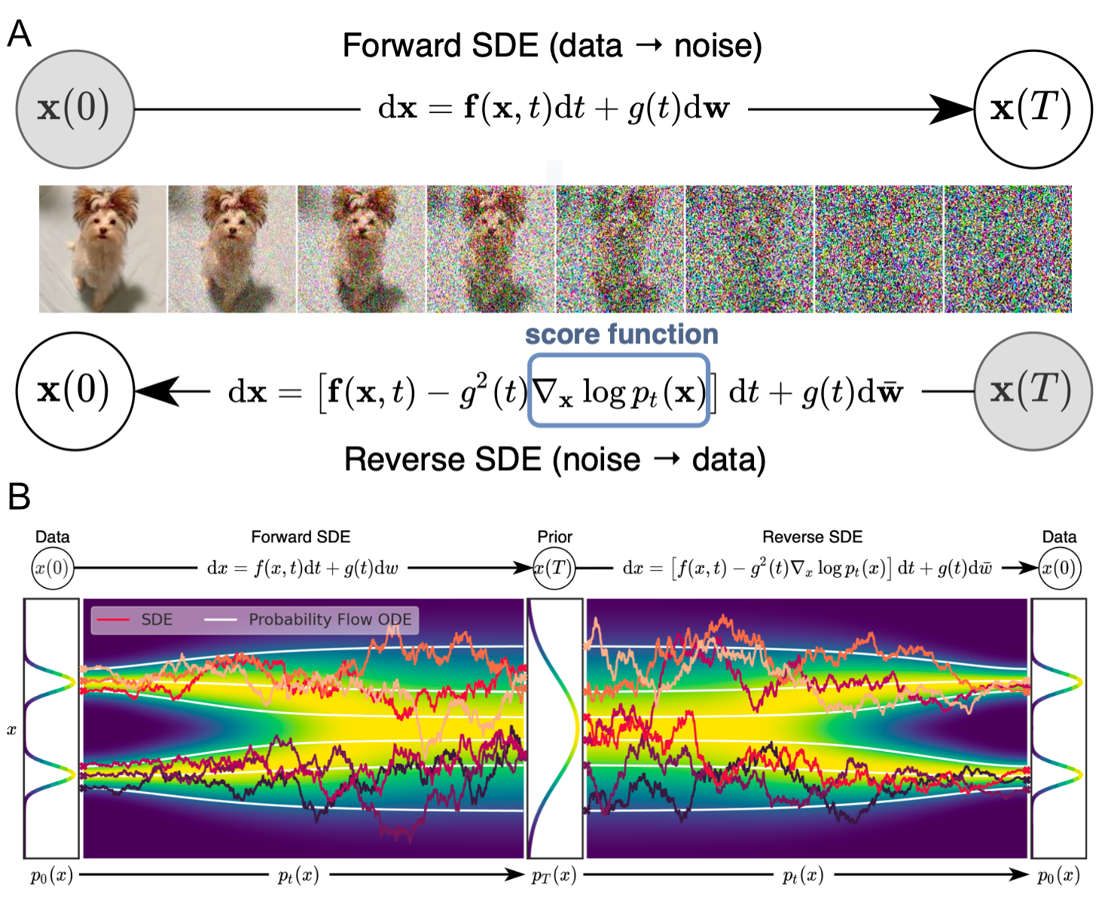
The same process across visual media
A learned prior guides plausible visual outputs.
Po et al., Visual Computing, 2024, Fig. 1
74
Notes:
TRANSCRIPT
A learned prior captures regularities in the material a model has seen during training. In practical terms, it influences what kinds of outputs the model considers plausible. The figure shows a process that moves from data toward noise and a learned process that moves back toward data. It also includes different mathematical formulations of those paths. You do not need the equations to understand the creative implication. The prior helps supply details that your inputs leave unspecified. Those details can be useful, but they are not guaranteed to be true. Plausibility should therefore be distinguished from faithful reconstruction, factual accuracy, and artistic appropriateness.
SOURCE AND FIGURE NOTES
Figure 1 illustrates diffusion trajectories. Explain prior informally as learned regularities in the training material. The equations distinguish stochastic and deterministic formulations. Neither is a guarantee of truth or artistic value.
Primary reading: https://web.stanford.edu/~gordonwz/diffusion/
Figure source: https://arxiv.org/html/2310.07204v1
Image URL: https://arxiv.org/html/2310.07204v1/figures/sdes.png
Original caption: Figure 1 : Diffusion Process. (A) The forward SDE transforms images to noise. The forward SDE can be reversed [ And82 ] if we can predict the score function, enabling image synthesis. (B) The distributions of images and noise are linked with stochastic trajectories, modeled by SDEs, and deterministic trajectories, modeled by a probability flow ODE. Figures adapted from [ SSDK∗20 ] .

Slide 75
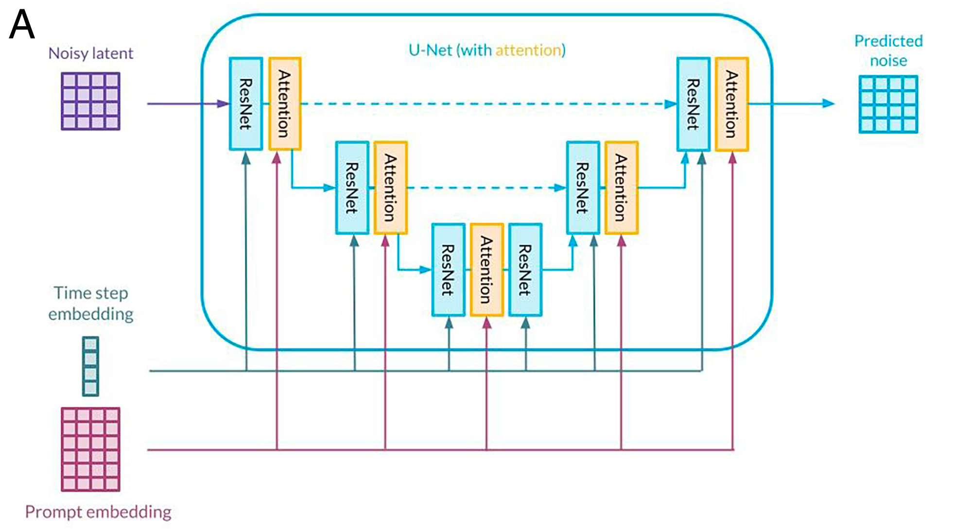
The denoiser uses the prompt at several scales
The network combines noisy content with conditioning.
Po et al., Visual Computing, 2024, Fig. 4 (detail)
75
Notes:
TRANSCRIPT
The upper diagram shows a denoising U-Net using information at several spatial scales. The U shape reflects a process that reduces and then rebuilds spatial detail, while connections carry information between stages. Prompt embeddings provide text conditioning. The time-step embedding tells the network about the current noise-removal stage. It does not indicate the moment of an action inside a video. As you trace the diagram, identify the noisy input, the conditions, and the predicted output. This reading strategy is more important than memorizing every block. It lets you connect a model's architecture to the information available when it makes each refinement.
SOURCE AND FIGURE NOTES
Top panel of Figure 4. Explain the U-shaped diagram as processing features at different spatial scales and combining them through skip connections. The time-step embedding indicates the current noise level. It is not the position of a frame in the video. The prompt embedding supplies text information.
Primary reading: https://web.stanford.edu/~gordonwz/diffusion/
Figure source: https://arxiv.org/html/2310.07204v1
Image URL: https://arxiv.org/html/2310.07204v1/figures/video_spatio_temporal_unet.jpg
Original caption: Figure 4 : Denoising U-Net with Spatio-temporal Attention. (A) Common attention U-Net used for the denoising step in image and video diffusion models comprising residual convolution blocks and attention blocks as well as concatenated time step and text prompt–embeddings. Figure adapted from [ KDSD23 ] . (B) Temporal structure in video diffusion and editing is commonly modeled by adding 1D temporal convolutions in the residual blocks (left) as well as 1D temporal attention blocks after each of the 2D spatial attention blocks (right). Figure adapted from [ ECA∗23 ] .
Figure detail enlarged for teaching. Repeated figure supports a progressive explanation.

Slide 76

Temporal layers connect the frame features
An image model gains operations that work across time.
Po et al., Visual Computing, 2024, Fig. 4 (detail)
76
Notes:
TRANSCRIPT
The lower diagram shows a common way to extend image-processing blocks across time. Spatial operations connect information within each frame. Temporal operations connect information across frames. The legend distinguishes these roles, and the inserted temporal components show where the sequence gains additional connections. This is one architectural family, rather than a description of every modern video model. The principle is that treating every frame independently leaves consistency to chance. Connecting frames gives the system a way to coordinate their features. For our moving painting, such coordination can help preserve structure while appearance changes. It still needs suitable training and conditioning to produce the particular change we want.
SOURCE AND FIGURE NOTES
Bottom panel of Figure 4. Read the legend: spatial operations work inside frames, temporal operations connect frames. The schematic shows a common way to extend a U-Net, not the only architecture for video generation. Compare this architecture detail with the earlier video-model overview.
Primary reading: https://web.stanford.edu/~gordonwz/diffusion/
Figure source: https://arxiv.org/html/2310.07204v1
Image URL: https://arxiv.org/html/2310.07204v1/figures/video_spatio_temporal_unet.jpg
Original caption: Figure 4 : Denoising U-Net with Spatio-temporal Attention. (A) Common attention U-Net used for the denoising step in image and video diffusion models comprising residual convolution blocks and attention blocks as well as concatenated time step and text prompt–embeddings. Figure adapted from [ KDSD23 ] . (B) Temporal structure in video diffusion and editing is commonly modeled by adding 1D temporal convolutions in the residual blocks (left) as well as 1D temporal attention blocks after each of the 2D spatial attention blocks (right). Figure adapted from [ ECA∗23 ] .
Figure detail enlarged for teaching. Repeated figure supports a progressive explanation.

Slide 77

Conditioning adds a control signal
A sketch or depth map can guide structure.
Po et al., Visual Computing, 2024, Fig. 3
77
Notes:
TRANSCRIPT
Conditioning adds information that guides generation. ControlNet is a well-known example of a method that incorporates structural signals such as edges or depth. The diagram shows a trainable branch alongside a fixed base network. At a high level, the added branch learns how to use the extra condition. Think of a sketch that places the painting on the left wall of the studio. The sketch provides a spatial constraint that a broad text prompt might not preserve reliably. Different conditions constrain different properties. An edge map says little about the intended material or mood, so you may still need text, references, and later selection to complete the result.
SOURCE AND FIGURE NOTES
Figure 3 shows ControlNet. The base network stays fixed while a trainable branch learns additional conditions. Explain a control signal as information that constrains an output. The figure is about architecture, not a user-interface recipe.
Primary reading: https://web.stanford.edu/~gordonwz/diffusion/
Figure source: https://arxiv.org/html/2310.07204v1
Image URL: https://arxiv.org/html/2310.07204v1/control-net.png
Original caption: Figure 3 : Overview of ControlNet. ControlNet [ ZA23 ] modifies existing network architectures by duplicating network blocks and connecting them through zero convolutions. The auxiliary module takes some conditioning c , allowing the model to learn additional control handles.

Slide 78
Inversion and personalization
Inversion starts with an existing result.
Personalization adapts to a subject or style.
Po et al., Visual Computing, 2024
78
Notes:
TRANSCRIPT
Inversion and personalization have different purposes. Inversion starts with an existing image and seeks a representation or generation path that can reproduce it, often approximately. That representation can then support edits. Personalization adapts a model or concept representation to a particular subject or style. A workflow may use both, but they answer different questions. If you want to edit one existing studio image, inversion may be relevant. If you want to generate many new views of a recurring character, personalization may be relevant. Neither label guarantees exact preservation. Check how well the method reconstructs the input or maintains the subject under the changes your project needs.
SOURCE AND FIGURE NOTES
Section 3.4 covers these ideas. Inversion seeks a generative representation or trajectory for an existing image, often approximately. Personalization adapts a model or representation to a concept. Their purposes differ even when a workflow uses both.
Primary reading: https://web.stanford.edu/~gordonwz/diffusion/

Slide 79

Video editing can preserve movement
TokenFlow changes appearance across a source sequence.
Po et al., Visual Computing, 2024, Fig. 5 (detail)
79
Notes:
TRANSCRIPT
TokenFlow illustrates video editing that aims to preserve coherent movement while changing appearance. The top row shows the input performance. The lower row changes the subject and object while retaining a related sequence of poses and positions. The method uses correspondences between features to help keep the edit consistent. This differs from independently generating a new image for every frame. The example is useful for understanding the task, but selected frames cannot show every temporal issue. For a performance-based art video, inspect whether the intended gesture remains clear and whether changing the surface appearance has unintentionally changed the emotion or physical meaning of the action.
SOURCE AND FIGURE NOTES
Top detail of Figure 5. Track the source motion and the edited appearance. TokenFlow uses feature correspondences for consistent editing. The example does not establish perfect preservation in every scene.
Primary reading: https://web.stanford.edu/~gordonwz/diffusion/
Figure source: https://arxiv.org/html/2310.07204v1
Image URL: https://arxiv.org/html/2310.07204v1/videomethods.png
Original caption: Figure 5 : Text-driven video editing. Top: Given an input video, TokenFlow [ GBTBD23 ] —a zero-shot method that leverages a pretrained T2I model—enables consistent editing according to a given text prompt. Bottom: VideoComposer [ WYZ∗23 ] —a conditional video diffusion model trained on a large-scale video dataset—enables various controls, including conditioning video generation on a given image and per-frame depth maps.
Figure detail enlarged for teaching. Repeated figure supports a progressive explanation.

Slide 80

Video generation can follow structure
VideoComposer uses an image and depth information.
Po et al., Visual Computing, 2024, Fig. 5 (detail)
80
Notes:
TRANSCRIPT
VideoComposer illustrates a different use of conditions. Here, an image supplies appearance information, while a depth sequence supplies structural guidance through time. The generated video combines those inputs with a text description. Look at how each condition answers a different question. The image helps specify what the subject looks like. Depth helps describe spatial structure and its progression. The text describes the desired content or action more broadly. This is a useful way to plan a controlled workflow: choose inputs according to the property each one constrains. More inputs do not automatically produce a better result, especially when their instructions or structures conflict.
SOURCE AND FIGURE NOTES
Bottom detail of Figure 5. Read the depth maps as structural guidance. Different references can constrain different aspects of the output. This is a distinct example from the TokenFlow comparison above it.
Primary reading: https://web.stanford.edu/~gordonwz/diffusion/
Figure source: https://arxiv.org/html/2310.07204v1
Image URL: https://arxiv.org/html/2310.07204v1/videomethods.png
Original caption: Figure 5 : Text-driven video editing. Top: Given an input video, TokenFlow [ GBTBD23 ] —a zero-shot method that leverages a pretrained T2I model—enables consistent editing according to a given text prompt. Bottom: VideoComposer [ WYZ∗23 ] —a conditional video diffusion model trained on a large-scale video dataset—enables various controls, including conditioning video generation on a given image and per-frame depth maps.
Figure detail enlarged for teaching. Repeated figure supports a progressive explanation.

Slide 81

A 3D object has many views
Geometry must agree when the viewpoint changes.
Po et al., Visual Computing, 2024
81
Notes:
TRANSCRIPT
A three-dimensional object has many views, including surfaces that a single picture does not show. The examples display objects under different conditions and viewpoints. A front view can be attractive while the side or back contains implausible geometry. This is a distinctive requirement of reusable three-dimensional material. The representation needs enough consistency to support the views you intend to render. For our studio chair, consider whether it will appear only in the background or whether the camera will circle it. The second use demands more complete inspection. Evaluate generated geometry as an object with a purpose, rather than as a single favorable preview image.
SOURCE AND FIGURE NOTES
Figure 6a illustrates object-level geometry generation. Explain why a pleasing front view is not enough for a reusable 3D object. Occluded surfaces and shape consistency become additional requirements.
Primary reading: https://web.stanford.edu/~gordonwz/diffusion/
Figure source: https://arxiv.org/html/2310.07204v1
Image URL: https://arxiv.org/html/2310.07204v1/figures/3dshape2vec.png
Original caption: (a) Object-level geometry

Slide 82

Shape and appearance are different outputs
A mesh describes surfaces.
Appearance describes how they look.
Po et al., Visual Computing, 2024
82
Notes:
TRANSCRIPT
Shape and appearance are related but distinct outputs. A mesh describes surfaces through connected geometric elements. Materials and textures describe how those surfaces look when rendered. The figure separates visual examples from extracted meshes, making the distinction visible. A plausible texture can hide a structural problem from one angle. A clean mesh can also look unfinished until materials and lighting are added. If the object must animate, connectivity and deformation introduce further requirements. For production, inspect the representation that you will actually use. A rendered preview is useful evidence, but it does not replace checking whether the underlying asset supports the intended movement and camera views.
SOURCE AND FIGURE NOTES
Figure 6b shows geometry and appearance examples. A mesh can exist without finished materials. For an animated project, topology and rigging may require further work beyond a generated shape.
Primary reading: https://web.stanford.edu/~gordonwz/diffusion/
Figure source: https://arxiv.org/html/2310.07204v1
Image URL: https://arxiv.org/html/2310.07204v1/figures/single-stage-3d-diffusion.png
Original caption: (b) Object-level geometry and appearance

Slide 83

A scene adds spatial relationships
A camera moves through a space with persistent structure.
Po et al., Visual Computing, 2024
83
Notes:
TRANSCRIPT
A scene adds relationships between objects and spaces. As a camera moves through a room, doorways, furniture, and walls should form a coherent arrangement. The figure illustrates scene-level generation and related views. This is more demanding than producing an isolated object against a simple background. It is also important to distinguish a video that looks like a camera move from an editable scene representation. The video may look convincing without providing geometry that you can manipulate. If your project needs to change the path later, determine whether the workflow actually supports that operation. The appearance of spatial movement alone does not establish control over three-dimensional space.
SOURCE AND FIGURE NOTES
Figure 6c illustrates scene-level generation. Ask students what must remain consistent as a camera passes through a room. A sequence that looks like a camera move does not necessarily provide editable geometry.
Primary reading: https://web.stanford.edu/~gordonwz/diffusion/
Figure source: https://arxiv.org/html/2310.07204v1
Image URL: https://arxiv.org/html/2310.07204v1/figures/3d-scene-generation.png
Original caption: (c) Scene-level geometry and appearance

Slide 84

Image models can guide 3D creation
DreamFusion uses image-based guidance to optimize a 3D result.
Po et al., Visual Computing, 2024, Fig. 7
84
Notes:
TRANSCRIPT
DreamFusion uses image-based generative guidance to optimize a three-dimensional result. The basic idea is to render views of a candidate scene and use a learned image prior to guide improvements. The figure shows outputs from multiple viewpoints, along with other visualizations of their structure. This connects the knowledge of an image model to a different representation. It is an influential idea because large image collections can provide information that is difficult to obtain directly for every three-dimensional object. However, an image prior does not automatically ensure agreement across all views. Look for repeated features, distorted geometry, or inconsistent appearances when evaluating a generated object.
SOURCE AND FIGURE NOTES
Figure 7 shows multiple views, untextured renders, and normals. Explain normals as directions perpendicular to the surface. The technical idea is to evaluate rendered views using image priors. Multi-view consistency remains a challenge.
Primary reading: https://web.stanford.edu/~gordonwz/diffusion/
Figure source: https://arxiv.org/html/2310.07204v1
Image URL: https://arxiv.org/html/2310.07204v1/dreamfusion.png
Original caption: Figure 7 : Text-to-3D Generation. Example text-to-3D generations from DreamFusion [ PJBM22 ] with corresponding input text-prompts. Each synthesized 3D model is rendered in two views with untextured renders and normals shown to the right. Image adapted from [ PJBM22 ] .

Slide 85

Editing a scene changes multiple views
InstructNeRF2NeRF edits a reconstructed scene.
Po et al., Visual Computing, 2024, Fig. 8
85
Notes:
TRANSCRIPT
InstructNeRF2NeRF illustrates editing a reconstructed scene using language instructions. The examples alter features while showing the results from related viewpoints. A neural radiance field, or NeRF, represents a scene through a learned function used for rendering. Editing such a representation differs from repainting one isolated photograph. The goal is for the change to appear coherently across views. This can be useful when a creator wants to revise the appearance of an existing captured space. It does not imply that every edit creates physically complete or animation-ready geometry. Always connect the demonstration to the operations you require, such as new camera views or consistent appearance changes.
SOURCE AND FIGURE NOTES
Figure 8 shows instruction-based edits of the same scene. A NeRF represents a scene through a learned rendering function. Discuss how this differs from independently repainting one photograph.
Primary reading: https://web.stanford.edu/~gordonwz/diffusion/
Figure source: https://arxiv.org/html/2310.07204v1
Image URL: https://arxiv.org/html/2310.07204v1/instructn2n.png
Original caption: Figure 8 : Instruction-based 3D Editing . Example instruction-based 3D edits from InstructNeRF2NeRF [ HTE∗23 ] with corresponding text-prompts. All edits are performed over the same input reconstructed NeRF scene. Image reproduced from [ HTE∗23 ]

Slide 86
The output format changes what we can edit
Pixels support direct image edits.
A scene representation supports new rendered views.
Po et al., Visual Computing, 2024
86
Notes:
TRANSCRIPT
The output format changes what we can edit later. Pixels give us a finished image surface. A scene representation can support rendering from additional viewpoints. Movement data can separate an action from the character that eventually performs it. Consider two projects: a fixed-view poster and a camera orbit around a sculpture. The poster may need no three-dimensional representation at all. The orbit does. Choosing a more complex representation can add flexibility, but also adds preparation and evaluation work. Pause and name the most important later edit in your project. Then ask which output format makes that edit possible, and what limitations you would need to test before committing.
SOURCE AND FIGURE NOTES
Discussion grounded in the visual-computing survey. Ask students to choose a representation for a fixed-view portrait and for a camera orbit. A scene representation may support viewpoint changes but still requires suitable geometry and coverage. Rendering freedom and editable animation are separate capabilities.
Primary reading: https://web.stanford.edu/~gordonwz/diffusion/

Slide 87

Motion can be generated as movement data
Audio can guide a dance before final rendering.
Po et al., Visual Computing, 2024, Fig. 9
87
Notes:
TRANSCRIPT
Motion generation can produce articulated movement rather than finished video pixels. The example shows audio-conditioned movement sequences that can later be rendered with a character. This separates what the body does from how the final image looks. The same movement might be applied to different character designs, subject to the capabilities of the rig and retargeting process. This is valuable when timing and performance matter more than a particular rendered appearance. It also introduces its own evaluation questions. Are contacts plausible? Does the body maintain balance? Does the movement relate to the music in a meaningful way? A visually attractive render can conceal problems in the underlying motion.
SOURCE AND FIGURE NOTES
Figure 9 reproduces audio-conditioned motion-generation examples from Alexanderson et al. The output is articulated motion rather than only finished pixels. This allows movement and appearance to be handled separately.
Primary reading: https://web.stanford.edu/~gordonwz/diffusion/
Figure source: https://arxiv.org/html/2310.07204v1
Image URL: https://arxiv.org/html/2310.07204v1/figures/Alexanderson_etal_2023.png
Original caption: Figure 9 : Motion Generation. Dances synthesised from audios by the approach of Alexanderson et al. [ ANBH23 ] for Locking (top row) and Krumping (bottom row) dance styles. Image reproduced from [ ANBH23 ] .

Slide 88
05
Creative industries
Anantrasirichai, Zhang, and Bull
Advances in Artificial Intelligence
Artificial Intelligence Review, 2026
Anantrasirichai et al., Creative Industries, 2026
88
Notes:
TRANSCRIPT
Our final reading is Advances in Artificial Intelligence: A Review for the Creative Industries by Anantrasirichai, Zhang, and Bull, published in Artificial Intelligence Review in 2026. Its scope extends beyond generation to analysis, enhancement, spatial reconstruction, and other parts of production. Some illustrated examples are older than the publication date, so we will keep those dates clear. This wider view helps explain why improving a generator may not solve the main problem in a project. The difficulty may involve selecting a region, preserving a performance, refining an asset, or judging a result. We now connect those supporting capabilities to the creative workflow as a whole.
SOURCE AND FIGURE NOTES
Source: https://link.springer.com/article/10.1007/s10462-026-11494-w. The review spans creation, analysis, enhancement, spatial reconstruction, compression, and quality assessment. Publication date does not mean all examples are from 2026.
Primary reading: https://link.springer.com/article/10.1007/s10462-026-11494-w

Slide 89
Creation sits inside a larger workflow
Before generation: intention and references.
After generation: selection, editing, sound, and review.
Anantrasirichai et al., Creative Industries, 2026
89
Notes:
TRANSCRIPT
Creation sits inside a larger process. Before generation, we establish an intention and gather material that helps communicate it. After generation, we select, revise, combine, and review the results. Sound and editing can change the experience substantially. Think about where time actually goes in your own work. If the problem is unclear pacing, generating a sharper image may not help. If the problem is identity drift, a new music track may not help. Identify the stage responsible for the mismatch between intention and result. This lets you choose a targeted intervention and evaluate whether it resolves the problem, instead of treating every issue as a reason to generate again.
SOURCE AND FIGURE NOTES
Teaching synthesis based on the review’s production coverage. Ask students which stage currently consumes the most time in their project. Improving the generator may not resolve a problem with pacing or sound.
Primary reading: https://link.springer.com/article/10.1007/s10462-026-11494-w

Slide 90

One prompt can produce different images
Models interpret composition and style differently.
Anantrasirichai et al., Creative Industries, 2026, Fig. 3; examples dated 27 Nov 2024
90
Notes:
TRANSCRIPT
This figure compares image examples produced from a prompt and includes an editing comparison. The examples are dated November 27, 2024. They are historical illustrations, not a current product ranking. Look at composition, object relationships, and the interpretation of style. A shared prompt can leave room for noticeably different results because models and generation settings differ. Even one model can vary across samples. For a fair creative comparison, decide which visible properties matter and inspect more than one output. Declaring a winner from a single attractive picture tells us little about reliability or whether the system can produce the specific sequence our project requires.
SOURCE AND FIGURE NOTES
Figure 3 contains examples generated on November 27, 2024. State the date visibly. This is historical illustration, not a current ranking. Ask students to compare framing and relationships rather than declaring a single winner.
Primary reading: https://link.springer.com/article/10.1007/s10462-026-11494-w
Figure source: https://link.springer.com/article/10.1007/s10462-026-11494-w
Image URL: https://media.springernature.com/lw685/springer-static/image/art%3A10.1007%2Fs10462-026-11494-w/MediaObjects/10462_2026_11494_Fig3_HTML.png
Original caption: Fig. 3 Full size image Text-to-image generation (generated on 27 November 2024). a text-to-image generation by Ideogram v1, DALL \(\cdot \) E 3, Photoshop 2025, and sdxy-turbo by Nvidia. b The top-row images were generated by DALL \(\cdot \) E in ChatGPT 4. The bottom-row images are generated by LLM-grounded Diffusion (Lian et al. 2024 )

Slide 91

A local instruction can affect the whole image
Compare the white car with its edited red version.
Anantrasirichai et al., Creative Industries, 2026, Fig. 3 (detail); examples dated 27 Nov 2024
91
Notes:
TRANSCRIPT
The enlarged editing example asks for a white car to become red. This sounds local, but we should inspect the whole image. Did the second car remain stable? Did the road, lighting, and viewpoint change? A method can satisfy the most obvious part of the request while introducing unwanted differences elsewhere. The figure presents selected historical examples, so it should not be used as a current benchmark. Its teaching value is the evaluation procedure. Define the intended change and the features to preserve, then inspect both. This is the same procedure we would use when editing the painting inside our otherwise stable studio scene.
SOURCE AND FIGURE NOTES
Detail of Figure 3b, examples dated November 27, 2024. Check both the requested color change and preservation of the other car, lighting, and road. These are selected historical examples, not a current benchmark or ranking of products.
Primary reading: https://link.springer.com/article/10.1007/s10462-026-11494-w
Figure source: https://link.springer.com/article/10.1007/s10462-026-11494-w
Image URL: https://media.springernature.com/lw685/springer-static/image/art%3A10.1007%2Fs10462-026-11494-w/MediaObjects/10462_2026_11494_Fig3_HTML.png
Original caption: Fig. 3 Full size image Text-to-image generation (generated on 27 November 2024). a text-to-image generation by Ideogram v1, DALL \(\cdot \) E 3, Photoshop 2025, and sdxy-turbo by Nvidia. b The top-row images were generated by DALL \(\cdot \) E in ChatGPT 4. The bottom-row images are generated by LLM-grounded Diffusion (Lian et al. 2024 )
Figure detail enlarged for teaching. Repeated figure supports a progressive explanation.

Slide 92

Performance can come from captured motion
Body movement and facial animation use different inputs.
Anantrasirichai et al., Creative Industries, 2026, Fig. 4
92
Notes:
TRANSCRIPT
Performance can come from different kinds of source information. The left example involves captured body movement and its use with an animated figure. The right example combines an image with audio for facial animation. These are separate systems, and their inputs constrain different properties. A body-motion reference tells us something about pose and timing. Audio can guide speech-related facial movement. A portrait supplies appearance but does not itself specify a whole performance. When planning a character shot, identify what you already have: a voice recording, an acted movement, or only a design. The available material helps determine which workflow is appropriate and what the model must invent.
SOURCE AND FIGURE NOTES
Figure 4 pairs DeepMotion with VASA-1. Discuss source motion for a body versus image and audio for facial animation. These are separate systems shown together in the review.
Primary reading: https://link.springer.com/article/10.1007/s10462-026-11494-w
Figure source: https://link.springer.com/article/10.1007/s10462-026-11494-w
Image URL: https://media.springernature.com/lw685/springer-static/image/art%3A10.1007%2Fs10462-026-11494-w/MediaObjects/10462_2026_11494_Fig4_HTML.png
Original caption: Fig. 4 Full size image (Left) Video-to-3D post animation by DeepMotion. (Right) Image and audio to video by VASA-1 (Xu et al. 2024 )

Slide 93

Post-production can change the result
Enhancement and editing continue after generation.
Anantrasirichai et al., Creative Industries, 2026, Fig. 5
93
Notes:
TRANSCRIPT
Post-production continues after generation. The figure places image enhancement beside portrait editing to show different kinds of intervention. Enhancement may improve apparent detail or resolution. Editing changes selected content or expression. Both can be useful, but they require evaluation according to the intended task. A sharper face is not necessarily a more faithful face, and an expressive alteration may affect identity. For an art video, you might welcome some changes while rejecting others. Keep an original version so that you can compare what happened. It is easier to judge a revision when the intended improvement is specific and the earlier state remains available for reference.
SOURCE AND FIGURE NOTES
Figure 5 juxtaposes super-resolution and portrait editing. Super-resolution adds plausible detail and can invent detail. It should not automatically be treated as recovery of what the original camera recorded.
Primary reading: https://link.springer.com/article/10.1007/s10462-026-11494-w
Figure source: https://link.springer.com/article/10.1007/s10462-026-11494-w
Image URL: https://media.springernature.com/lw685/springer-static/image/art%3A10.1007%2Fs10462-026-11494-w/MediaObjects/10462_2026_11494_Fig5_HTML.jpg
Original caption: Fig. 5 Full size image (Left) Examples of SR ( \(\times \) 4) using generative model. (Right) Real-time portrait editing with FacePoke

Slide 94

Upscaling adds detail that needs inspection
Compare the generated texture with the high-resolution reference.
Anantrasirichai et al., Creative Industries, 2026, Fig. 5 (detail)
94
Notes:
TRANSCRIPT
Compare the low-resolution input, the AI-upscaled image, and the high-resolution reference. Pay attention to texture rather than just overall sharpness. The upscaled version can create convincing detail that differs from the reference. This happens because a model uses learned regularities to fill in information that the input does not fully contain. In a new artwork, that contribution may be acceptable or desirable. In faithful restoration, it may be a problem. For video, repeat the comparison across time to check whether the added texture flickers. The evaluation should follow the purpose of the work, rather than assuming that more visible detail always means better quality.
SOURCE AND FIGURE NOTES
Detail of Figure 5, left panel. Compare low-resolution input, AI upscaling, and the high-resolution reference. Generated detail can look convincing while differing from the reference. In artwork this may be acceptable. In faithful restoration the difference matters.
Primary reading: https://link.springer.com/article/10.1007/s10462-026-11494-w
Figure source: https://link.springer.com/article/10.1007/s10462-026-11494-w
Image URL: https://media.springernature.com/lw685/springer-static/image/art%3A10.1007%2Fs10462-026-11494-w/MediaObjects/10462_2026_11494_Fig5_HTML.jpg
Original caption: Fig. 5 Full size image (Left) Examples of SR ( \(\times \) 4) using generative model. (Right) Real-time portrait editing with FacePoke
Figure detail enlarged for teaching. Repeated figure supports a progressive explanation.

Slide 95

Selection makes local editing possible
Segmentation identifies a region.
Tracking follows it through time.
Anantrasirichai et al., Creative Industries, 2026, Fig. 6
95
Notes:
TRANSCRIPT
Segmentation identifies regions or objects in an image. Tracking follows an object through a sequence. Together, they can make local video editing more manageable. Suppose we want to alter the returning person's coat while leaving the room unchanged. We need to identify the coat and keep the selected region attached to it as the person moves. The figure organizes several object-understanding tasks and includes segmentation examples. These capabilities support generation and editing without necessarily generating the final content themselves. They are part of the larger workflow. Failures around occlusion or fast movement can cause an edit to jump, leak into the background, or disappear temporarily.
SOURCE AND FIGURE NOTES
Figure 6 surveys object-centric understanding and segmentation. Explain the practical purpose: editing one subject while keeping surrounding content stable. Masks and tracks can fail around occlusion, hair, and fast movement.
Primary reading: https://link.springer.com/article/10.1007/s10462-026-11494-w
Figure source: https://link.springer.com/article/10.1007/s10462-026-11494-w
Image URL: https://media.springernature.com/lw685/springer-static/image/art%3A10.1007%2Fs10462-026-11494-w/MediaObjects/10462_2026_11494_Fig6_HTML.png
Original caption: Fig. 6 Full size image a Tasks in Object-centric understanding defined by Yan et al. ( 2023 ) ( REC Referring Expression Comprehension, RES Referring Expression Segmentation, VOS Video Object Segmentation, RVOS Referring Video Object Segmentation, MOT Multiple Object Tracking, MOTS Multi-Object Tracking and Segmentation, VIS Video Instance Segmentation, SOT Single Object Tracking. b Current high-quality segmentation (Ke et al. 2023 )

Slide 96

Fine boundaries make selection difficult
Thin structures need careful masks.
Anantrasirichai et al., Creative Industries, 2026, Fig. 6 (detail)
96
Notes:
TRANSCRIPT
Fine boundaries are difficult because small selection errors can be highly visible. Look at the butterfly outline and the thin structure in the comparison. Hair, transparent material, and narrow gaps create similar challenges in creative work. The figure compares selected outputs from SAM and HQ-SAM. It illustrates the importance of boundary detail, rather than proving that one method always performs better. A mask that looks acceptable in a still frame may still change inconsistently during movement. For our studio, the edge of the painting is a useful inspection point. A clean interior transformation can be undermined by a shifting outline or an edit that spills onto the frame.
SOURCE AND FIGURE NOTES
Detail of Figure 6b. Compare the butterfly outline and the thin structure on the right. The visual example contrasts SAM and HQ-SAM. It illustrates boundary detail rather than proving one system always wins. In video, inspect the mask across movement and occlusion.
Primary reading: https://link.springer.com/article/10.1007/s10462-026-11494-w
Figure source: https://link.springer.com/article/10.1007/s10462-026-11494-w
Image URL: https://media.springernature.com/lw685/springer-static/image/art%3A10.1007%2Fs10462-026-11494-w/MediaObjects/10462_2026_11494_Fig6_HTML.png
Original caption: Fig. 6 Full size image a Tasks in Object-centric understanding defined by Yan et al. ( 2023 ) ( REC Referring Expression Comprehension, RES Referring Expression Segmentation, VOS Video Object Segmentation, RVOS Referring Video Object Segmentation, MOT Multiple Object Tracking, MOTS Multi-Object Tracking and Segmentation, VIS Video Instance Segmentation, SOT Single Object Tracking. b Current high-quality segmentation (Ke et al. 2023 )
Figure detail enlarged for teaching. Repeated figure supports a progressive explanation.

Slide 97

Spatial capture supports new viewpoints
NeRFs and Gaussian splats represent scenes differently.
Anantrasirichai et al., Creative Industries, 2026, Fig. 7
97
Notes:
TRANSCRIPT
NeRFs and Gaussian splats are different ways to represent scenes for rendering. A NeRF uses a learned field that describes properties queried along viewing rays. Gaussian splatting uses many spatial primitives with properties such as position and appearance. The figure places their processes alongside examples of spatial interaction. You do not need to master their mathematics to understand the production question: what views can this representation render well, and what can I edit? Capture coverage and reconstruction quality still matter. A scene representation does not automatically contain reliable hidden surfaces. Test the intended viewpoint range before building a film or interactive experience around that freedom.
SOURCE AND FIGURE NOTES
Figure 7 juxtaposes NeRF, Gaussian splatting, and VR interaction. NeRF uses a learned field. Gaussian splatting uses many spatial primitives for rendering. Both have capture and reconstruction limitations.
Primary reading: https://link.springer.com/article/10.1007/s10462-026-11494-w
Figure source: https://link.springer.com/article/10.1007/s10462-026-11494-w
Image URL: https://media.springernature.com/lw685/springer-static/image/art%3A10.1007%2Fs10462-026-11494-w/MediaObjects/10462_2026_11494_Fig7_HTML.png
Original caption: Fig. 7 Full size image 3D representation. a Neural Radiance Fields (NeRFs) (Mildenhall et al. 2020 ). b Gaussian Splatting (Kerbl et al. 2023 ). c Example scenes of VR-GS system for 3D content interaction in VR (Jiang et al. 2024 )

Slide 98
Quality has several meanings
A sharp image can still fail the scene.
A strange image can serve an artistic intention.
Anantrasirichai et al., Creative Industries, 2026
98
Notes:
TRANSCRIPT
Quality has several meanings. An image can be sharp but fail to convey the intended action. A sequence can match a prompt yet feel emotionally wrong. A distorted image can also serve a deliberate artistic purpose. These observations call for separate judgments, rather than one vague claim that the output is good. For the studio, you could assess technical continuity, the clarity of the reveal, and the audience's interpretation. Different viewers may disagree about the last part, and that disagreement can be useful evidence. Explain the criteria you chose and why they suit the work. Automated measures can contribute, but they cannot settle every question about artistic experience.
SOURCE AND FIGURE NOTES
Teaching discussion connected to Section 3.7 on quality assessment. Separate technical defects, instruction alignment, and artistic judgment. Ask students to give an example in which these evaluations disagree.
Primary reading: https://link.springer.com/article/10.1007/s10462-026-11494-w

Slide 99
A process others can understand
Record references and major edits.
Explain the decisions behind the result.
Anantrasirichai et al., Creative Industries, 2026
99
Notes:
TRANSCRIPT
A process record helps other people understand what you made and how you made it. Save important references and meaningful before-and-after versions. Record model names and versions when available, along with settings needed to repeat a comparison. Explain the decisions that changed the work, including choices made in editing or sound. This is more informative than presenting a final output with only a prompt. It also helps you diagnose your own workflow when a later result differs. For coursework, follow the assignment's actual requirements. The broader habit is to make your contribution and source material understandable without turning the record into an unstructured collection of every experiment.
SOURCE AND FIGURE NOTES
The review discusses human oversight, bias, and provenance concerns. For class work, propose a concise process record with source material, model settings when available, and meaningful before/after changes. This is classroom guidance, not a new assignment requirement.
Primary reading: https://link.springer.com/article/10.1007/s10462-026-11494-w

Slide 100
Five readings to keep
01
Video models: how a sequence forms
02
Visual art: what the artist controls
03
Film: how shots work together
04
Visual computing: what transfers across media
05
Creative industries: how the work reaches an audience
Anantrasirichai et al., Creative Industries, 2026
100
Notes:
TRANSCRIPT
We have used five readings to follow a creative process from model behavior to finished work. The video survey explains how sequences form and how inputs constrain them. The visual-art survey connects methods to intention. The film survey shows creators combining tools and making production decisions. Visual computing explains how related ideas transfer across different representations. The creative-industries review places generation alongside supporting tools and evaluation. Choose one decision you would now change in your own project. Explain which reading informed it, what visible result you expect, and how you would test that expectation. That connection between a method, an intention, and evidence is the central skill to take from today's lecture.
SOURCE AND FIGURE NOTES
Closing question: identify one decision you will change in your project after today. Reading links are included in these notes and the companion reading guide. An artistic result should be judged against its intention and audience experience.
Primary reading: https://link.springer.com/article/10.1007/s10462-026-11494-w
Wang et al., Video Diffusion Survey, rev. 2026
https://arxiv.org/abs/2504.16081v3
Wang, Chen & Wang, Visual Art Creation, 2025
https://arxiv.org/abs/2408.12128
Zhang et al., Film Creation, CVPR Workshop 2025
https://arxiv.org/abs/2504.08296
Po et al., Visual Computing, 2024
https://web.stanford.edu/~gordonwz/diffusion/
Anantrasirichai et al., Creative Industries, 2026
https://link.springer.com/article/10.1007/s10462-026-11494-w

